Slide 1
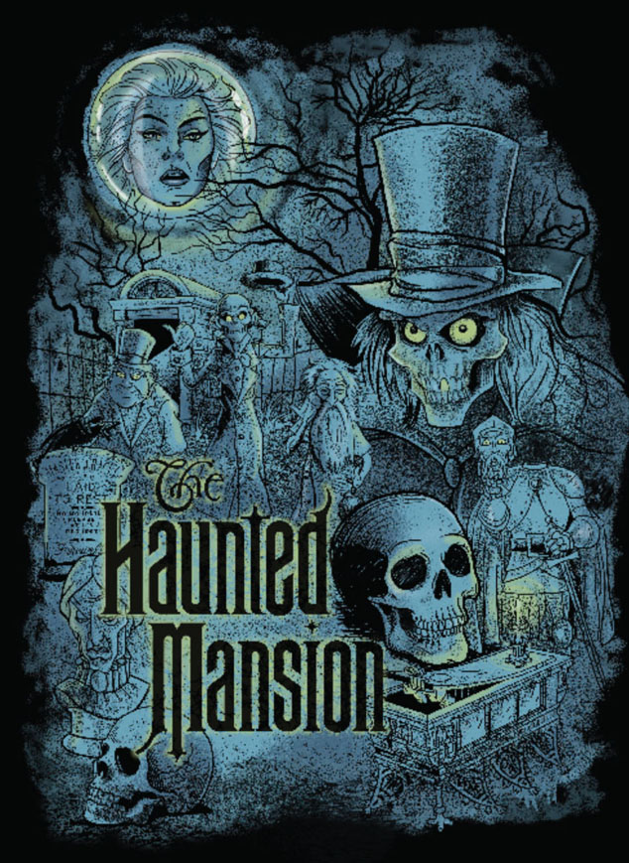
Sound Design For Disney’s Haunted Mansion Attraction
By Richard Holzhauer

Slide 2
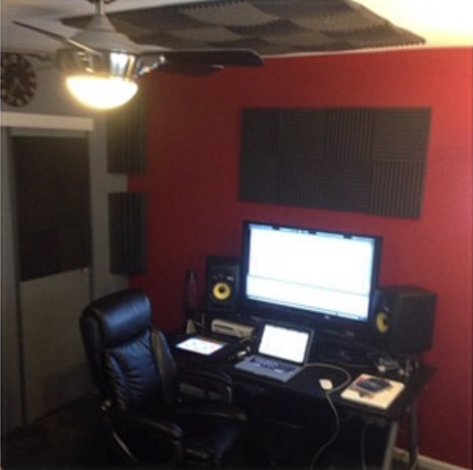
Introduction

Slide 3
Deliverables
Video of the Haunted Mansion attraction with my sound design in stereo.
Cue list of the Haunted Mansion attraction in surround sound
Equipment list and budget
Journals

Slide 4
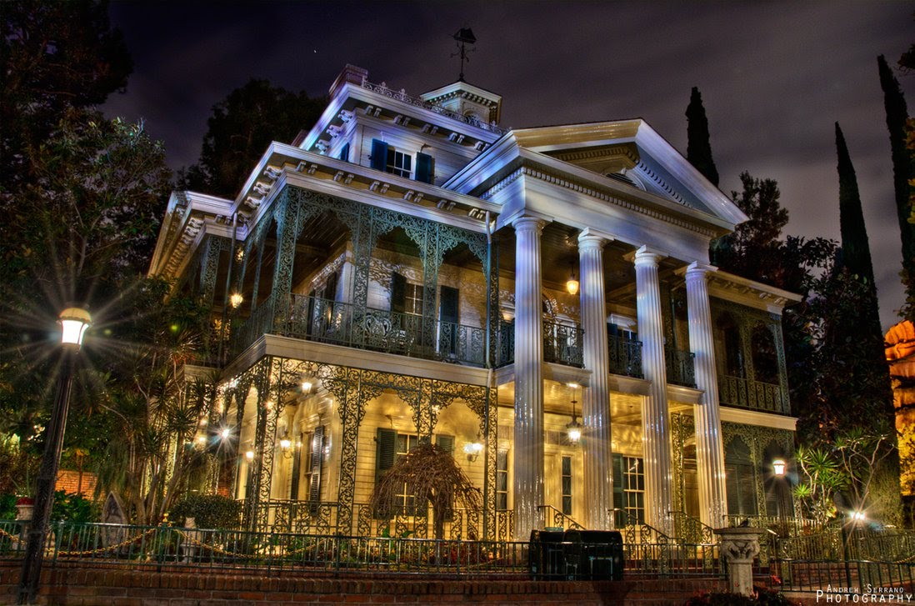
History

Slide 5
Process
Learn the history of the Haunted Mansion attraction
Get the appropriate video footage for the project
Process and arrange the sounds in Ableton Live
Mix the volumes of the sounds in Ableton Live
Mix the sounds’ stereo position in surround sound in QLab

Slide 6
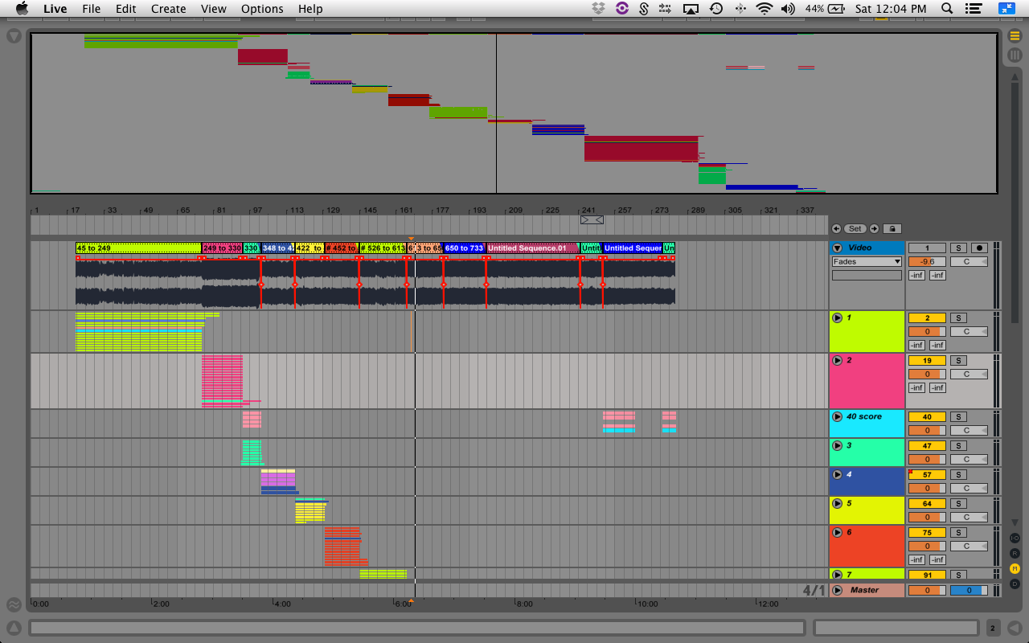
Ableton Live Session

Slide 7
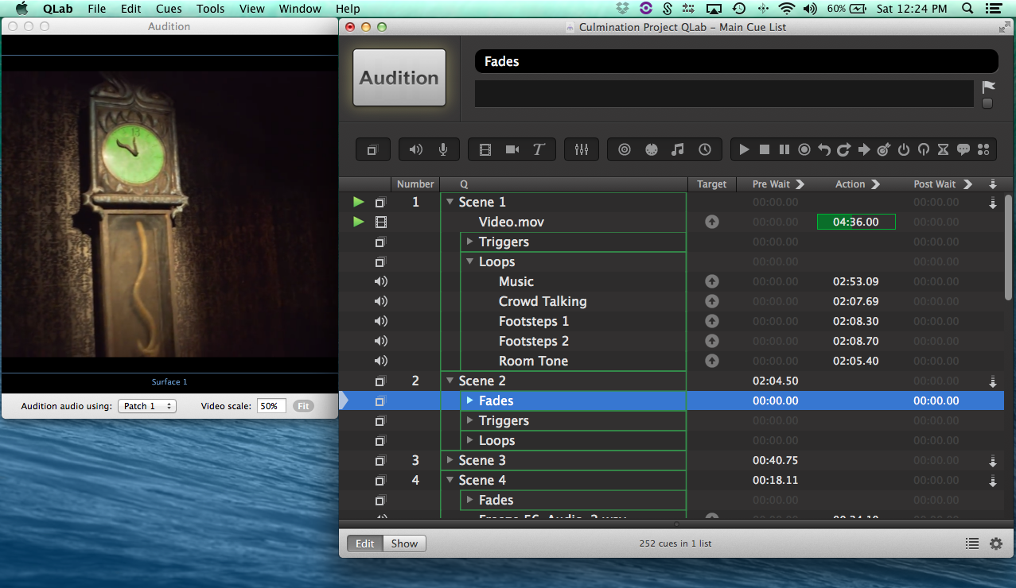
Qlab Session

Slide 8
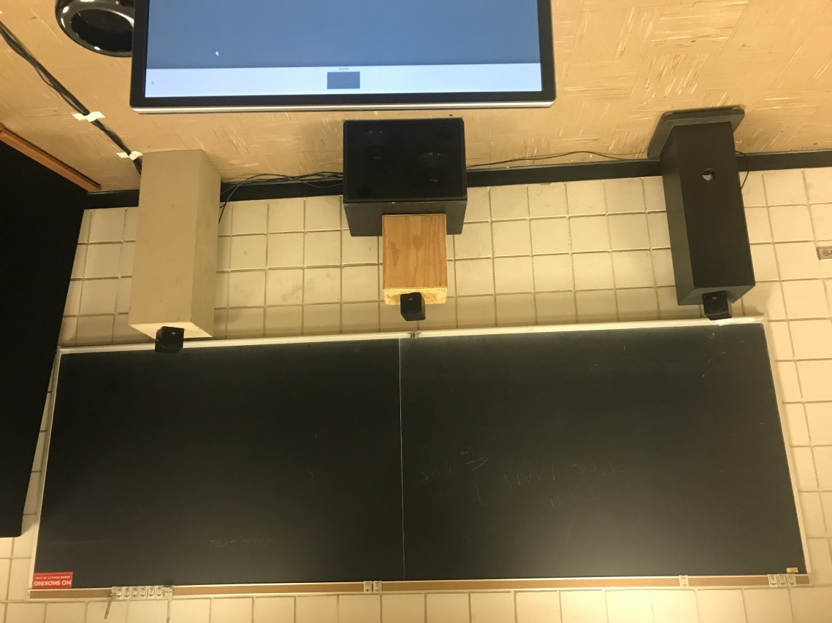
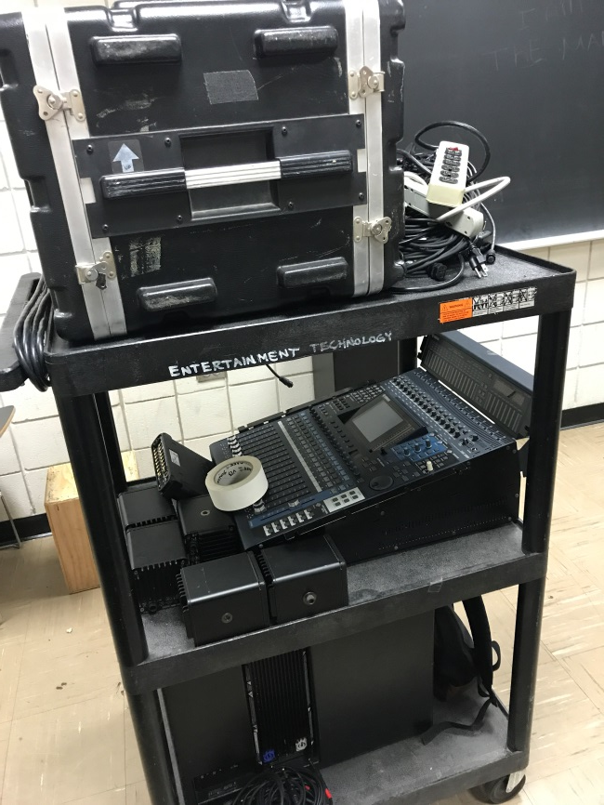
Equipment

Slide 9
Budget

Slide 10
Schedule

Slide 11
Problems Faced
Needed to wait for permission before I could borrow the equipment
Had to ensure the lab was available when I was available
Was sick the week I planned to start the lab work
Had to prepare and build a system I was not very familiar with
Experienced issue syncing sound to picture in QLab

Slide 12
Conclusion/Lessons Learned
Worked on a sound design project at a much larger scale
Take problems and delays into scheduling
Expanded Knowledge in post production and surround sound
This project will look great on my resume

