Slide 1
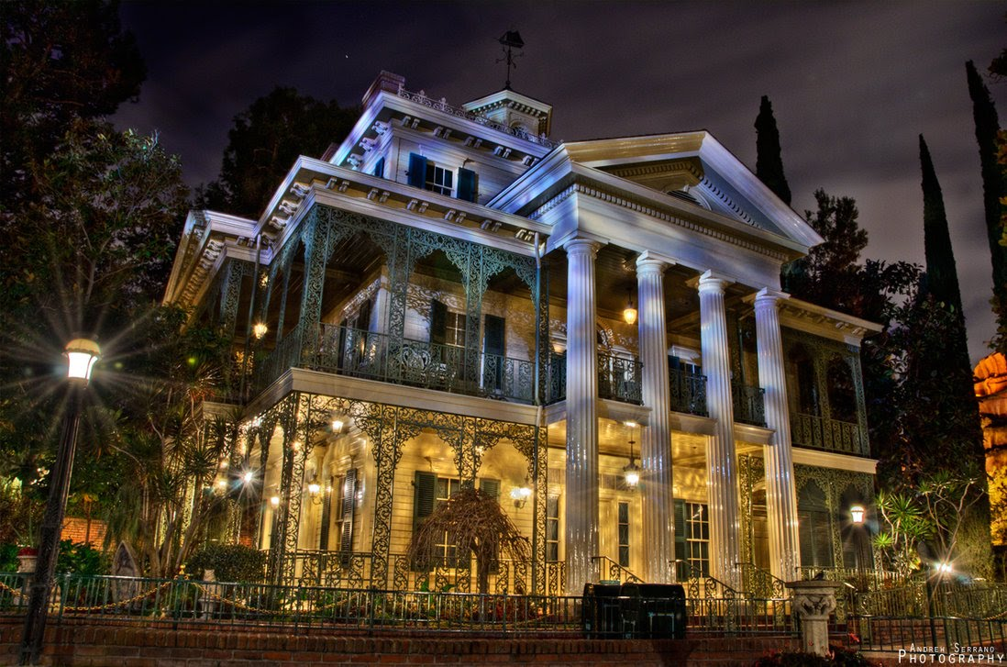
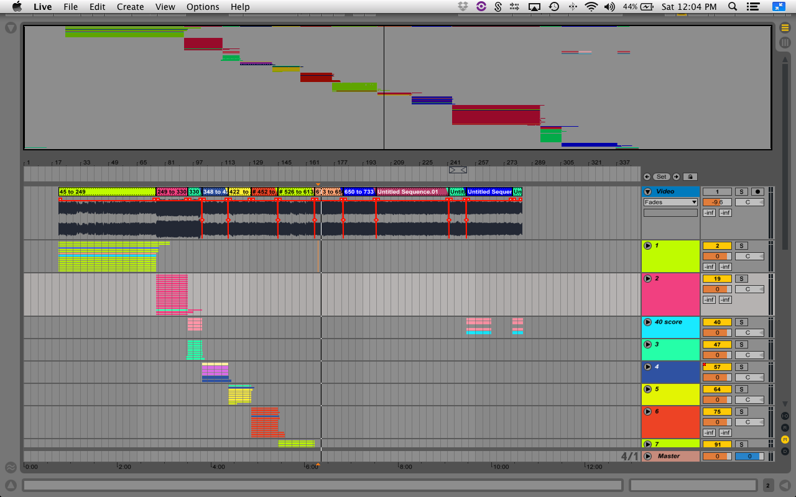
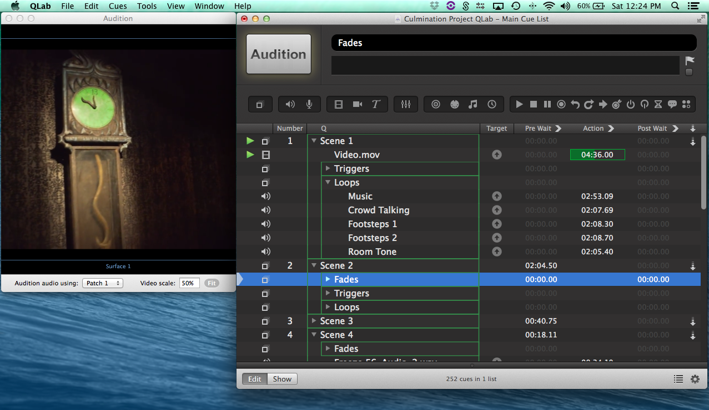
Sound Design For Disney’s Haunted Mansion Attraction By Richard Holzhauer
Introduction
The Haunted Mansion
Ableton Live
Qlab
Sound has always been an interest of mine. Being a part of the Entertainment Technology Department of New York City College of Technology, I had the opportunity to learn about all aspects of live entertainment. As I completed my sound track curriculum, I have become deeply interested in sound design. I prefer using sound as a tool to take audience members from their seat to a new place, experiencing the sound from all around them. Video is another great interest of mine. I plan to combine both sound and video into my culmination project, which is taking Disney’s Haunted Mansion attraction ride through video and totally redesigning the practical and creative sounds. Because it is video footage of a live attraction, the project is a hybrid between sound for film and sound for live entertainment.
.
Procedure
Schedule
Conclusion
The sound design process consists of taking royalty free sounds from Freesound.org and manipulating them in Ableton Live. I took real world recordings, and processed them by adding reverb, amplifiers, delays, and other effects to make the sounds original and unique. The sounds were intended to fit a practical but supernatural world. I then had to mix the volumes of the sounds according to their location in the video.
After the design process was completed, I inserted the sounds into QLab, in which they can be launched according to the walk through attraction in the video. The sounds will also be mixed in surround sound to expand on the creativity and experience of the project. For example, you may hear a grandfather clock ringing to your left, but also hear the creaking of a door behind you.
After a semester of work, I finally completed my culmination project. This includes the sound design for the walk through video of Disney’s Haunted Mansion live attraction, which was made for the poster session. My culmination project also includes a QLab session consisting of cues for Disney’s Haunted Mansion which can be played in surround sound. I calculated a theoretical budget for the project of just below $20,000. There is no definite budget, because there are endless possibilities for which equipment to use, and whether you purchase or rent. Any equipment that I did not own, I borrowed from the school. The last deliverable for the project is a schedule I documented on a weekly basis over the course of the semester.
With this project, I challenged myself by working with surround sound on a much larger scale than I ever have. The video footage was approximately ten minutes long and my sound design consisted of around 200 sounds. This experience taught me to take problems and delays into account when scheduling a project. Aside from time management, this project expanded my horizons to use surround sound in live production and in post-production. Though I am still relatively new at sound design for video, this project will be great for my resume and will benefit my future.
Budget

