Slide 1
MA3D Visualization Culmination Project
Ryan Fallon

Slide 2
Introduction
The senior culmination project that will be worked on is a MA3D visualization project. For this project, a series of lighting cues will be created for a set of 6 songs using MA3D.
Each song would have its own set of lighting cues, making up a set for a live show. This would allow for further exploration of the MA3D software and online console.
In addition to all of the actual lighting cues, a light plot, cue list and a Lightwright document detailing the channel hookup and instrument schedule.

Slide 3
Introduction…Cont’d.
Budget and Time spent on project (40 Hours) as well as weeks spent during semester.
Meetings/deadlines with John as well as the culmination class itself.

Slide 4
Point #1: Technical aspect of MA 3D
Drafting the environment and patching the lights.
Cue Creation.
Documents that accompany the file.
Online vs. Console.
Learning software.

Slide 5
Point #2: Creative aspect of MA 3D
Design looks, fixture editing
Drafting stage/venue
Creative aspects of cue creation

Slide 6
Point #3: Challenges
Learning Software
No Console
Authentic looking show
Substantial amount of cues/looks
Managing show/enviroment size

Slide 7
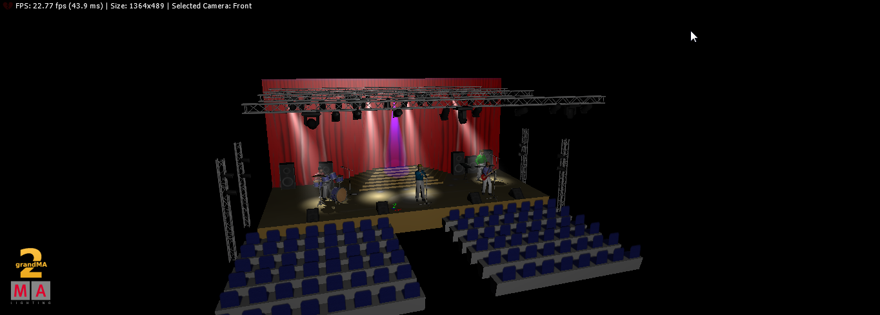
The Venue Drafted

Slide 8
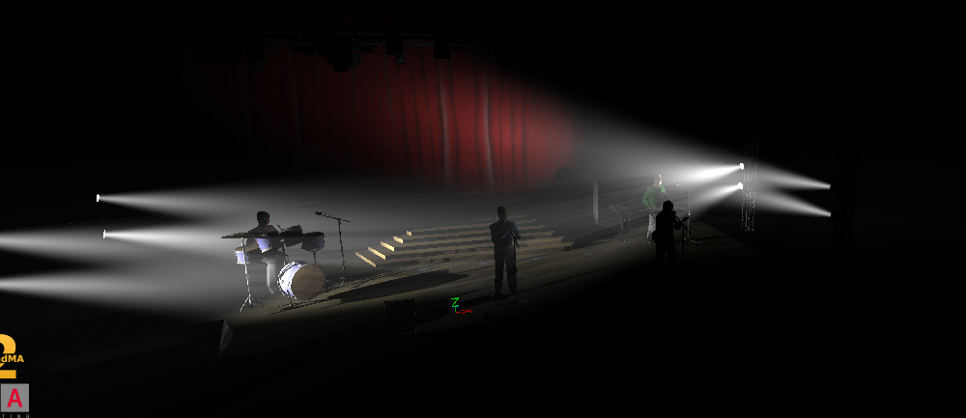
Design
One of the design looks that utilizes side lights.

Slide 9
In Conclusion
Technical Aspects of project
Creative Aspects of project
Challenges
Lighting outside of CUNY

