Slide 1
MA3D Visualization Culmination Project
Ryan Fallon

Slide 2
Introduction
The senior culmination project that will be worked on is a MA3D visualization project. For this project, a series of lighting cues will be created for a set of 6 songs using MA3D.
Each song would have its own set of lighting cues, making up a set for a live show. This would allow for further exploration of the MA3D software and online console.
In addition to all of the actual lighting cues, a light plot, cue list and a Lightwright document detailing the channel hookup and instrument schedule.

Slide 3
Point #1: Technical aspect of MA 3D
This section would be used to describe the technical aspects of creating and operating the MA3D visualization. I would talk about drafting the environment and patching the lights.
Cue Creation would also be discussed.
Also, an overview of the accompanying documents would be discussed (LP, LW, Cues)

Slide 4
Point #2: Creative aspect of MA 3D
This section would be used to describe the creative aspects of creating and operating the MA3D visualization. I would talk about certain looks, why I chose certain light fixtures
I would discuss how my studies in LD helped me in designing the project and helped in creating the necessary documents in addition to the MA file.

Slide 5
Point #3: Challenges
This section would be used to describe the challenges faced while preparing, executing and troubleshooting the project.
Editing certain fixtures and cues, Vectorworks troubleshooting, adding or subtracting lights from the environment to better suite the overall design.

Slide 6
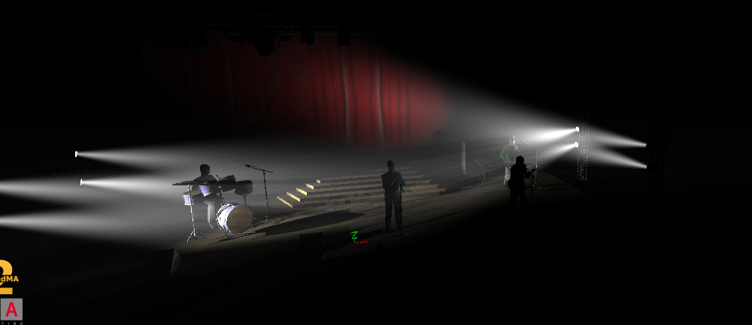
Video/Photos
I will add photos or a short clip of video detailing my progress over the months.

Slide 7
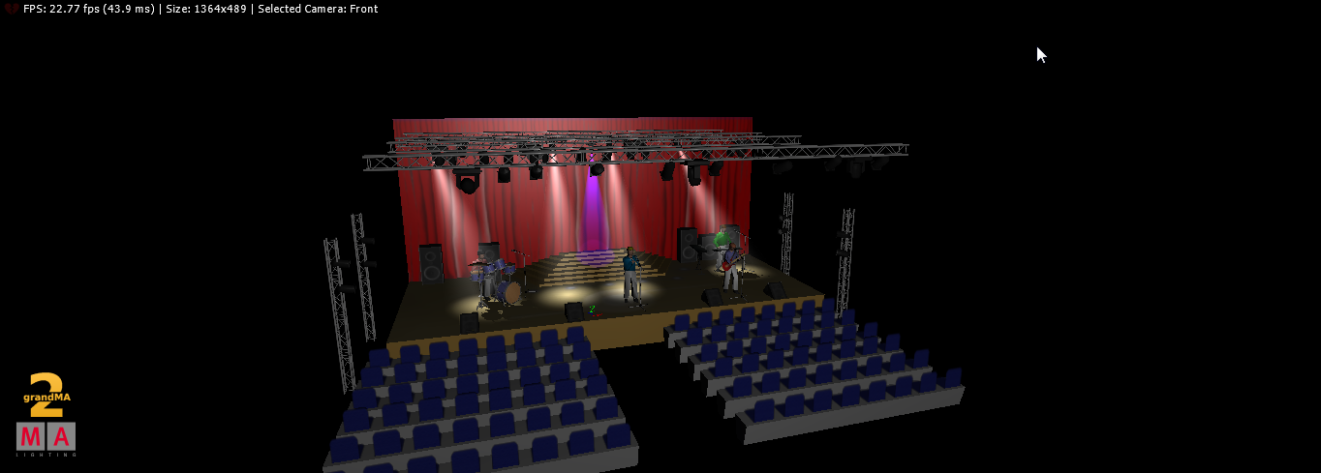
Video/Photos
More photos

Slide 8
Conclusion
This section would be used to list points in presenting the conclusion, what I learned, what I can use in the future and what I will use in my career.

