Slide 1
Research Approaches
Dr. Hans Tokke, Ph.D.

Slide 2
Research Question
A Question about the social world that is answered through the collection and analysis of firsthand, verifiable, empirical data.
P. 22
Feasible
Socially
Important
Scientifically
Relevant
Social Research “Sweet Spot”

Slide 3
Theory
A logically interrelated set of propositions about empirical reality.
What do we know about this?
What has been studied about this before?
What does literature say about this?

Slide 4
Literature Review
Articles, readings, books…..
The
theory research funnel
The theory with literature support for analysis (the literature review.

Slide 5
The Development of Theories: The Research Circle
Theory
Research
Findings
Hypothesis
Observations

Slide 6
Research Project
Hypothesis based on theoretical idea.
The
Research
project funnel
Data collection
The theory with literature support for analysis (the literature review).

Slide 7
Conflict Theory
“Society consists of different groups who struggle with one another to attaint scarce societal resources that are considered valuable.” (Marx 1867-1967; Sullivan, 2007)

Slide 8
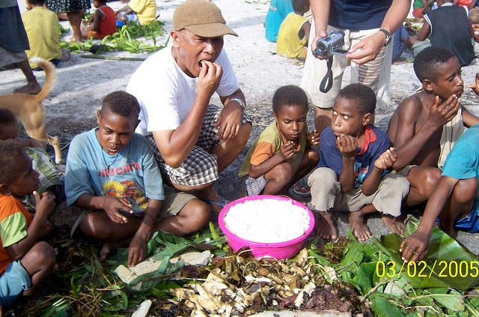
Interactionist
“Focuses on everyday social interaction among individuals rather than on large societal structures such as politics and education.”
(Blumer, 1962; Hewitt, 2003; Stryker, 1990.)
Interactionists are concerned with observing how people react to one another, discovering the meanings behind what individuals do and value.

Slide 9
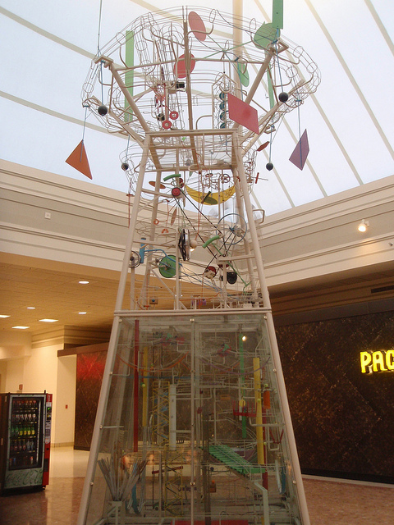
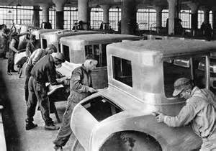
Functionalism
Durkheim: society is like a clockwork machine.
Social facts, regular expectations, structures of social behaviors and institutions, civility.

Slide 10
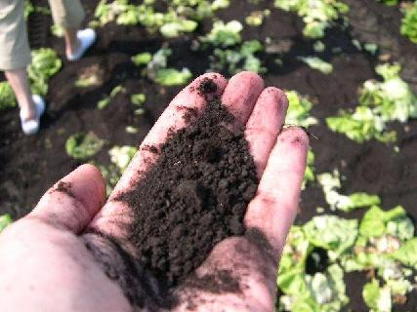
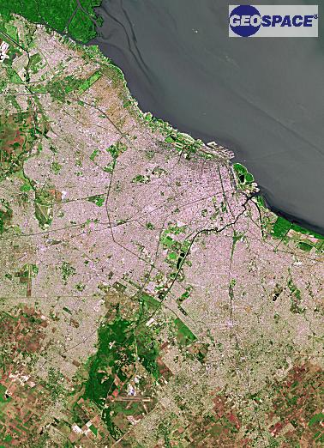
Micro/Macro View
Micro view sees the individual.
Macro view sees the broader society and influences on that society, and the systemic effects on the individual.
Microview: Dirt
Macroview:Earth

Slide 11
Social Groupings (Cohorts)
Having relationships with others in building associations whether formal or informal
Cohort Studies will narrow the research field to a specific grouping of people.
They may include various elements but are concerned with finding commonalities.

Slide 12
Grouping by age
Ageism
Age Categories
Grouping by Age
Age Sets
Age Rituals

Slide 13
Grouping by Gender
Matriarchialism
Grouping by Gender
Patriarchialism

Slide 14
Grouping by Class
Classism
Social Stratification
Grouping by Class
Caste & Class
Socioeconomic Standing

Slide 15
Grouping by commonalities
Associations
Cohort
Grouping by Commonalities
Social Capital
Social Codes

Slide 16
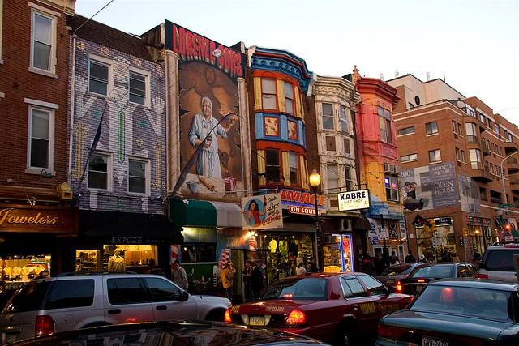
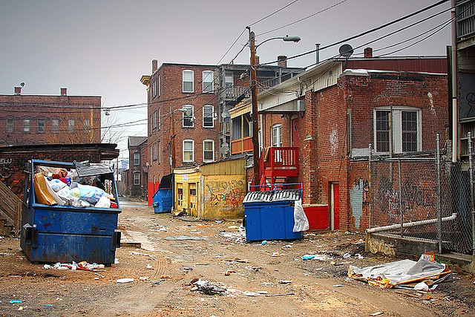
Ecology or Environment
Park and Burgess: Urban Ecology, neighborhoods shift and change socially and culturally, though the buildings and structures may remain the same.
Social research takes place in an ecology or environment that affects the study group.

Slide 17
Research Approaches
There are two schools in research
Qualitative
Inductive Methodology
Subject Data
Field Data
Meanings
Interpretation
Phenomenon
Reporting
Journalistic
Narrative
Story-telling
Quantitative
Deductive Methodology
Numerical Data
Calculated Data
Calculated Results
Analysis of Numbers
Reporting
Numerical
Trends
Significant Outcomes
Correlations
Numbers Reporting

Slide 18
Research Approaches
There are two schools in research
Qualitative
Inductive Methodology
Subject Data
Field Data
Meanings
Interpretation
Phenomenon
Reporting
Journalistic
Narrative
Story-telling
Quantitative
Deductive Methodology
Numerical Data
Calculated Data
Calculated Results
Analysis of Numbers
Reporting
Numerical
Trends
Significant Outcomes
Correlations
Numbers Reporting

Slide 19
The Different Approaches
Quantitative
Qualitative
A + B + C=D
A/B/C – D=A+B
#A + #B = Comparison #
H
S
A
N
Z
B
V
R
C
K
F
A
G
E

Slide 20
What to do?
Is your interest in understanding the meaning or a phenomenon or testing a theory? Usually need qualitative
Is your interest in calculating results and outputs? Usually need quantitative.
Mixed methods approach: Applies both methods to support the thesis. Program Planning methods often use Mixed Method approaches

Slide 21
Deductive Research
We start with a theory and then try to find data that will confirm or deny it. (p. 24)
What is the presumption?
What do we expect to find out?
What do we suppose will be the result?
Testing through research what we hypothesize.

Slide 22
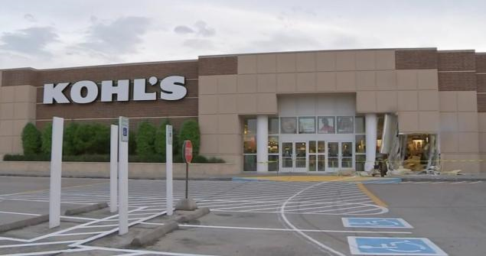
The KOHL’s Store Experiment
EXIT DOOR
ENTRANCE DOOR

Slide 23
Quantitative Deductive Approach

Slide 24
Quantitative Deductive Approach

Slide 25
Quantitative Deductive Approach
Dependent Variable:
The response/result based on the Independent Variable
Independent Variable:
The amount of pressure exerted on the teetor-totter

Slide 26
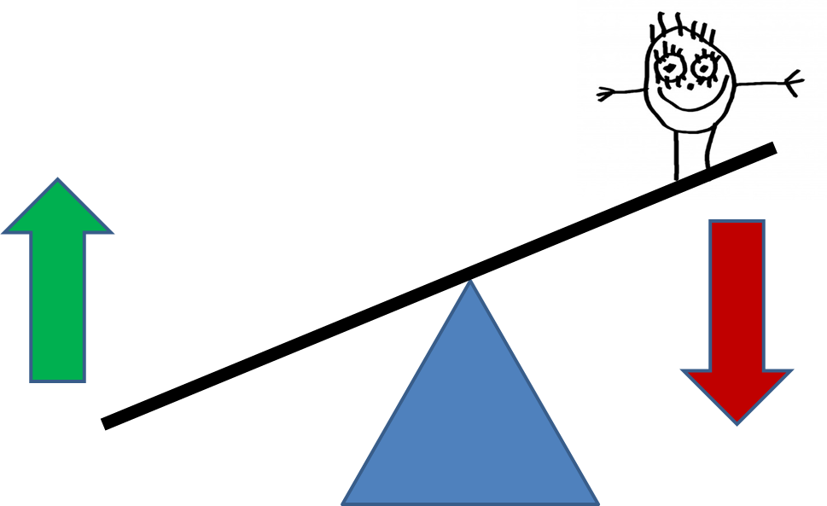
Longitudinal/Trend Study

Slide 27
Bibliography
Again, the bibliography is dictated by the methodology.
The narrower your question (phenomenological, case etc.) the more specific the literature
Depending on the grounded or ethnographic research one can have very narrow (issue one is critiquing) or generalized based on a theme.

