Slide 1
Introduction to Research
Dr. Hans Tokke Ph.D.

Slide 2
The Social World
The World of “Happy Johnny”

Slide 3
Thinking like a social scientist
Bias=
Own experiences
Own perception
Own experience
The Everyday Experience
Not thinking like a social scientist
“Social science is an effort to get beyond personal biases and limited viewpoints to something at least a bit more objective

Slide 4
Self-Interested Participants
People who make mistakes about how the world works based on their own bias
People who make mistakes about social policies or issues, based on their own bias
People who make mistakes based on “getting their own point across” without any sense of rational thinking.

Slide 5
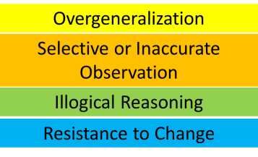
Errors in Opinion
Overgeneralization
Selective or Inaccurate Observation
Illogical Reasoning
Resistance to Change

Slide 6
Errors in Opinion
Overgeneralization
“I speak on behalf of the class”
“Everyone is thinking that…..”
A person may believe their own truth, when there is no proof that their truth is actually true.
The goal of research is TRUTH.

Slide 7
Errors in Opinion
Overgeneralization
Selective or Inaccurate Observation
“What did you see?”
compared to
“What did you think you saw?”
“Dense detail” in field observation
precision
opinion

Slide 8
Errors in Opinion
Overgeneralization
Selective or Inaccurate Observation
Illogical Reasoning
Primary Question: “Does it make sense?”
Logical: Employment numbers in a neighborhood = sanitation workers, security guards, store clerks, employment office postings, unemployment benefits, education related to hiring……
Illogical: “I can’t get a job”= Nobody's got a job. Can’t get a job around here.

Slide 9
Errors in Opinion
Overgeneralization
Selective or Inaccurate Observation
Illogical Reasoning
Resistance to Change
“Tradition can stifle adaptation to changing circumstances.”
Bias: It has always been this way!

Slide 10
Hunter’s Model
Home, Car:
Family/Close Friend spaces
Private
Park, Café, School, Church : Neighborhood or Community Spaces
DMV, Sidewalk, Subway: Shared Impersonal Spaces
Public
Parochial
Notes:
10

Slide 11
Third Place
HOME
JOB
HOME
We all have a regular cycle of urban life. This can create the mundane world of Simmel’s blasé.

Slide 12
Third Place
HOME
JOB
HOME
Third Place
The Third Place interrupts the regular cycle of urban life. It can become a place we “separate ourselves” from the regular mundane world of life. Church, Gym, Coffee Shop, Restaurant, Sports Club, Bar, Dance Club, Beauty Salon

Slide 13
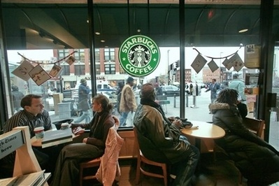
Third Place Marketing
How many times do you actually sit in Starbucks?
The perception
of urban rest.
Notes:
13

Slide 14
Merton’s Strain Theory
Conventional Means
Accept Reject
Conformity
Innovation
Cultural Goals
Reject Accept
Ritualism
Retreatism
Through New Means
Rebellion
Seeking New Goals

Slide 15
Scientific Process Viewpoint
Science: a set of logical, systematic, documented methods for investigating nature and natural processes; the knowledge produced by these investigations
Question
Investigation
Knowledge
Conclusion
“It’s about people”
logic
system
method
Social Science: The use of scientific methods to investigate individuals, societies, and social processes; the knowledge produced by these investigations.
The Social Question Filter
Why do people do what they do?
Why do groups of people do what they do?

Slide 16
The Ego!
“Scientific methods lessen the tendency to answer questions about the social world from ego-based commitments, excessive devotion to tradition, or unquestioning respect for authority. Social scientists insist, Show us the evidence!” (p. 7)

Slide 17
Exploratory Research
“What’s going on here?”
“What caused the change?”
CHANGE
Cause
Effect

Slide 18
Evaluation or Impact Research
“What is going on here?”
The Research Field
INTERNAL
EXTERNAL
“To what degree are the internal forces affecting….”
“What are the external forces affecting….?”

Slide 19
Generalizability
A
B
C
D
Generalizability:
A+B+C=D
Sample
A=A
B=B
C=C
D does not matter
Cross-population
A=B but not C
Or
A= 1/2B + 1/4C
Or
B=C but not A

Slide 20
Cross-Population Generalizability
Global, National, Local

Slide 21
Your Research Project
Neighborhood
+
Professional Field
Research Question,
Social Question
Research Method
Mixed Methods:
Qualitative
Quantitative
Case Study

Slide 22
Homework
Copy a map of your neighborhood and define your research geography
Come up with a social issue that interests you in regards to your neighborhood
Attempt to walk your neighborhood for a half hour and document “what you see” with unbiased observation to see things you did not notice before.
Formulate a research question/hypothesis about the social issue.

