Slide 1
5 Types of Qualitative Research
Research Methods in the Social Sciences

Slide 2
5 Approaches to Qualitative
Creswell: Chapter 4
Narrative
Phenomenological
Grounded Theory
Ethnographic Study
Case Study

Slide 3
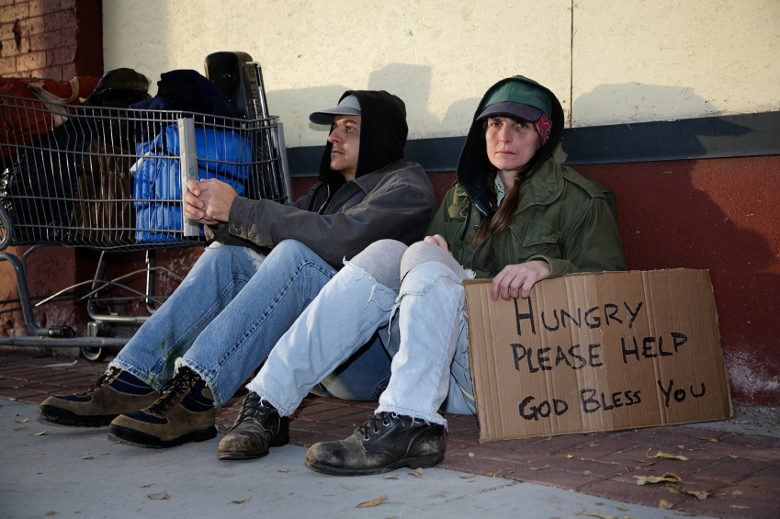
Narrative
Unearthing the “stories” of individual people
Usually through interviewing, but also through tracking their histories, lives, life affects
Biographical, Oral History, Autobiographical
Testimonials: This is used often in advocacy work.
Leadership studies.

Slide 4
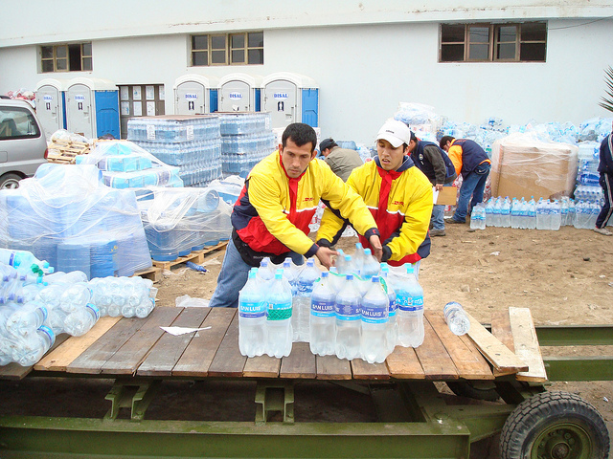
Phenomenological
Researching people and places to capture how they react to a common thing. (i.e. disaster response research, food usage research)
Several people’s lived experiences unearth results through coding. Thematic interpretation based on field research.
One begins with a concept of what they want to research, a question, an idea, a fact, and then research locations that will supply data for it.

Slide 5
Phenomenological
Reflect on central themes
Researcher makes an interpretation of the situation. Possibly prone to bias, but also if one is responsible in analysis can be a strong methodology for “third eye” perspective.
One is in the “scene” but not “of it”.
Deep description is necessary to gain empirical data for coding and theming.

Slide 6
Grounded Theory
Truth rises from the research. It emerges. Understanding of theory from below.
The researcher AFTER the data collection creates a “proposition” based on what the coding of the field notes unearths.
One goes into the field with very open approach. Really, one is available in their observations to see whatever “they see”, not being narrowed by a research idea as in Phenomenological Approach
Episodes become important.

Slide 7
Grounded Theory
Generate or uncover a theory about what you are seeing.
Seeing “situations”. Situated research.
Categorical field (different places with similarities)
Comparative fields (different places with variations. One looks to see the differences and the results of the differences)
Theoretical fields (people interviewed or places observed have some common thread in theory, but may be different categories). (i.e. Death is the overarching theory. How do young people compared to elders deal with memorializing the dead?)

Slide 8
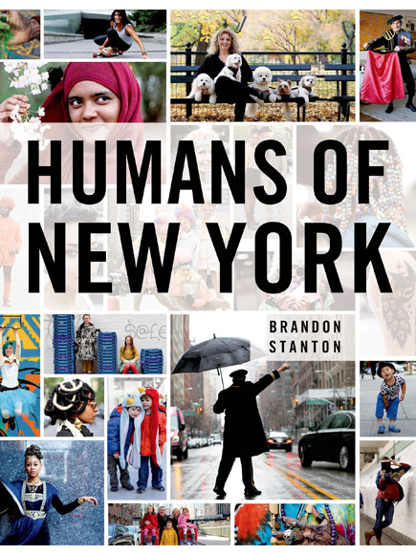
Ethnographic
Emerged out of anthropology
Technically: the study of a culture group through participant observation
Core is learning a culture both personally and collectively.
Garfinkel: “ethnomeds”

Slide 9
Ethnography
Realist ethnography: Third Person reporting. Strong third eye posture. Weber: “value-free”
Rational non-emotional involvement. One interprets the meaning based on engagement with key consultants and “the People”.
Critical ethnography: The goal is to criticize and challenge something (i.e. “the history from below”, “emergency medical care”)
The field notes are passionate and engaged and one is focused on a particular issue

Slide 10
Case Study
The research field is a particular organization.
Bounded system (a cases). One is “bound” to that particular case in data-gathering. “boundaries”
What, then, is one attempting to find out about the case in question?
Case studies can often use mixed methods for a full-analysis. Both qualitative and quantitative are useful. One interprets the data based on what one is searching for (i.e. The demographic shows regional spread (Quant.), The observations show employees apply the policies differently in different regional offices. (Qual.)

Slide 11
Case Study
It needs multiple data sources (Yin argues for 6 sources; each case has variances of what is valuable data)
Documents
Archival
Interviews
Field Observations
Participant Observation
Physical Artifacts

Slide 12
Differentiating Approaches p. 94
A Portrait
A Culture-Sharing Group
A CASE
Ethnography
Case Study
Narrative Study
Phenomenology
A THEORY
A Phenomenon
Grounded Theory

Slide 13
Your Research Proposal
So then, now what do I do? I’m not sure what my research proposal is to look like.
There is a variance based on what type of research you are doing.

Slide 14
Research Proposals
Phenomenological
Geography
Field
What are you observing?
What is the phenomenon you are observing?
Research question defines what you specifically are observing.
Grounded Theory
Geography
Field
Episodes
Why are you observing those particular fields?
No research question per se.
Ethnographic
Geography
Culture, Group of People
Meaning they place
Critical?
What are you critiquing?
If critical, research question narrows.
Case Study
Case Description
Research Methods, Data-Sources, Current material
What are do you want to find out about the case?
Narrative
Who? Which individuals
How will you unearth the story?
What is the general rationale for this particular story?
Meaning will emerge in analysis of the data.

