Slide 1



Determining Aerosol Optical Depth Utilizing A Multi-Filter Rotating Shadowband Radiometer, Microtops. Inter-Comparison With A CIMEL Sunphotometer
Antonio Aguirre and Agossa Segla
Mentor Viviana Vladutescu
ETET Department, NYCCT/CUNY
Electrical Engineering Technology Departmental Meeting
9/27/2011

Slide 2
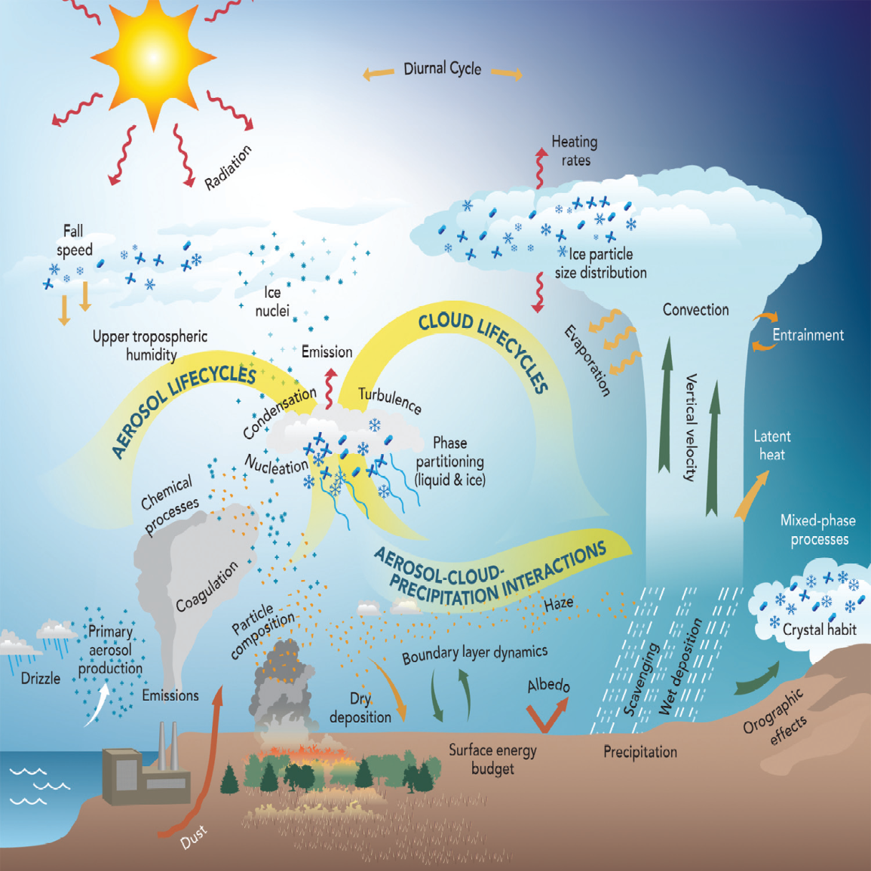
What is an aerosol?
An aerosol is a suspension of fine solid or liquid particles in air, ranging from a few nanometers to several tens of micrometers.
Fine aerosols impact health by getting into the lung and blood stream.
Aerosols affect climate and climate change by absorbing and scattering
incoming solar radiation.
Notes:
Agossa

Slide 3
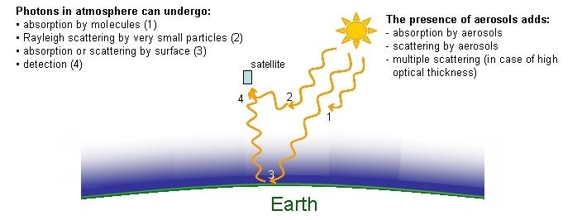
Solar Radiation Extinction
Extinction = Absorption + Scattering
Absorption and Scattering of sunlight = Direct Effect of Aerosols
Different aerosols scatter or absorb sunlight depending on their physical properties (i.e. color and composition).
Pure sulfates and nitrates reflect nearly all radiation, cooling the atmosphere.
Black carbon absorbs radiation, warming the atmosphere but also shading the surface.

Slide 4
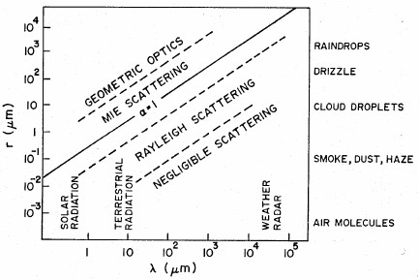
Scattering Theories
Rayleigh Scattering : Occurs when the λ of incident radiation is proportionally larger than the particle/molecule diameter.
Mie Scattering : Occurs when the λ of incident radiation is approximately the same as the particle/molecule diameter.
Geometric Scattering : Occurs when the λ of incident radiation is proportionally smaller than the particle/molecule diameter.

Slide 5
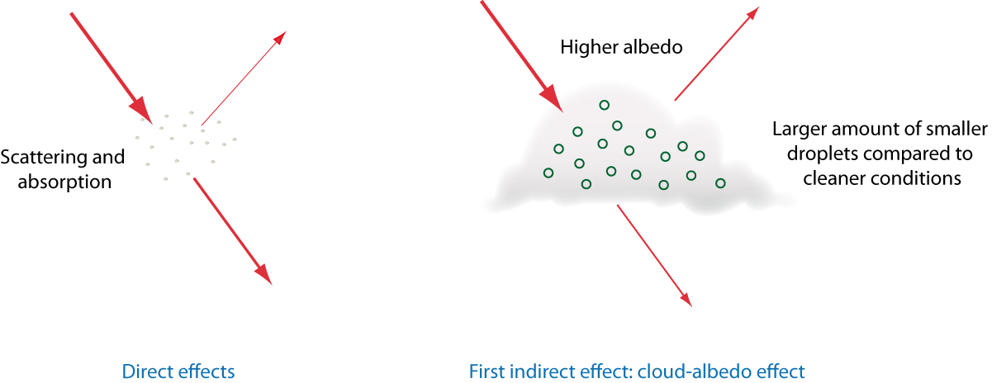
Direct and Indirect Effects of Aerosols
Direct Effect – responsible for fluctuations in the radiation budget of the Earth, due to the scattering and absorption of solar radiation
* The net effect of tropospheric aerosols is the cooling of the atmosphere.
Indirect Effect:
Effects cloud lifetime.
Effects probability of precipitation.
Effects radiation budget of Earth.
Notes:
Volcanoes and industrial emissions

Slide 6
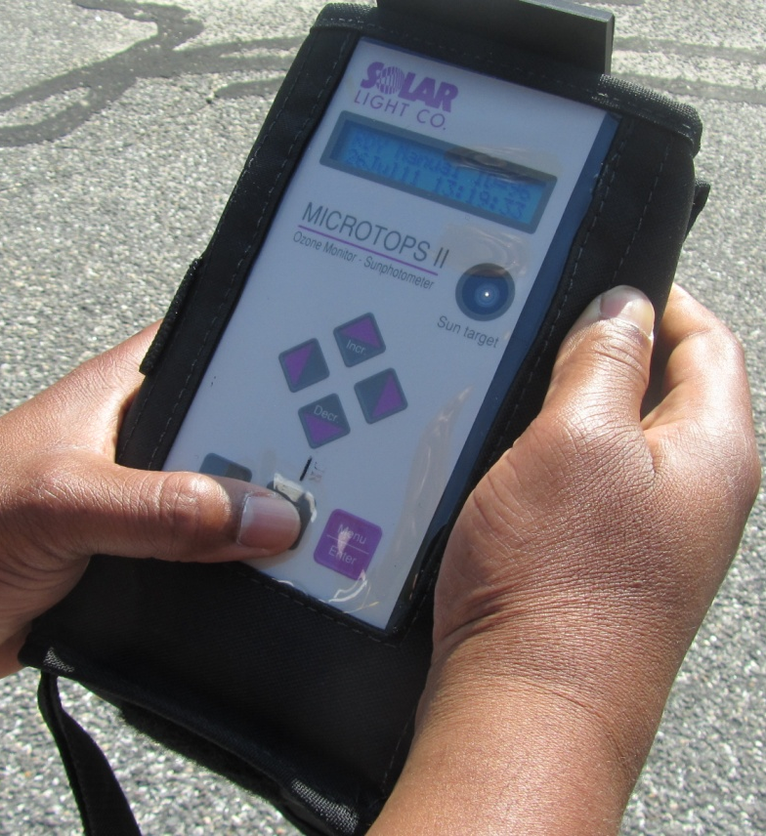
MICROTOPS II 5 Channel Sun-photometer
Aerosol optical depth (AOD)
Direct solar irradiance (in W/m^2)
Optical Collimator
Bull’s-eye of the
Sun target
LCD Screen
Wavelengths: 340, 500, 870, 936 and 1020 nm
Notes:
Agossa

Slide 7
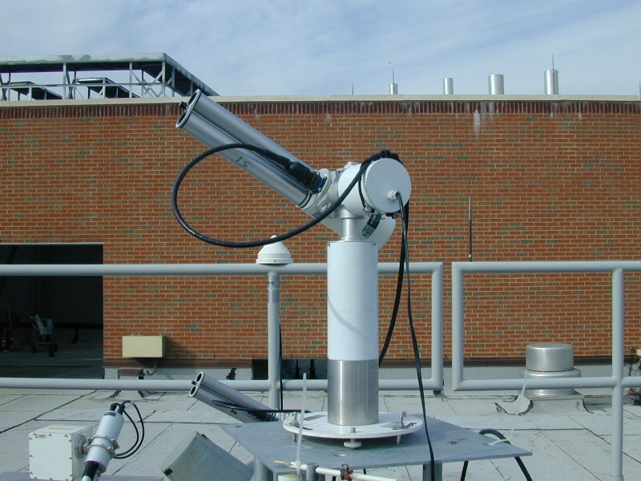
CIMEL SUN- PHOTOMETER
Different parts of the instrument
Control and measuring unit (the electronic box)
Two axis motorized system
Sensor head
Wavelengths: 440, 670, 870, 936,1020 nm

Slide 8
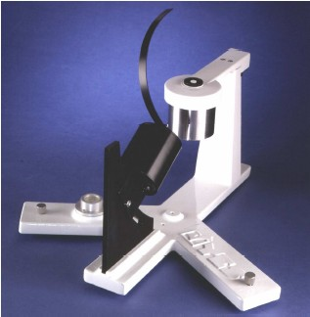
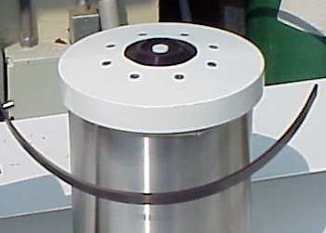
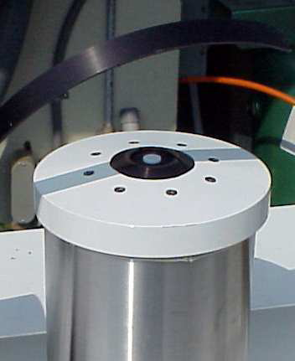
Multi-Filter Rotating Shadowband Radiometer
Measures total and diffuse solar irradiance.
Wavelengths: 410, 500, 615, 675, 870 nm.
MFRSR
Measuring Total Irradiance
Measuring Diffuse Irradiance
Direct Irradiance = Total Irradiance – Diffuse Irradiance
Notes:
Tony

Slide 9
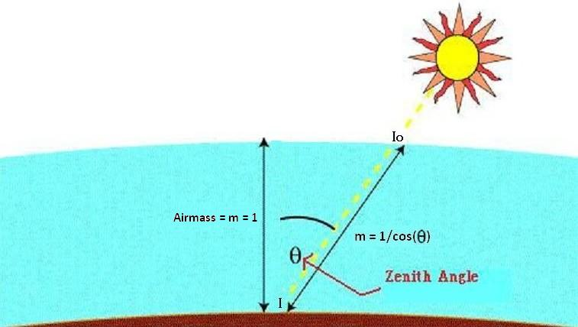



Atmospheric Extinction
Total Optical Depth is a measure of the extinction (absorption and scattering) of solar radiation through the atmosphere.
depends on wavelength (λ).
Notes:
AGOSSA

Slide 10


Contributions To Optical Depth
Rayleigh Scattering
  Scattering by air molecules
  Why sky is blue
Gaseous Absorption
Aerosols
  Aerosol Optical Depth is the contribution of aerosols to the total optical depth
Notes:
TONY

Slide 11
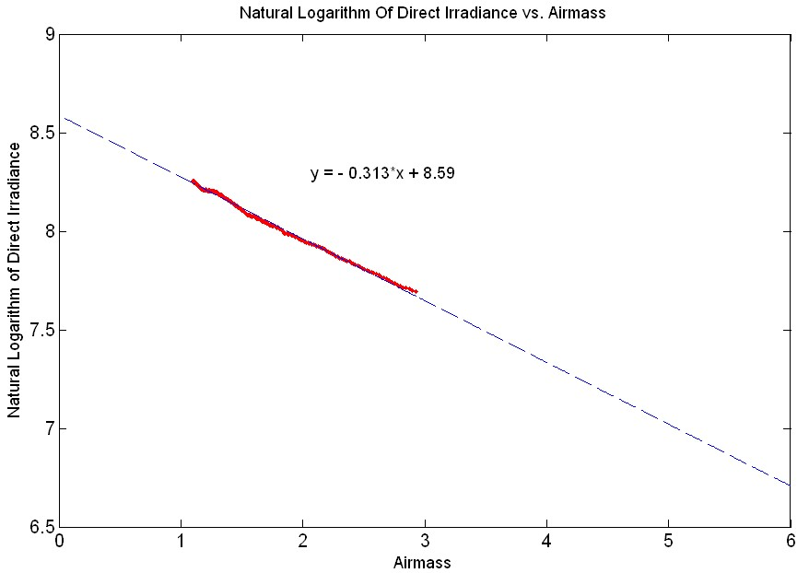


Langley Plot at 496nm
Notes:
TONY

Slide 12
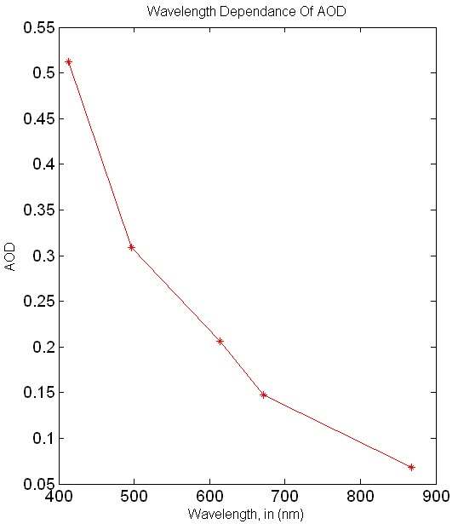
AOD Dependence On Wavelength
AOD is dependant on wavelength
AOD typically decreases as wavelength increases
Wavelength dependence of AOD provides information on the sizes of aerosol particles responsible for the majority of the extinction.
Notes:
AGOSSA

Slide 13
Time Series AOD for MICROTOPS II Across All Channels
AOD varies as function of wavelength and
illustrates variability over time and day due to
fluctuation in aerosol concentration and size
Notes:
AGOSSA

Slide 14
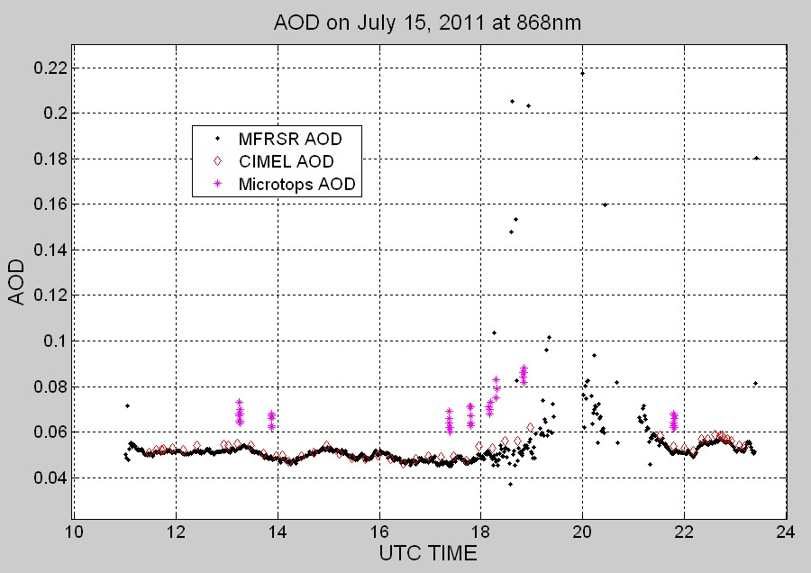
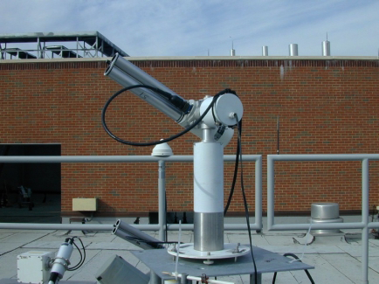
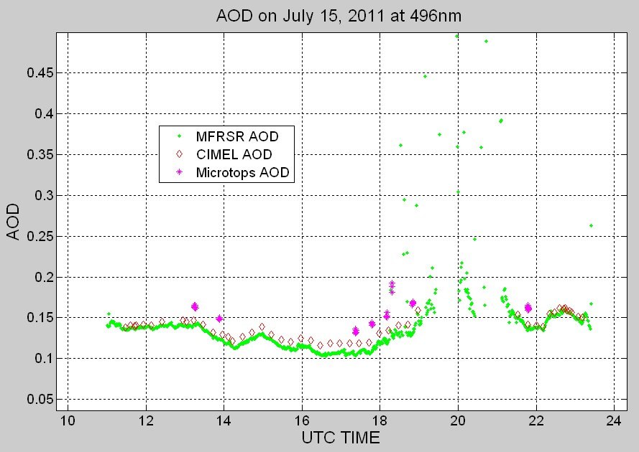
MFRSR vs. CIMEL and MICROTOPS II
Agreement throughout the day.
Agreement across multiple days.
Notes:
TONY

Slide 15

MFRSR/CIMEL Angstrom Comparison
Notes:
AGOSSA

Slide 16
END

Slide 17
MFRSR/CIMEL AOD Comparison

