Slide 1
Reading Strategies in the classroom
Rob Ostrom reading effectively across the disciplines faculty lead
Amanda Huminski Writing Across the Curriculum Fellow
April 26, 2018

Slide 2
Workshop outline
Writing intensive certification
Reading Effectively Across the Disciplines (READ) overview
Freewriting prompt
Reading strategy implementation discussion
Summary and reflection

Slide 3
WAC CERTIFICATION PROCESS
Before the end of the Spring 2018 semester, participate in six WAC workshops (in person or online): Designing Effective Assignments, Avoiding Plagiarism, Effective Grading / Minimal Marking, Creative Classrooms, Writing Intensive Syllabus, and Reading Strategies in the Classroom
Meet regularly with your paired writing fellow
Develop and revise teaching materials following WAC principles to prepare a WAC portfolio that includes:
Revised syllabus highlighting the role of writing in your course
At least one scaffolded assignment
Present your experiences and materials at the year-end colloquium on May 3rd (location forthcoming)

Slide 4
READ OVERVIEW
READ is a multi-component, multi-disciplinary project in which reading and content area faculty collaborate to design discipline-specific reading strategies to improve student learning in selected courses
Four key program components
1. Faculty development – Through workshops and mentoring 2. Peer-Led Team Learning (PLTL) – Workshops facilitated by undergraduates 3. Reading assessments – Administered pre and post interventions 4. READ Open Lab – To disseminate the project output and outcomes

Slide 5
FREEWRITING AND DISCUSSION
In your own experience (not that of students), what is so difficult about reading?
Free write for 2 minutes.

Slide 6
Text preview
How would you acquaint your students with this book?

Slide 7
Reading strategies implementation
In your small group, discuss your strategy and how each of you might be able to use it in a course
Strategy assignment
Group 1: Anticipation Guide (Chapter 3, p. 12)
Group 2: Exit Slips (Chapter 9, p. 28)
Group 3: KWL (Chapter 17, p. 51)
Group 4: Split-Page Notetaking (Chapter 35, p. 101)
Notes:
Split participants into four groups and assign each group a strategy to review and discuss. (10 minutes)

Slide 8
Text preview
For each small group to share with the room:
Explain your strategy and how it could benefit your students. What are some different ways your group thought about implementing this strategy?
Notes:
10 minutes, use following slides as visual illustration

Slide 9
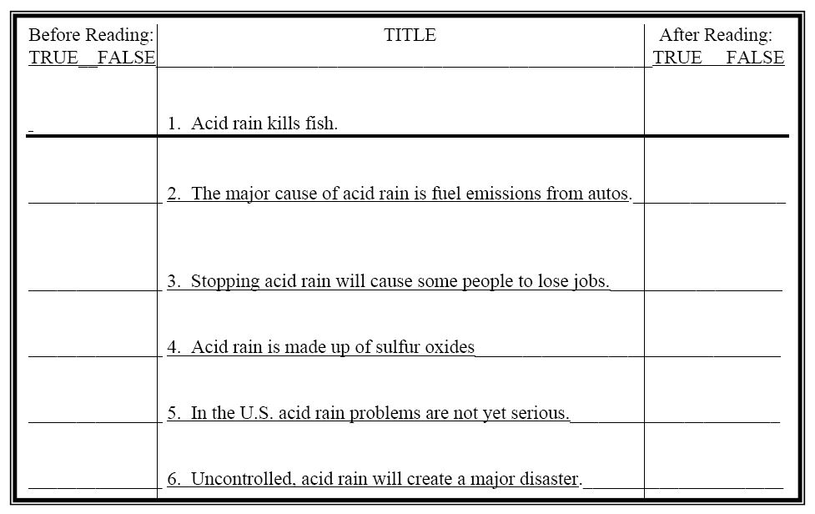
ANTICIPATION GUIDE
Notes:
An anticipation guide asks students to respond to content-specific claims before and after reading a text. They are asked to judge each claim as “true or false” before reading a text, and then to reflect on and potentially change their answer after reading a text.

Slide 10
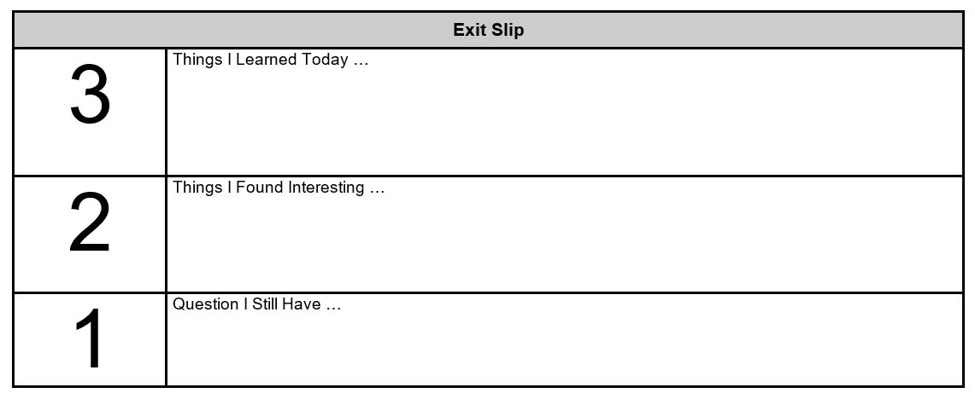
EXIT SLIPS
Notes:
Reflections on a specific text OR after a specific lecture

Slide 11
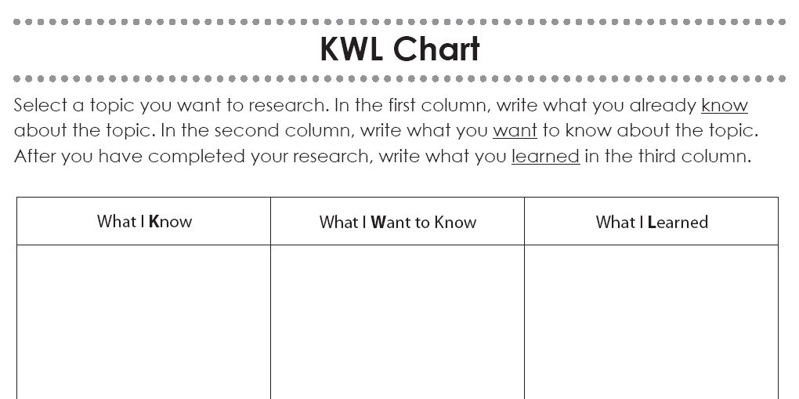
KWL CHART
Notes:
An KWL chart guides students through the research process by asking them what they want to know (before reading a text) and what they’ve learned (after reading a text)
In a three-column format, students are prompted to think about
K Column 1: What they already know
W Column 2: What they want to know
L Column 3: What they learned

Slide 12
SPLIT-PAGE NOTETAKING (E.G., THE CORNELL METHOD)
Notes:
A method for taking notes on reading OR in class.

Slide 13
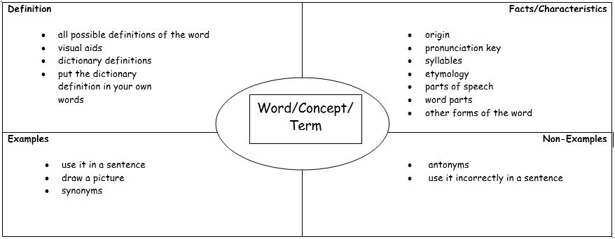
FRAYER MODEL
Notes:
Tool for focusing in on a specific word, concept, or term. Offers multiple modalities of gaining familiarity with a single concept.

Slide 14
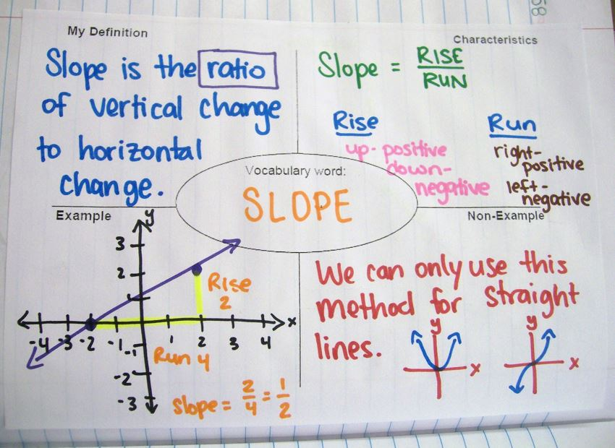
FRAYER MODEL EXAMPLE
Notes:
Student example

Slide 15
REFLECTION QUESTION
What content-specific reading strategy/strategies will you implement in your classes?

