Slide 1
Learning Goals, Objectives, & Curriculum Mapping
Linking curriculum & pedagogy to demonstrations of knowledge, skills, and abilities
Dr. Marjorie Dorimé-Williams

Slide 2
Introduction
Why Have Learning Goals, Objectives and Curriculum Maps?
“College standards are becoming diluted and there is a fuzziness about what faculty teach and what is expected from students.”
(Miller & Malandra, 2006, p. 3/
Commission on the Future of Higher Education)
Notes:
Objectives were conceptualized and used
during WWII as a way to make teaching and
learning more efficient.
• In the late 1950s and in the 1960s this approach
was applied to the public schools.
• By the 1960s higher ed was
developing behavioral objectives.
• 1962 = publication of Preparing Instructional
Objectives by Robert F. Mager
Communicating Curriculum Intentionality – Curriculum Purpose and Goals
Transparency and clarity of intended learning outcomes and the curriculum that advances these outcomes become increasingly critical for accountability purposes
Structures of current curricula often resemble mazes; often, not only students but experienced professors-advisors experience difficulties in progressing through curricula.
Structure and purposes of the curriculum should be transparent, explicit, easy to demonstrate, and easy to understand, and easy to navigate
Alexei G. Matveev, Ph.D.
NORFOLK STATE UNIVERSITY
Southern University at New Orleans // Workshop on SACS Reaffirmation Preparations
New Orleans, LA // October 16-17, 2008
Miller, C., & Malandra, G. (2006). The Secretary of Education’s
Commission on the Future of Higher Education, issue paper:
Accountability/Assessment. Washington, DC: U.S. Department
of Education. Retrieved from https://www2.ed.gov/about/bdscomm/list/hiedfuture/reports/miller-malandra.pdf
Purposes of Objectives
– By knowing where you intend to go, you
increase the chances of you and the learner
ending up there
– Guides the teacher relative to the planning of
instruction, delivery of instruction and
evaluation of student achievement.
– Guides the learner; helps him/her focus and
set priorities
– Allows for analysis in terms of the levels of
teaching and learning
Additional purposes of objectives include:
•Shows colleagues and students what we value.
•Guide for the learner relative to self-assessment.
•Basis for analyzing the level of cognitive thinking we are expecting
from the learner.
•Makes teaching more focused and organized.
•Provides models so that the students can write their own objectives
and thus helps develop an important life long learning skill; “the setting
of objectives.”

Slide 3
What are Learning Goals?
“Broad statements concerning knowledge, skills, or values that faculty expect graduating students to achieve. They describe general expectations for students, and they should be consistent with the program mission.” (Mary J. Allen, 2004 p. 29)
Students know basic biological principles and concepts. (Knowledge)
Students can use statistical packages to analyze sociological data and can interpret results accurately. (Skill)
Students value and respect the scientific approach to understanding natural phenomena. (Value)
Notes:
Talk about types of goals? Knowledge / Skill / Value?

Slide 4
Example Learning Goals at Baruch
Communications:
demonstrate empirical knowledge of the history, development, and contributions of the communication disciplines;.
interpret communication texts, artifacts, and performances
Political Science:
Consider alternative perspectives regarding a political question
Develop a greater sense of civic duty to participate in public affairs..
Apply a key concept, theory, or method of political science to analyze a political question.
History:
To explain causality in history or how and why change occurs
To use primary and secondary evidence in support of observations and claims.
Notes:
Discuss questions to consider when formulating learning goals.
Also note that learning goals are typically too general to be directly assessable and that’s why we need Objectives.

Slide 5
What are Learning Objectives?
“Learning objectives operationalize program goals; they describe, in concrete terms what program goals mean… They describe observable behaviors that allow faculty to know if students have mastered the goals.” (Mary J. Allen, 2004 p. 30)
Notes:
Objectives should not be so specific that they are trivial, nor so general that they are vague.
A statement in specific and measurable
terms that describes what the learner will
know or be able to do as a result of engaging
in a learning activity.
Other terms for Learning objectives
•Outcomes
•Enabling objectives
•Terminal objectives
•Educational objectives
•Performance objectives
•Instructional objectives
•Aims
•Competencies

Slide 6
Example Learning Objectives
By the end of this course, students will be able to categorize macroeconomic policies according to the economic theories from which they emerge. (Content)
By the end of this course, students will be able to analyze qualitative and quantitative data, and explain how evidence gathered supports or refutes an initial hypothesis. (Skill)
By the end of this course, students will be able to identify their own position on the political spectrum. (Value)
Notes:
Objectives should not be so specific that they are trivial, nor so general that they are vague.
A statement in specific and measurable
terms that describes what the learner will
know or be able to do as a result of engaging
in a learning activity.
Other terms for Learning objectives
•Outcomes
•Enabling objectives
•Terminal objectives
•Educational objectives
•Performance objectives
•Instructional objectives
•Aims
•Competencies

Slide 7
How to Write Good Learning Objectives
According to Robert F. Mager, the ideal learning objective has 3 parts:
1. A measurable verb.
2. The important condition (if any) under which the performance is to occur
3. The criterion of acceptable performance.
Notes:
Good learning objectives are focused on what the learner will know or be able to do by the end of a defined period of time and indicate how that knowledge or skill will be demonstrated.
Frequently you will not see the criterion or the condition specified if they are obvious. However, sometimes the adding the condition(s) and/or the criterion add much clarity to a learning objective.
Additionally, Bloom’s Taxonomy can help you get the right level of precision

Slide 8
How to Write Good Learning Objectives
Additionally, effective learning objectives are:
Consistent with the goals of the curriculum
Clearly stated
Clearly measurable
Realistic and doable
Appropriate for the level of the learner
Worthy (Important stuff)
Notes:
Good learning objectives are focused on what the learner will know or be able to do by the end of a defined period of time and indicate how that knowledge or skill will be demonstrated.
Frequently you will not see the criterion or the condition specified if they are obvious. However, sometimes the adding the condition(s) and/or the criterion add much clarity to a learning objective.
Additionally, Bloom’s Taxonomy can help you get the right level of precision

Slide 9
Bloom’s Taxonomy
6. Creating
5. Evaluating
4. Analyzing
3. Applying
2. Understanding
1. Remembering
Notes:
You’ve probably all seen Benjamin Bloom’s taxonomy, which has been around since the mid to late 50’s. His taxonomy of cognitive behavior provides a nice stair-step approach to thinking about levels of learning. The knowledge level is supposed to be the level of memorization and regurgitation. The creating level is supposed to be the production of new art or knowledge. (For a more complete explanation of Bloom’s
taxonomy visit the following site: http://a41064.west.asu.edu/students/dfields/96-598/b.bloom.html)
Bloom’s taxonomy can help you to be precise about your learning objectives, i.e. you can use it to decide what level you want your objectives to cover and figure out which measurable verbs to use when writing your goals. In the next few slides are lists of helpful measurable verbs at various levels of the taxonomy.

Slide 10
Measurable Verbs
Remembering
Define
Memorize
List
Recall
Repeat
Relate
Name
Repeat

Slide 11
Measurable Verbs
Understanding
Restate
Discuss
Describe
Identify
Locate
Report
Explain
Express
Recognize
Review

Slide 12
Measurable Verbs
Applying
Translate
Interpret
Apply
Practice
Illustrate
Operate
Demonstrate
Dramatize
Sketch
Employ
Schedule
Use

Slide 13
Measurable Verbs
Analyzing
Distinguish
Differentiate
Appraise
Analyze
Calculate
Criticize
Compare
Contrast
Examine
Test
Relate
Experiment

Slide 14
Measurable Verbs
Evaluating
Judge
Appraise
Evaluate
Revise
Score
Select
Measure
Value
Estimate
Choose
Compute
Assess

Slide 15
Measurable Verbs
Creating
Compose
Plan
Propose
Design
Assemble
Create
Prepare
Formulate
Organize
Manage
Construct
Set-up

Slide 16
Exercise: Operationalize the Goals
Communications:
demonstrate empirical knowledge of the history, development, and contributions of the communication disciplines;.
interpret communication texts, artifacts, and performances
Political Science:
Consider alternative perspectives regarding a political question
Develop a greater sense of civic duty to participate in public affairs..
Apply a key concept, theory, or method of political science to analyze a political question.
History:
To explain causality in history or how and why change occurs
To use primary and secondary evidence in support of observations and claims.
Notes:
Have people attempt to turn these goals into objectives?

Slide 17
Curriculum Mapping
What Is it?
Curriculum mapping is a process that helps teachers keep track of what has actually been taught throughout an entire year
A Curriculum Map is an outline of the implemented curriculum
More specifically, it is typically a table that shows how each course aligns with the learning goals and objective set by the department.

Slide 18
The Seven Phases of Curriculum Mapping
1. Collect Data
2. Individual Review
3. Mixed Group Review
4. Department Review
5. Immediate Action
6. Long Term Action
7. Review and Revise

Slide 19
Phase 1 of Curriculum Mapping
Collect Data
Each instructor should keep track of what they actually teach, when, and how during a course.
The level of granularity should be dictated by the learning goals/objectives.
They should do so in a way that makes it easy for other people to understand .
Notes:
Should

Slide 21
Phase 2 of Curriculum Mapping
Individual Review
Each instructor individually reviews all the other instructors data.
Look for gaps or repetition.
Look for what works.
Notes:
The idea is to help everyone develop a common understanding of the curriculum flow.

Slide 22
Phase 3 of Curriculum Mapping
Mixed Group Review
Ideally groups of people that don’t typically work closely together.
Each instructor can share their observations from the individual review.
Come to an agreement on present gaps or repetitions, as well as successful strategies.

Slide 23
Phase 4 of Curriculum Mapping
Large Group Review
All staff attend the review.
Look for patterns.
Transition from review mode to making decisions.

Slide 24
Phase 5 of Curriculum Mapping
Immediate Action
Decide what immediate steps the department is going to take to improve .
These should be steps that can be taken without major changes or further study.
Should be easy, i.e. change or drop a learning objective.

Slide 25
Phase 6 of Curriculum Mapping
Long Term Action
Decide what long term actions the Department will pursue.
These steps might require extensive structural changes or major course revisions.
Might not be so easy, but can be worked on slowly.

Slide 26
Phase 7 of Curriculum Mapping
Review and Revise
Curriculum Mapping should be dynamic.
Keep maps current.
Review the process as well as the results, continue to try to find ways to improve both.

Slide 27
How To Write A Good Curriculum Map
Identify the opportunities where key outcomes are introduced, practiced, and reinforced as students progress through their program.
Delineate the course(s) in which each program goal is addressed.
Encourage the integration of knowledge and skills over time through various courses and activities.
Notes:
If a particular goal is not addressed in any of the program’s courses, re-evaluate the goals and the scope of the required courses. Either or both can be changed (or proposals can be drafted to begin that process) in order to bring the program’s goals and curriculum into alignment.

Slide 28
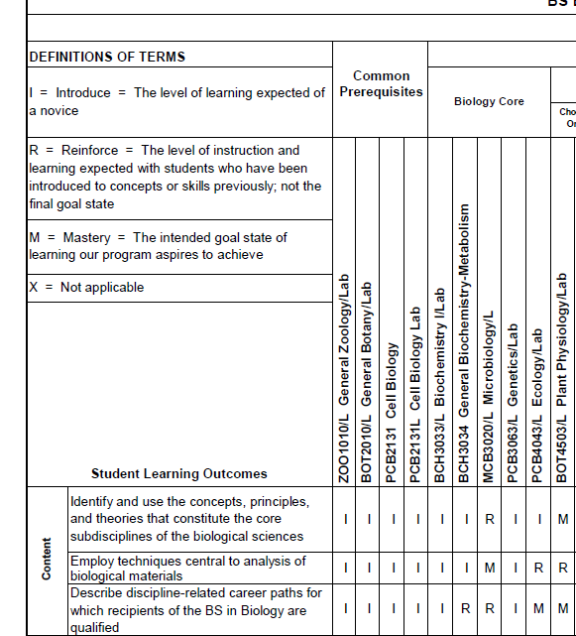
A Good Curriculum Map

Slide 29
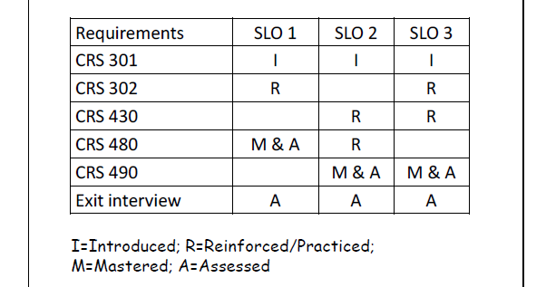
Another Good Curriculum Map

Slide 30
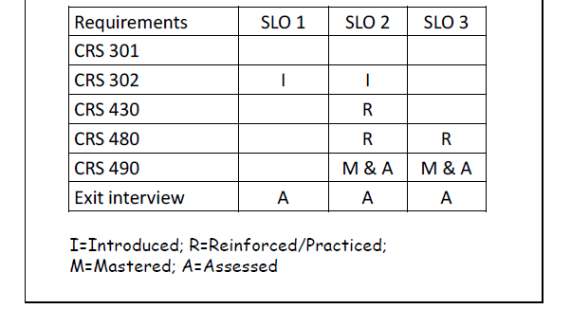
A Poor Curriculum Map
Notes:
What’s the difference?
(The good one does the 3 things recommended in the previous slide)

Slide 31
Your Turn
Groups of 4 (or 3)
• Complete the Curriculum Map
– Provided
• Blank Curriculum Map Grid
• 4 Learning Outcomes
• 6 Required Courses
– Arrange the learning outcomes and required courses
on the grid
– Use the Post‐its & pen to align instruction with
outcomes where:
I=introduce, R= reinforce/practice, M=master at senior level,
A=assess

Slide 32
Check-In
• In your group, discuss:
– Is this a cohesive curriculum?
– What makes it cohesive or not?
– What recommendations, if any, would you make to
the X department?
• Share

Slide 33
Questions?

Slide 34
Learning Goals, Objectives, & Curriculum Mapping
Linking curriculum & pedagogy to demonstrations of knowledge, skills, and abilities
Dr. Marjorie Dorimé-Williams

