Slide 1
Top 20 Prescribed Drugs 2013
Olha Vashkevych
Qing Jiang Huang
Fannyeu Liou
Yineeta Chitlall

Slide 2
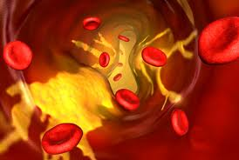
Zetia (Ezetimibe)
Pharmacologic category: Atilipemic agent
Use: Treatment of primary hypercholesterolemia
MOA: Inhibits absorption of cholesterol at the brush border of the small intestines.
Decreased delivery of cholesterol to the liver.
Adverse effects: fatigue, diarrhea.
Drug interaction: may decrease the effect/levels of Cyclosporine, levels of Ezetimibe maybe increased by Cyclosporine, levels/effects of Ezetimibe may be decreased by bile acid sequestrants.

Slide 3
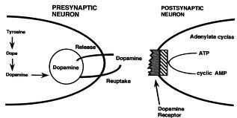
Methylphenidate (Concerta, Daytrana, Metadate CD, Ritalin)
Pharmacological Category: Central nervous system stimulant
Use: treatment of ADHD; symptomatic management of narcolepsy (except Concerta, Daytrana, Metadate CD, Ritalin LA, and Quillivant XR).
MOA: Blocks the reuptake of norepinephrine and dopamine into presynaptic neurons.

Slide 4
Adverse effects: hypertension (monitor blood pressure prior to using local anesthetic with vasoconstrictors), insomnia (6-13%), irritability (7%-11%), nausea 10-12%).
Drug interactions: Avoid concomitant use with alcohol (may increase levels), inhalational anesthetics, MAO inhibitors (increase levels). Methylphenidate may increase effects of Anti-Parkinson’s agent, antipsychotics.

Slide 5
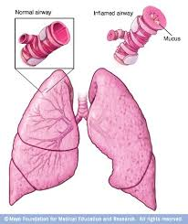
Symbicort (Budesonide and Formoterol)
Pharmacologic Category: Beta2 Agonist, corticosteroid, inhalant
Use: treatment of asthma in patients ≥12 years of age, maintenance treatment of airflow obstruction associated with COPD, bronchitis and emphysema.
MOA: Formoterol relaxes bronchial smooth muscle by selective action on beta2 receptors.

Slide 6
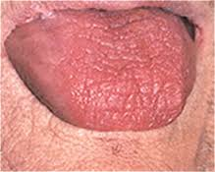
Adverse effects: headache (7%-11%), nasopharyngitis (7%-11%), upper respiratory infections (4%-11%), xerostomia.
Drug interactions: not listed

Slide 7
Albuterol (ProAir HFA)
Beta2 agonist
Use: treatment or prevention of bronchospasm in patients with reversible obstructive airway disease; prevention of exercise induced bronchospasm.

Slide 8
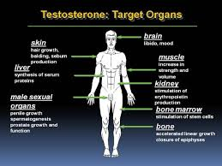
AndroGel (testosterone)
Pharmacologic Category: Androgen
Use: replacement therapy in the treatment of delayed male puberty.
MOA: endogenous androgen responsible for promoting the growth and development of the male sex organs and maintaining secondary sex characteristics in androgen-deficient males.
Adverse effects: prostate specific antigen increase (5%-11%), application site pruritus (17%-37%).

Slide 9
Viagra (Sildenafil)
Pharmacologic Category: Phosphodiesterase-5 Enzyme inhibitor.
Use: Revatio: treatment of pulmonary arterial hypertension in adults to improve exercise ability and delay clinical worsening.
Viagra: treatment of erectile dysfunction.
Unlabeled use: persistent pulmonary hypertension after recent left ventricular assist device placement.
MOA: Erectile dysfunction: does not directly cause penile erections, but affects the response to sexual stimulation.
Pulmonary arterial hypertension: inhibits PDE-5 in smooth muscle of pulmonary vasculature where PDE-5 is responsible for the adaptation of cyclic guanosine monophosphate (cGMP). Increased cGMP concentration results in pulmonary vasculature relaxation.

Slide 11
Adverse effects: headache (16%-46%), dyspepsia (7%-17%), flushing (10%).
Drug interaction: avoid concomitant use with Alprostadil, Amyl Nitrite, Boceprevir, Cobicistat, Fusidic acid, Phosphodiesterase 5 inhibitors, Pimozide, Rioclgust, Telaprevir, Vasodilators.

Slide 12
Cialis (Tadafil)
Pharmacologic category: Phosphodiesterase-5 ezyme inhibitor.
Use: signs and symptoms of benign prostatic hyplerplasia, erectile dysfunction, pulmonary arterial hypertension.
MOA: likely due to PDE-5 mediated reduction in smooth muscle and endothelial cell proliferation, decreased nerve activity, and increased smooth muscle relaxation. PAH: pulmonary vasculature relaxation.
Adverse effects: flushing (1-13%), headache (3%-42%), nausea (10%-11%).
Drug interaction: Avoid concomitant use with Alprostadil, Amyl Nitrite, Fusidic acid.

Slide 13
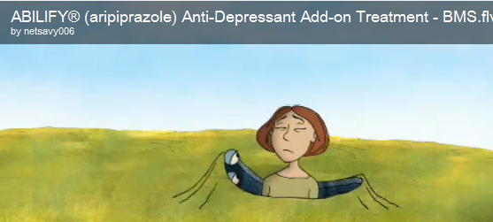
Abilify (ARIPiprazole)
Pharmacologic category: Antipsychotic agent, Atypical
Use: for bipolar, irritability associated with autistic disorder, major depressive disorder, and schizophrenia.
MOA: Quinolone antipsychotic which exhibits high affinity for D2 and D3 receptors. Moderate affinity for the serotonin reuptake transporter.
Adverse Effects: Headache (27%), extrapyramidal reaction (does related) (8-26%), sedation (13%), insomnia (18%), anxiety (17%), chest pain *10%)
Drug Interactions: may increase the level/ effect of alcohol; CNS depressant; thalidomide; Zolpidem.

Slide 14
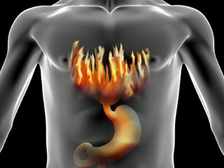
Nexium ( Esomeprazole)
Pharmacologic category: Proton pump inhibitor; substituted Benzimidazole.
Use: Treatment for erosive esophagitis, gastroesophageal reflux disease GERD.
MOA: Proton pump inhibitor suppresses gastric acid secretion by inhibition of the H+/K+ ATPase in the gastric parietal cell.
Adverse Effects: Headache I.v. 11%
Drug Interactions: May increase the level; effect of Vitamin K
antagonists, Voriconazole

Slide 15
Humira ( Adalimumab)
Pharmacologic category: Antirheumatic, Gastrointestinal agent, Monoclonal antibody, Tumor Necrosis Factor Blocking Agent.
Use: Ankylosing spondylitis. Crohn’s disease, plaque psoriasis. Psoriatic arthritis, rheumatoid arthritis and ulcerative colitis.
MOA: recombinant monoclonal antibody that bind to human tumor necrosis factor alpha (TNF- alpha), thereby interfering with binding to TNFa receptor sites and subsequent cytokine driven inflammatory processes.
Adverse Effects: Headache 12%, skin rash 12%, antibody development 26%, upper respiratory tract infection 17%.

Slide 16
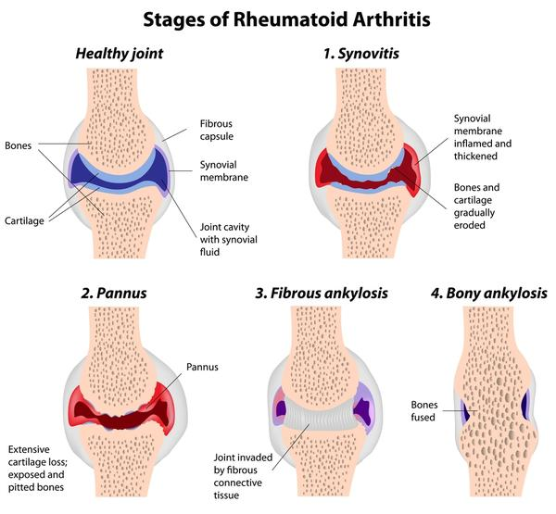
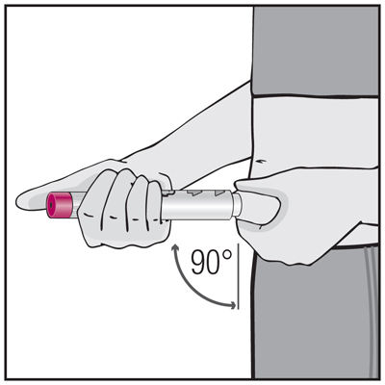

Slide 17
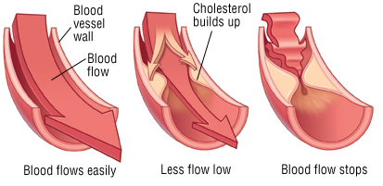
Crestor(Rosuvastatin)
Pharmacologic category: antilipemic agent, HMG-CoA reductase inhibitor
Use: Treatment for hypercholesterolemia, hyperlipidemia and mixed dyslipidemia and hypertriglyceridemia.
MOA: increase in the expression of LDL receptors on hepatocyte membranes and a stimulation of LDL catabolism.
Adverse Effects: Myalgia 13% headache 6%
Drug Interactions: none

Slide 18
Cymbalta(Duloxetine)
Pharmacologic category: Antidepressant, Serotinin/ Norepinephrine reuptake inhibitor
Use: Treatment for major depressive disorder (MDD), generalized anxiety disorder (GAD), diabetic peripheral neuropathic pain (DPNP).
MOA: Potent inhibitor of neuronal serotonin and norepinephrine reuptake and a weak inhibitor in dopamine reuptake.
Adverse Effects: Headache 14% fatigue 11% nausea 25% xerostomia 15%
Drug Interactions: None

Slide 20
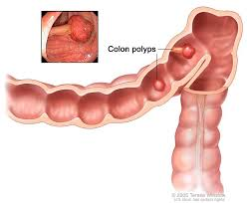
Avastin ( Bevacizumab)
Pharmacologic category: Antineoplastic agent.
Use: Treatment of metastatic colon or rectal cancer, non-squamous, non-small cell lung cancer, metastatic breast cancer used as part of a combination chemotherapy regimen, glioblastoma (GBM),metastatic renal cell carcinoma.
MOA: inhibits the biologic activity of human vascular endothelial growth factor (VEGF) in in vitro and in vivo assay systems.
Adverse effects: hypertension, thromboembolism,pain,fatigue, headache, dizziness, abdominal pain, vomiting, stomatitis, upper respiratory infection.
Drug interaction: No significant effects

Slide 21
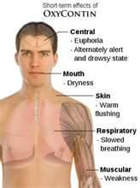
Oxycontin (Oxycodone)
Pharmacologic category: Analgesic, opioid.
Use: relief of moderate to severe pain, for acute pain and in some instances of chronic cancer pain.
MOA: Binds to opiate receptors in the CNS, causing inhibition of ascending pain pathways, altering the perception of and response to pain, produces generalized CNS depression.
Adverse effects: euphoria, constipation, fatigue, dizziness, nausea, vomiting, dry mouth, anxiety, itching, and sweating.
Drug interactions: Avoid taking Oxycodone with sleeping pill, muscle relaxer, other pain medicine, or medicine for anxiety, depression, or seizures.

Slide 22
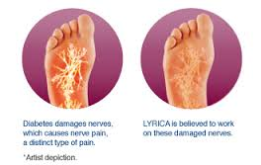
LYRICA( Pregamblin)
Pharmacologic category: Analgesic, Anticonvulsant
Use: Neuropathic pain associated with diabetic peripheral neuropathy, Postherpetic neuralgia, adjunctive therapy for adult patients with partial onset seizures, fibromyalgia, neuropathic pain associated with spinal cord injury.
MOA: inhibit excitatory neurotransmitter release including glutamate, norepinephrine, serotonin, dopamine.
Adverse effects: Serious, even life-threatening, allergic reaction, suicidal thoughts or actions, swelling of your hands, legs and feet, dizziness and sleepiness.
DRUG INTERACTIONS: Avoid use with Azelastine,Thalidomide, Pregablin may increase levels/effects of : Alcohol, Azelastine(nasal), CNS depressants, Hydrocodone, Selective Serotonin Reuptake Inhibitors, Zolpidem

Slide 23
CELEBREX (Celecoxib)
Pharmacologic category: nonsteroidal anti-inflammatory drug
Use: Osteoarthritis, Rheumatoid Arthritis, Juvenile Rheumatoid Arthritis in patients 2 years and older, Acute Pain.
MOA: inhibition of prostaglandin synthesis, primarily via inhibition of cyclooxygenase-2.
Adverse effects: abdominal pain, diarrhea, dyspepsia.
Drug interactions: CELEBREX and warfarin may result in increased risk of bleeding complications, CELEBREX may reduce the antihypertensive effect of ACE Inhibitors and angiotensin II antagonists, CELEBREX with ACE-Inhibitors in elderly or volume depleted or renally compromised patients may result in deterioration of renal function, including acute renal failure.

Slide 25
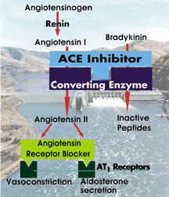
Diovan (Valsartan)
Pharmacologic category: angiotensin II receptor blocker, antihypertensive
Use: Treatment of hypertension, heart failure, reduction of cardiovascular mortality in clinically stable patients with left ventricular failure or left ventricular dysfunction following myocardial infarction.
MOA: direct antagonism of the angiotensinII(AT2) receptors, displaces angiotensin II from AT1 receptor and lowers blood pressure.
Adverse effects: headache, dizziness.
DRUG INTERACTIONS: NSAID use may lead to increased risk of renal impairment and loss of antihypertensive effect.

Slide 26
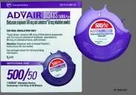
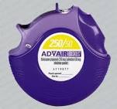
Advair diskus (Fluticasone & Salmeterol)
Pharmacologic category: Beta2 Agonist
Use: maintenance treatment of asthma and COPD
MOA:
Fluticasone: potent vasoconstrictive and anti-inflammatory activity
Salmeterol: relaxes bronchial smooth muscle by selective action on beta 2 receptors with little effect on heart rate
Adverse effect: upper respiratory tract infection (16%-27%), headache (12%-21%).
Drug interaction: may increase level/toxicity of beta2 agonists, loop diuretics, sympathomimetics; may decrease levels/effects of antidiabetic agents.

Slide 27
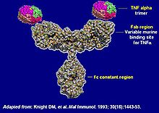
Remicade (Infliximab)
Pharmacologic category: antirheumatic, GI agent, immunosuppressant agent, tumor necrosis factor (TNF) blocking agent.
Use: treatment of moderately-to-severely active rheumatoid arthritis and Crohn’s diease
MOA: Infliximab is a chimeric monoclonal antibody that binds to human tumor necrosis factor alpha, thereby interfering with endogenous tumor necrosis factor alpha activity.
Adverse effect: infection (36%), upper respiratory tract infection (32%), Nausea (21%), headache (18%), abscess (15%), sinusitis (14%), cough (12%).
Drug interaction: combining with anakinra (kineret), abatacept (orencia) or tocilizumab (acemra) may increase risk of serious infections.

Slide 28
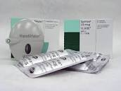
Spiriva (Tiotropium)
Pharmacologic category: anticholinergic agent
Use: maintenance treatment of bronchospasm associated with COPD
MOA: inhibit actions of acetycholine at type 3 muscarinic receptors in bronchial smooth muscle causing bronchodilation.
Adverse effect: upper respiratory tract infection (41%), xerostomia (5%-16%)
Drug interaction: not listed

Slide 29
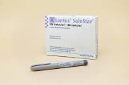
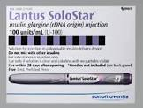
Lantus Solostar/Lantus (insulin glargine)
Pharmacologic category: insulin
Use: treatment of type 1 & 2 diabetes mellitus to improve glycemic control
MOA: insulin acts via specific membrane-bound receptors on target tissues (liver, skeletal muscle, and adipose tissue) to regulate metabolism of carbhydrate, protein, and fats.
Adverse effect: hypoglycemia, tachycardia, fatigue, headache, and mental confusion.
Drug interaction: not listed

Slide 30
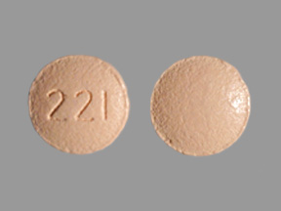
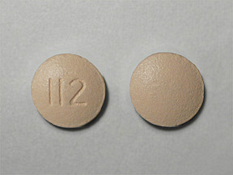
Januvia (Sitagliptin) Januvia 25mg Januvia 50mg
Pharmacologic category: Antidiabetic agent, dipeptidyl peptidase IV inhibitor
Use: Management of type 2 diabetes mellitus
MOA: inhibits dipeptidyl peptidase enzyme resulting in prolonged actie incretin levels.
Adverse effect: diarrhea, constipation
Drug interaction: may increase levels/effects of ACE inhibitor, hypoglycemic agents; may be increased by herbs, MAO inhibitors, SSRI; may be decreased by corticosteroids (orally inhaled and systemic) and loop diuretics.

Slide 31
Reference
Drug information handbook for Dentistry, 20th edition.
www.drugs.com/stats/top100/2013/sales

Slide 32
Q&A

Slide 33
1. Abilify is for??
Major depressive disorder
Management of type 2 diabetes mellitus
Analgesic
Maintenance treatment of asthma

Slide 34
1. Abilify is for?
Major depressive disorder

Slide 35
2. Nexium is for??
Analgesic
Maintenance treatment of asthma
Gastroesophageal reflux disease
HMG CoA reducatese inhibitoroesophageal reflux disease

Slide 36
2. Nexium is for??
C. Gastroesophageal reflux disease

Slide 37
3. Crestor is for??
Analgesic
Maintenance treatment of asthma
Gastroesophageal reflux disease
Antilipemic agent

Slide 38
3. Crestor is for??
D. Antilipemic agent

Slide 39
4. Lantus solostar/Lantus is for??
Major depressive disorder
Management of type 2 diabetes mellitus
Analgesic
Maintenance treatment of asthma

Slide 40
4. Lantus solostar/Lantus is for??
B. Management of type 2 diabetes mellitus

