Slide 1
Stress and Coping

Slide 2
Stress
Stressful stimulus: An external event that provokes a response
Stressful response: Physical or emotional reaction to stimulus
1) Acute time-limited stressors
2) Brief naturalistic stressors
3) Stressful event sequences
4) Chronic stress (daily stressor build-up)
5) Distal stressors

Slide 3
Example of Distal Stressors
Passing on Experience of Trauma to Offspring
Study: In Black Men, Internalized Racism Speeds Up Aging

Slide 4
Stress Appraisal
Cognitive Appraisal
(how we make sense of events and deem them as stressful or not)
A) Primary Appraisal
Initial thought: is this event harmful or not?
B) Secondary Appraisal
Determination of resources: do I have what it takes to cope?
C) Cognitive reappraisal
Reappraising as the event continues/develops
Stressfulness depends on our perceptions (open to interpretation)
The same situation may be appraised differently based on mood, health, motivation, presence of others, etc.

Slide 5
What causes stress?
Everything!
Stress is a subjective experience
(we will discuss appraisal later)
What are some of your current stressors?
Two-way street:
STRESS → ILLNESS
(CHRONIC) ILLNESS → STRESS

Slide 6
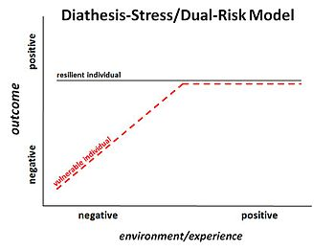
Sources of Stress
Individual
Personality type
E.g., Type A, Type D
Environmental
Psychosocial events
E.g., illness of loved one, death of loved one, suicide, poverty, workplace responsibilities
Biopsychosocial
Diathesis-Stress model of disease
E.g., schizophrenia, depression, alcoholism

Slide 7
Different Types of Stress
Daily life hassles
Good stress (focus) vs. bad stress (fear)
Microaggressions (identity based and political)
Catastrophic events and PTSD
Loosely related to high risk health behaviors
Comorbidity- meaning and relevance

Slide 8
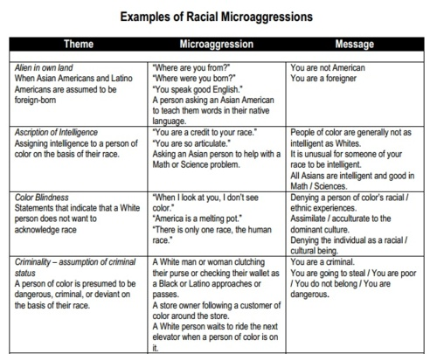
Microaggressions

Slide 9
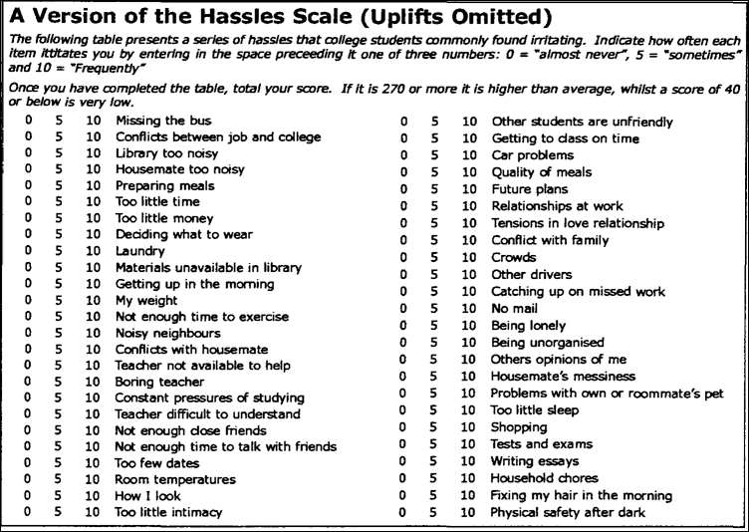
Daily Hassles

Slide 10
COPING: Cognitive Coping
Coping= Response to stress
Cognitive coping= what we think in the presence of stress
Engagement (obtain information) or Disengagement (minimize discomfort)
These terms can describe both cognitive and behavioral coping
Two types of Cognitive Coping:
Problem-focused
Emotion focused

Slide 11
COPING: Behavioral Coping
Exercise and stress
Music (interesting one!)
Humor
Social support (buffering)
Spirituality/religion/traditions
What do ya’ll do when something has made you feel afraid, vulnerable, angry, alone? How do you deal?

Slide 12
Stress can lead to high risk behavior…
This is a form of behavioral coping…poor behavioral coping
Stress and eating
Stress and sleep deprivation
Sexual behaviors (escape)
Substance abuse (escape)

Slide 13
Positivity and Stress
Stress can be positive (focus)
Positive attitude can reduce perceptions of stress
More positivity than stress is a form of illness prevention
How stressed are you? (LIVEWELL ASSIGNMENT)

Slide 14
Stress: Let’s Get Physical!

Slide 15
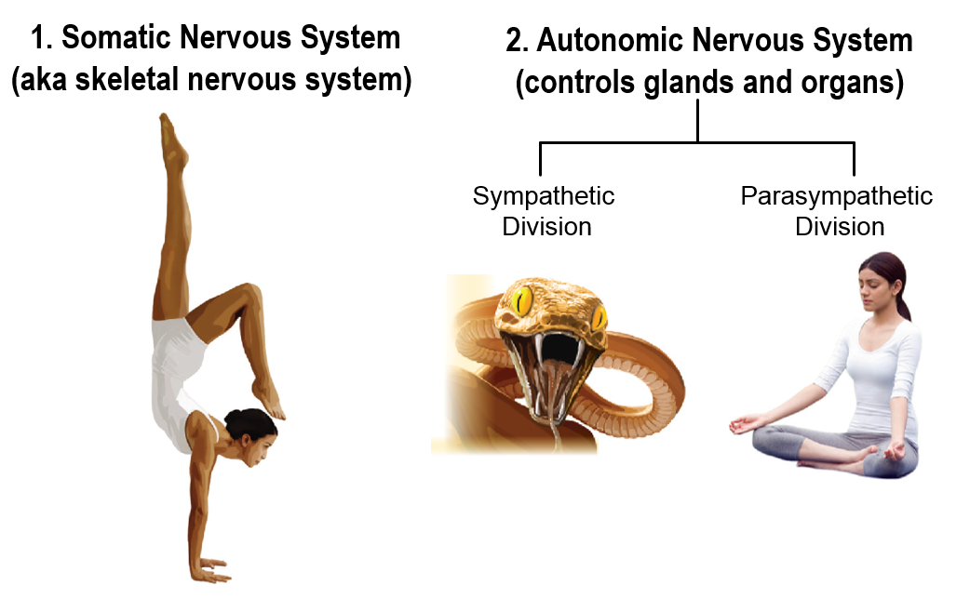
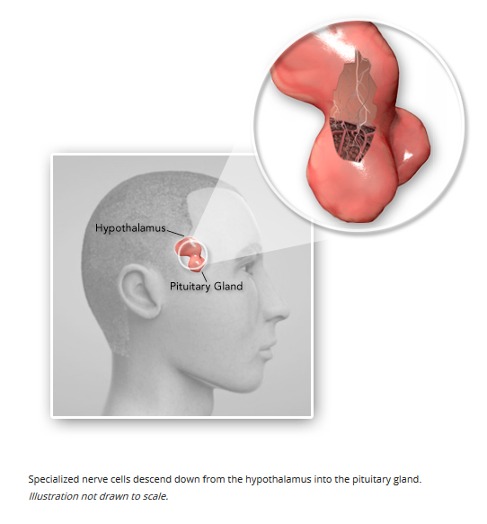
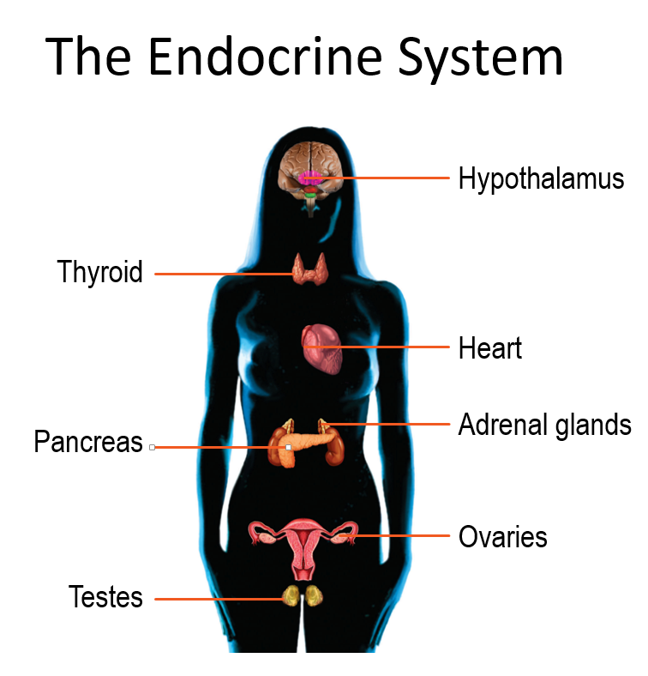
Systems Involved…

Slide 16
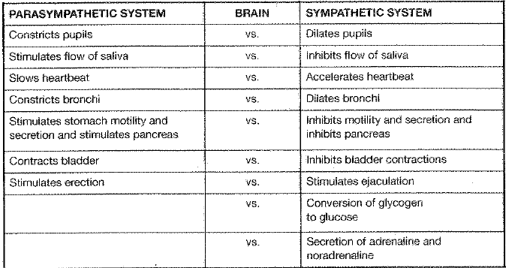
Fight or Flight Response

Slide 17
Stress Response: All the Players
Stressors activate the immune system (within minutes <hour)
Hypothalamus: leader of the stress response
Adrenal gland secretes epinephrine and norepinephrine (FIRST RESPONDERS) as instructed by Hypothalamus
Hypothalamus secretes corticotrophin-releasing hormone (Stress hormone: CRH)
CRH tells neighbor (pituitary gland) to secrete adrenocorticotrophic hormone (ACTH)
ACTH signals the release of glucorticoids (LONG TERM RESPONDERS)
Glucorticoids relate to decreases in lymphocytes (one of the two types of cells in body’s immune system)
Lymphocytes help attack foreign organisms (viruses, bacteria) in the body, so a decrease is seen as bad.

Slide 18
Stress, the Immune System, and Disease: Glucorticoids and Lymphocytes (The Benefits of Animal Studies)
Altering immune functioning can happen 2 ways:
Chronic Stress → reduction of white blood cells (lymphocytes) and poor/ supressed immune system
Acute stress → redistribution of white blood cells (lymphocytes go elsewhere, specifically skin) results in overactive immune system
If chronic stress is not permanent, then eventually body’s immune system will return to normal. (Same for repeated acute stressors)
Problems (diseases) occur when…
Chronic stress remains
Glucorticoid level remains high (decreasing lymphocytes)
The sympathetic nervous system remains activated

Slide 19
Stress and Disease
Overactive Immune System → body may attack its own tissues, causing an allergic reaction or diseases such as Lupus, Multiple Sclerosis, or Rheumatoid Arthritis (all chronic)
Underactive/ supressed Immune System → promote bacterial infection, eruption of dormant virus, or reproduction of cancer cells
Looking ahead….
HIV/AIDS: Stress and negative emotions speed the transition from HIV to AIDS
Stress predicts a faster decline in those living with AIDS
Education, support groups, and effective coping mechanisms are an important part to treating the disease(s)

