Slide 1
Dilaceration and Dens in Dente
Prianka Roy
DEN 1218

Slide 2
Dilaceration is a developmental disturbance in shape of teeth. Trauma, altered tooth germ position and delayed tooth eruption have been hypothesized as possible causes of tooth root Dilaceration.

Slide 3
Panoramic radiograph showing a Dilacerated mandibular second premolar with advanced bone loss on mesial aspect.

Slide 4
On this radiograph, diagram A is maxillary lateral incisor and diagram B is mandibular 3rd molar . Both has dilacerated roots .

Slide 5
On this picture there are some extracted Dilacerated teeth.

Slide 6
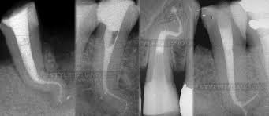
Periapical radiographs of the Dilaceration tips in its position in the arch Endodontics treatment.

Slide 7
Dens in Dente also known as Dens invaginatus, is a rare dental anomaly. This anomaly occurs when the enamel folds into the dentin during tooth development.

Slide 8
The picture is maxillary lateral incisor showing Dens in Dente .

Slide 9
Bilateral radicular Dens in Dente in mandibular premolars.

Slide 10
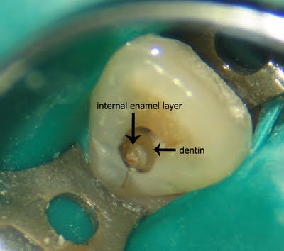
This is a extracted picture showing Dens in Dente.

Slide 11
This picture is for follow up of Dens invaginatus with retrograde endodontic treatment .

Slide 12
Dens in Dente: A minimally invasive non surgical approach .

Slide 13
Five root canal in peg lateral incisor with Dens invaginatus

Slide 14
REFERENCE
http://directionsindentistry.net/dental-gallery-for-dentists/dens-in-dente-lateral-incisor-tooth/?fbclid=IwAR0d-LYN5DqmAhnwfJY3XrS3lvlGYP_XezZ9nmwpFC0NfL4c1fRKzNzemxM.
http://www.endodontologyonweb.org/fulltext.asp.
https://www.researchgate.net/figure/The-abnormal-shape-of-the-mandibular-teeth-presenting-dens-in-dente-can-be-seen-in-this_fig2_23959999?fbclid=IwAR3eA9niwZCciSWqsF69ntbOYy9L8ZcSC8V6yNYcQaqMTdMvhI5sTtSz76k.
https://www.researchgate.net/?fbclid=IwAR3ne6LTVjIPHYsUnv0Jm4z0AlJkYkrfqQbl_rF4a_Qlr1tpJDWqhINzI4U
http://www.joomr.org/fulltext.asp.

