Slide 1
COLONIZING MARS: THE NEW FRONTIER
Presented By
Rachel Alexander, Juan Carlos, Bryon & Ali Akram

Slide 2
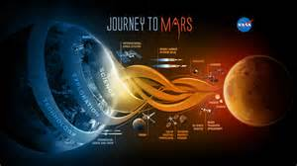
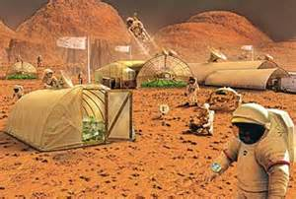
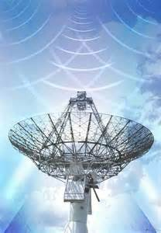
LETS UNDERSTAND
Travel
Necessities
Living Conditions
Communications

Slide 3
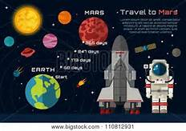
TRAVEL
Between earth & Mars is about 140 million miles ( 0.00000589429108 ths of a light yr) that is about 13 mins @ full impulse.
Calculations should be precise.
(Columbia & Challenger ) disasters
Designing of the spacecraft
Necessities

Slide 4
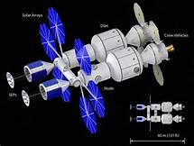
SPACE SHUTTLE

Slide 5
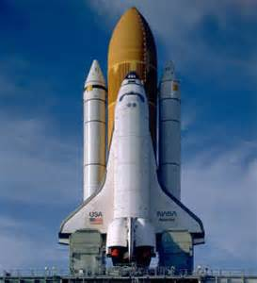
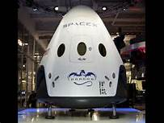
GOVERNMENT Vs PRIVATE
SPACE X
NASA
FALCON HEAVY LAUNCH SYSTEM
SPACE LAUNCH SYSTEM

Slide 6
SUCCESSFUL TRIPS
6 successful landings (Robots) – slightly larger.
Viking I & II, Pathfinder, MER spirit, Opportunity & Phoenix
Balancing act between minimizing the weight and fuel efficiency.

