Slide 1

Cholesterol

Slide 2
Cholesterol is a waxy substance that travels in your bloodstream.
Cholesterol is needed to make some hormones, vitamin D, and substances that help you digest foods.
Cholesterol is also found in foods that come from animal sources.

Slide 3
HDL vs. LDL
High- Density Lipoprotein Low- Density Lipoprotein
Good
Bad
Remove
Cholesterol
From
Arteries
Causes
Cholesterol
Build Up &
Blockages

Slide 4
Cholesterol Levels
LDL
Less than
100
HDL
More than
40
Total
Lower than
200

Slide 5
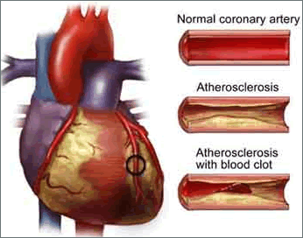

Slide 6
Risk Factors
Lack of Exercise
Diabetes
Diet
High Blood Pressure
Smoking

Slide 7
Gender: After menopause, a women’s LDL level goes up
Age: Your risk increases as you get older. Age 45 for men and age 55 for women
Family History: Your risk increases if a father or brother was affected by early heart disease (before age 55) or a mother or sister affected by early heart disease (before age 65)

Slide 8
Fats
LDL (BAD) is found in saturated fats
Examples of saturated fats are fatty meats, poultry skin, coconut and palm oil, pastries, cookies, and high fat dairy foods like milk.
HDL (GOOD) is found in unsaturated fats
Examples of unsaturated fats are fish, avocado, nuts (almond, peanuts, hazelnut, ad pecan), and some oils (canola, olive, peanut)
Trans fat (VERY BAD) raises LDL & lower HDL. Found in fried and processed foods.

Slide 9
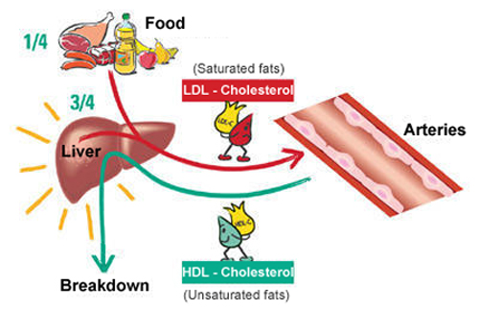

Slide 10
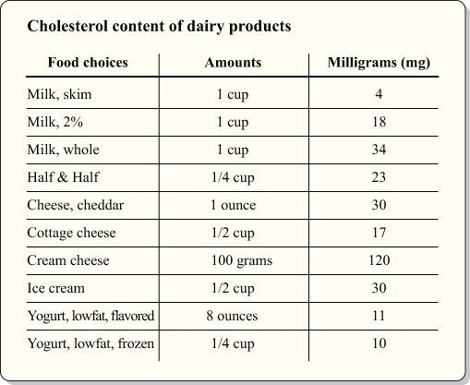
http://timigustafson.com/2010/dietary-cholesterol/

Slide 11
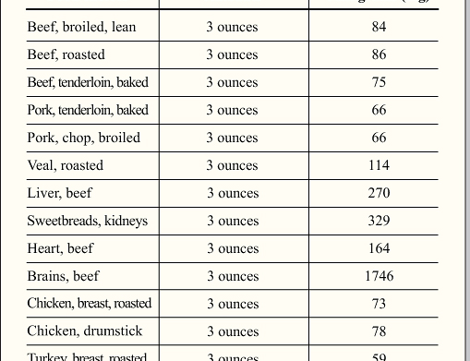
http://timigustafson.com/2010/dietary-cholesterol/

Slide 12
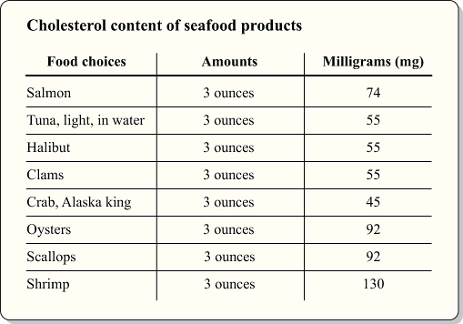
http://timigustafson.com/2010/dietary-cholesterol/

Slide 13
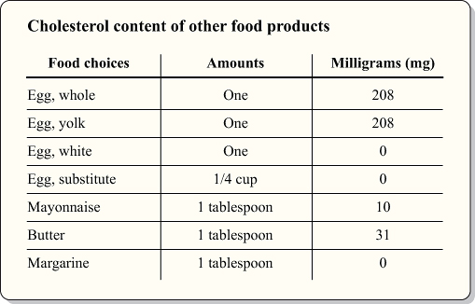
http://timigustafson.com/2010/dietary-cholesterol/

Slide 14
Good Choices
Fruits
Whole – grain cereals : oatmeal, oat- bran
Legumes : kidney beans, lentils, chickpeas, black-eyed peas, lima beans
Dietary Supplements: flaxseed oil, fish oil, B- complex vitamin

Slide 15
Medications
There are various types of medications for high cholesterol. Some…
lower LDL cholesterol
Raise HDL cholesterol
Block intestines from absorbing cholesterol

Slide 16
Recommendations
Lifestyle Changes and Medicine can lower your high Cholesterol
Increase Physical Activity
Follow a diet lowers bad cholesterol and increases good cholesterol
Check your cholesterol levels at least once every 5 years
Stop smoking
If your doctor prescribes cholesterol- lowering medication, take it as instructed

