Slide 1
Measure Development:
Self-Care Inventory for Psychology Graduate Students and ECPs (SCI-PSY)
Self-Care Inventory for Graduate Students and Early Career Professionals in Psychology
Note:
We will be exploring this entire model in two ways; that is comparing it across gender. If the relationships between or within these variables shown here are different between the two groups, we would argue for there to be “gender-specific scales”
Physical and Mental Health
This should be a very strong relationship
These relationships should be positive.
Health Promotion/Lifestyle Habits
Flourishing
We don’t even want these relationships to exist.
These relationships are being understood in an exploratory way; meaning, we are unsure of what to expect, but it would be interesting to know.
Social Desirability
Professional Organization Involvement

Slide 2
Promoting Well-Being and Empowerment for Women Professional Psychologists: Does it get better/easier over time?
Individual Characteristics
(Sexual Orientation, Gender Identity, Parent, Disability, Skin Color)
Self-Compassion
Well-Being/Flourishing
Self Care/Health Promoting Behaviors
Environmental Intersectional Microaggressions
Environmental Psychological Empowerment
Professional Organization Involvement
Environmental Features (Program/Degree Type/Workplace)
Career Stage

Slide 3
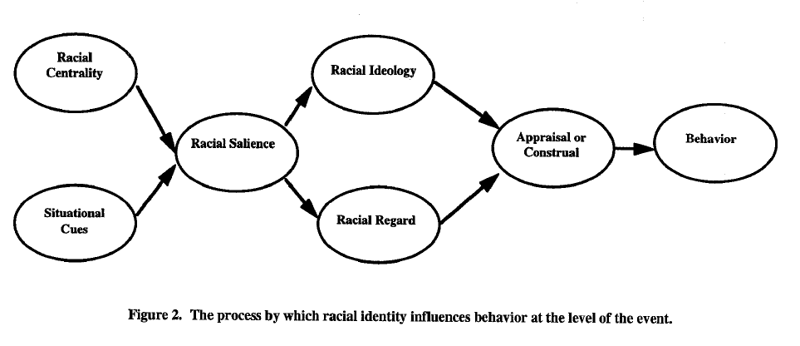
Racial Framing of Disease Risk for Black Americans: The Role of Racial Identity in Shaping Cognitive Structures for Health Promotion
Black Identity: Centrality
Black Identity: Ideologies
Appraisal/
Construal: Attributions of Stroke, Flourishing, General Self-Efficacy
Experimental Conditions:
Emphasis Placed on Race via Racial Framing across 3 Stroke Messages
Stage of Behavior Change for Smoking, Weight Maintenance, and Exercise
Racial Microaggressions in Medical Practice (RMMPS)
Black Identity: Public and Private Regard
Seller’s Theoretical Model:

