Slide 1
The different forms of Pop Culture

Slide 2
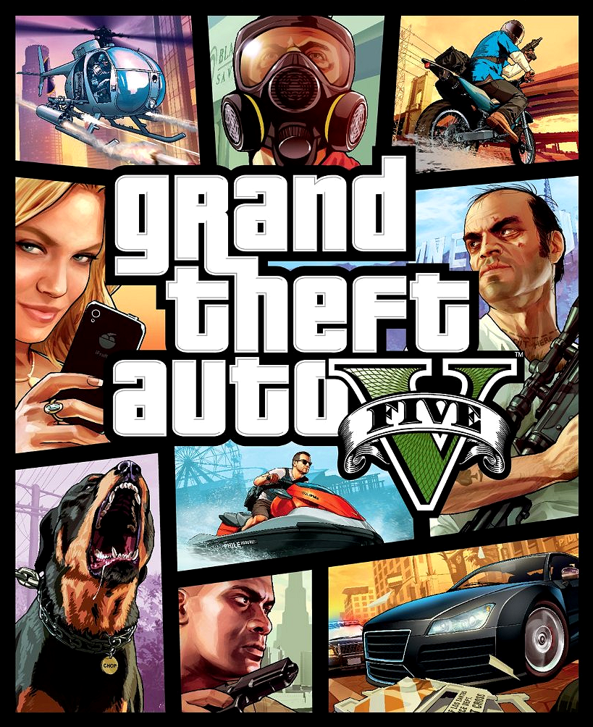
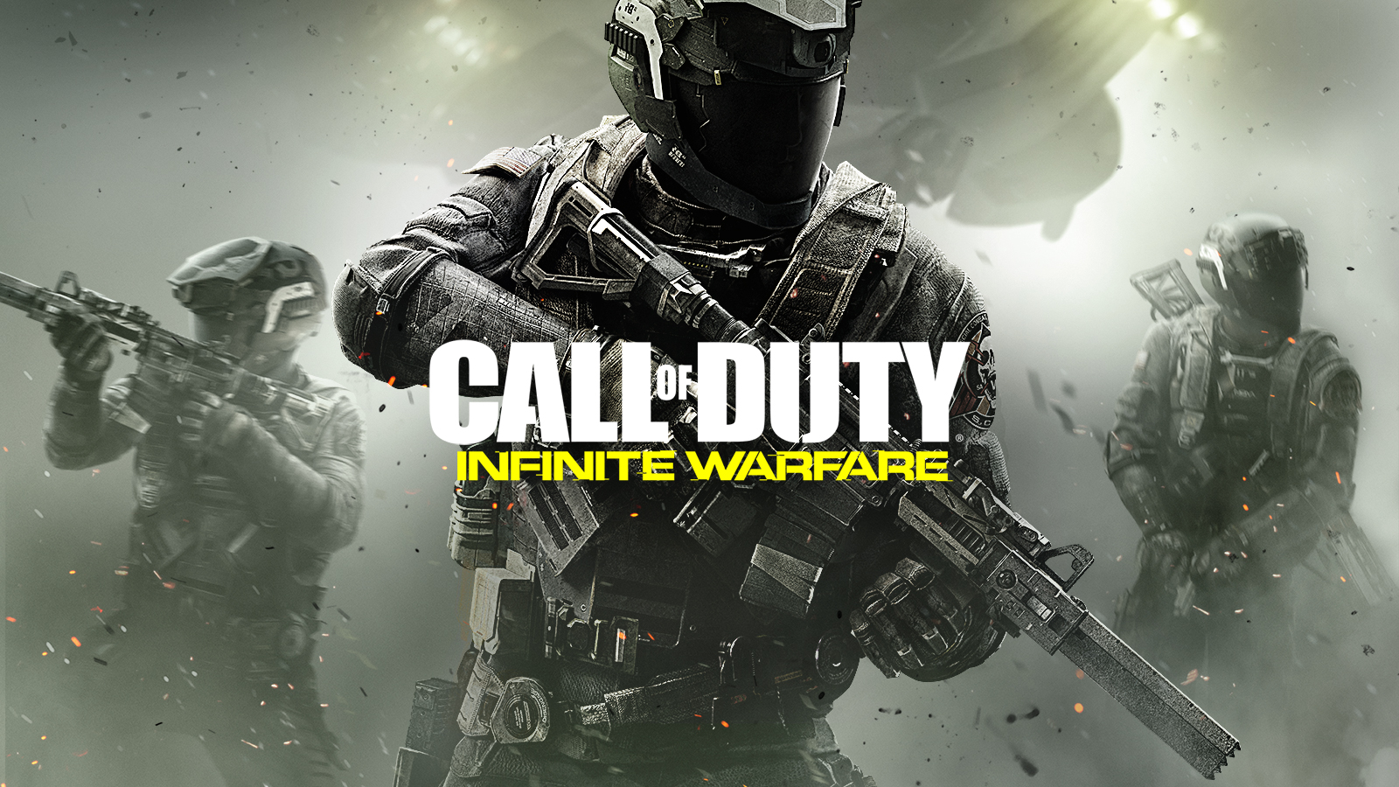
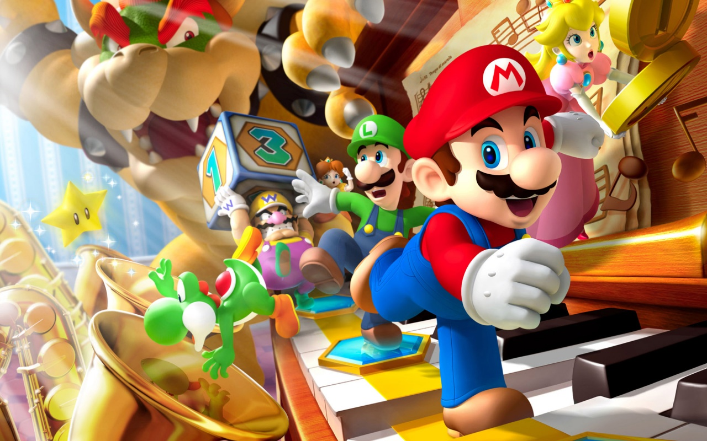
Video Games
In the last decade, video games easily became one of the most popular forms of enjoyment for the public. The most well known and rated games emerged in Pop Culture : Call of Duty, Pokémon, Super Mario, Grand Theft Auto, etc.

Slide 3
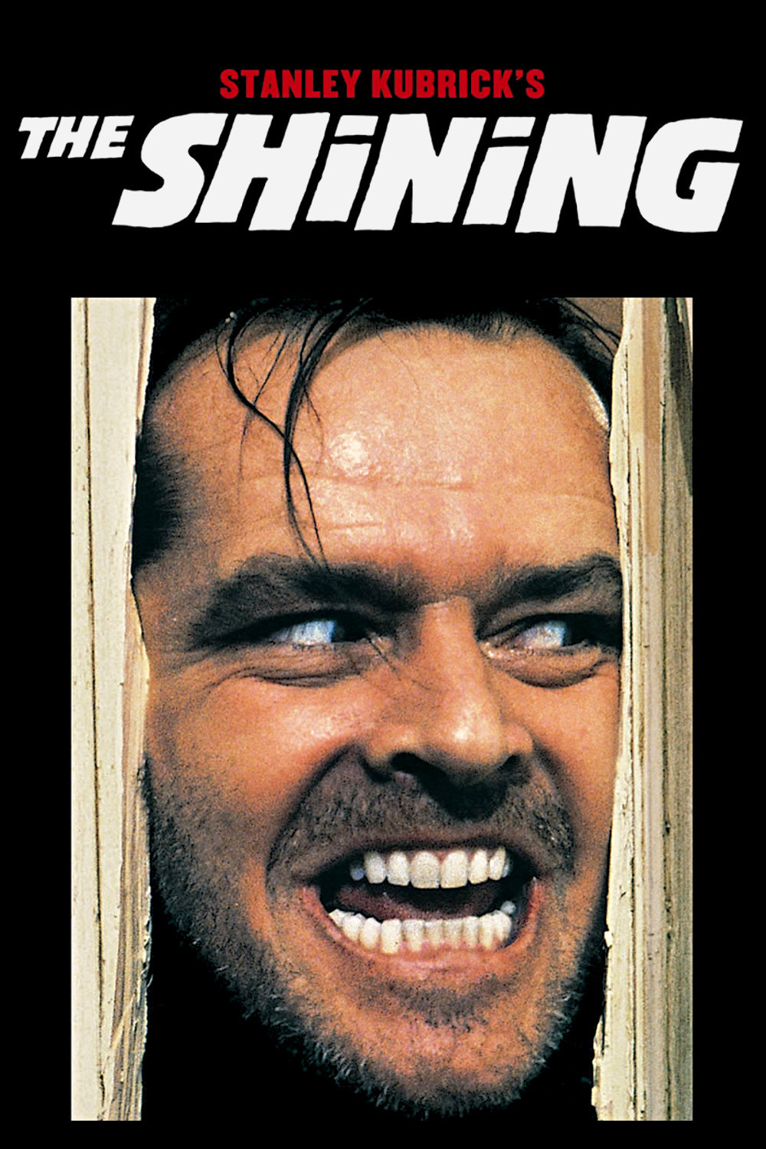
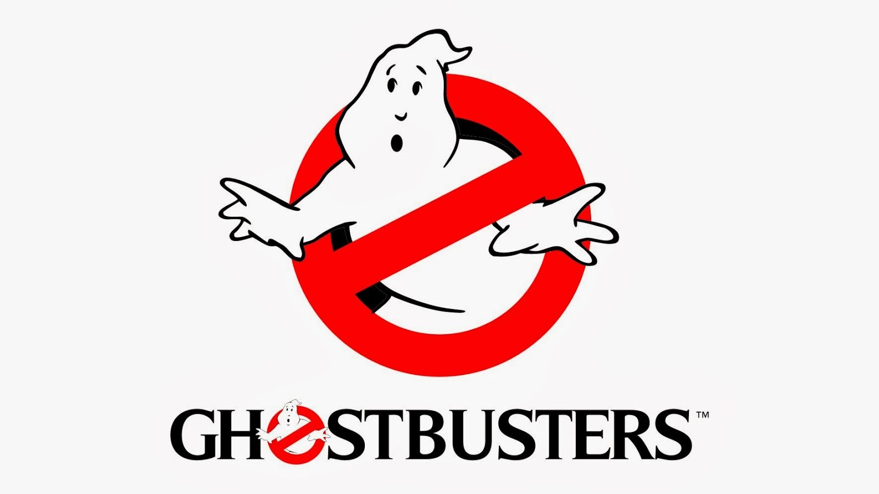
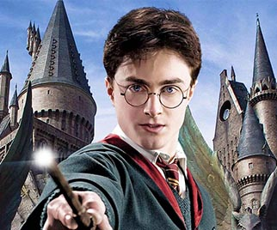
ENTERTAINMENT ( Movies)
Films play an enormous role in pop culture. Some of the most iconic films were the Star Wars tribology, The Harry Potter movies, Ghostbusters, The Shinning, the Titanic…

Slide 4
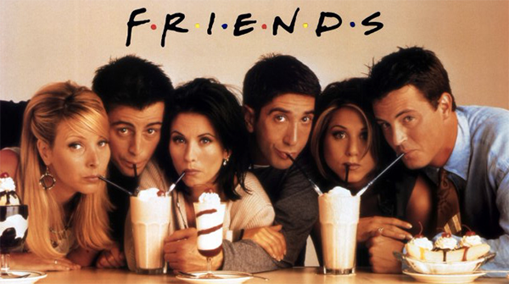
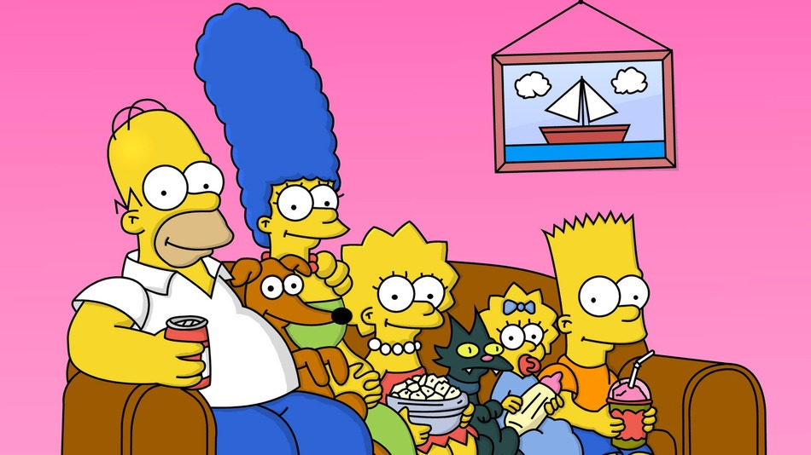
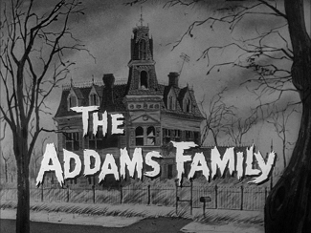
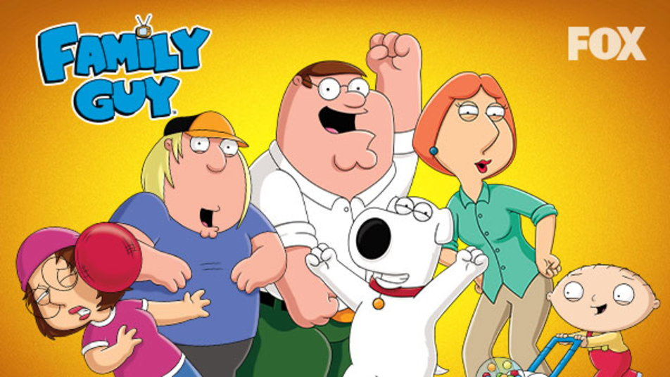
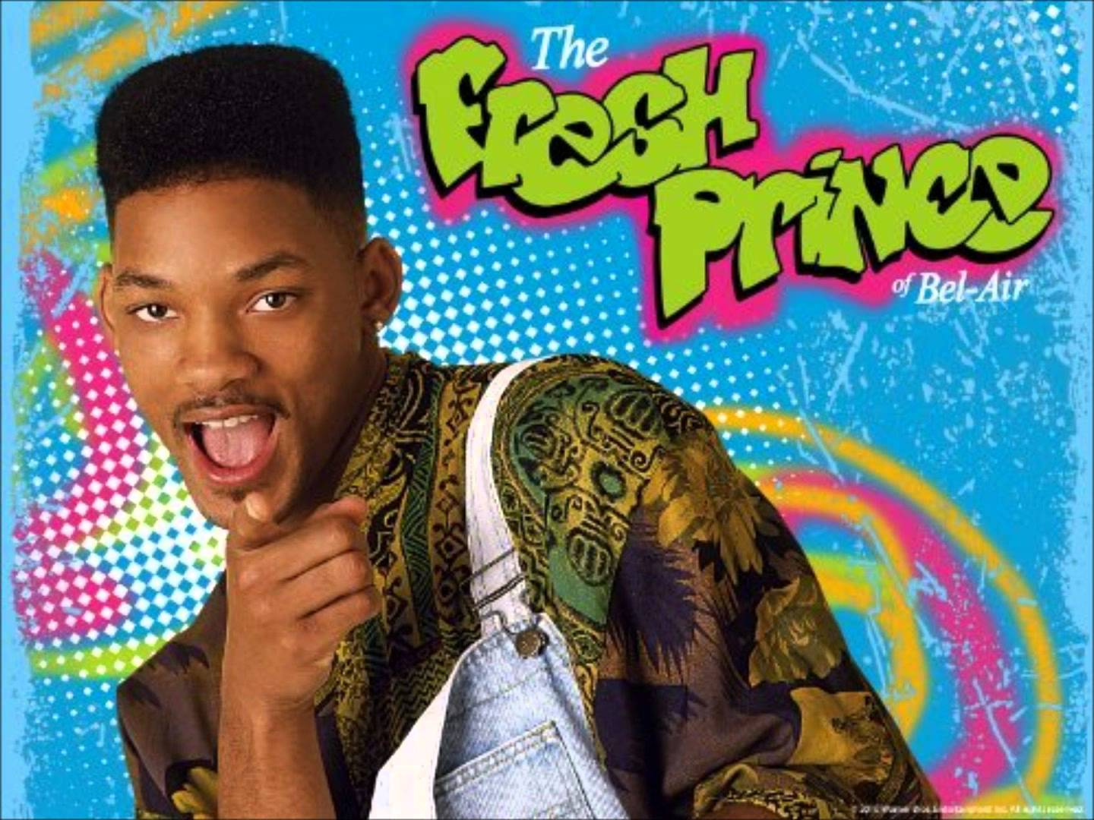
Television
The Major and most popular TV shows in Pop Culture

Slide 5
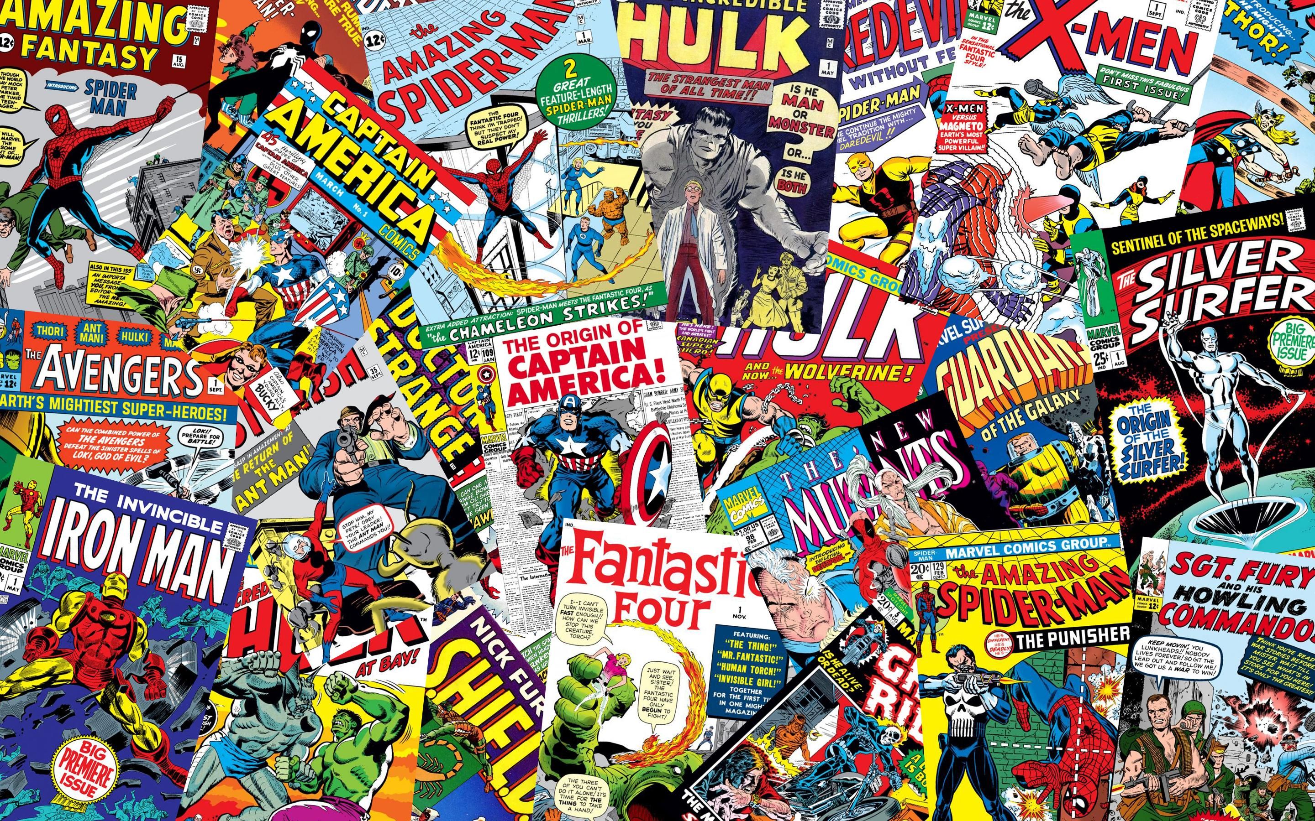
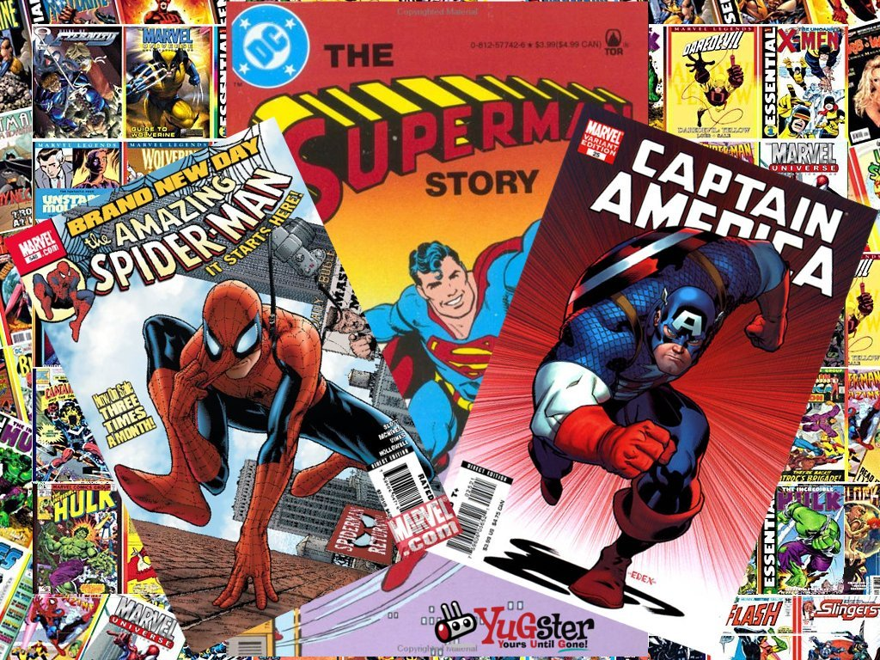
Comic Books
Comic books were a significant part of history in the 1920’s. When the Great Depression happened people were discouraged and had nothing to look forward to. Comic Books were greatly appreciated and loved as it gave people a sense of escape and adventure.

Slide 6
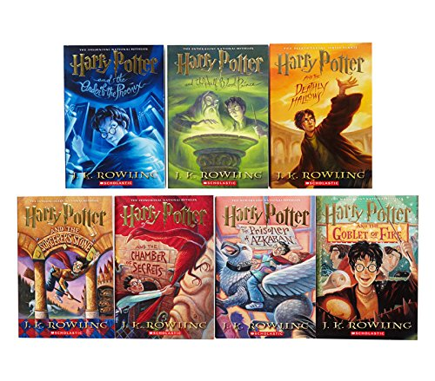
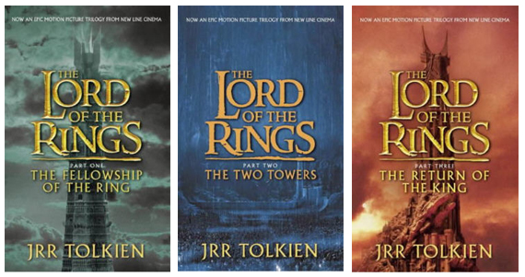
Novels
The most well known novels

Slide 7
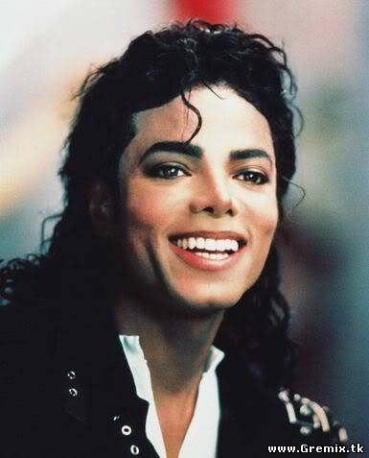
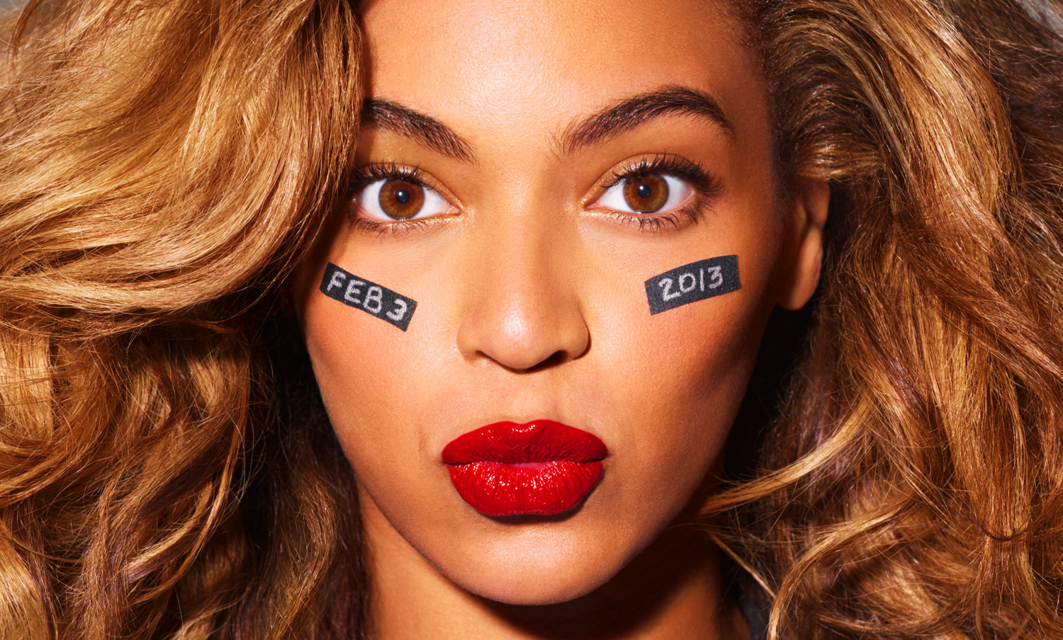
Pop Culture Icons

