Slide 1
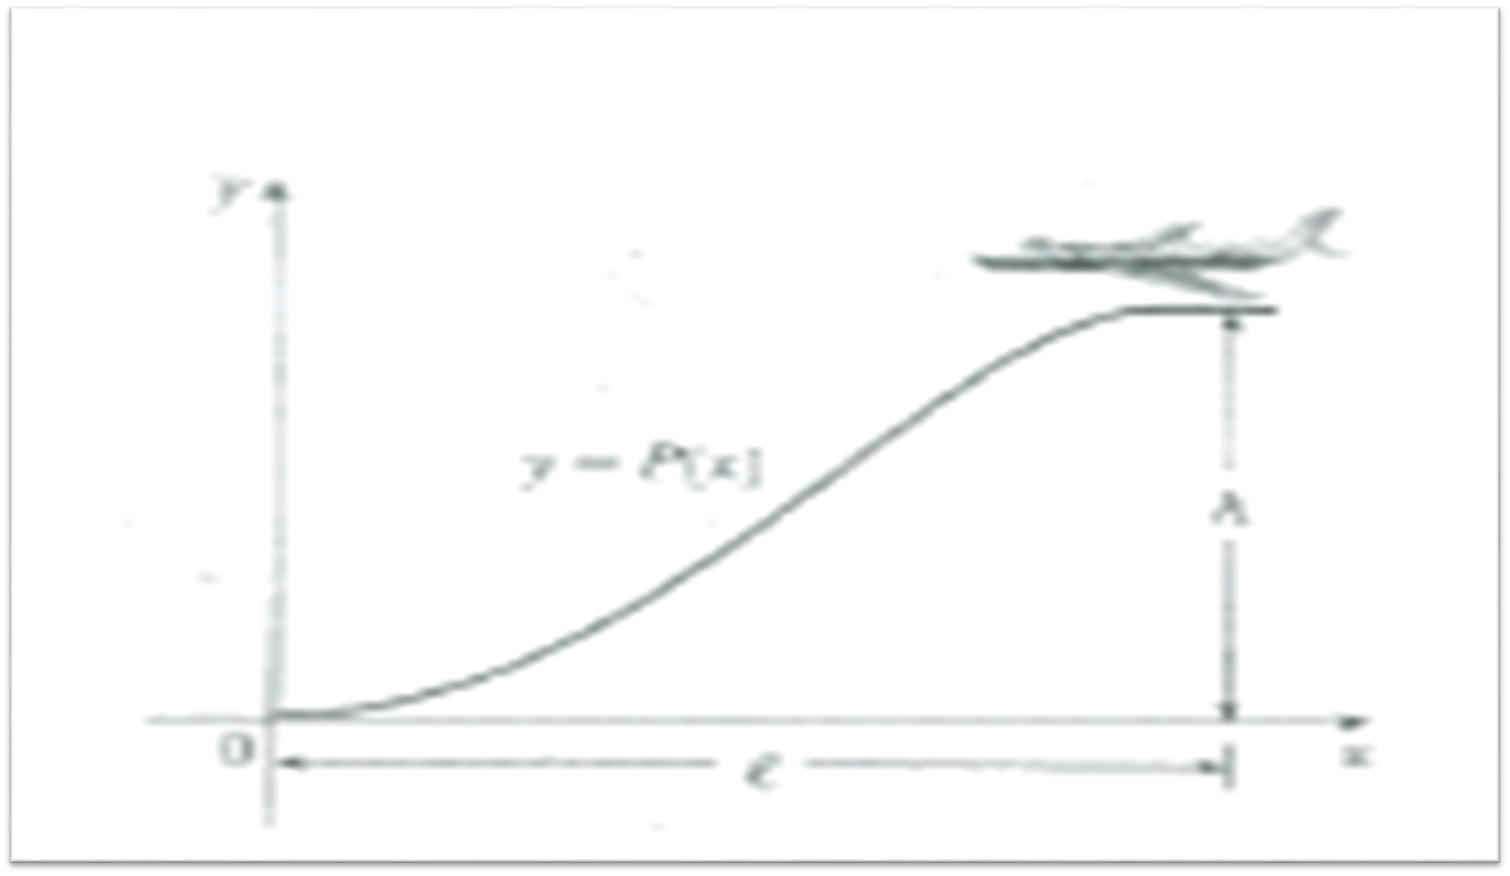
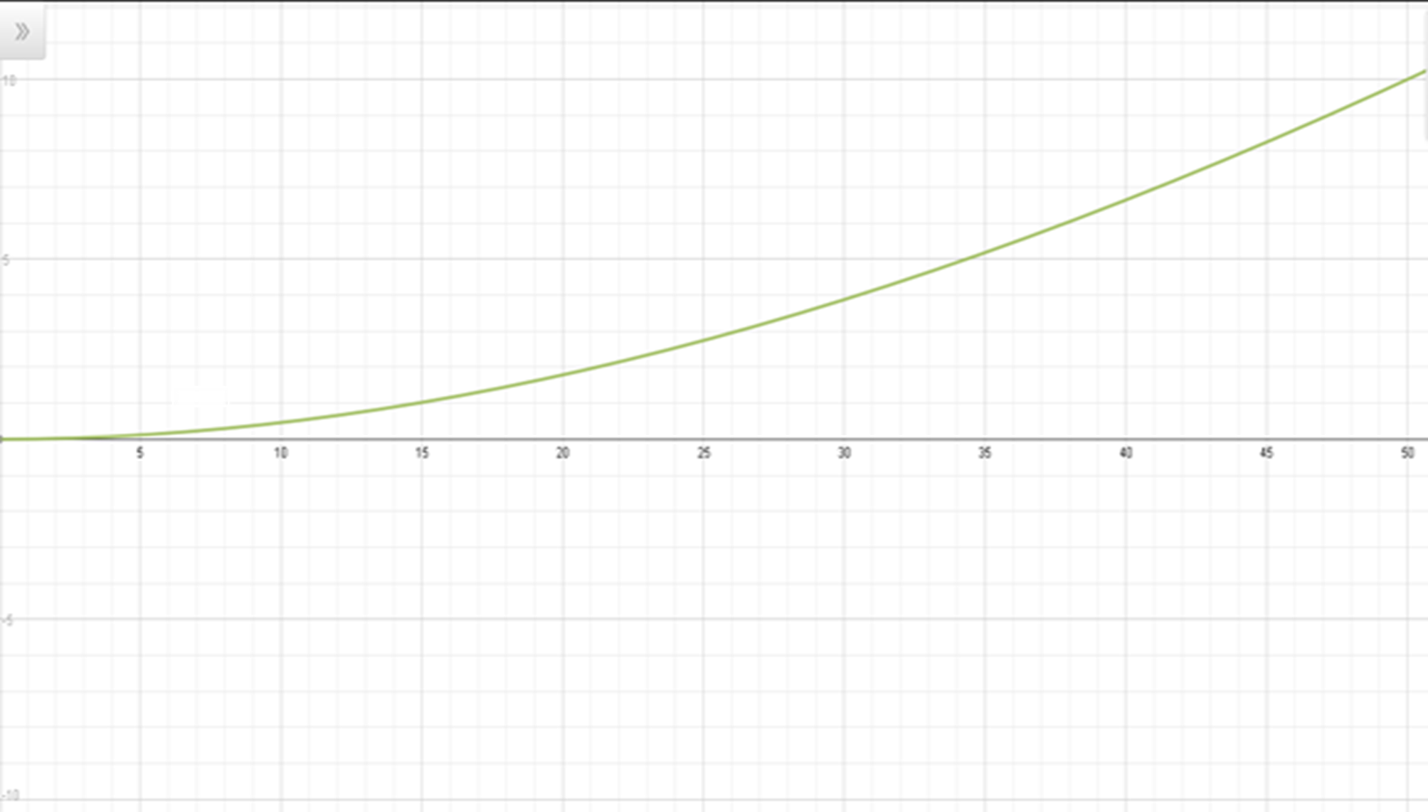
1) Find a cubic polynomial P(x) = ax³+bx²+cx+d that satisfies conditions 1 by imposing suitable conditions on P(x) and P’(x) at the start of descent and at touchdown?
The original equation is P(x) = ax³ + bx² + cx + d
P (0) = 0, so plug in zero for x. You will find that d = 0.
P (0) =0 Altitude is zero, when plane is on ground.
ax³ + bx² + cx + d
a(0)³+b(0)²+c(0)+d=0
d=0
Simplify d=0 into ax³ + bx² + cx + d, which is ax³ + bx² + cx
Find the derivative of P(x), which is 3ax²+ 2bx + c
Simplify the equation to P(x) = 3ax²+ 2bx + c
P (0) = 3a(0)²+2b(0)+c
c=0
P(x) = ax³+bx²
P(l)=h at a certain length, the altitude is h.
P(l)=al³+bl² =h
Take derivative P(l)= al³+bl², then simplify for b
3al²+2bl=0
3al²= -2bl
b= (-3al)/2
Now plug b value into the original equation
al³+ ((-3al)/2)l² =h
Solve for a:
a = -2h/l³
Now put a value in b to find the exact value:
b= (-3(-2h/l³)*l)/2
= 3h/l²
2) Use condition 2 and 3 to show that 6hv²/l²$\text{<}$k
y=P(l)=al³+bl² (note: x$→$l in this equation)
dy/dt=P’(l)=3al²(dl/dt)+2bl(dl/dt) (note: dl/dt= -v)
P’(l)=3al²(-v)+2bl(-v) = -3avl²-2bvl
d²y/dt²= -6avl(dl/dt)-2bv(dl/dt)
= -6avl(-v)-2bv(-v)
= -6av²l-2bv² (note: d²y/dt²$≤$k)
-6Lav² -2bv² < K
Now plug a and b value:
-6lv²(-2h/l³) - 2(3h/l²)v²< K
12hlv²/l³– 6hv²/l³ < K
12hv²/l² - 6hv²/l² < K
6hv²/l² < k
3) Suppose that an airline decides not to allow vertical acceleration of a plane to exceed k = 860 mi/h². If the cruising altitude of a plane is 35,00 ft, and the speed is 300 mi how far away from the airport should the pilot start descent?
6hv²/l² ≤k Change from feet to miles
(6(6.629)*(300)2)/l² ≤ 860 (35000ft)*(1mi/5280ft)
Solve for l: =6.629mi
l$≥$ 64.5 mi
Let’s assume I = 64.5
Graph
A= -2h/l³
h= 6.629, l= 64.5
A= (-2*6.629) / (64.5)³
A= -.00004937
P(x) = ax³+bx²
-.00004937x³+0.004777x²
B= 3h/l²
h= 6.629, l= 64.5
B= (3*6.629) / (64.5)²
B= 0.004777
Conclusion
With calculus, we were able to compute real life problems that we face in our everyday situation. Understanding the theoretical part of this, has made us aware that the plane has to be reached at an approximate value(64.5mi) in order to successfully descent.

