Slide 1
Where Should A Pilot Start Descent?
By: Abu Butt, Amir Magar, Nai Bing

Slide 2
Problem we must solve
An approach path for an aircraft landing is shown in the figure and satisfies the following conditions:
The cruising Altitude is h when descent starts at a horizontal distance l from touching down at the origin.
The pilot must maintain a constant horizontal speed v throughout descent.
The absolute value of the vertical acceleration should not exceed a constant k ( which is much less than the acceleration due to gravity)

Slide 3
1) Find a cubic polynomial P(x) = ax³+bx²+cx+d that satisfies conditions 1 by imposing suitable conditions on P(x) and P’(x) at the start of descent and at touchdown
Process:
You are given P(0) = 0, P'(0) = 0, P(L) = h, P'(L) = 0
The original equation is P(X) = ax^3 + bx^2 + cx + d
P(0) = 0, so plug in zero for X. You will find that d = 0.
Simplify the equation to P(X) = ax^3 + bx^2 + cx.
Find the derivative of P(X), which is 3ax^2 + 2bx + c
Simplify the equation to P(X) = ax^3 + bx^2
Plug in L into X.
Solve for b.
Now that we have "b," we can substitute it into the equation of aL^3 + bL^2 = h
Solve for a
Since we have "a" in terms of h and L, we can plug it into the ”b
As a result, P(X) = (-h/L^3)x^3 + (3h/2L^2)x^2

Slide 4
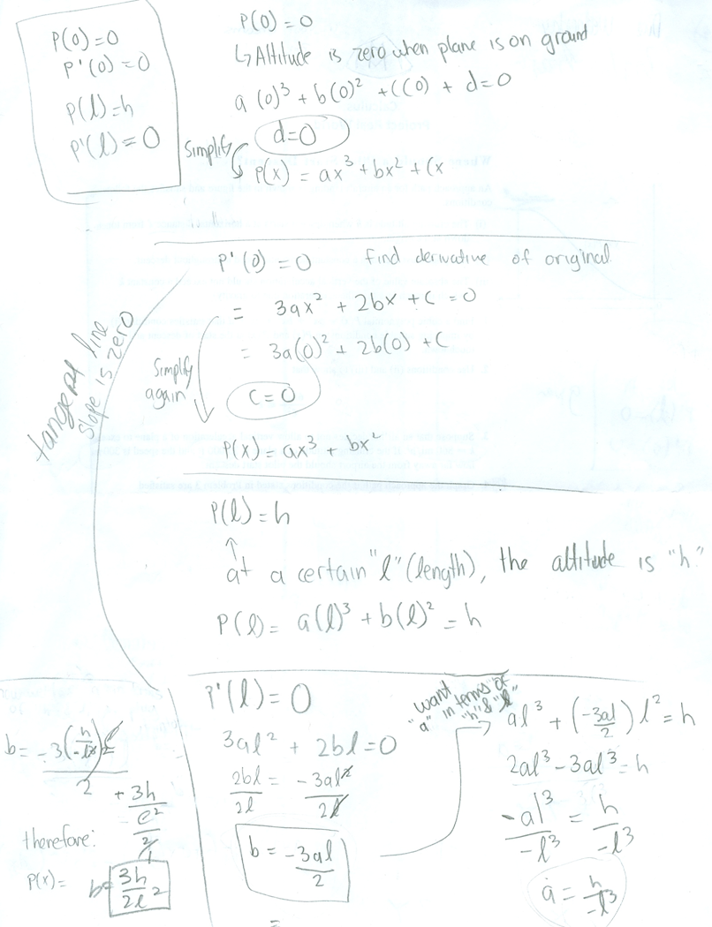

Slide 5
2) Use conditions 2 and 3 to show that 6hv²/l² ≤ k
Process:
Take the derivative of the equation P(x)=ax3+bx2 with respect to time (t)
(dx/dt) being with respect to time, replace (dx/dt) with (-v). Where (-v) stands the horizontal velocity
Find the derivative again
Substitute a, and b that were found in the previous problem
SOLVE

Slide 7
Suppose that an airline decides not to allow vertical acceleration of a plane to exceed k = 860 mi/h². If the cruising altitude of a plane is 53,00 ft and the speed is 300 mi how far away from the airport should the pilot start descent?
Process:
Take the equation that was found in part 2 and apply it to this problem.
Take the equation and the variables that are known and start plugging into the equation. We already know that: k = 860 v = 300 h = 35000 but we must find l
Since h is in feet, we must change it to miles so we must divide 35000 by 5280 getting an answer of 6.63 miles.
We must now plug in the variables into the equation.
Find the square root of l² and get l.

Slide 8
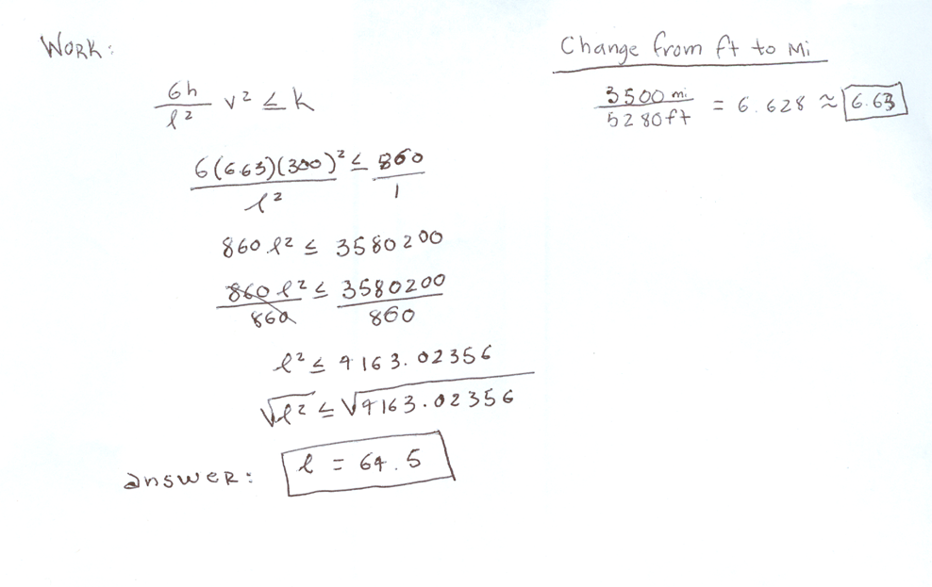

Slide 9
Graph

Slide 10
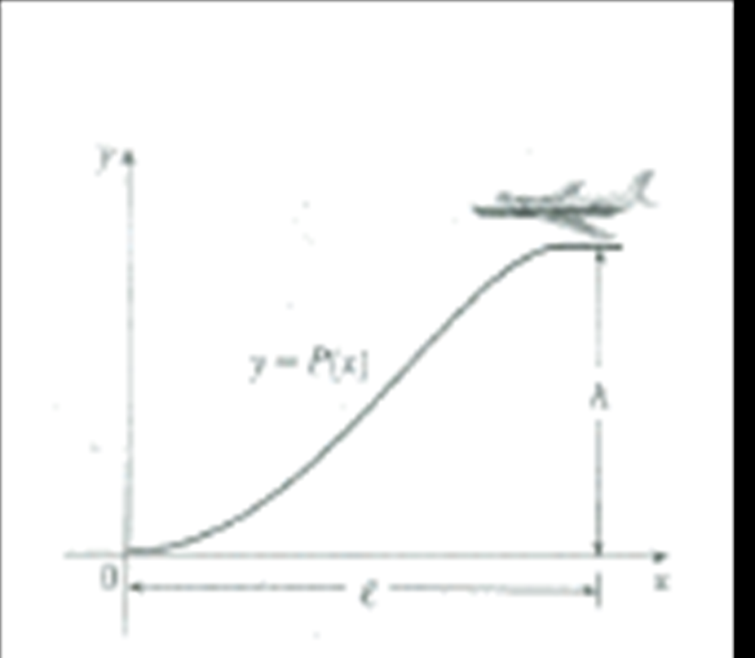

Slide 11
Conclusion
In conclusion to our project, we found l in the equation. We proved that the plane would land without a vertical acceleration.
It was a hard problem but in the end we found out how to do it.

