Slide 1
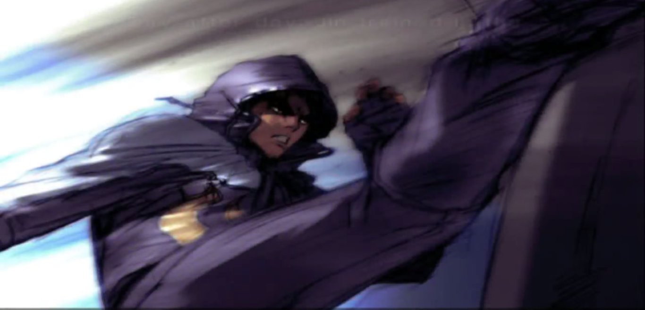
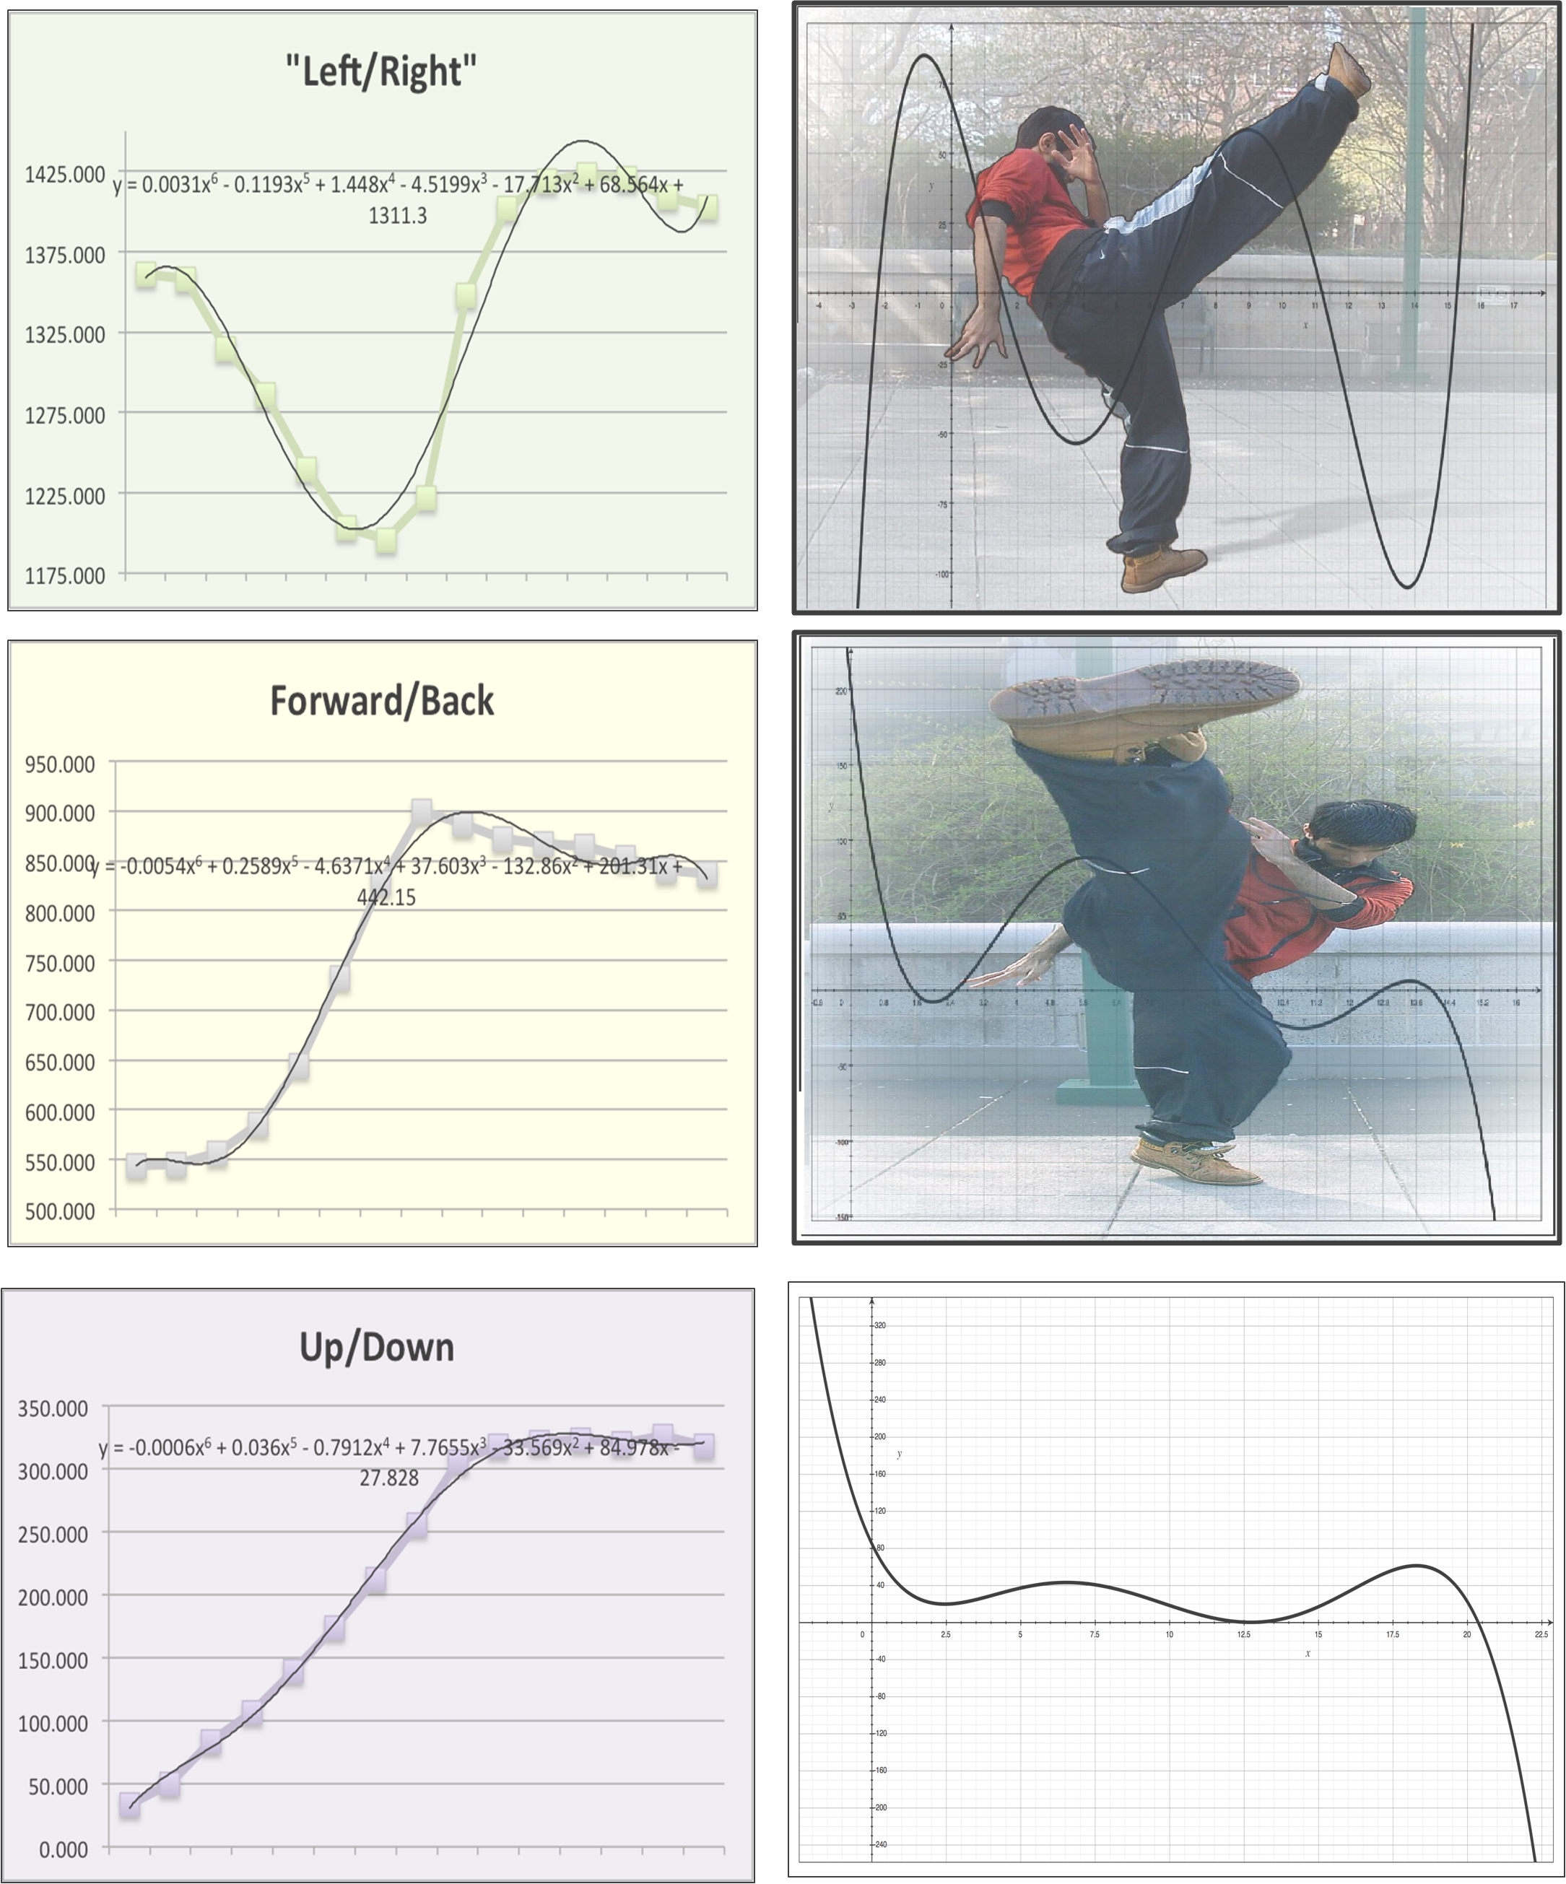
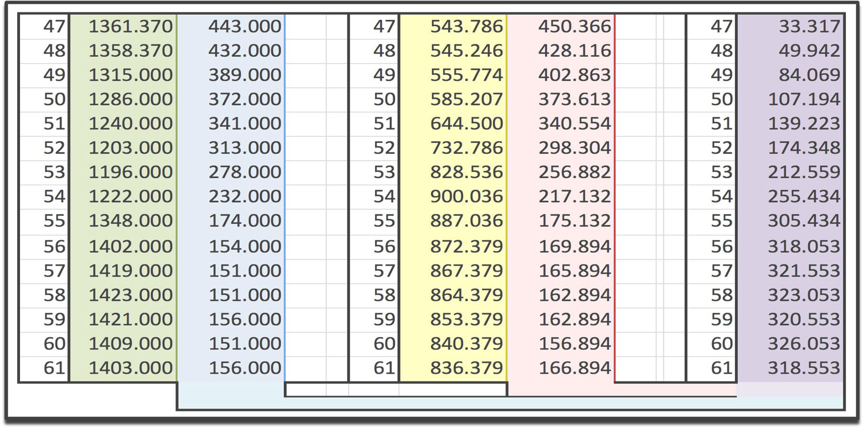
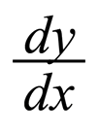
Andrew M, Darren G, Izzy A, Gabriel O.
Prof. Kate Poirier.
New York City College of Technology, CUNY Fall 2013
Dynamic Maui Thai Kick!
Ponder the difference between the concrete mathematics and the organic martial arts. Initially, one would think that the two have very little in common. However, as juxtaposing they may be, martial arts thrive on mathematics. In our project, we shall research the mathematical aspects of a Maui Thai roundhouse kick.
We shall analyze several key components of the kick; velocity, acceleration, etc. to conclude the following: the point at which the kick is at its highest speed and speed at impact.
Abstract
The research uses data we collected based off video recordings of the kick itself. The Maui Thai Roundhouse kick can be used in various ranges such as low, middle,and high to inflict damage to different parts of the opponents body. A total of 4 students were involved in the data collection.
The Data was obtained by using 2 still cameras to record the time at which the kick was delivered at each impact. We recorded several attempts (made by Izzy) until we captured the best kick Izzy could perform.
(Camera Name): ( info about it)
(Thing Used to make Graphs) ( Ex: Excel) : (Info about it)
Methodology
By recording Izzy’s kick from two different perspectives we can generate three graphs, (the third was calculated). Andrew tracked Izzy’s right foot and plotted the points on a graph. Using these points we generated a graph and hence we obtained a function, a polynomial for the Side, Front and Top down view of the kick.
We all found the kick’s mathematical nature to be very enticing, the juxtaposition of concrete math and organic fighting technique riveted all 4 of us, we also wanted to stand out among other projects due to the peculiar nature of our project.
In conclusion, by working with the generated polynomial we can find all sorts of useful information such as: the limit of speed at impact, the point in which the speed of the kick is at it’s max. This helped all 4 of us to develop a new found appreciation for martial arts.
Conclusion
Method
Graphics
We would like to sincerely thank Professor Kate Poirier for supervising this research and for giving us the opportunity to work on this project.
We also give gratuitous warm blessings to the Emerging Scholar program and the Honor Scholar program and their director Dr. Selwin William and Dr. Janet Liou-Mark.
Acknowledgement
Results
y = 0.0031x⁶ - 0.1193x⁵ + 1.448x⁴ - 4.5199x³ - 17.713x² + 68.564x + 1311.3
= 0.0186x⁵ - 0.5965x⁴ + 5.792x³ - 13.5597x² - 35.426x + 68.564
y = -0.0054x⁶ + 0.2589x⁵ - 4.6371x⁴ + 37.603x³ - 132.86x² + 201.31x + 442.15
= -0.0324x⁵ + 1.2945x⁴ – 18.5484x³ + 112.809x² – 265.72x + 201.31
y = -0.0006x⁶ + 0.036x⁵ - 0.7912x⁴ + 7.7655x³ - 33.569x² + 84.978x - 27.828
= -0.0036x⁵ + 0.18x⁴ – 3.1648x³ + 23.2965x² – 67.138x + 84.978
Data/Functions/ Models: How we used?
The methodology should answer two questions:
1. How did you collect or generate the data?
2. How did you analyze the data?
Our Method
"Swinging the Bat: How to Do the Maui Thai Roundhouse Kick." Breaking Muscle. N.p., n.d. Web. 22 Apr. 2014.
Reference 2.
References

