Slide 2
What is HIV?
H- Human
I- Immunodeficiency
V- Virus
Only transferrable between humans
Weakens immune system by destroying cells that fight disease= “deficient”
Can reproduce by taking over a cell in the body of the host
Notes:
Attacks key part of immune system –T-Cells/ CD4. Subset of WBC’s. Works as generals and detects foreign bodies. But HIV binds to them= lock and key, reverse transcriptase, enters CD4/T-Cells, makes similar replications, and destroys them.
Illust. T-Cells/CD4- watchmen of city.
HIV- enemies, kill and pretend to be watchmen.
Meanwhile, destroys.
City= falls.
HIV leads to AIDS.

Slide 3
What is AIDS?
A- Aquired
I- Immuno-
D- Deficiency
S- Syndrome
Aquired= not something inherited from birth. HIV- can be inherited, AIDS- acquired.
Immuno-deficient= body does not work the fight off dangerous invaders as it was able to.
Syndrome- (not a disease) because has a wide range of complications.
Notes:
Final stage of HIV infection.
Diagnosis dependent:1+ specific OI’s, certain cancers, or a very low number CD4 cells.

Slide 4
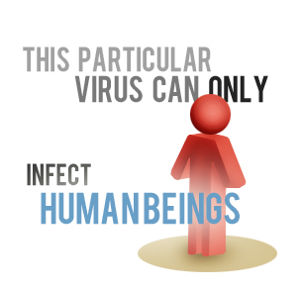
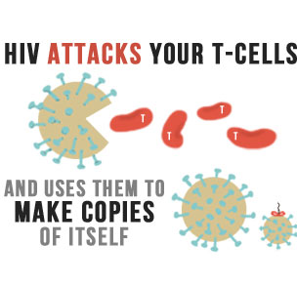
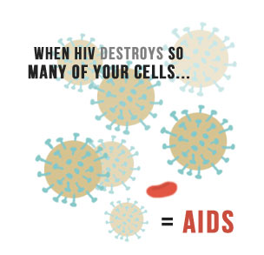
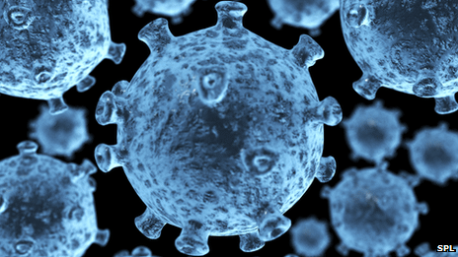
Notes:
http://aids.gov/hiv-aids-basics/hiv-aids-101/what-is-hiv-aids/

Slide 5
Signs and Symptoms
HIV + many do not know because no symptoms.
Symptoms appears as they progress towards AIDS
Periods of feeling healthy and then sick.
Most symptoms are from OI’s.

Slide 6
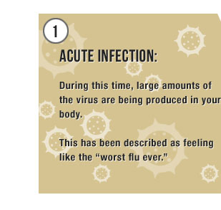
ARS
Acute Retroviral Syndrome or Primary HIV infection
Notes:
Early as 2-4 weeks or up to 3 months, some will experience ARS= feels like “worst flu ever” (Body’s natural response)
During ARS= higher levels of virus and more easily transmitted.
CD4 count fall rapidly.
Viral set point- stable level of virus in your body= Increase CD4

Slide 7
Symptoms can include:
Fever
Chills
Rash
Night sweats
Muscle aches
Sore throat
Ulcers in the mouth
Fatigue
Swollen lymph nodes

Slide 8
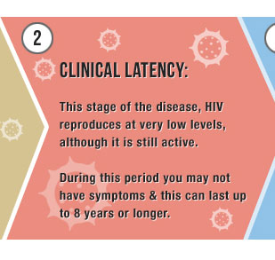
Next…
Chronic/ Latent phase where people do not have any symptoms.
Can last 10+ yrs.
Notes:
During this phase, HIV reproduces at very low levels. May be able to maintain an undetectable viral load and a healthy CD4 cell count without the use of medication during the earlier years of this phase. You may not have symptoms or opportunistic infections. This period can last up to 8 years or longer.

Slide 9
Finally!!!
However, as HIV progresses to AIDS: fatigue, diarrhea, nausea, vomiting, fever, chills, night sweats, and even wasting syndrome at late stages. Many of the signs and symptoms of AIDS come from opportunistic infections which occur in patients with a damaged immune system.
Notes:
CD4 cells begins to fall below 200 cells per cubic millimeter of blood (200 cells/mm3), you will be diagnosed as having AIDS.
(Normal CD4 counts are between 500 and 1,600 cells/mm3.)
Immune system is badly damaged and OI’s prevalent.
Without treatment, people who are diagnosed with AIDS typically survive about 3 years.
With dangerous OI’s life-expectancy falls to about 1 year.

Slide 10
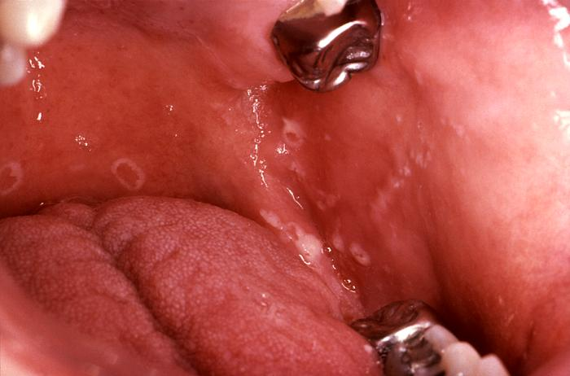

Slide 11
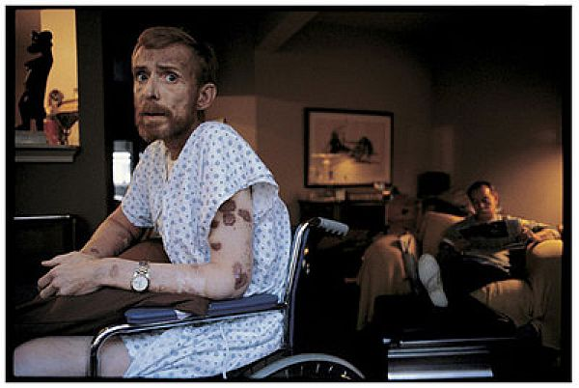

Slide 12
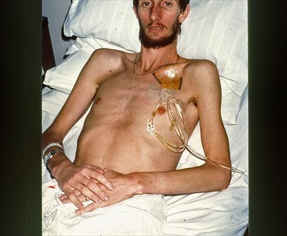
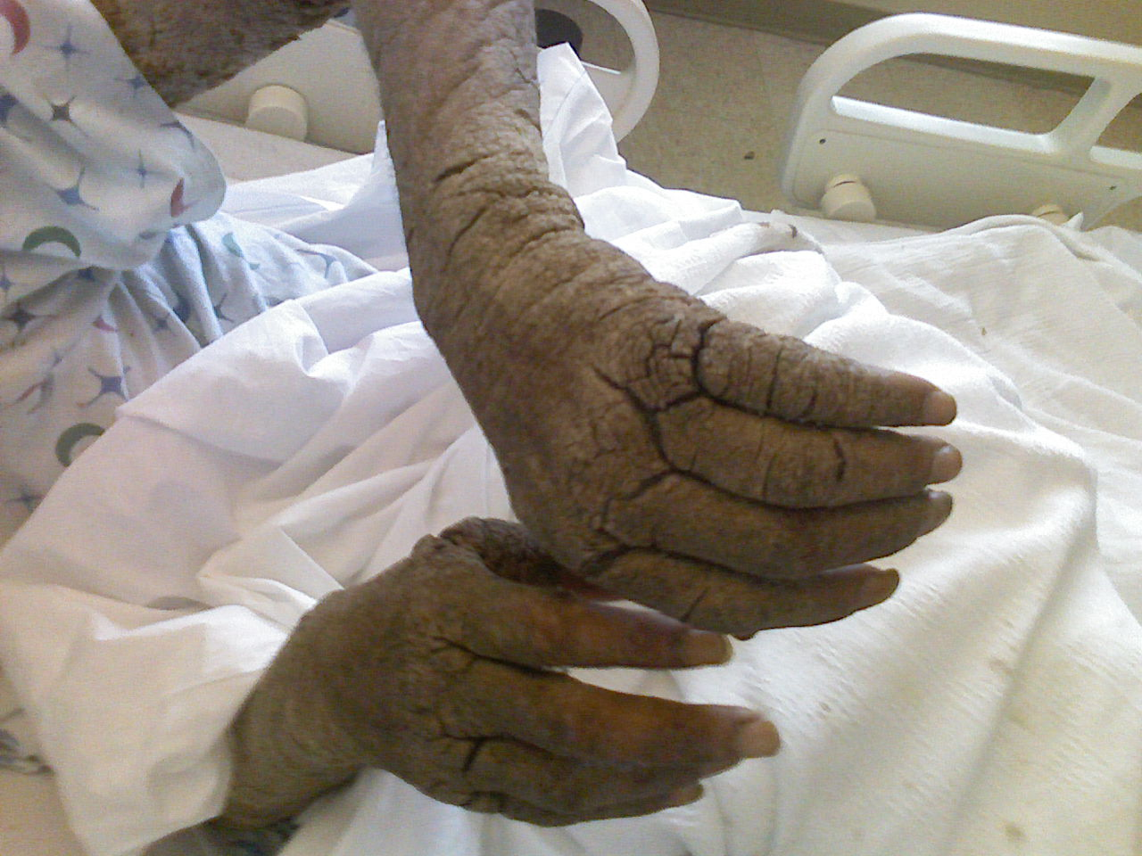

Slide 13
NNRTI’s
Non Nucleoside Reverse Transcriptase Inhibitors

Slide 14
COMMON NNRTI’s
Efavirenz (Sustiva)
Delavirdine (Rescriptor)
Nevirapine (Viramune)

Slide 15
What is reverse transcriptase?
An enzyme
Needed in HIV for replication

Slide 17
NRTI’S
Nucleoside Reverse Transcriptase Inhibitors

Slide 18
NNRTI’S VS. NRTI’S
What’s the difference?

Slide 19
NNRTI

Slide 20
nrti
Adenine ---- Thymine
Guanine ---- Cytosine
NRTI’s create faulty nucleosides

Slide 21
Protease Inhibitors
Protease Enzyme
Proteins are building blocks for living things
Mechanism of Action: Lock and Key
Viral Assembly

Slide 22
Contiuned…
One of the “good guys”
Primary function: Blockage of viral assembly
No more copies!

Slide 23
Protease inhibitors
Idinavir (Crixivan)
Blockage action
Effect on viral load?
Cure?
Prevents transmission?

Slide 24
Lopinavir-Ritonavir (Kaletra)
Against HIV due to Lopinavir
Blockage action
Effect on viral load?
Cure?
Prevents transmission?

Slide 25
Saquinavir (Invirase)
Blockage action
Effect on viral load?
Cure?
Prevents transmission?

Slide 26
Last, but not least…
Great Optimism!
Notes:
http://www.phaseware.com/PhaseWare-Files-blog/bid/81498/A-Little-Optimism-Goes-A-Long-Way-in-Customer-Service
http://www.mentalhealthy.co.uk/news/996-optimism-can-be-helpful-to-mental-health.html

Slide 27
Extra
Early detection tests
PCR or RNA tests
p24 antigen tests
Early treatment
ART
Avoiding transmission
Mother to child
Sexual intercourse
Blood

Slide 28
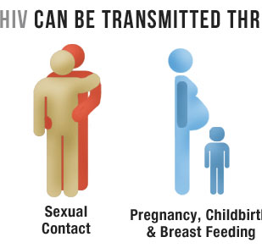
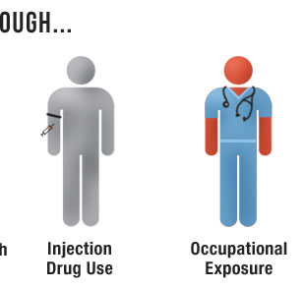
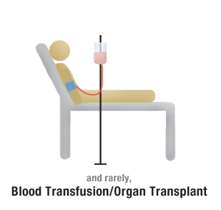

Slide 29
Statistics of HIV
In 2011, there were about 2.5 million new cases of HIV
About 34.2 million people are living with HIV.
In 2010, about 1.8 million deaths due to AIDS
Nearly 30 million people have died since the epidemic began.

Slide 30
In the U.s.
At the end of 2010, an estimated 872,990 persons in the United States were living with HIV
In 2010, the estimated number of 15,529deaths due to AIDS

Slide 31
Notes:
http://www.cdc.gov/hiv/statistics/basics/ataglance.html

Slide 32
HIV and the effects on the Oral cavity
HIV disease can make you more susceptible to:
HPV
Herpes simplex
Hairy leukoplakia
Candidiasis
Aphthous ulcers
Cavities
Periodontitis and Gingivitis
Medication can cause Xerostomia

Slide 33
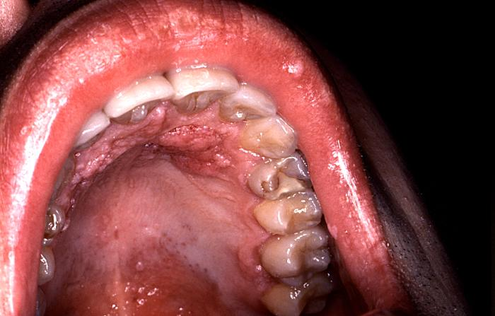
ORAL WARTS
Notes:
http://hardinmd.lib.uiowa.edu/cdc/6056.html

Slide 34
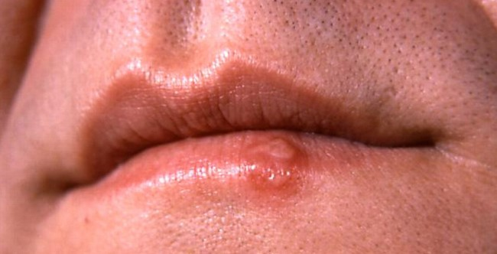
HERPES SIMPLEX
Notes:
http://guardianlv.com/wp-content/uploads/2013/02/herpes-simplex-e1360859939606-650x332.jpeg

Slide 35
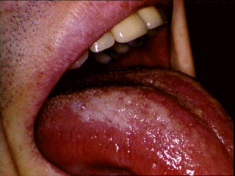
HAIRY LEUKOPLAKIA
Notes:
http://pathmicro.med.sc.edu/lecture/images/hairy_tongue.gif

Slide 36
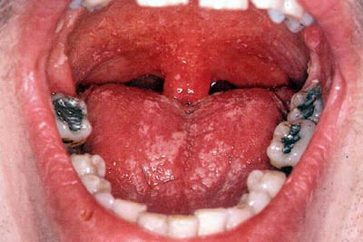
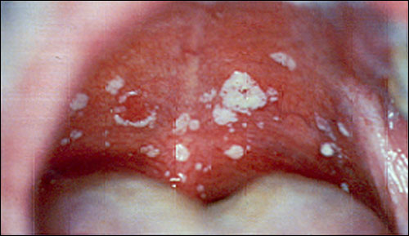
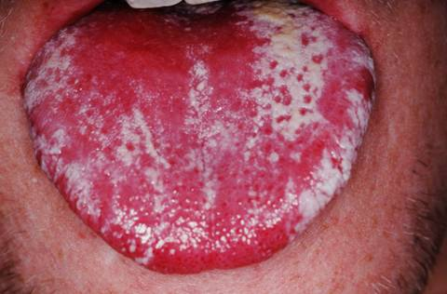
CANDIDIASIS
Notes:
http://www.life-worldwide.org/fungal-diseases/oral-candidiasis/
http://treatmentofyeastinfections.com/oral-candidiasis/
http://www.medicalook.com/Mouth_diseases/Oral_thrush.html

Slide 37
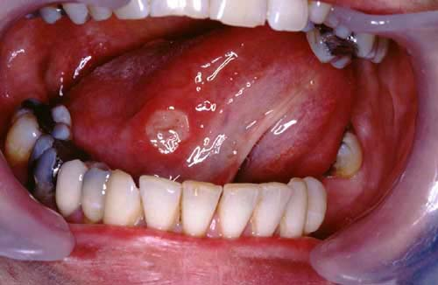
APTHOUS ULCERS
Notes:
http://www.patient.co.uk/doctor/behcets-disease

Slide 38
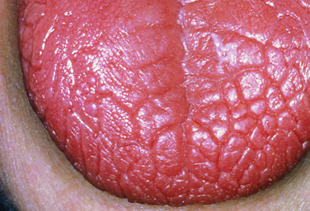
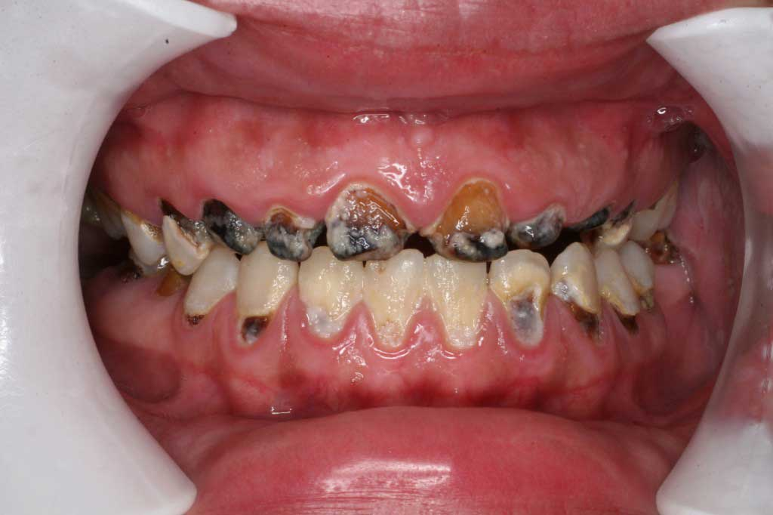
XEROSTOMIA
Notes:
http://www.capedental.com/cdmain/wp-content/uploads/2012/03/radiation-caries-1024x682.jpg
http://smileplus.files.wordpress.com/2010/10/photoresearchers_rm_photo_of_dry_tounge2.jpg?w=630

Slide 39
Our role as Hygienist:
Thorough dental and medical history
Thorough dental assessment
Oral health education
Periodontal screening or examination
Phase I treatment - Prevention and maintenance.

Slide 40
Educate patients:
Certain lesions are contagions like Herpes and HVP
Medication can cause dry mouth
Avoid alcohol
Avoid tobacco

Slide 41
THE END!!!

