Slide 1
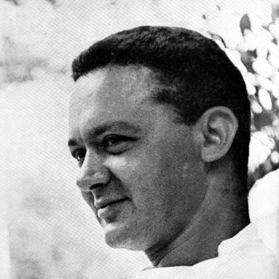
Paul Rand Graphic Designer

Slide 2
Paul Rand Bio
Paul Rand (Born Peretz Rosenbaum, August 15, 1914) was a well-known American graphic designer, best known for his corporate logo designs. Rand was educated at the Pratt Institute (1929-1932), the Parsons School of Design (1932-1933), and the Art Students League (1933-1934). He was one of the originators of the Swiss Style of graphic design. From 1956 to 1969, and beginning again in 1974, Rand taught design at Yale University in New Haven, Connecticut. Rand was inducted into the New York Art Directors Club Hall of Fame in 1972. He designed many posters and corporate identities, including the logos for IBM, UPS and ABC. Rand died of cancer in 1996.
Rand was born in Brooklyn, New York in 1914. He embraced designs at a very young age, painting signs for his father’s grocery store as well as for school events at P.S. 109. Despite studying at Pratt and other institutions in the New York area, Rand was by-and-large “self-taught as a designer, learning about the works of Cassandre and Moholy-Nagy from European magazines.

Slide 3
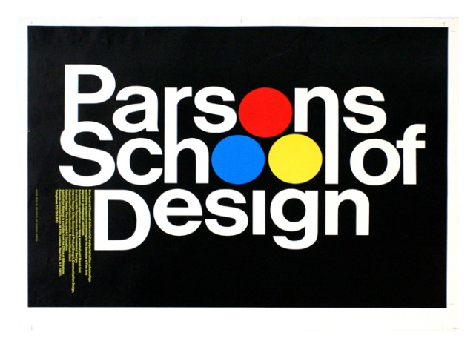
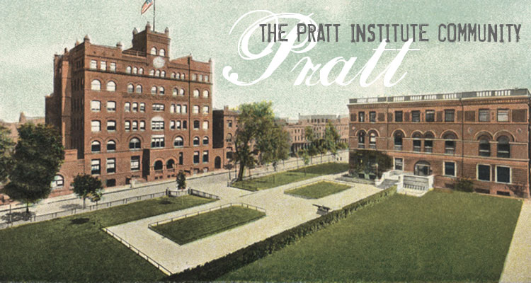
1929-1932
1932-1933
1933-1934

Slide 4
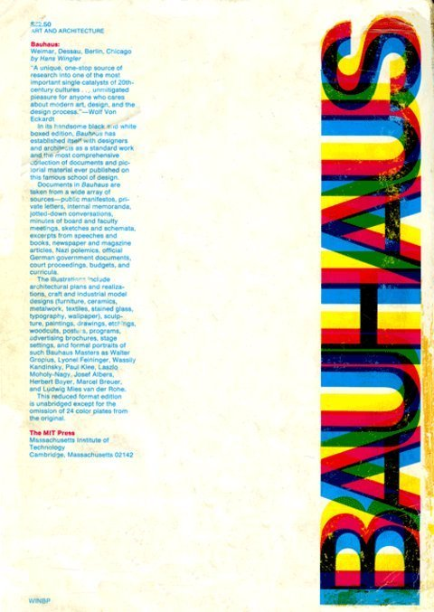
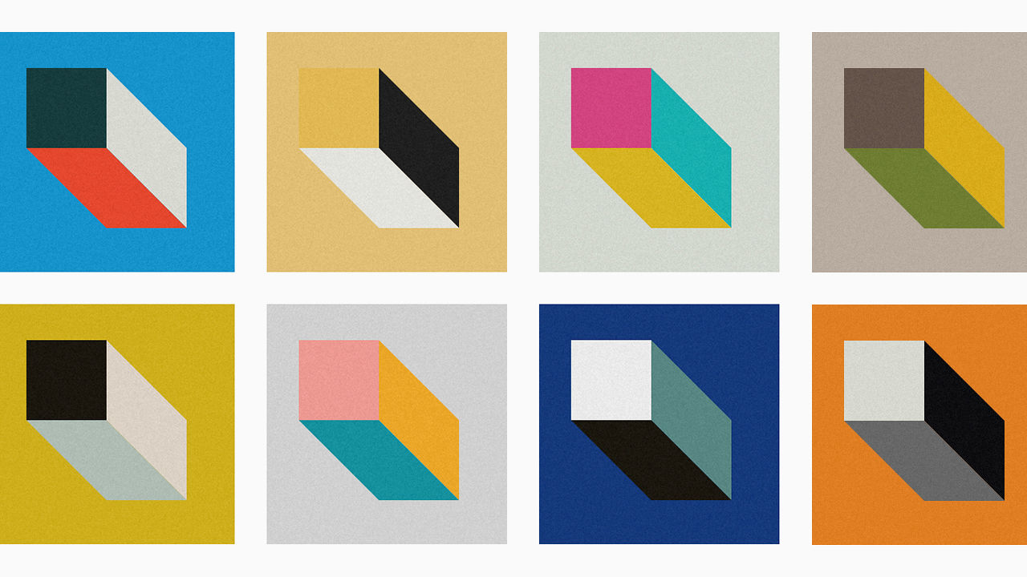
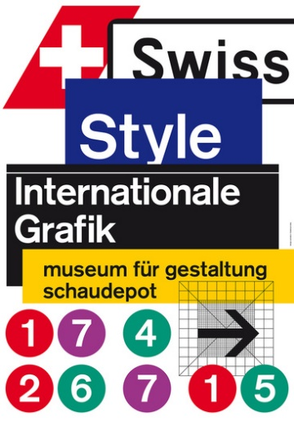
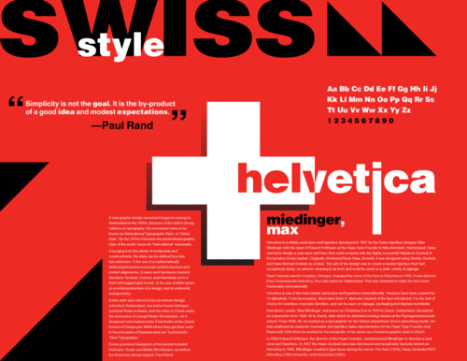
1956-1969 (1974)

Slide 5
IBM Designed 1950’s-1960’s

Slide 7
ABC Designed 1962

Slide 8
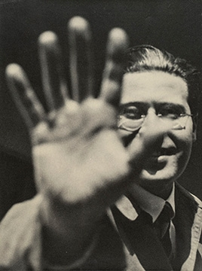
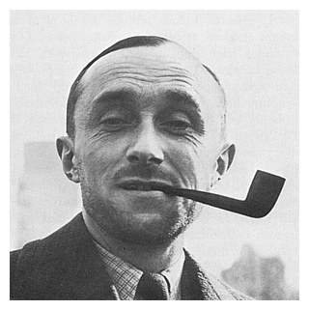
Prominent Designers
Maholy – Nagy
Cassandre

Slide 9
Early Career

Slide 10
Early Career
His career began with humble assignments, starting with a part-time position creating stock images for a syndicate that supplied graphics to various newspapers and magazines. Between his class assignments and his work, Rand was able to amass a fairly large portfolio. Indeed, Rand was rapidly moving into the forefront of his profession. In his early twenties he was producing work that began to garner international acclaim, notably his designs on the covers of Direction magazine, which Rand produced for no fee in exchange for full artistic freedom.
The cover art for Direction magazine proved to be an important step in the development of the “Paul Rand look” that was not as yet fully developed. The December 1940 cover, which uses barbed wire to present the magazine as both a war-torn gift and a crucifix, is indicative of the artistic freedom Rand enjoyed at Direction.
Although Rand was most famous for the corporate logos he created in the 1950s and 1960s, his early work in page design was the initial source of his reputation. In 1936, Rand was given the job of setting the page layout for an Apparel Arts magazine anniversary issue. “His remarkable talent for transforming mundane photographs into dynamic compositions, which [. . .] gave editorial weight to the page” earned Rand a full-time job, as well as an offer to take over as art director for the Esquire-Coronet magazines.

Slide 11
DIRECTION MAGAZINE

Slide 12
Apparel Arts magazine anniversary issue
Summer
Interior page 1936

Slide 13
Corporate identities
Indisputably, Rand’s most widely known contributions to graphic design are his corporate identities, many of which are still in use. Cummins Engine, Westinghouse, Fed Ex and Ford, among many others, owe their graphical heritage to him. One of his primary strengths, as Maholy-Nagy pointed out, was his ability as a salesman to explain the needs his identities would address for the corporation. According to graphic designer Louis Danziger:
He almost singlehandedly convinced business that design was an effective tool. Anyone designing in the 1950s and 1960s owed much to Rand, who largely made it possible for us to work. He more than anyone else made the profession reputable. We went from being commercial artists to being graphic designers largely on his merits.

Slide 18
Collaboration With
Steve Jobs
For The NeXT Computer

Slide 19
Modernist Influences
Undoubtedly, the core ideology that drove Rand’s career, and hence his lasting influence, was the modernist philosophy he so revered. He celebrated the works of artists from Paul Cezanne to Jan Tschichold, and constantly attempted to draw the connections between their creative output and significant applications in graphic design. In A Designer’s Art Rand clearly demonstrates his appreciation for the underlying connections:

Slide 20
1946, cover design, Jazzways magazine

Slide 21
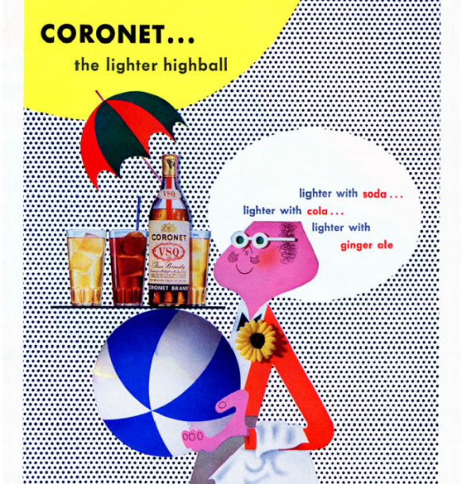

Slide 22
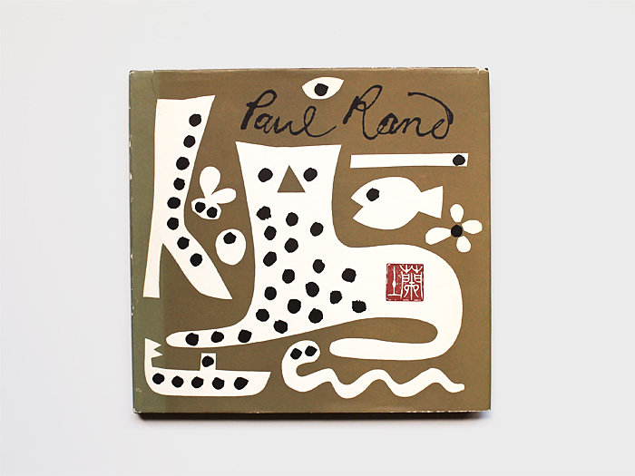

Slide 24
Paul Rand makes the nurse's needle a little less scary: Big Families advertising flyer 1947

Slide 26
Thank You!!!

Slide 27
Resources/Bibliography
http://www.paul-rand.com/
Paul Rand. (2007, April 11). Wikipedia, The Free Encyclopedia.
http://swystuncommunications.com/newwp/everything-is-design/
http://www.iconofgraphics.com/paul-rand/

