Slide 1
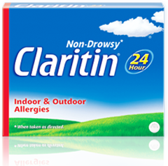
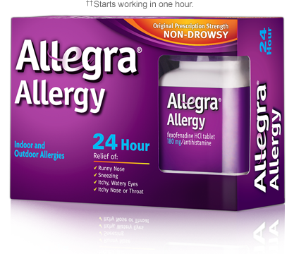
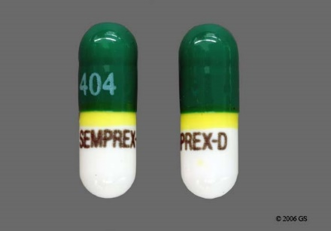
Prescription and OTC Anti-Allergy Medications

Slide 2
Over the Counter Anti-Allergy Medications
An allergy is the response of the body's immune system to normally harmless substances such as pollen and food.
While in most people these substances pose no problems, in allergic individuals their immune system sees this as a’ threat’ and produces a response.
Most allergy sufferers first reach for over-the-counter antihistamine pills, which work by blocking histamine.
Histamine is a natural chemical produced by mast cells. When your immune system detects a foreign substance, histamine is released and it binds to H1 receptors in blood vessels, causing them to enlarge. Histamine also binds to other receptors causing redness, swelling, itching, and changes in secretions.
Second generation oral antihistamines block the histamine and keep it from binding to receptors thus preventing those symptoms.
-fexofenadine (Allegra)
-loratadine (Claritin)
First generation oral antihistamines do the same but also contain ingredients that cause drowsiness.
- diphenhydramine (Benadryl) 1

Slide 3
Prescription Anti-Allergy Medications
Prescribed and OTC drugs are regulated by the FDA to ensure that they're safe and effective.
The same drug may be prescribed or OTC, but the potency will be higher for those that require physician scripts.
According to the Iodine website there have been a lot more reported side effects with prescription Clarinex vs OTC Claritin.
There may also be more drug interactions with medications that are prescribed vs OTC.
-Desloratadine (Clarinex)
-Levocetirizine (Xyzal)
-Azelastine HCL (Astelin) 2

Slide 4
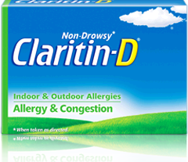
Combination Anti-Allergy Medications
Some allergy medications contain an antihistamine and a decongestant to relieve multiple allergy symptoms.
Pseudoephedrine is often added as the decongestant. It is a sympathomimetic drug of the phenethylamine and amphetamine class. It shrinks blood vessels in the nasal passages, which is the main cause of nasal congestion.
- loratadine and pseudoephedrine (Claritin-D)
- acrivastine and pseudoephedrine (Semprex-D) 3

Slide 5
Types of allergic reactions
Type I- Immediate or anaphylactic-type
A mild form would include Allergic Rhinitis (seasonal allergies) that cause things like coughing, sneezing, watery eyes and nasal congestion.
This type is also responsible for peanut or bee sting allergies that can lead to swelling of the lips, tongue, throat, shortness of breath and anaphylactic shock.
It is treated with epinephrine, (EpiPen), which acts on Alpha-1 adrenergic receptors to raise blood pressure through vasoconstriction.
This is the most common type of allergy and also one of the most dangerous if reaches anaphylactic shock.
Type II- Antibody
Involves specific antibodies called the Immunoglobulin G (IgG) and IgM.
Often occurs after an organ transplant when the body doesn’t recognize the new organ.
-Examples: Rheumatic Fever, Hemolytic Disease of Newborns

Slide 6
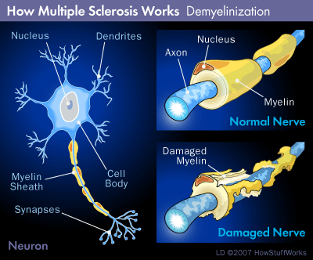
Type III- Immune complex-mediated
Immune complexes are the bound form of an antibody and an antigen.
Occurs when there are more antigens then antibodies. Thus the antibodies bind to multiple antigens causing clumps.
-Examples: Lupus, Rheumatoid Arthritis
Type IV- Delayed or cell-mediated
Involves T1 cells attracting and activating macrophages.
It is cell-mediated and antibody dependent.
-Examples: Contact Dermatitis, Multiple Sclerosis 4

Slide 7
Diseases and conditions they are intended to treat
OTC
diphenhydramine ( Benadryl )
It is indicated for the relief of allergy associated symptoms such as sneezing, runny nose, itchy throat, and itchy and watery eyes.
It used to neutralized the action of histamine in many directions, and it is recommended for the relief of allergic symptoms. Benadryl is to be taken 4 times daily by patients with acute or chronic urticaria and by those with hay fever.
Urticaria are red welts on the skin that itch intensely, sometimes with dangerous swelling, caused by an allergic reaction, typically to specific foods.
fexofenadine ( Allegra )
This drug can be used in adults and children 2 years of age and older. Allegra is an antihistamine indicated for the treatment of symptoms of seasonal allergic rhinitis, itchy nose, watery eyes and chronic idiopathic urticaria (CIU).
According to Medscape, Chronic idiopathic urticaria (CIU), is defined as the occurrence of daily, or almost daily, wheals and itching for at least 6 weeks, with no obvious cause, has not been the subject of detailed epidemiological studies.
Also, It is often used as a potential treatment for mild to moderate allergic asthma. According to a long-term Brown University study published in the Annals of Allergy, Asthma and Immunology (Vol. 84 No. 5, 2000), individuals with allergic rhinitis are about three times more likely to develop asthma.
loratadine ( Claritin )
Claritin is a heavily advertised drug that is safe and effective for chronic hives, seasonal nasal allergies. Also created to treat outdoor allergens such as pollen and molds.
Claritin is used to treat seasonal allergic rhinitis commonly called hay fever.

Slide 8
PRESCRIPTION
desloratadine ( Clarinex )
Clarinex is the successor to its enormously popular allergy drug Claritin.
Clarinex is often used against hives and indoor allergies.
Clarinex allergy drug is used for treatment of hives and reactions to dust and animal dander which are often produced by pets, mice or cockroaches. Animal dander is composed of tiny, even microscopic, flecks of skin shed by cats, dogs, rodents, birds and other animals with fur or feathers and this can cause an allergic reaction to certain people.
Clarinex new labeling states that patients can drink grapefruit juice without fearing that it will affect bioavailability of the drug. In addition, broadened labeling states that the drug can be used for patients with both seasonal allergies and mild to moderate asthma.
azelastine ( Astelin )
Azelastine is an antihistamine; oral antihistamines are effective in treating most symptoms of seasonal allergic rhinitis, but are generally marginally effective in relieving nasal congestion, the number-one complaint of allergy sufferers.
Azelastine hydrochloride (ASTELIN Nasal Spray) may improve nasal congestion in patients with symptomatic seasonal allergic rhinitis.
Astelin is indicated for the treatment of the symptoms of seasonal allergic rhinitis (patients 5 years of age and older) and nonallergic vasomotor rhinitis (patients 12 years of age and older).
levocetirizine ( Xyzal )
Xyzal is indicated for treating nasal allergies in young children.
Xyzal is used for children age six months and older for the relief of symptoms of perennial allergic rhinitis (indoor allergies) and chronic idiopathic urticaria (chronic hives); for children age two years and older is indicated for symptoms of seasonal allergic rhinitis (outdoor allergies).

Slide 9
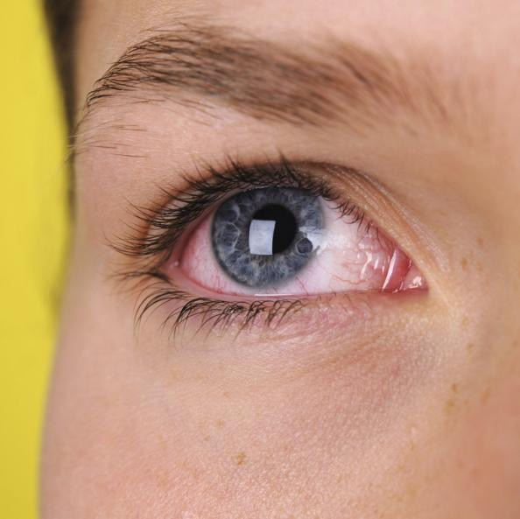
Combined anti-allergy medications
OTC
loratadine and pseudoephedrine (Claritin -D )
Claritin-D was approved by the FDA for the treatment of symptoms associated with seasonal allergic rhinitis.
Recent studies have demonstrated that loratadine plus pseudoephedrine significantly reduces nasal congestion and relieves symptoms of rhinitis more effectively than either loratadine or pseudoephedrine alone.
Prescription
pseudoephedrine and acrivastine ( Semprex - D )
Semprex-D has been shown to be effective in treating manifestations of seasonal allergies including runny nose, itchy and watery eyes, sneezing and nasal congestion, with many patients experiencing relief within one hour.
Semprex-D reduced the intensity of sneezing, runny nose, itching and watery eyes more than pseudoephedrine alone, and reduced the intensity of nasal congestion more than acrivastine alone, demonstrating a therapeutic contribution of each of the components.

Slide 10
References:
1. http://www.livescience.com/45335-allergy-medications.html
2. http://www.iodine.com/compare/clarinex-vs-claritin
3. https://www.drugs.com/pseudoephedrine.html
4. http://www.stomponstep1.com/hypersensitivity-type-1-2-3-4-urticaria-anaphylaxis-immune-complexes-i-ii-iii-iv/
Benadryl. (1946). The British Medical Journal, 2(4465), 162.
McNeil Consumer Healthcare Recalls Four Product Lots of BENADRYL[R] ALLERGY ULTRATAB TABLETS, 100 Count, and One Product Lot of EXTRA STRENGTH TYLENOL[R] Rapid Release Gels, 50 Count. (2010). Biotech Week, 657.
Aventis Discloses Details of Most Extensive Research Program on Allegra(R). (2002, November 27). PR Newswire, p. PR Newswire, Nov 27, 2002.
Medscape Log In. (n.d.). Retrieved August 02, 2016, from http://www.medscape.com/viewarticle/461843
Freudenheim, Milt. (2002, April 23). Panel Endorses Use of Claritin Over Counter For Some Hives.(Business/Financial Desk). The New York Times, p. C1.
Schering-Plough's allergy drug gets wider approval.(Clarinex). (2002, February 12). The New York Times, p. C4.

Slide 11
Lynn, Kathleen. (2002, February 12). SCHERING'S NEW ALLERGY DRUG OK'D FOR EXPANDED USE; CLARINEX IS VIEWED AS SUCCESSOR TO THE BLOCKBUSTER CLARITIN.(BUSINESS). The Record (Bergen County, NJ), p. L6.
Two new uses boost prospects for Schering's allergy drug. (Newsbreaks: Major stories for pharmacists at deadline). (2002). Drug Topics, 146(5), 25.
Pilot Study Finds Azelastine Nasal Spray Improves Nasal Congestion In Patients With Seasonal Allergic Rhinitis; Encouraging Results Add to Growing Data Supporting Use of Intranasal Antihistamine. (2003, November 10). PR Newswire, p. PR Newswire, Nov 10, 2003.
FDA Approves XYZAL[R] for Use In Children Age Six Months and Older for the Relief of Perennial Allergic Rhinitis and Chronic Idiopathic Urticaria. (2009). Biotech Week, 2792.
http://onlinelibrary.wiley.com.citytech.ezproxy.cuny.edu:2048/doi/10.1002/pds.816/epdf
Manda, B., Drinkard, C., Shatin, D., & Graham, D. (2004). The risk of esophageal obstruction associated with an anti‐allergy medication (Claritin‐D® 24‐Hour—original formulation. Pharmacoepidemiology and Drug Safety, 13(1), 29-34.
Efficacy and safety of loratadine plus pseudoephedrine in patients with seasonal allergic rhinitis and mild asthma.(Clinical report). (1997). The Journal of Allergy and Clinical Immunology, 100(6), 781.
"BURROUGHS WELLCOME'S SEMPREX-D RELEASED FOR MARKETING BY FDA; ADAMS LABORATORIES, INC. TO EXCLUSIVELY MARKET ON BEHALF OF BW." PR Newswire 5 Apr. 1994: 0405CH001. Academic OneFile. Web. 29 July 2016.

