Slide 1
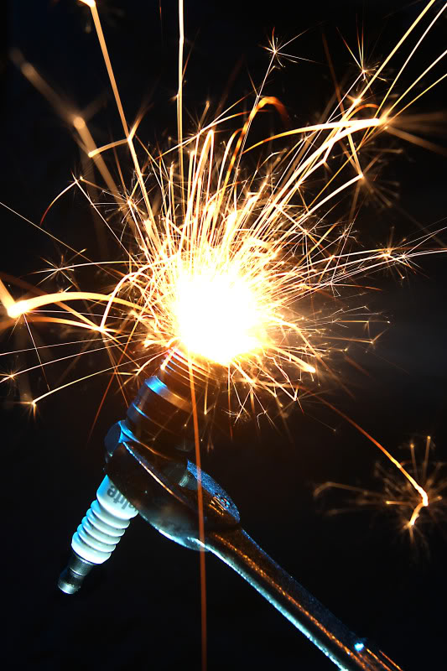
Spark of Inspiration
Philip Zeng

Slide 2
Spark of Inspiration
About Me
My name is Philip Zeng, currently a sophmore student at New York City College of Technology and I live in Brooklyn. I am currently studying Graphic Design and interested in web and packaging design. I created this blog because it was for a class assignment and the topic I have chosen seems to be kind of interesting. The art work that I have seen are mostly made from ordinary art mediums and not from uncommon art mediums. for example chalk art, moss art, origami, paper craft, etc. You can reach me at philip.zeng@citytech.cuny.edu

Slide 3
Spark of Inspiration
The mission of The Spark of Inspiration is to inspire people of the different unique art or design works. I chose this name for my blog because a spark is all a person needs to ignite their imagination, therefore they can create many different things.
This blog will show readers visual images and descriptions about the different creative works that can created from the use of different mediums. Art work is not based on only using the mediums that we see in our everyday lives. For example pencil, pen, paint, marker, color pencils, etc. This blog will show viewers unique ways for creating something that is not limited to those items. I hope this blog will bring people to realization about the different things we can use to create an art piece.

Slide 4
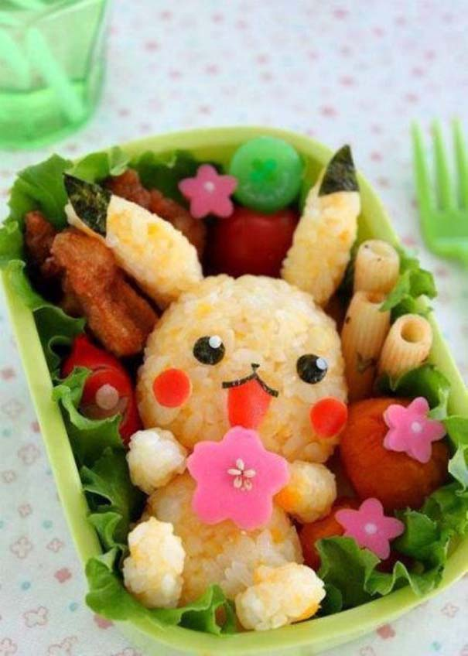
Spark of Inspiration
Food art is changing the placement or shape of the food on ones serving container to make the food or cuisine more appealing or appetizing. Food art can be different in various places of the world. For example some cuisines uses a large white plate as their display platform and puts their little bit of food in there. Although there is a little bit of food, it is still decorated with different sauces, textures, herbs, fruits, and uses the eye catching colors of vegetables to make it look elegant.
Read more of this post here.

Slide 5
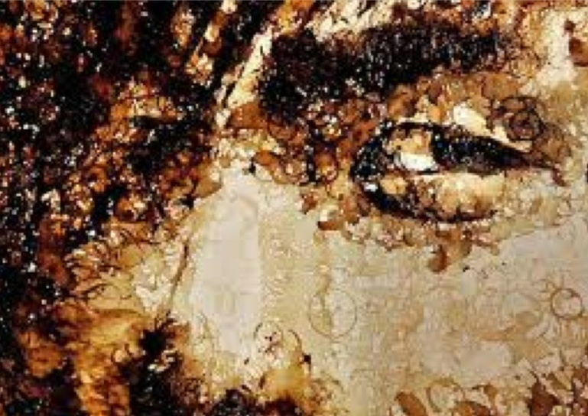
Spark of Inspiration
In these series we will be viewing famous fine art work that have been recreated using the unusual or uncommon art mediums. I will be giving a description on how the art work have been made and how the art medium being used effect the art work itself.

Slide 6
Spark of Inspiration
I have an idea to connect special education and to use unique mediums to create art work, this classroom project can be afford able and fun. It is the use of recyclable items that can be found in the recycle bin.
There are so many possibilities of things that can be created ranging from sculptures to collages, with the use of the different materials they can find. Using the different materials can effect their art works in different ways that can effect our senses. The use of different colors and the placement can effect how our eyes see their art work. The different materials that are used can have texture that can effect our sense of touch. Even our sense of smell can be effected depending on how sanitary the materials are.
Read more of this post here.

Slide 7
Spark of Inspiration
Thank you for your time! =D

