Slide 1
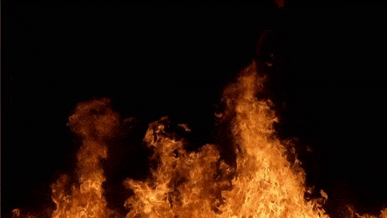
FLAMMABLE MATERIALS

Slide 2
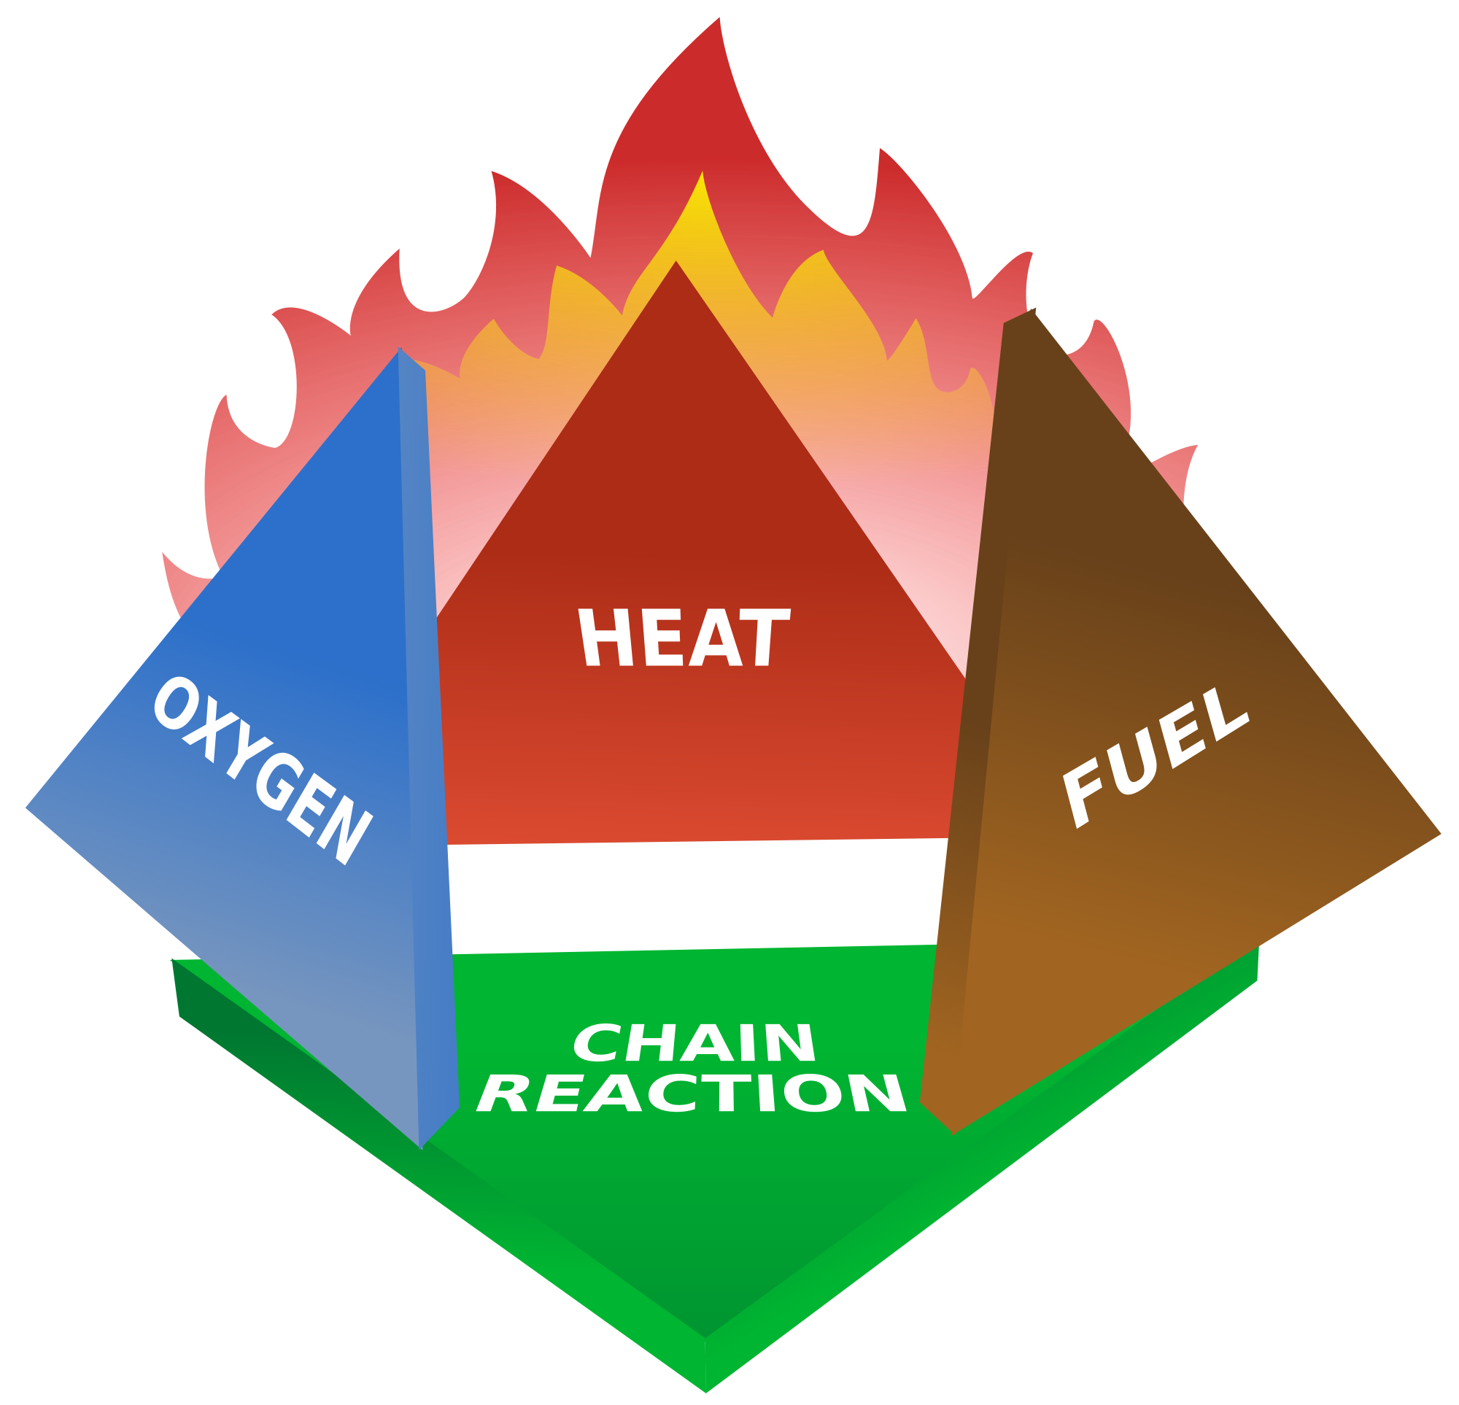
Flammable and combustible
Flammable: easily set on fire
Combustible: able to catch and burn easily
These two have similar definitions, but what is the difference between the two?
They are categorized based on their flash points.
Flammable flash point-100.4F
Combustible flashpoint- 100.4-199.94F

Slide 3
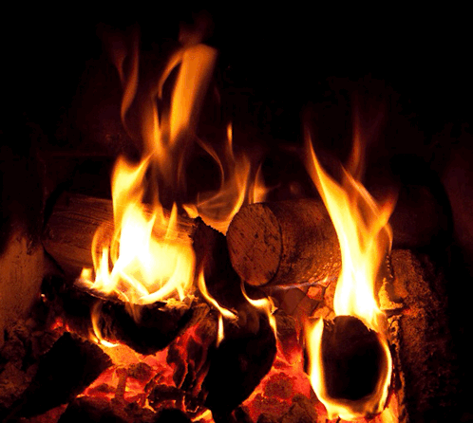
Wood
The most commonly used material in construction since it has a higher insulation rating than either plastic or steel this means that it takes less energy to heat up and cool down
It is a common misconception that wood is in fact flammable however it has been confirmed by the NFPA that this material is a combustible since it will burn but it takes a significant and prolonged heat source.

Slide 4
Light Fixtures
Light fixtures is often one of the reasons for a fire.
light fixtures that are flammable are those with a high wattage which will lead to a electrical fire. It’s recommended to always pay attention to the maximum wattage in a bulb or any lighting fixture and don’t go over the recommended amount.
Another cause of fire is placing materials like cloth or paper over a lampshade. The material heats up and ignites, causing a fire. Faulty lamps and light fixtures also frequently result in fires.

Slide 5
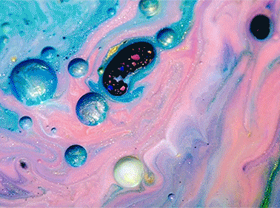
Paint
-Oil-based paints contain flammable components such as methanol,ketones & toluene.
-They also contain petroleum & gas making the paint thinner causing a disadvantage to the owners because it takes 6-8 hours to dry.

Slide 6
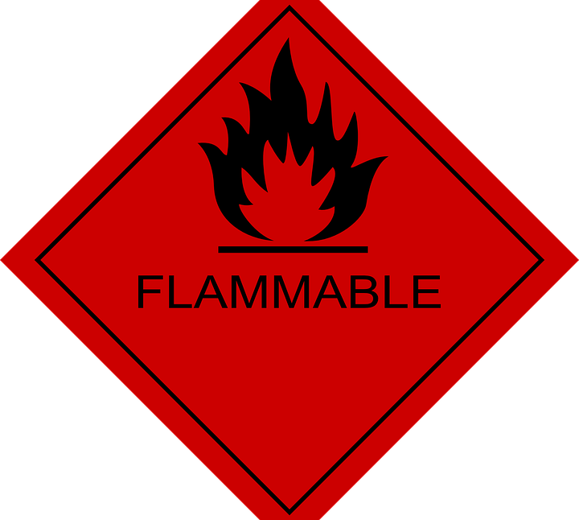
Aerosols
A flammable aerosol is any non-refillable receptacle designed to eject components at least one of which is a flammable gas, liquid, or solid
Flammable liquids in pressurized containers may rupture and aerosolized when exposed to heat, creating a highly flammable vapor cloud.
As with flammable liquids, these should be stored in a flammable storage cabinet.

