Slide 1
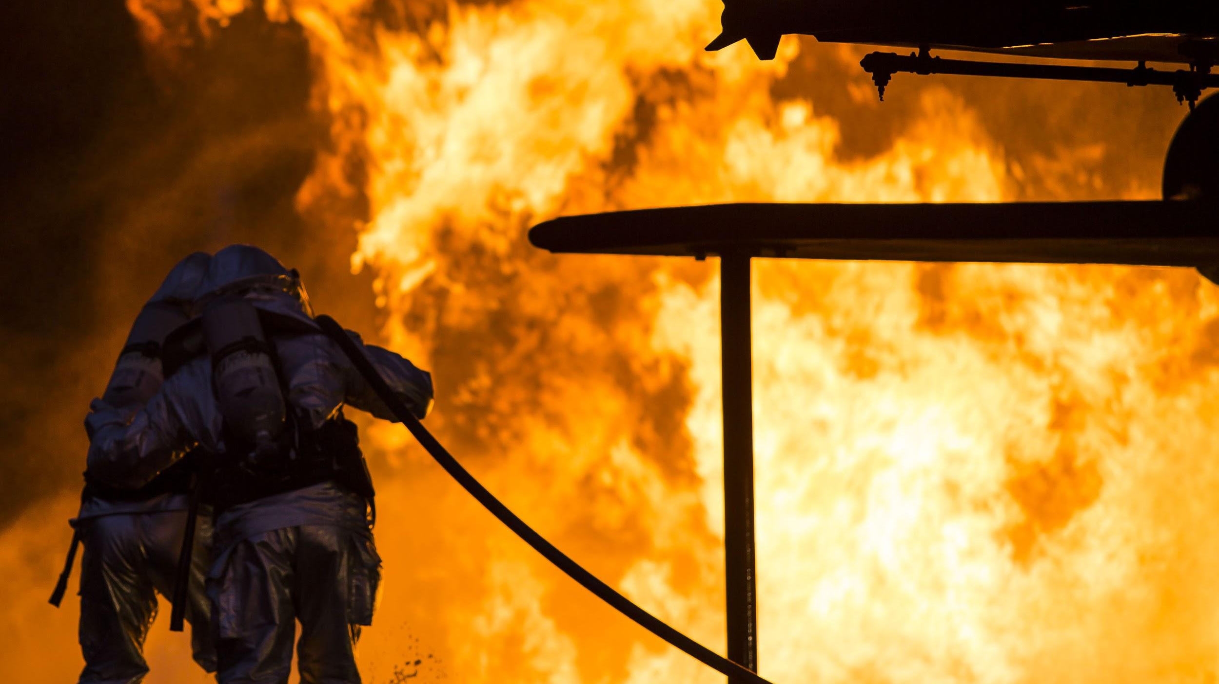
FIRE RESISTANT MATERIALS

Slide 2
Special wood(mineral and fire retardant wood)
Wood is usually a material that burns
But there are wood materials that can be
more fire resistant than regular wood
Mineral wood is a specific type of fire
Retardant wood, fire retardant means
A material which is resistant to fire
How wood can be made fire retardant, using chemicals in order to to make the wood fire resistant the wood itself does not become fire resistant but the chemical helps the wood resist the fire, the chemical interacts with the carbon fire treating a piece wood makes the wood non combustible meaning it will not suddenly light up or suddenly catch fire
The pros of fire treated wood is that the wood is cost effective, still looks good but is fire resistance and is good for lowering insurance cost

Slide 3
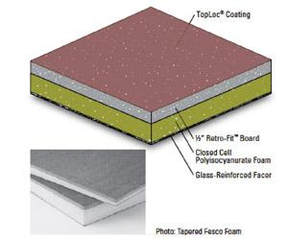
PERLITE BOARDS
energyGuard™ Perlite roof insulation is a homogeneous board composed of expanded perlite particles, selected binders and cellulose fibers, which give EnergyGuard™ Perlite roof insulation its insulating efficiency. The surface is treated to reduce bitumen absorption assuring proper adhesion of roof membranes.

Slide 4
Disadvantaged :
Perlite is a naturally occurring siliceous rock and as such, is not toxic. Perlite is used in horticultural, construction and industrial applications. Ingesting the products that incorporate perlite may cause illness and, in excessive amounts, permanent harm or death.
Advantage:
Perlite is non-combustible with a service temperature of 1800F. Perlite is a common insulating material with low thermal conductivity. Perlite is very light. Perlite will absorb water but retain 100% of its insulating qualities once dry

Slide 5
How does it work in a fire:
This expansion is due to the presence of two to six percent combined water in the crude perlite rock. When quickly heated to above 1600° F (8700 C)
Expanded perlite can be manufactured to weigh from 2 lb/ft³ (32 kg/m³) to 15 lb/ft³ (240 kg/m³) making it especially suitable for use in insulation
In the U.L. Fire Resistance Directory, for instance, there are many ratings of up to four hours for basic mixes of gypsum plaster and either perlite or vermiculite for use around steel beams and columns, or under metal decks. Here is a sampling of these:

Slide 6
Gypsum Board
Gypsum Board is a excellent fire resistive material, and the most commonly used interior finish where fire resistance classifications are required. The long that this material take is that can receive crushed rock that ground into a fine powder and heated about 350 degrees F.
Advantages
Fire Resistive
Sound Attenuating
Durable
Economical
Versatile
Disadvantages
Difficulty in curved
Low durability
Damage from impact

Slide 7
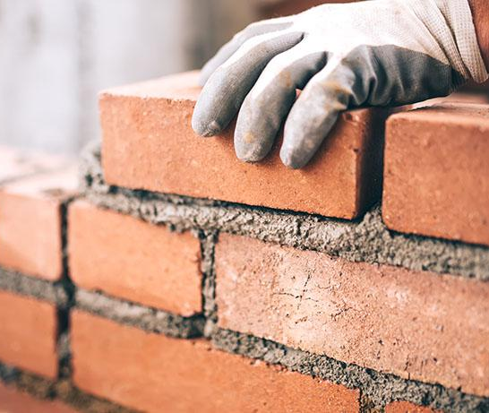
BRICK
Since the primary ingredient in brick is clay which is fired to around 20008 F.A brick wall fire resistance rating can be calculated.fire resistance periods for a given thickness of wall.2 hour rating and involves a brick veneer drainage wall with wood studs and gypsum sheathing and wallboard.

Slide 8
ADVANTAGES & DISADVANTAGES
Economical (Raw material is easily available)
Hard and durable
Different orientations and sizes give different surface textures
Very low maintenance cost is required
Demolishing of brick structures is very easy, less time consuming and hence economic
Reusable and Recyclable
Highly fire resistant
Produces less environmental pollution during manufacturing process
Time consuming construction
Cannot be used in high seismic zones
Since bricks absorb water easily, therefore, it causes fluorescence when not exposed to air
Very Less tensile strength
Rough surfaces of bricks may cause mold growth if not properly cleaned
Cleaning brick surfaces is a hard job
Color of low quality brick changes when exposed to sun for a long period of time

Slide 9
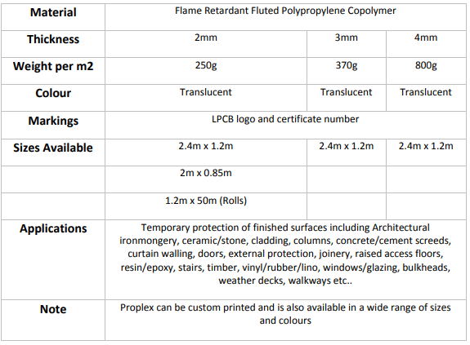
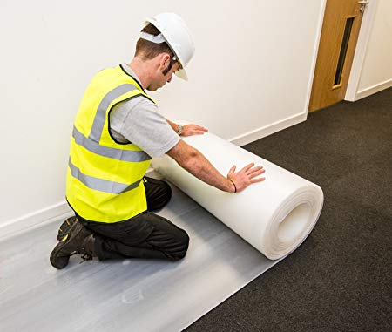
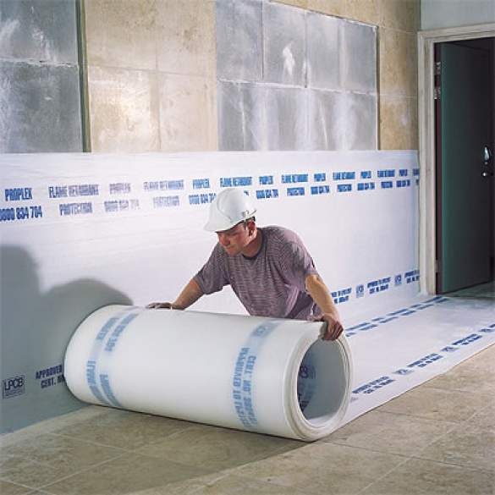
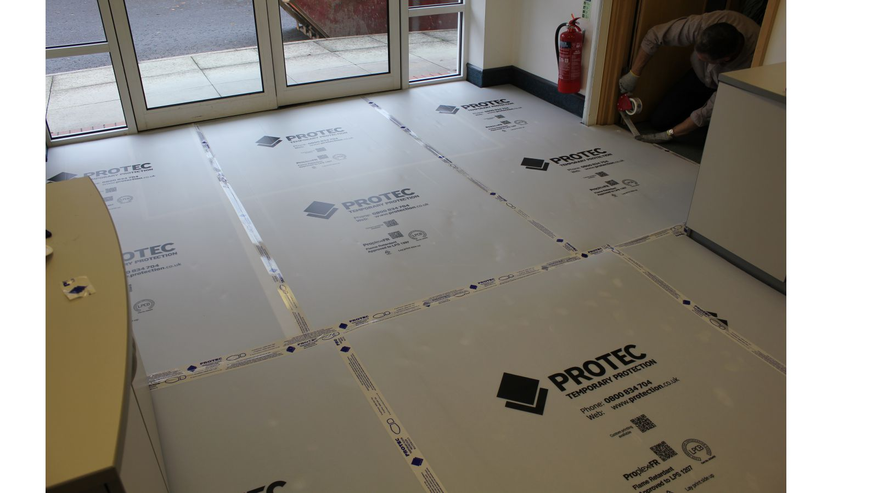
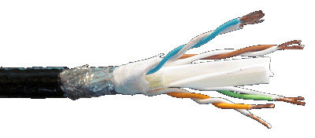
Proplex Sheets.
Proplex sheets is another variety of fire rated material. It is lightweight and versatile, with usage in the construction phase of many interior components of modern buildings. Other properties are its waterproofing, excellent compression, impact resistance, will provide outstanding protection for any project to come.

Slide 10
CITATION
https://www.interstatebrick.com/faq/what-fire-resistance-rating-brick-wall-assembly
https://www.hunker.com/12276642/is-perlite-toxic
https://www.aboutcivil.org/bricks-advantages-disadvantages-uses.html
https://www.gypsum.org/press-room/media-guide/
https://www.mugnaini.com/2016/07/what-is-perlite/
http://www.schundler.com/fireprotection.htm
http://objects.eanixter.com/PD368686.PDF

