Slide 1
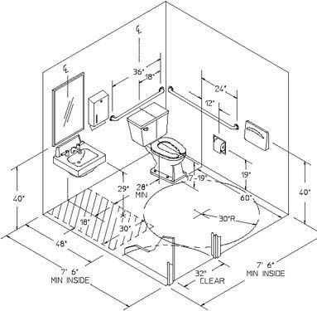
ADA PLUMBING FACILITIES

Slide 2
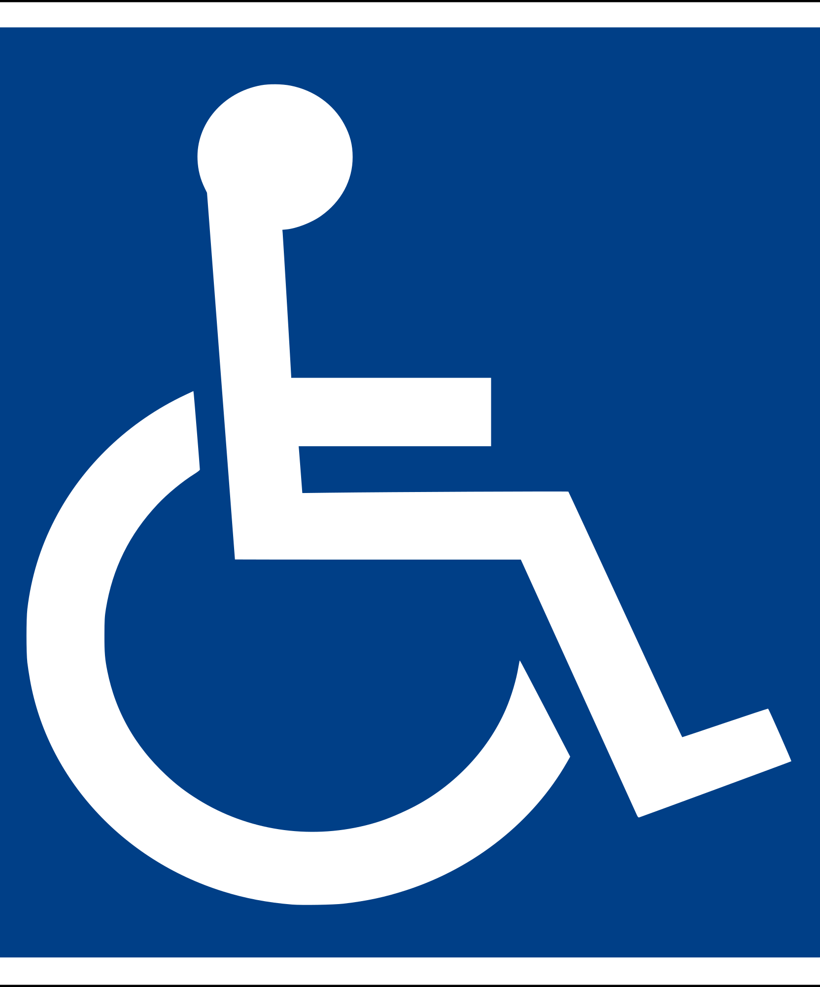
How to Determine if a Bathroom is ADA Compliant?
Bathrooms can lead to serious confusion when dealing with ADA compliant restrooms.
Most Basic and least expensive way of determining whether a restroom is ADA compliant is to review the ADA guidelines and the national standards institutes guidelines

Slide 3
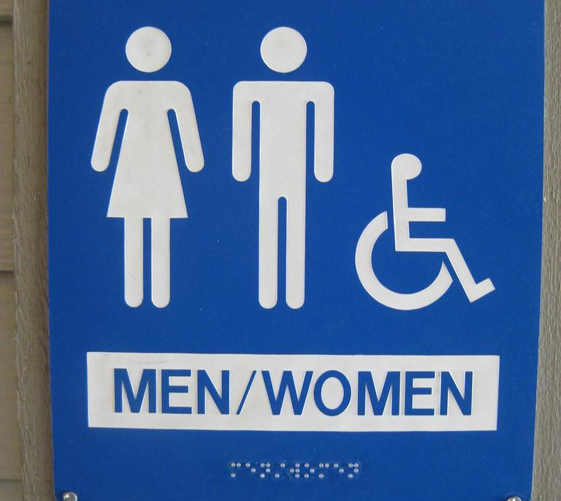
Areas that Must be ADA Compliant Plumbing Facilities
Mirror Height
Grab Bars
Water Closets
Sinks
Doors
Drinking Fountains

Slide 4
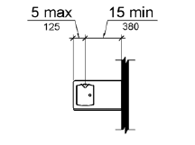
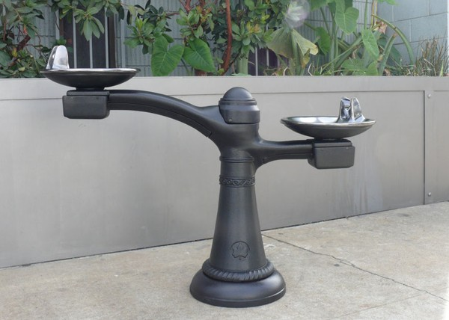
Drinking fountains :
Drinking fountains shall comply with 307 and 602.
602.2 Clear Floor Space. Units shall have a clear floor or ground space complying with 305 positioned for a forward approach and centered on the unit. Knee and toe clearance complying with 306 shall be provided.
A parallel approach complying with 305 shall be permitted at units for children's use where the spout is 30 inches (760 mm) maximum above the finish floor or ground and is 3½ inches (90 mm) maximum from

Slide 5
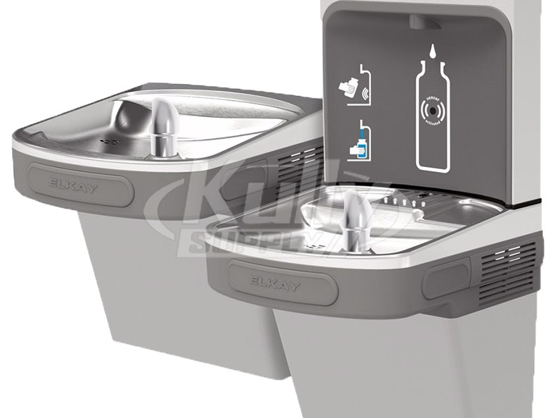
Drinking fountains
Advisory 602.6 Water Flow. The purpose of requiring the drinking fountain spout to produce a flow of water 4 inches (100 mm) high minimum is so that a cup can be inserted under the flow of water to provide a drink of water for an individual who, because of a disability.
Drinking Fountains for Standing Persons. Spout outlets of drinking fountains for standing persons shall be 38 inches minimum and 43 inches

Slide 6
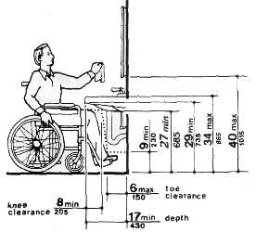
ADA Compliant Sink
In order to protect the right of the disabled there have been guidelines and requirements that have been established by the U.S government. There are three levels that have been taken into consideration kindergarten, elementary, and adult.
At the Kindergarten level, knee clearance should be 19 inches minimum and sink top should be 24 inches maximum.
At the Elementary level, knee clearance should be 24 inches minimum and sink top should be 29 inches maximum.
At the Adult level, knee clearance should be 29 inches minimum and sink top should be 34 inches maximum.

Slide 7
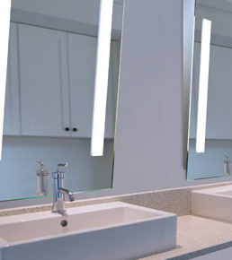
ADA Compliant Mirror
A mirror in the bathroom is the most common thing there is in order for people to be able to check their appearance and do minor grooming.
A toilet and bathing room mirror should be mounted so that the bottom edge of the reflecting surface is not more than 40” above the floor if above a sink or countertop or 35” if there is no object below.

Slide 8
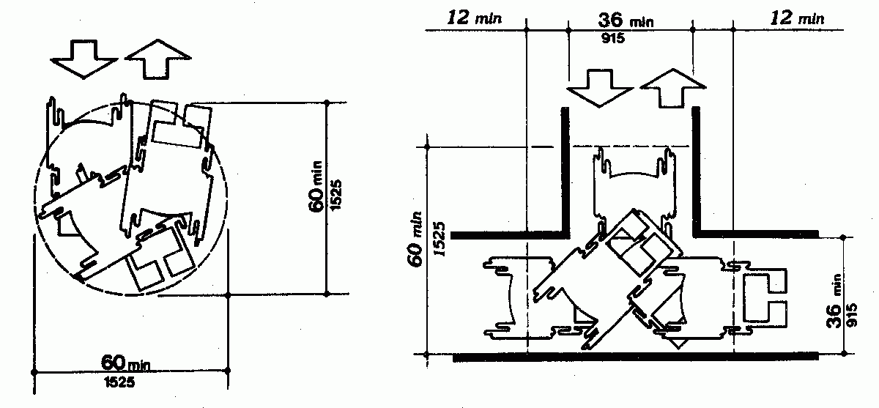
ADA COMPLIANT TOILET AND ROTATION
ROTATION:
floor space of at least 60 inches in diameter is required, 180-degree turn
TOILET:
A clear space around the toilet with minimum dimensions of 30 by 48 inches must be provided
designed for a forward or parallel approach to the toilet

Slide 9
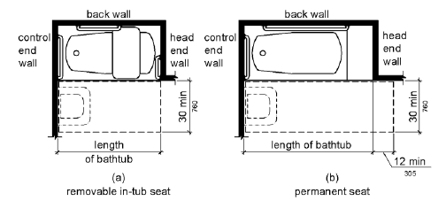
ADA BATHTUBS
607.2 Clearance. Clearance in front of bathtubs shall extend the length of the bathtub and shall be 30 inches (760 mm) wide minimum. A lavatory complying with 606 shall be permitted at the control end of the clearance. Where a permanent seat is provided at the head end of the bathtub, the clearance shall extend 12 inches (305 mm) minimum beyond the wall at the head end of the bathtub.

Slide 10
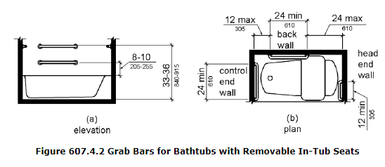
SEATING & GRAB BARS
607.3 Seat. A permanent seat at the head end of the bathtub or a removable in-tub seat shall be provided. Seats shall comply with 610.
607.4 Grab Bars. Grab bars for bathtubs shall comply with 609 and shall be provided in accordance with 607.4.1 or 607.4.2.
607.4.2.2 Control End Wall. A grab bar 24 inches (610 mm) long minimum shall be installed on the control end wall at the front edge of the bathtub.

Slide 11
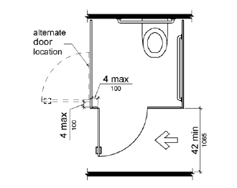
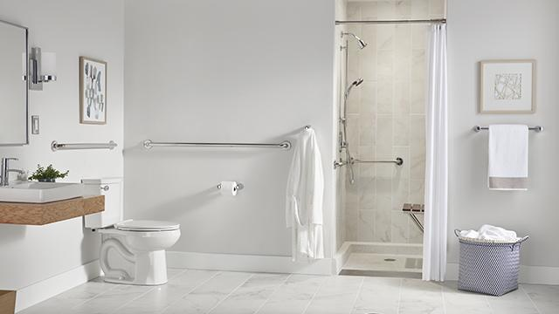
ADA Compliant Bathroom Door
To know is ADA compliant bathroom door should open with a minimal force and, also have handles that are easy to grab with one hand.
The doorways should be at least 32 inches wide with the door open a 90 degrees.
Door closers often require more than 5 pounds of force to open.

Slide 12
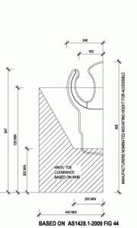
HAND DRYERS
ADA bathrooms must have hand dryers that are motion-activated or touch-free devices.
Hand dryer sensors or buttons must be 38 to 48 inches above the finished floor
Dryer units must be accessible for right- and left-handed users.

Slide 13
CITATIONS
https://www.thebalancesmb.com/ada-construction-guidelines-for-accesible-bathrooms-844778
https://www.buildings.com/article-details/articleid/9242/title/the-ada-compliant-restroom
https://www.access-board.gov/guidelines-and-standards/buildings-and-sites/about-the-ada-standards/ada-standards/chapter-6-plumbing-elements-and-facilities
https://canterbury-designs.com/products/drinking-fountains/
https://www.progrss.com/policy/20180127/water-fountains-london/attachment/drinking-fountain-water/
https://www.drinkingfountaindoctor.com/elkay-lzstlddwsvrlk-ezh2o-bi-level-bottle-filling-station-filtered-non-ref-vr-bubbler-light-gray

