Slide 1
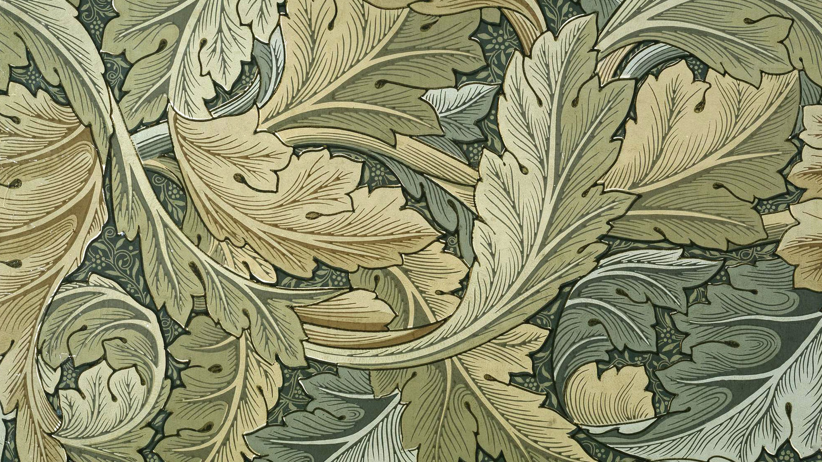
ART NOUVEAU 1890-1910
HISTORY
JURNALS AND ARTISTS
THE FAMOUS ARCHITECTS AND THEIR PROJECTS
THE MAIN EVENT
WRITERS
PERSONAL EXPERIENCE
CONCLUSION
MIMOZA DEMIRAJ

Slide 2
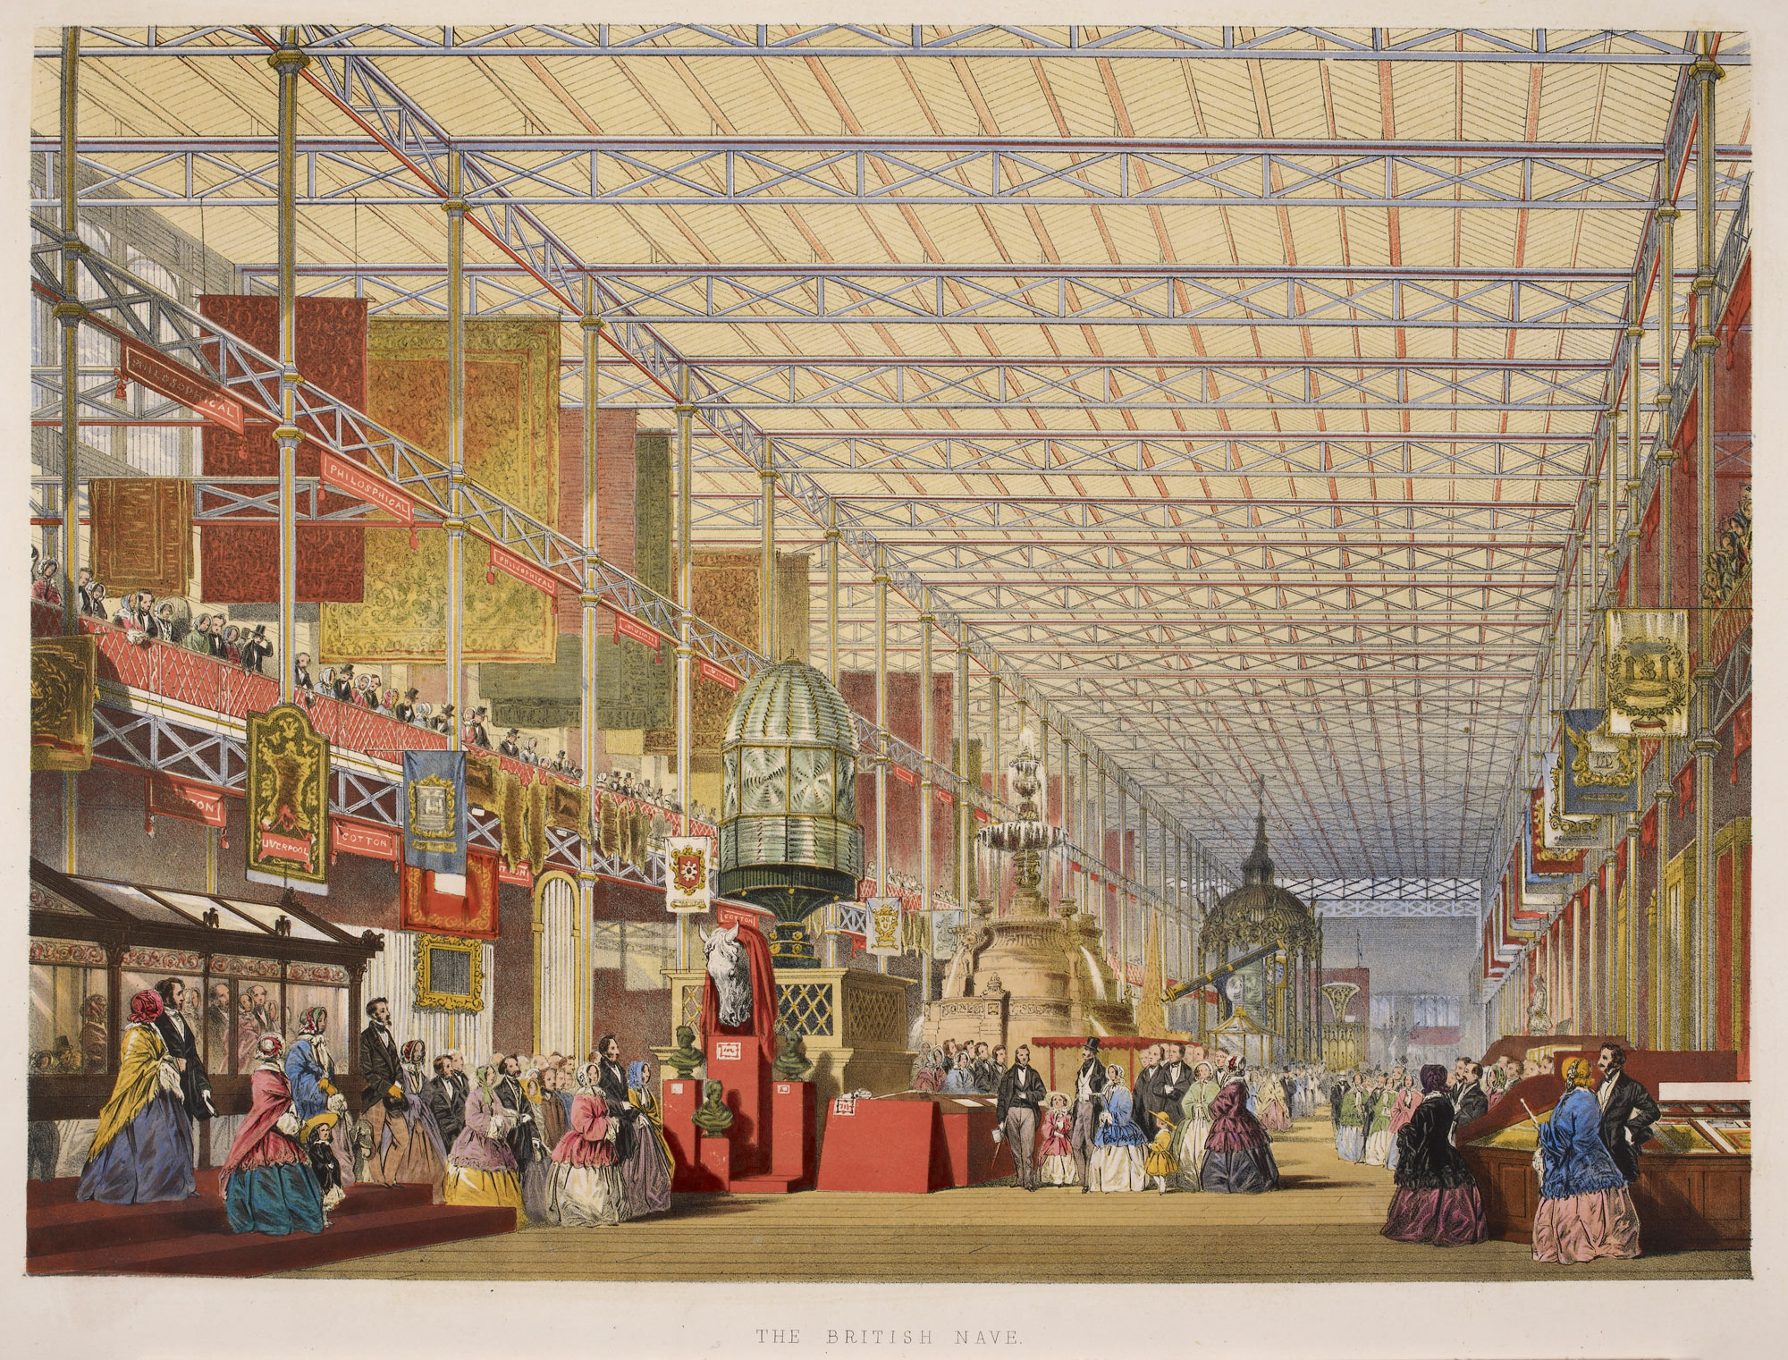
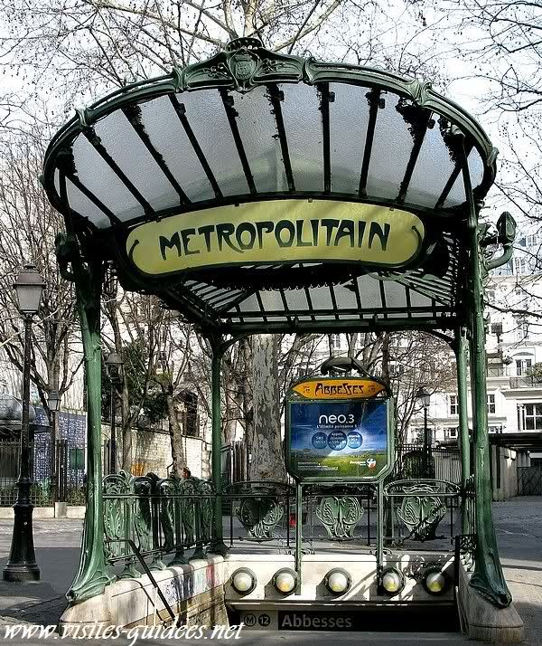
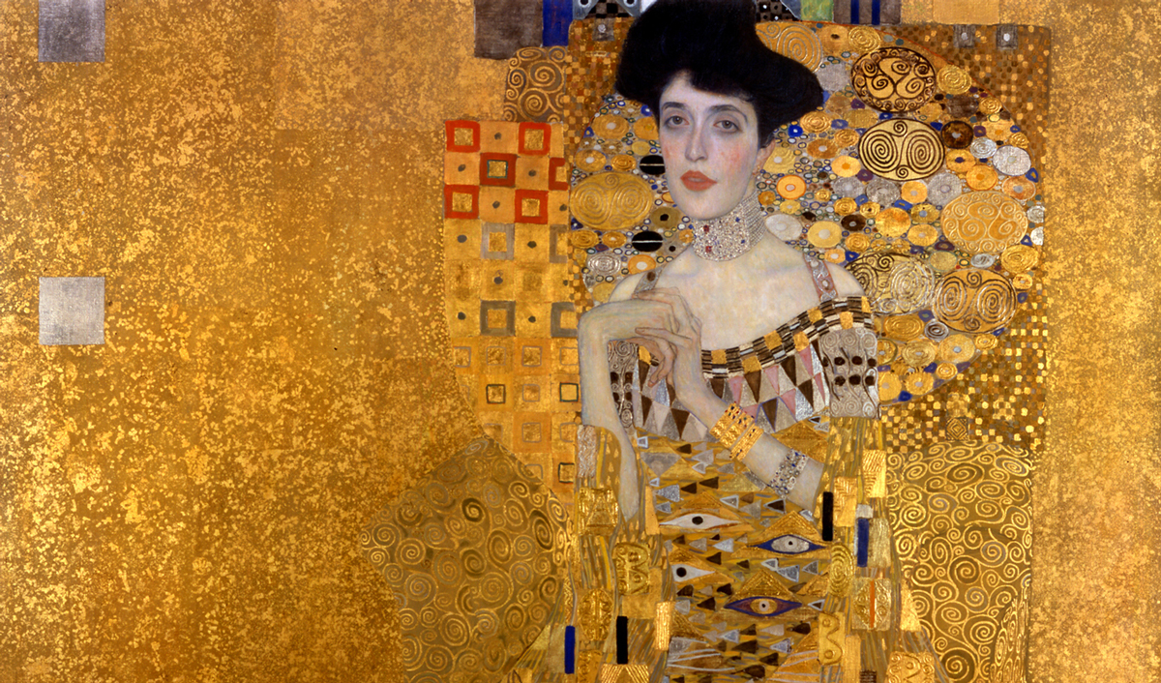
Art nouveau (New Art) had it roots in Britain, inspired by the arts and crafts movement founded by William Morris and developments in wrought iron technology. It is an international style of art, architecture, and applied art, especially the decorative arts, that was most popular between 1890-1910. The academic art of 19th century, moved away from imitation of real subjects and moved toward the flowing and twisting lines and shapes of nature.

Slide 3
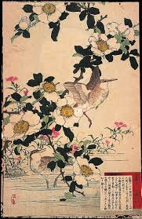
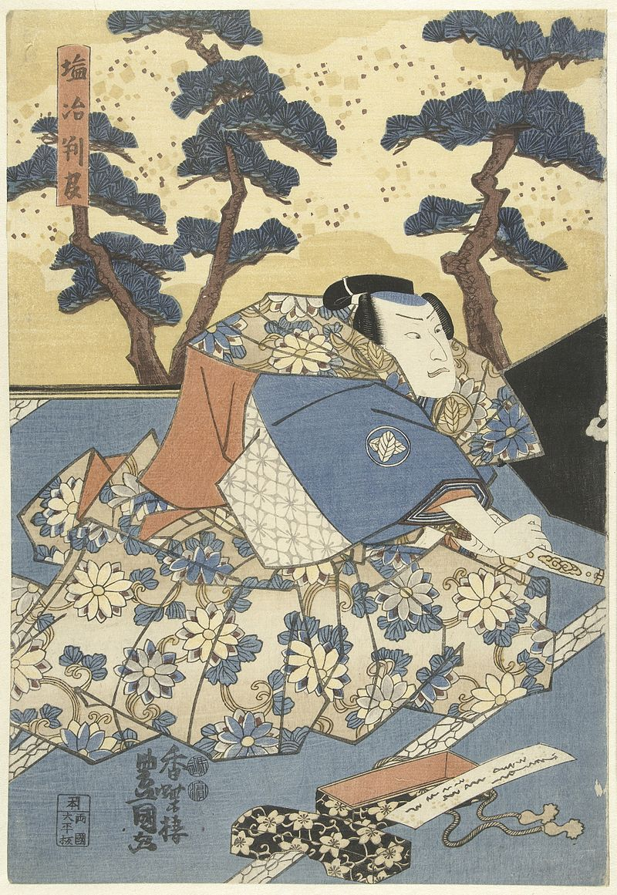
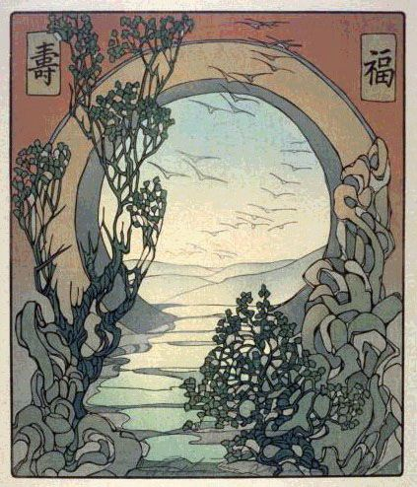
The new movement abandoned the drawing inspiration from styles outside the classical canon from flowing lines of Japanese woodblock printings, simplicity, colors, and riches two-dimensional imagery.
For more information’s : https://www.britannica.com/art/Art-Nouveau

Slide 4
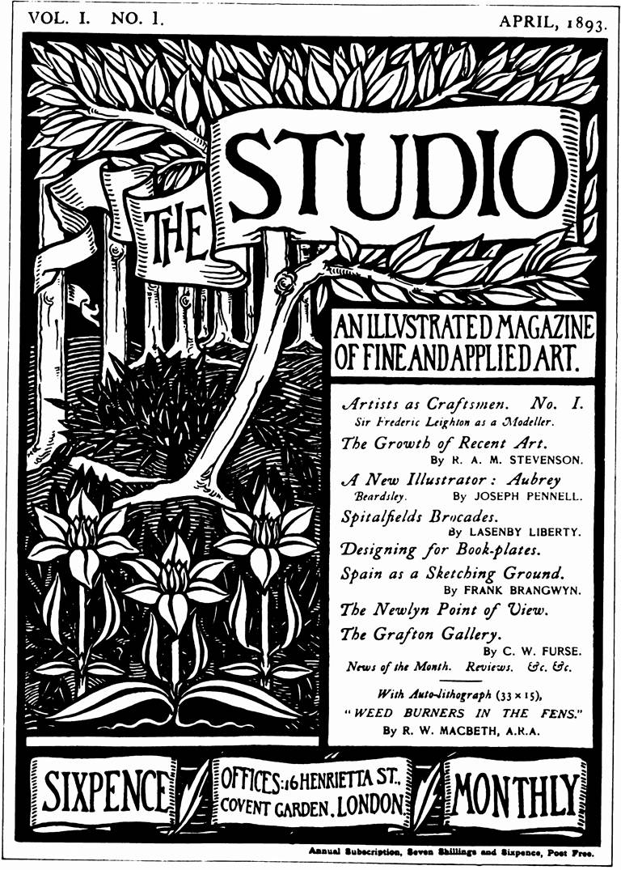
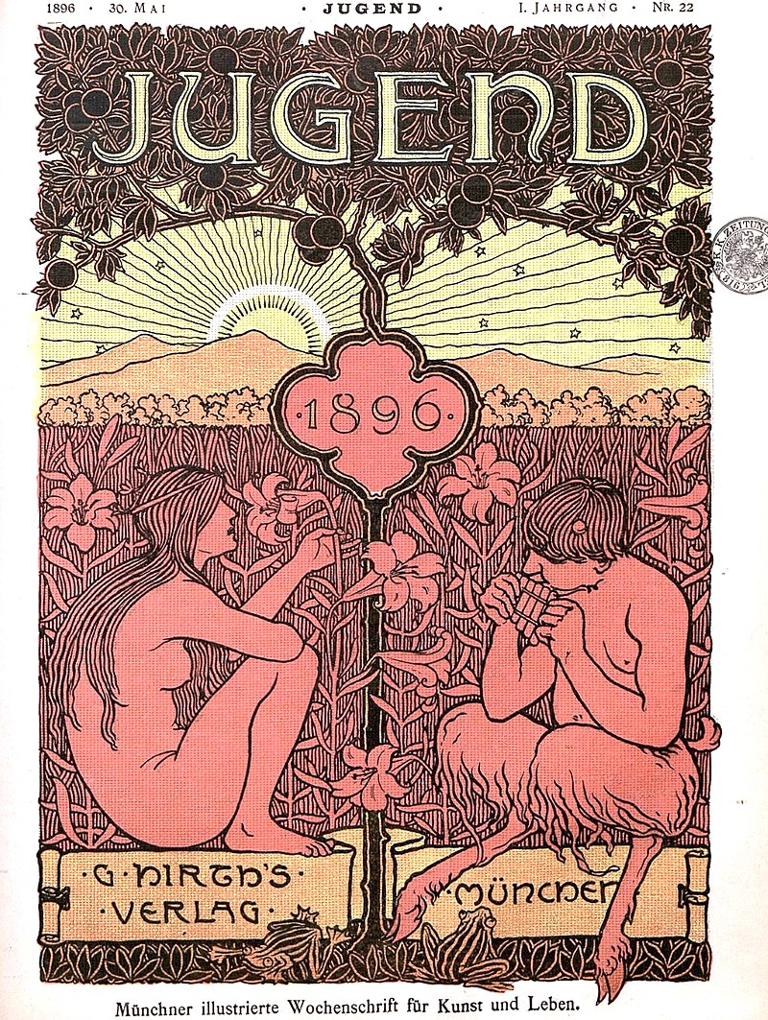
Journals
Art Nouveau spread rapidly by means of journals such as The Studio in England, Arts et idèes and Art et decoration in France, and Jugend in Germany.

Slide 5
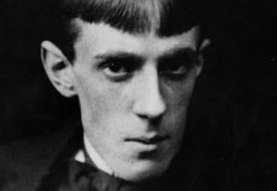
Artists
Aubrey Beardsley

Slide 6
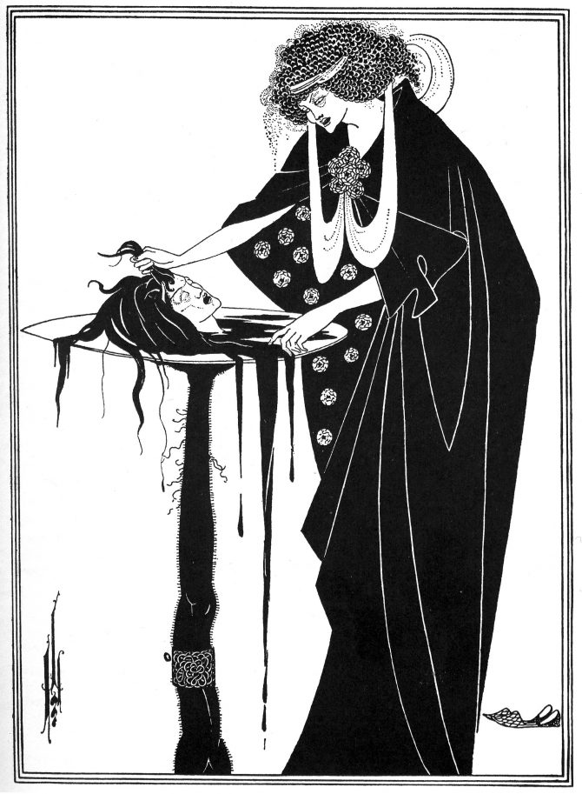
Beardsley’s illustration for Oscar Wilde’s play Salome is considered one of the most controversial of the Art Nouveau movement. In his poster, the character Salome holds the head of John the Baptist on a table.
https://www.brainpickings.org/2016/01/25/aubrey-beardsley-oscar-wilde-salome/

Slide 7
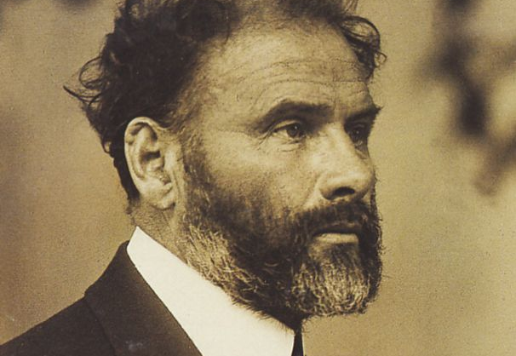
Artists
GustaKlimtv

Slide 8
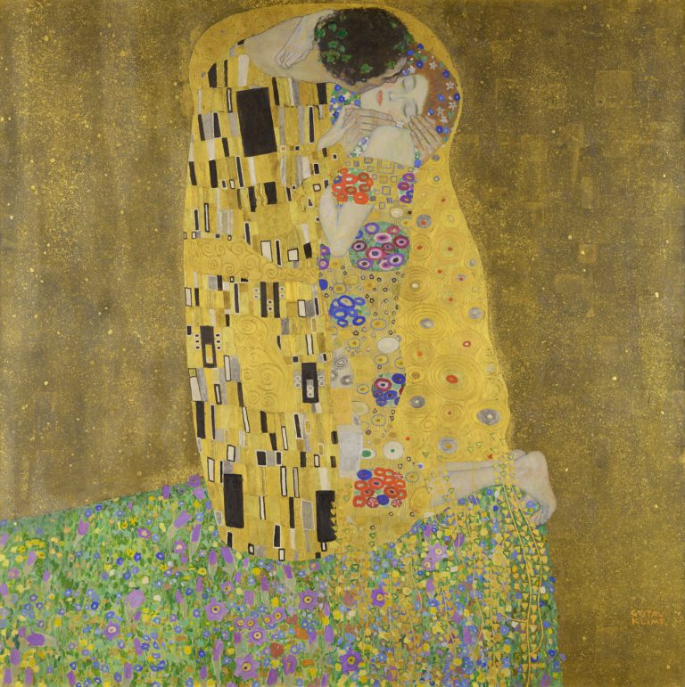
Klimt’s primary subject in his Art Nouveau paintings was the female figure. His popular work, The Kiss, is one of the most instantly recognizable examples of his work, and one the few paintings of his that features a man.
https://en.wikipedia.org/wiki/The_Kiss_(Klimt)

Slide 9
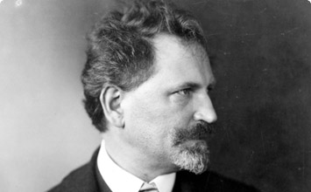
Artists
Alphonse Mucha

Slide 10
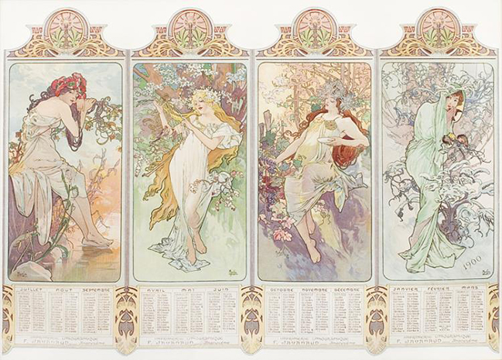
Gismonda, had a large impact on Art Nouveau. This piece was created for the eponymous Renaissance play by Victorien Sardou.
The woman in the poster, Sarah Bernhardt, wears a costume from the fourth and final act of the play. She was the single most influential figure in Mucha’s work.
https://www.myddoa.com/gismonda-alphonse-mucha/

Slide 11
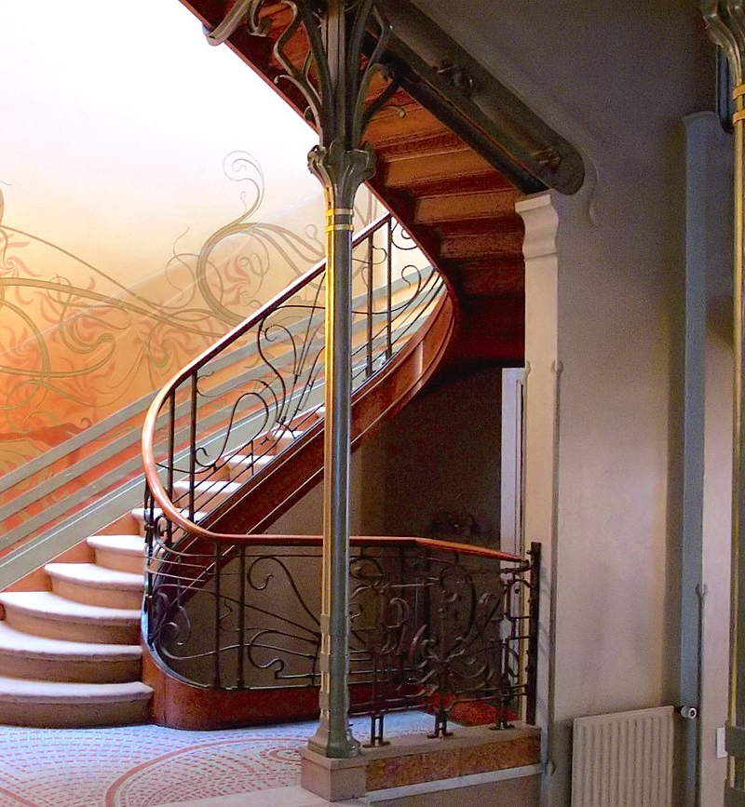
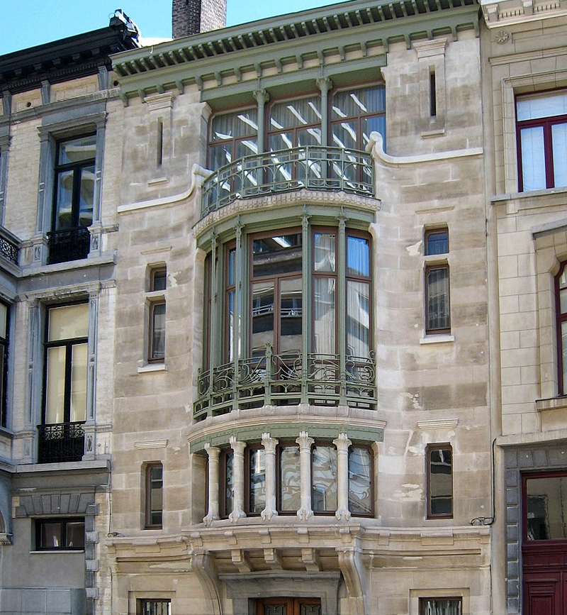
The first Art Nouveau House, Brussels in 1893–1895

Slide 12
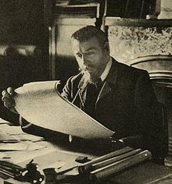
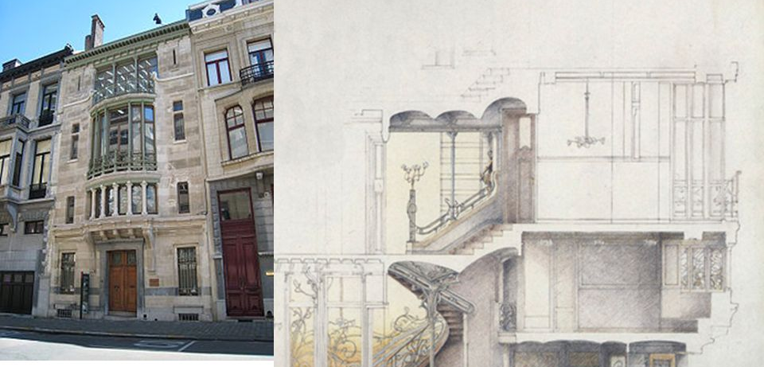
The first Art Nouveau House, Brussels in 1893–1895
Hotel tassel was a residence of a prominent Belgian chemist, Émile Tassel, on a very narrow and deep site. The central element became the stairway, beneath a high skylight. The floors were supported by slender iron columns like the trunks of trees. The mosaic floors and walls were decorated with delicate arabesques in floral and vegetal forms, which became the most popular signature of Art Nouveau.
Victor Horta

Slide 13
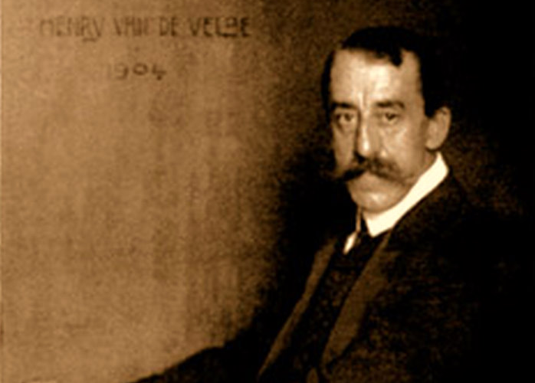
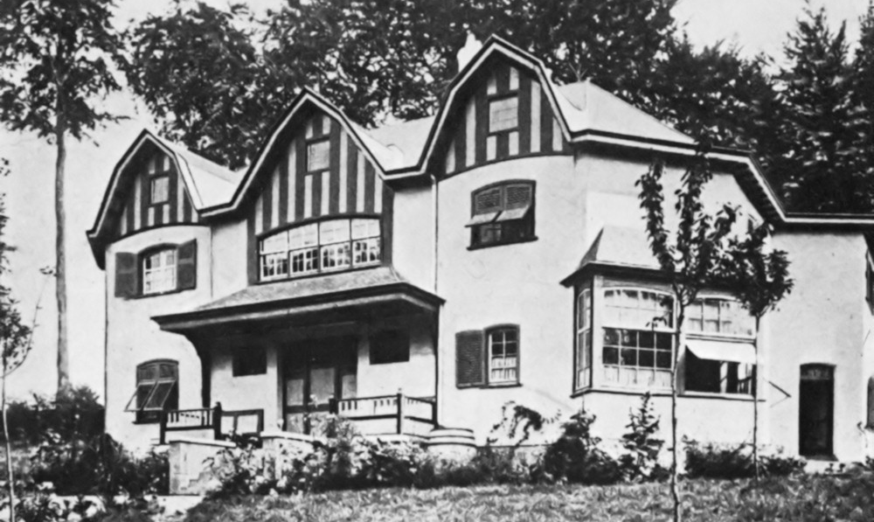
The first Art Nouveau House, Brussels in 1893–1895
De Velde collaborated with an architect on the plan of the Bloemenwerf, the house that he built for himself. He was inspired by the British Arts and Crafts Movement, particularly William Morris's Red House, and like them he designed all aspects of the building, including the furniture, wallpaper and carpets.
Henry Van De Velde

Slide 14
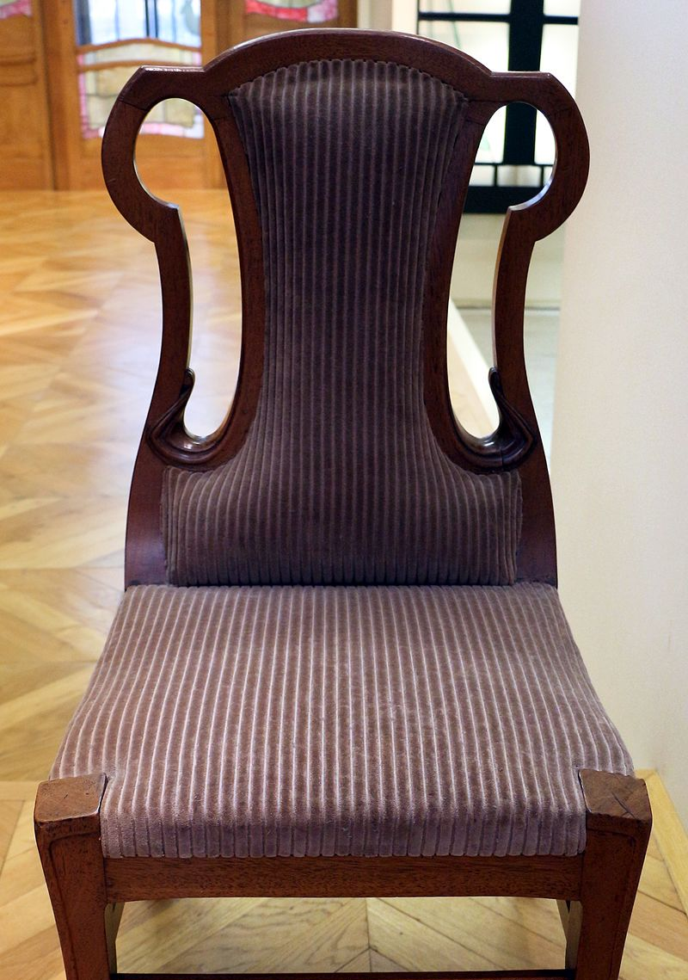
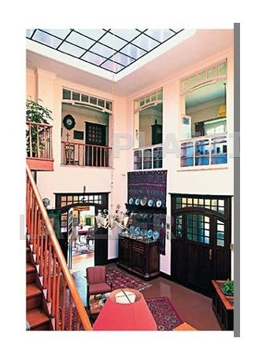
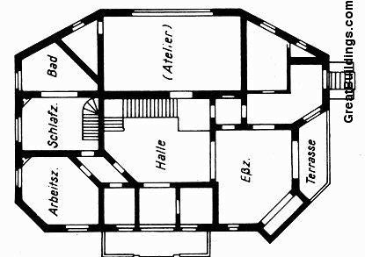

Slide 15
THE GRAND EVENT OF THE MOVEMENT
The Great Exhibition, which opened in London's Hyde Park in the Crystal Palace was a huge commercial and political success, but it confirmed the low quality of decorative products not only in England but in all the industrial countries. A million square feet of glass on a framework of bare iron forming its walls and roof. The Great Exhibition celebrated the height of civilization to which the whole of mankind had risen.
https://www.metropolismag.com/architecture/exhibition-started-international-style-art-deco/

Slide 16
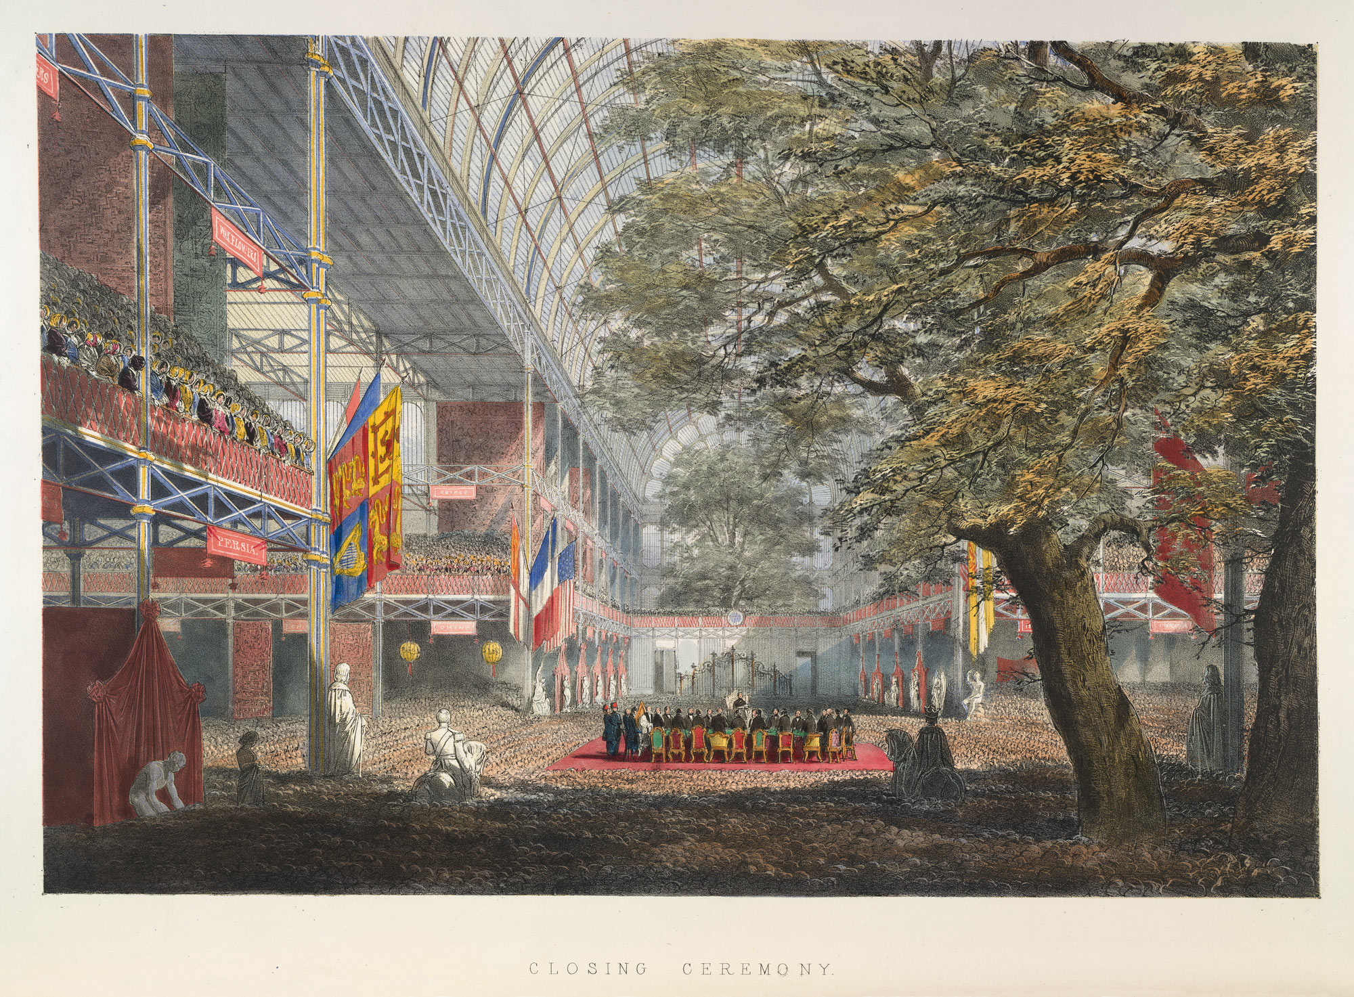
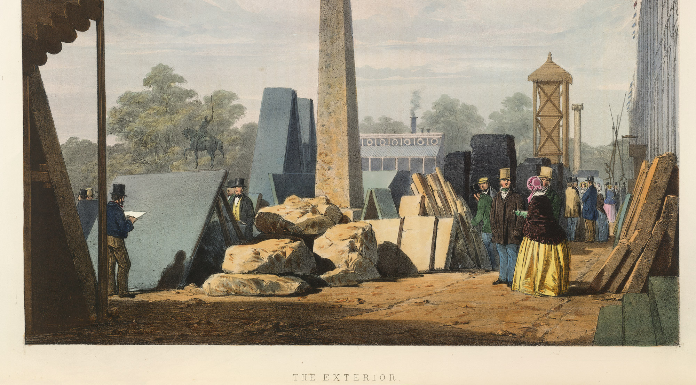

Slide 17
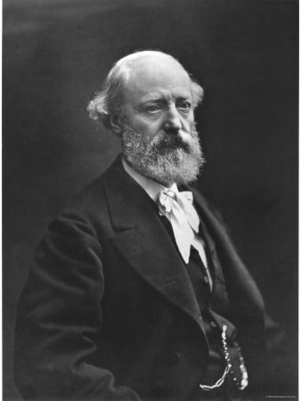
Eugene Viollet-le-Duc in his book Entretiens sur l'architecture wrote : "use the means and knowledge given to us by our times, without the intervening traditions which are no longer viable today, and in that way, we can inaugurate a new architecture. For each function, its material; for each material, its form and its ornament."

Slide 18
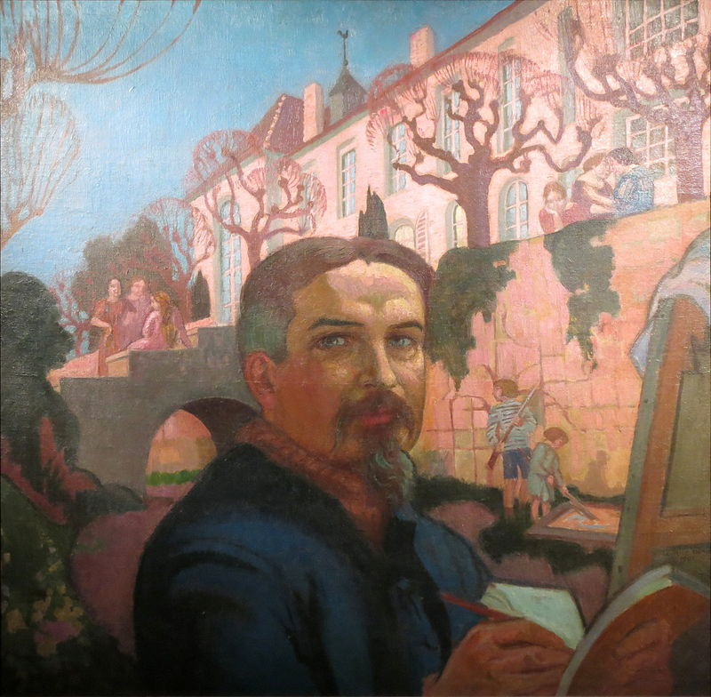
"I believe that before everything a painting must decorate“ Maurice Denis
1891.

Slide 19
PERSONAL EXPERIENCE
Art nouveau is one of my favorite styles in architecture history. It’s a movement that broke the classical and random forms of art and architecture. My interest to this style is the influence of nature that stylized forms and elaborated architecture in a much different perspective. It is also known as pre-modern style. The growth of this movement was helped by the invention of wrought iron, and the use of it brought sculptural elements to Art Nouveau structures. For one of my projects I had studied the organic forms of architecture history, and Art Nouveau was the style I fell in love with. Many structures include shapes and forms that are drawn from nature, like birds, plants. It was a start in transferring linear architectural forms into curvature. The buildings did not necessarily have to be balanced asymmetrically.

Slide 20
CONCLUSION
Art nouveau flourished in the first decades of the twentieth century but was killed off by the First World War.
The remain art pieces, sculptures, structures, furniture are left thanks to the rapid spread of style through the world.

Slide 21
THANK YOU

