Slide 1
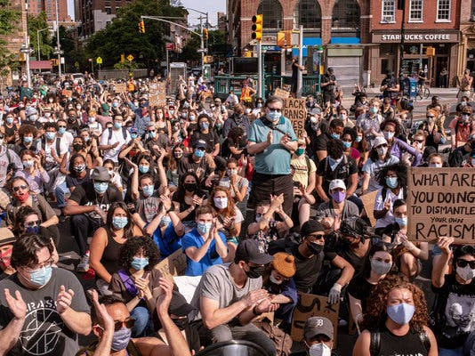
Issue of Inequality in America
BY:Justin Henry

Slide 2
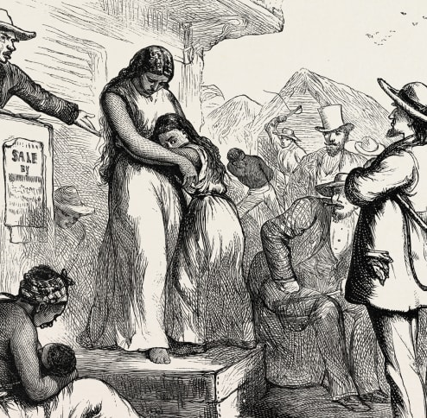
Where it all started?
Slavery in America was one the first inequality white man would sale black African Americans.
They would do so much more to these African which I don’t even want to talk about.

Slide 3
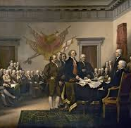
Declaration Independence
However, there have been questions of what impact did the declaration has or is supposed to have on Americans and America as a nation.
” Nevertheless, are these rights subjected to all people in America? Are all Americans subjected to equality, or are there people who are esteemed while others are subjected to brutality and hardship?

Slide 4
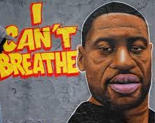
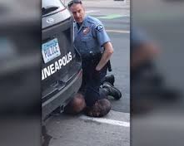
George flyod

Slide 5
George flyod
The article has highlighted the recent instance of George Floyd, who died in the hands of police. Despite this black American being unarmed and ready to comply with each order, he was given, he was choked to death.
. The question raised by the article is, did Floyd face his death because he was black? Could it be a similar case if the person under custody was white?

Slide 6
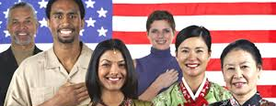
Immigrants in America

Slide 7
Immigrants In america
However, there have been various narratives that the immigrants are there to exhaust the resources meant for Americans.
For this reason, the debate concerning the welfare of immigrants is shuttered and has been causing disparities among various agencies and leaders. Therefore, the most appropriate way of addressing this issue is by establishing a fair, humane, and workable system.
Immigration is among the topics that require to be debated as far as equality is being pursued.

