Slide 1
How are women affected in Immigration Detention Centers?
By: Yaire Castillo

Slide 2
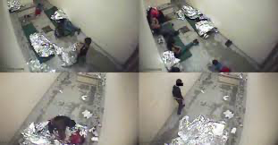
POOR CONDITIONS
Unfortunately, women who have been detained spend one to three nights or even longer in CBP holding cells where they sleep on the floor with only a Mylar blanket. Immigration detention centers rarely care to provide immigrants with sleeping mats to have them avoid sleeping on the cold and hard floor. Not only are they being forced to sleep on the floor when they don’t have sleeping mats but they are also forced to stay at cells that are overcrowded, making them vulnerable to spread germs and develop illnesses.

Slide 3
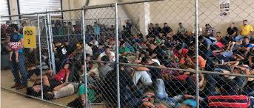
CONTINUED...
Not only are they being forced to sleep on the floor when they don’t have sleeping mats but they are also forced to stay at cells that are overcrowded, making them vulnerable to spread germs and develop illnesses.

Slide 4
LACK OF HYGIENE
Women who have been detained have admitted that they would not be allowed to shower, brush their teeths, wash their hands before or after eating or even after using the bathroom. They would barely have access to their menstrual hygiene products leading them to dirty their clothes

Slide 5
CONTINUED...
and to stay with it on because they wouldn’t have extra clothes to change to. Some women would have strong and painful cramps yet no way to control it because they couldn’t get medicine for it.

Slide 6
NEGLECTED OF MEDICAL CARE
Women who are pregnant and those who are not have complained of feeling sick and not well. They have asked for help to be seen by doctors and they are often taken away from that right.

Slide 7
CONTINUED...
They are neglected from basic medical care often leading them to lose their babies, having complications, and getting infections causing them to be more sick. It isn’t unlikely for them to have the adequate medication that is needed for their current status.

Slide 8
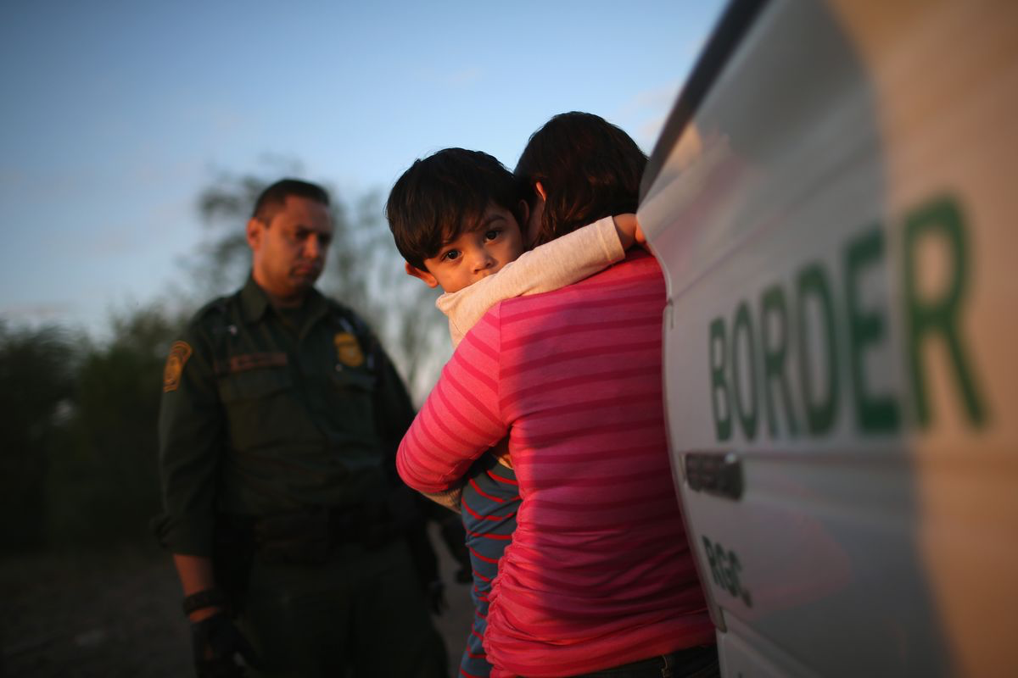
SEPARATED FROM THEIR
FAMILIES
Women who are detained are separated from their children for a crucial amount of time. The availability and experience of seeing their kids grow up is taken away. All they really get are phone calls, clearly not the same as being together in person.

Slide 9
CONTINUED...
Not being able to hold their children or families torments them making them lose hope that one day they will be reunited. Some women are in danger of going back to their native country because they are all alone making it extremely easy to be victims of rape, kidnapping, sex trafficking and death.

Slide 10
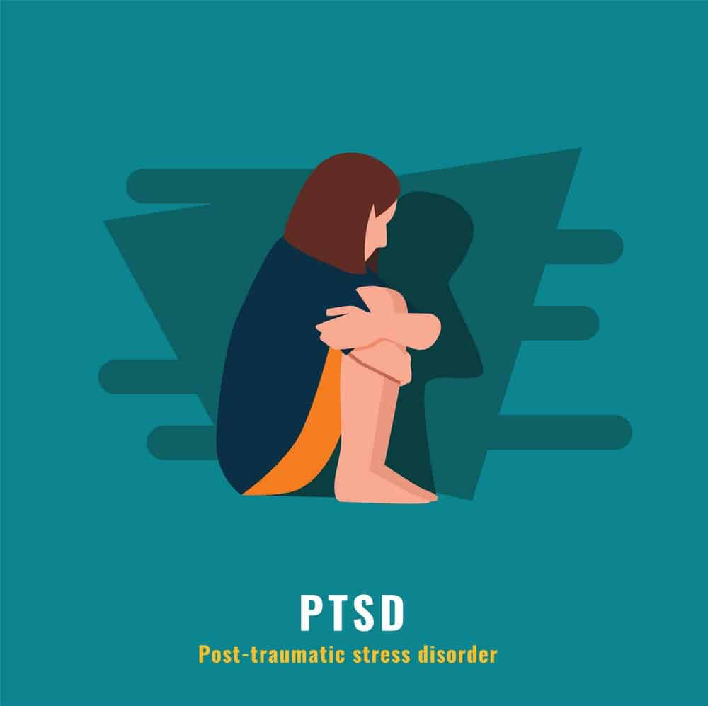
DEVELOP MENTAL ILLNESSES
Immigration detention centers are one of many places that women develop mental illnesses. Mental illnesses such as PTSD, anxiety, depression. When women get depressed it often leads to suicide because they have experienced a miscarriage due to negligence of medical care, they get PTSD because they are separated from their families.

Slide 11
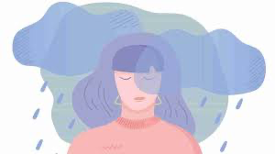
CONTINUED...
And anxiety because all they can think of is being free and seeing their families again. All these illnesses go untreated which makes it harder for them to be okay on a day to day basis. There has been many cases where women don’t ever go back to the same person they were before being detained.

Slide 12
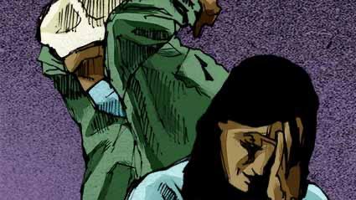
ABUSED BY DOCTORS
Women have admitted to getting mass hysterectomies without their consent and unnecessary medical procedures. Not only were they a victim of medical malpractice but they were violated of their own right and privacy.

Slide 13
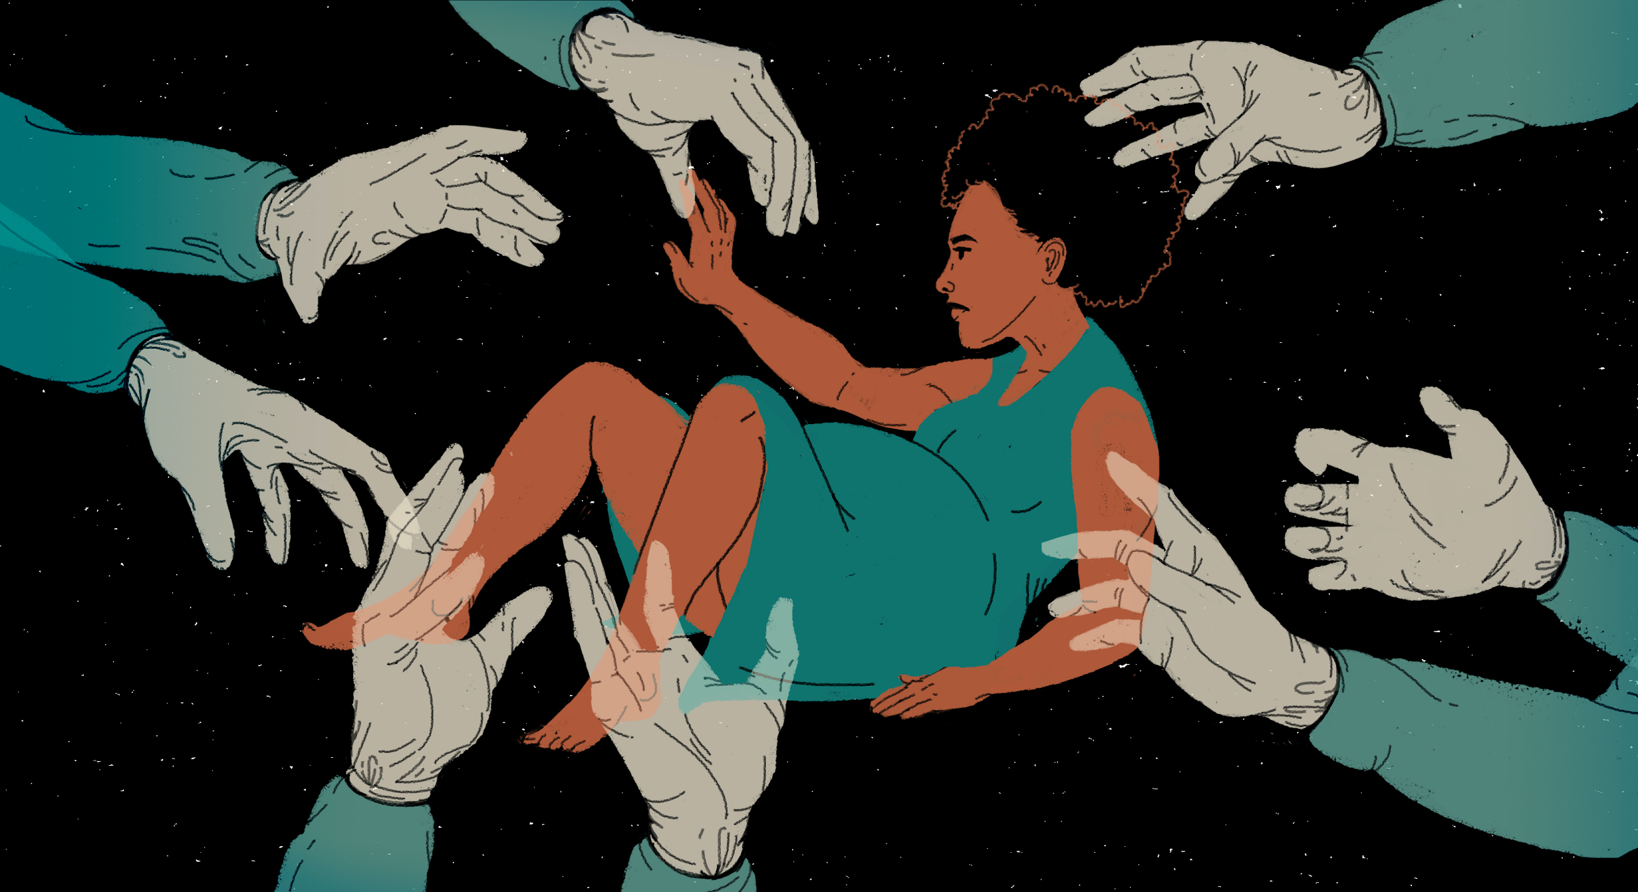
CONTINUED...
Some doctors threaten women to lie and say that they are feeling better and if they don’t do as told then they won’t ever be reunited with their children. It doesn’t matter if they are in pain or in need of medicine, they are told they have to lie because it is beneficial for them in the long run.

Slide 14
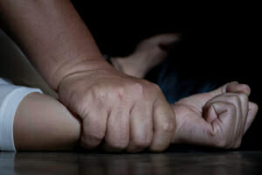
SEXUALLY ABUSED BY ICE AGENTS
When women are in immigration detention centers they are extremely vulnerable because they are getting deported. Women are raped by ICE agents in places that there are no cameras. Women are told that if they try to complain they will never see their families

Slide 15
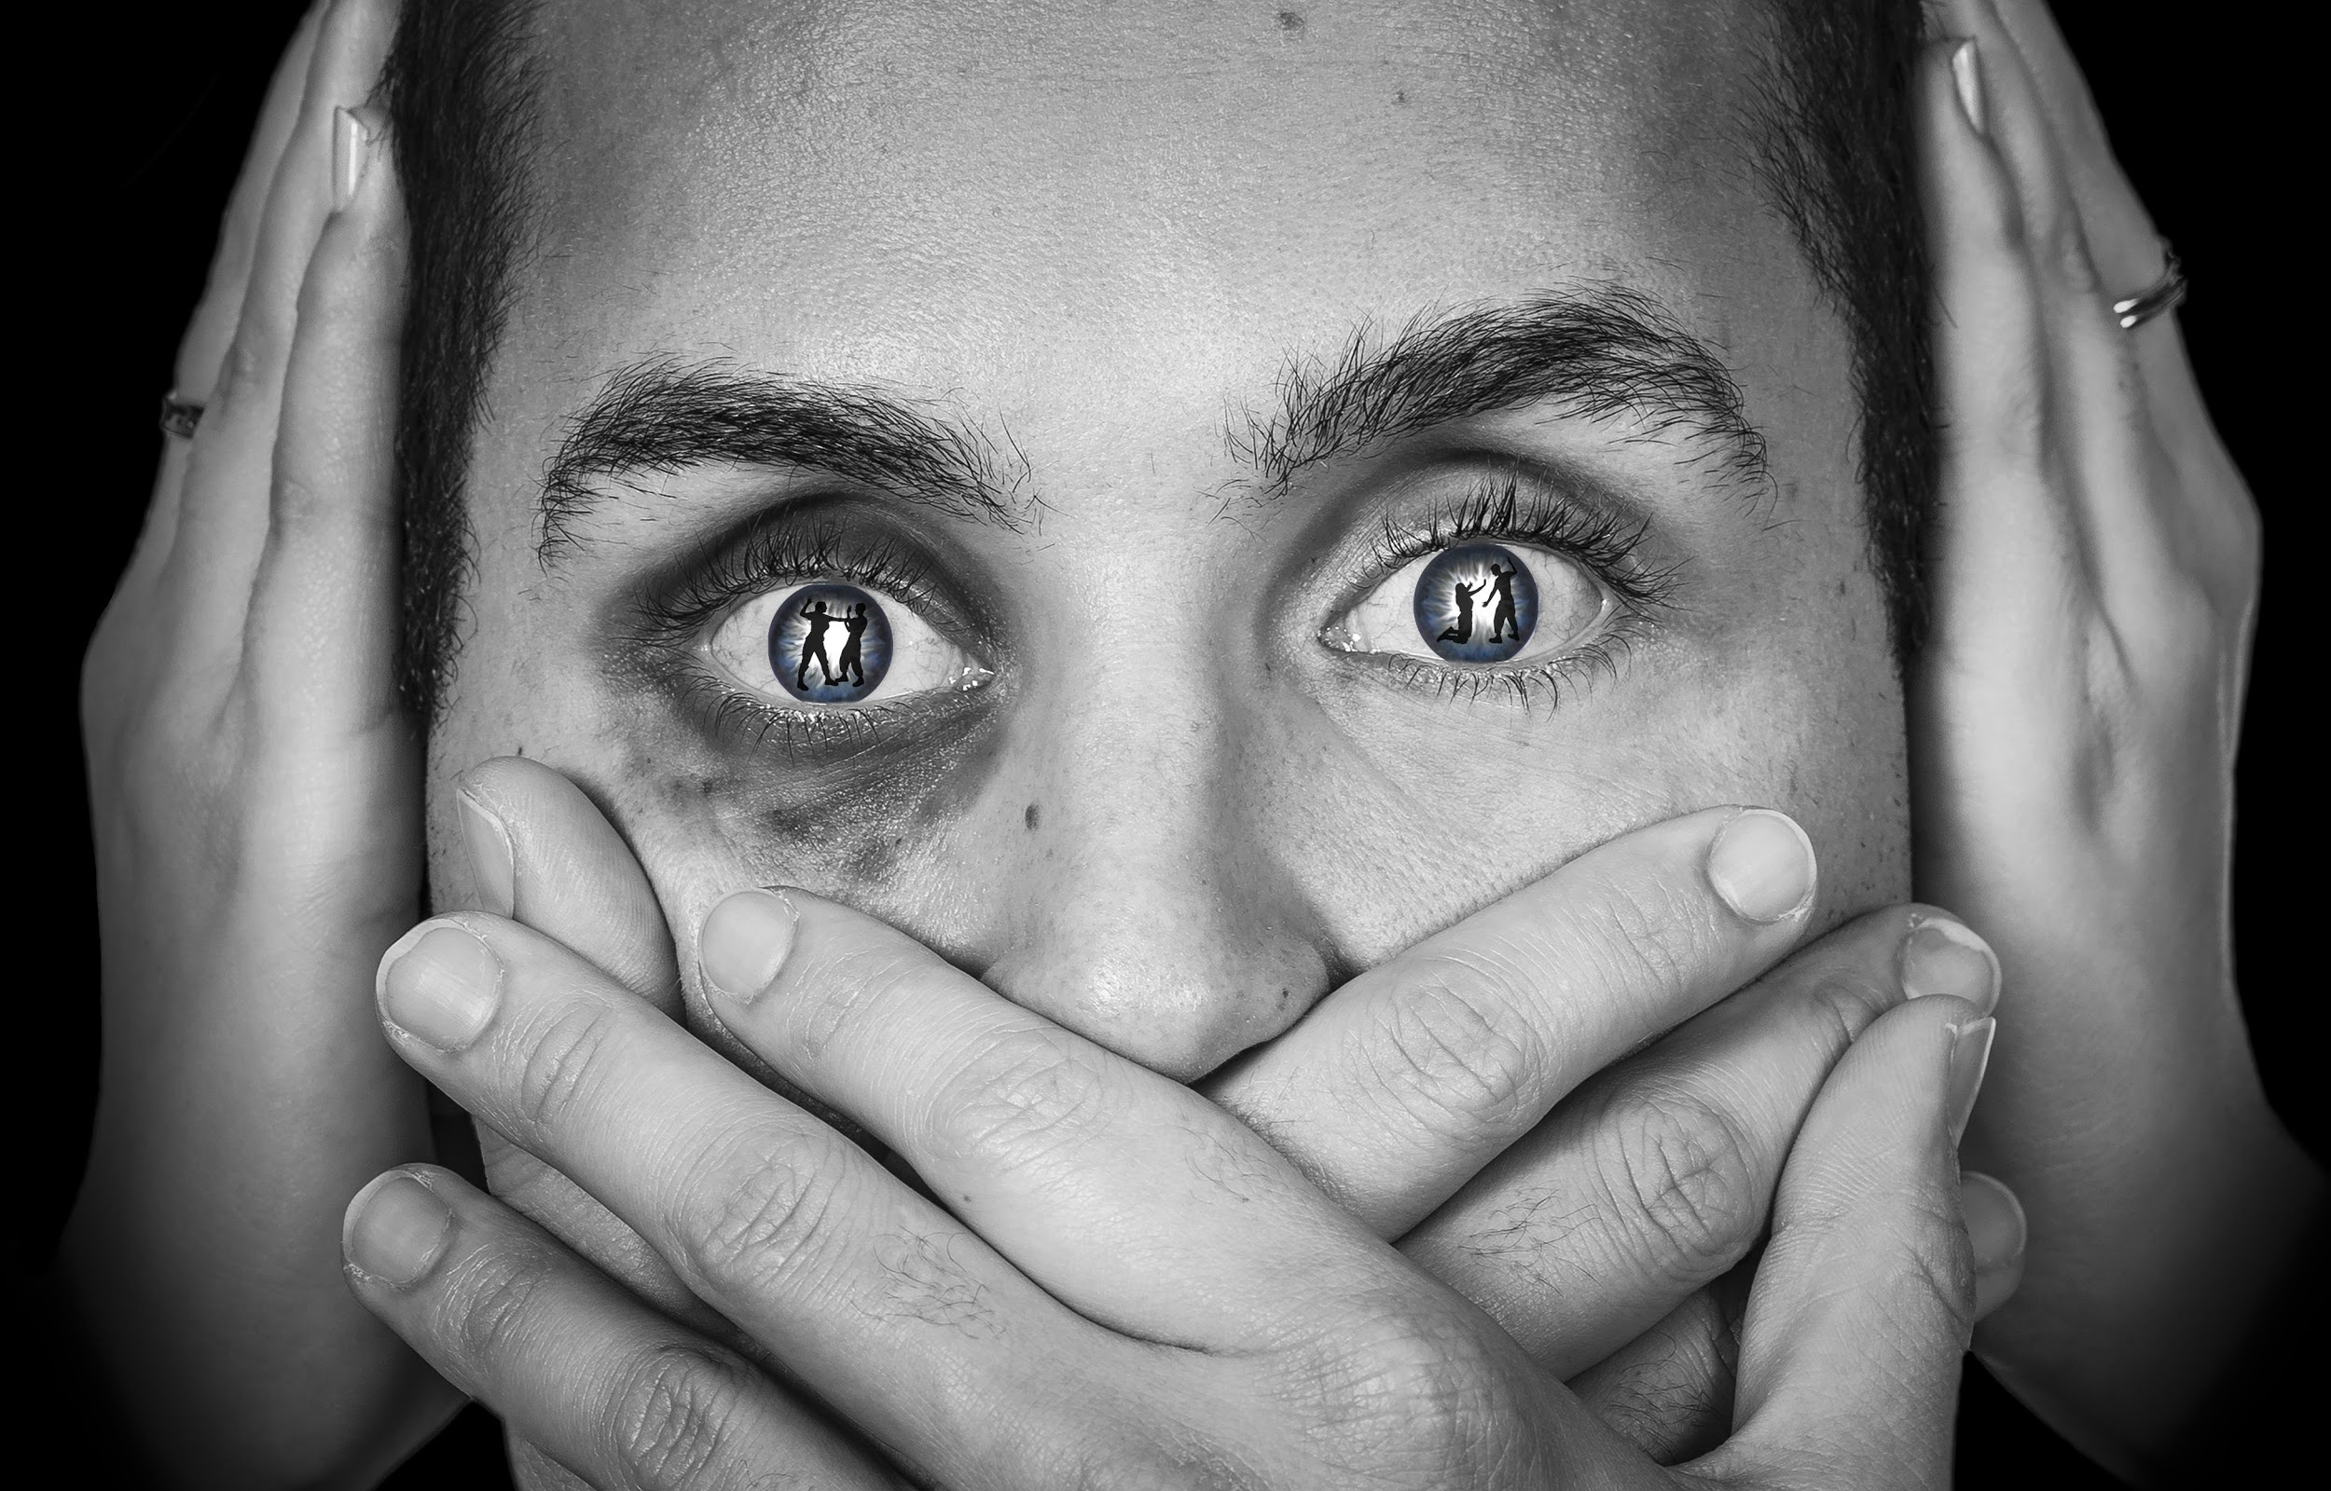
CONTINUED...
won’t be trusted and believed that they are saying the truth. Furthermore, ice agents tell women that if they “behave” they won’t be deported. Out of vulnerability women believe them and let things happen without them actually realizing that they are being lied to.

Slide 16
VIOLATION OF HUMAN RIGHTS
Women are humiliated in immigration detention centers. They are told to drink out of toilet bowls if they are thirsty. They neglect them of basic medical care, self hygiene and access to their loved ones. Uneducated women don’t realize that they have rights they can speak up about which makes them really vulnerable to getting their rights taken away.

Slide 17
CONTINUED...
Women are being abused and mistreated all the time. Even if they were to speak up they would just get ignored and told to shut up, that they have no rights because they aren’t an American citizen and entered the country illegaly.

Slide 18
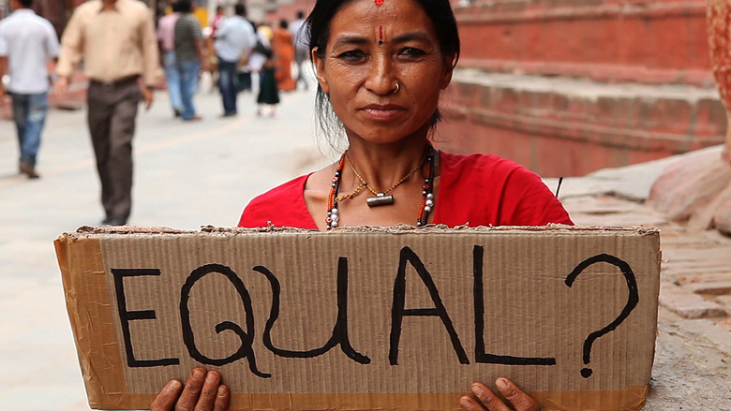
DISCRIMINATION
Due to the color of their skin and their native country women are being discriminated against. They are told that they deserve being mistreated and deported. They are minimized and told that the best they can do is go back to their country because they are not American citizens.

Slide 19
CONTINUED...
They develop the feeling of being unwanted and feel humiliated and sad. Throughout their days they go hours with being ignored.

Slide 20
Citations
Wilson, Iaura. “Violence Against Women and Girls in ICE Custody.” Global rights for women, 21 September 2020, https://globalrightsforwomen.org/featured/violence-against-women-and-girls-ice-custody/.
P, A. Migrant women deported from US after accusing gynaecologist of abuse, 11 November 2020, https://www.trtworld.com/americas/migrant-women-deported-from-us-after-accusing-gynaecologist-of-abuse-41347.
Jimenez, Rafael. “Abusive Conditions for Women and Children in US Immigration Holding Cells.” https://www.hrw.org/report/2018/02/28/freezer/abusive-conditions-women-and-children-us-immigration-holding-cells#.
O’Connor, Kathleen, et al. “No Safe Haven Here: Mental Health Assessment of Women and Children Held in U.S. Immigration Detention.” UUSC, 2015, www.uusc.org/sites/default/files/mental_health_assessment_of_women_and_children_u.s._immigration_detention.pdf.

