Slide 1
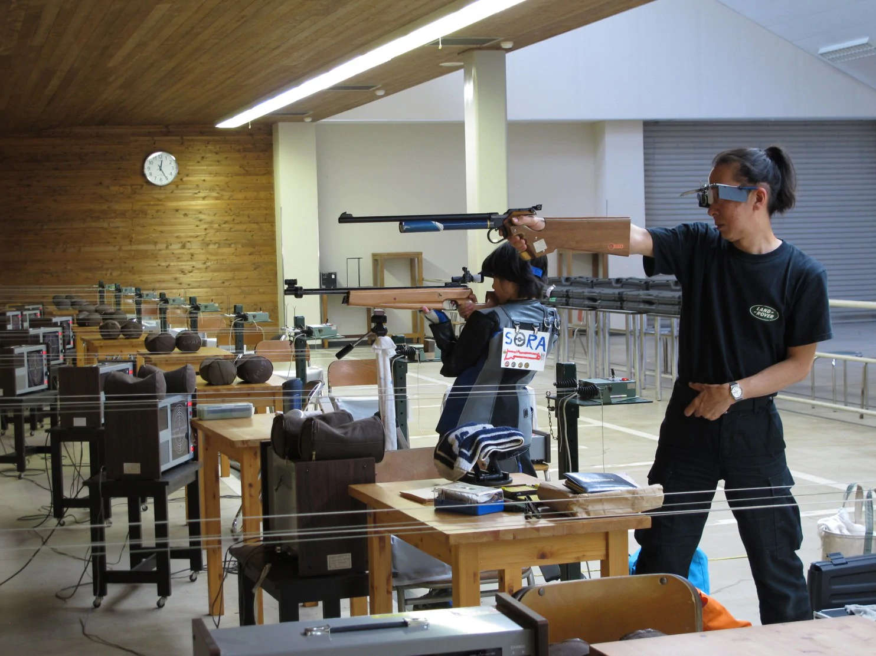
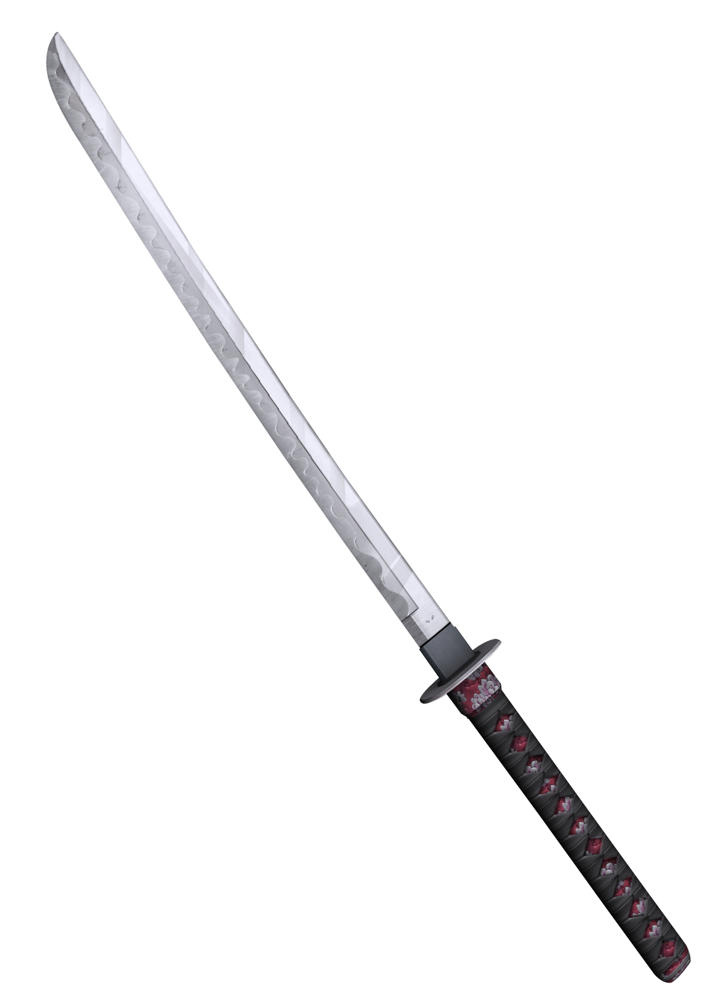
Japan’s Example ⁶
Alternative Solution
"No one shall possess a firearm or firearms or a sword or swords"
Gun buyers need patient and determination!!
Have to attend an all day class
Take written exam
Pass shooting range test (95% score)
Mental health and drug test
Criminal records are checked
Checks your relatives and work colleagues!
6. Low, Harry. “How Japan Has Almost Eradicated Gun Crime.” BBC News, BBC, 6 Jan. 2017, www.bbc.com/news/magazine-38365729.

Slide 2
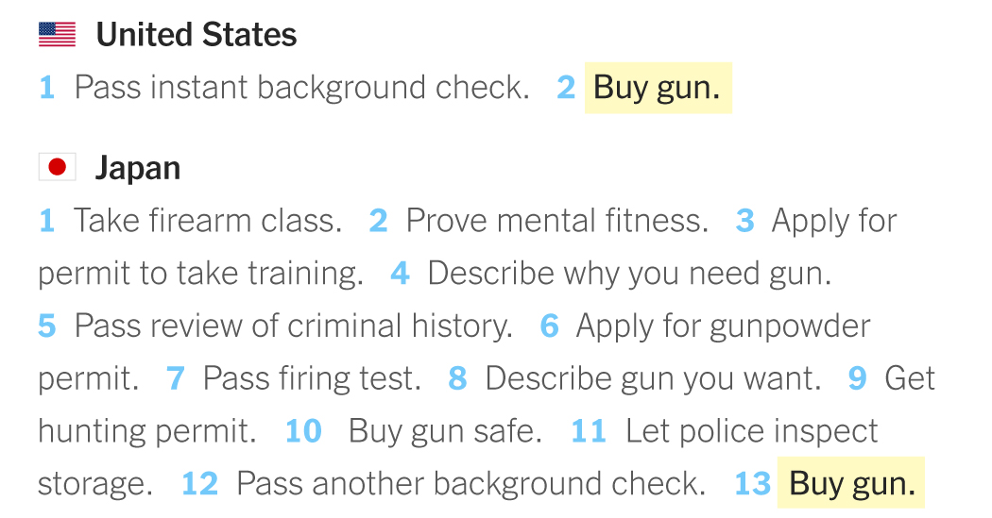
Alternative Solution

Slide 3
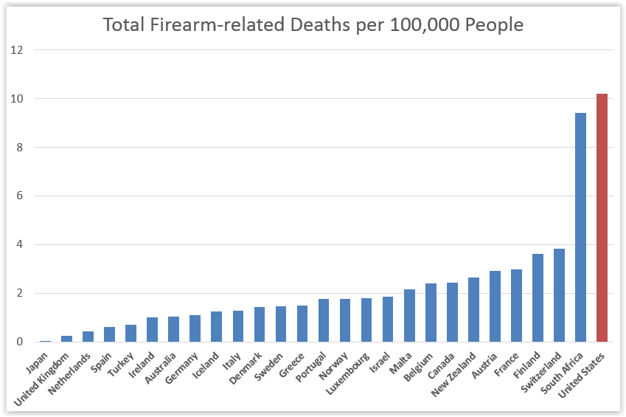

Slide 4
Conclusion

Slide 5
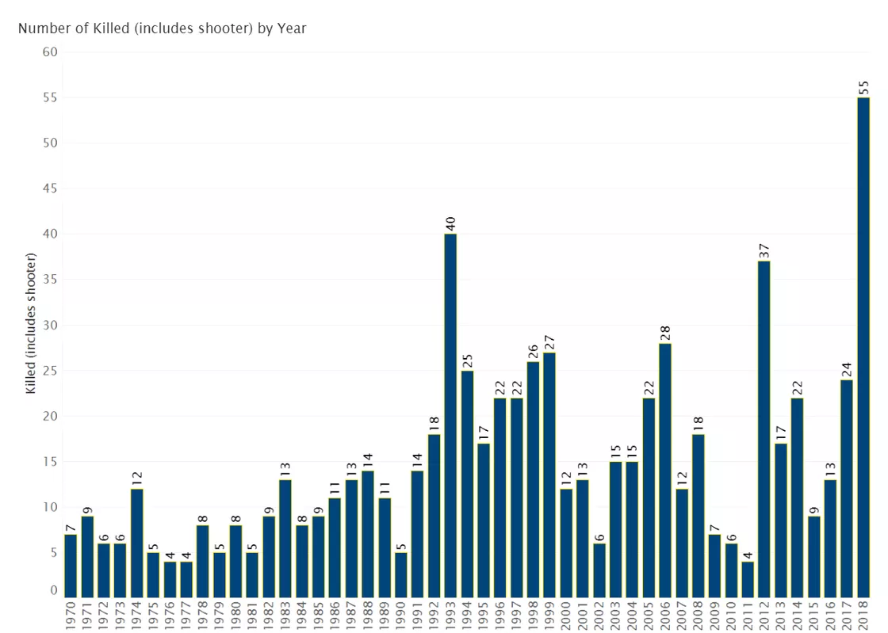
Recap
The problem
How bad is the gun violence crisis in America?
has taken many human lives
Increasing day by day
Why the problem has worsened?
Weak gun control laws
Gun ownership
Cheap Guns
Current Solution
Background Check
Arm the teachers
Alternative solution
Ban Ban high capacity magazines and bump stock
Reduce easy access to dangerous weapons
Complicated Background Checks

Slide 6
Call to Action
Ban Guns
Change the way we view 2nd Amendment
Raise Awareness about gun violence
Pressure lawmakers to improve gun laws
Educating the public about common-sense gun laws and responsible gun ownership

Slide 7
Bibliography
“America's Gun Culture in 10 Charts.” BBC News, BBC, 27 Oct. 2018, www.bbc.com/news/world-us-canada-41488081.
“Gun Violence Must Stop. Here's What We Can Do to Prevent More Deaths.” Prevention Institute, www.preventioninstitute.org/focus-areas/preventing-violence-and-reducing-injury/preventing-violence-advocacy#Full Recommendations.
Holpuch, Amanda. “Trump Insists on Arming Teachers despite Lack of Evidence It Would Stop Shootings.” The Guardian, Guardian News and Media, 22 Feb. 2018, www.theguardian.com/us-news/2018/feb/22/donald-trump-insists-arming-teachers-guns-shootings.
“I'm Supporting Everytown for Gun Safety.” ActBlue, secure.actblue.com/donate/everytown-eoy-p/?source=ggnp_DON18_EOY-ET&utm_source=gg_n_&utm_medium=_p&utm_campaign=DON18&gclid=Cj0KCQiAr93gBRDSARIsADvHiOr4qTVU_UElVliEcQkGseauhb2Y9KCn08oiWsRA489xgW031nJ3_iYaAtigEALw_wcB.
Lopez. “2018 Was by Far the Worst Year on Record for Gun Violence in Schools.” Vox.com, Vox Media, 10 Dec. 2018, www.vox.com/2018/12/10/18134232/gun-violence-schools-mass-shootings.
guns, Hundreds of stores sell. “This Is How Easy It Is to Buy Guns in America.” CNNMoney, Cable News Network, money.cnn.com/2015/06/19/news/guns-background-checks/index.html.
Low, Harry. “How Japan Has Almost Eradicated Gun Crime.” BBC News, BBC, 6 Jan. 2017, www.bbc.com/news/magazine-38365729.

