Slide 1
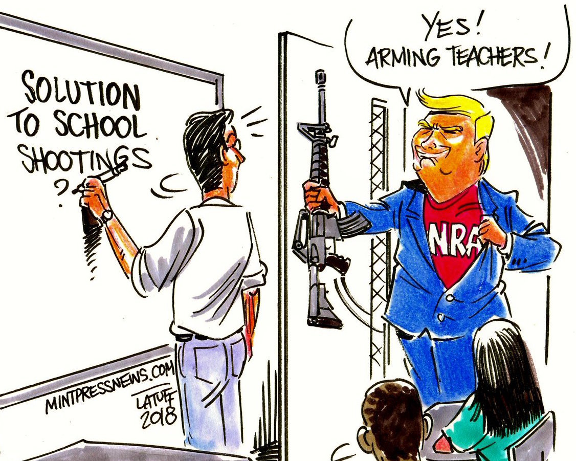
Trump’s Solution ( School Shootings Prevention) ⁴
Current Solution
Marjory Stoneman Douglas high school (School Shooting)
Feb 14, 2018
Arm the teachers
“If you had a teacher who was adept at firearms, they could very well end the attack very quickly” - Trump
4. Holpuch, Amanda. “Trump Insists on Arming Teachers despite Lack of Evidence It Would Stop Shootings.” The Guardian, Guardian News and Media, 22 Feb. 2018, www.theguardian.com/us-news/2018/feb/22/donald-trump-insists-arming-teachers-guns-shootings.

Slide 3
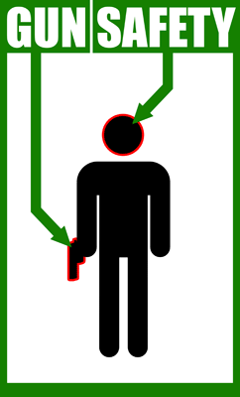
Alternative Solution
Gun Safety Programs
Japan’s example

Slide 4
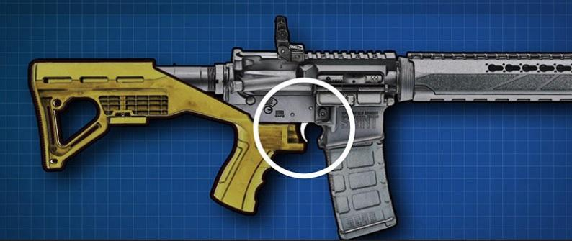
Gun Safety Programs ⁵
Alternative Solution
Reduce easy access to dangerous weapons!
Ban high capacity magazines and bump stock
Require efficient background checks without loopholes
Ban Assault weapon
5. “Gun Violence Must Stop. Here's What We Can Do to Prevent More Deaths.” Prevention Institute, www.preventioninstitute.org/focus-areas/preventing-violence-and-reducing-injury/preventing-violence-advocacy#Full Recommendations.

