Slide 1
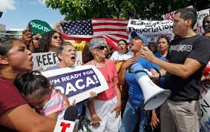
U.S Immigration and Customs Enforcement: History & Controversy
By: Xavier Manzanares

Slide 2
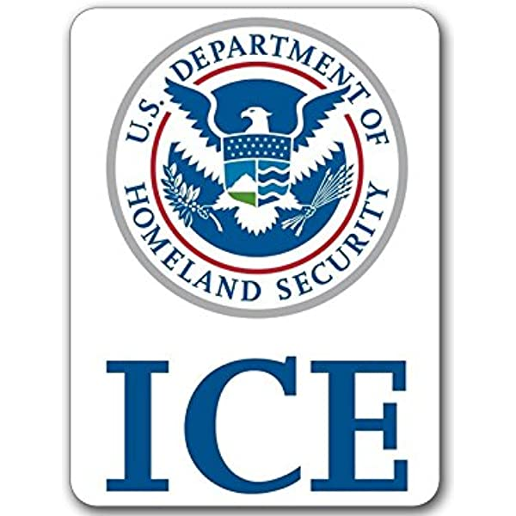
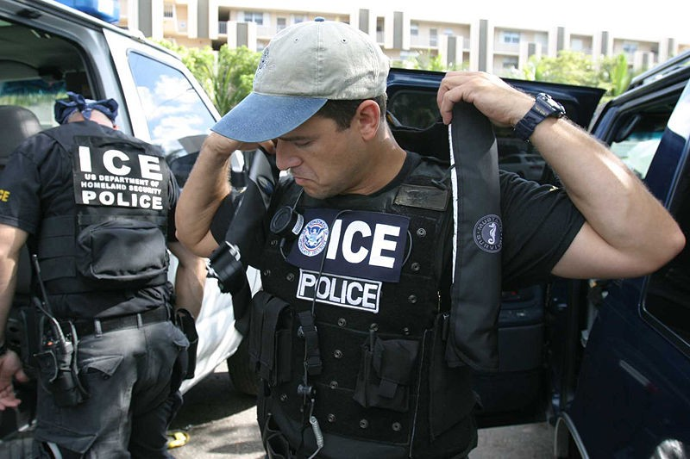
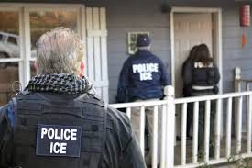
History: What is Ice ?
U.S immigration and Customs Enforcement also known as ICE Was founded in 2003 by President George W Bush . ICE focuses on the enforcement of the interior of the U.S. It is the duty of ICE to recognize and carry out the detention, enforcement, and placement of undocumented children and adults. The agency works closely with Customs and Border Protection.

Slide 3
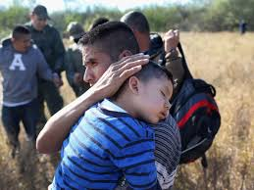
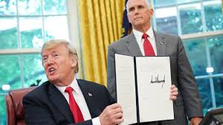
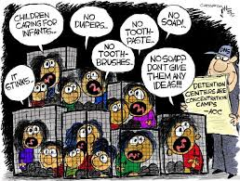
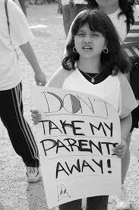
Controversy: Impact on immigrants
In 2018 about 2,700 migrant children were separated from their families. Before they made the “zero tolerance” policy public which is the policy which allows the government to separate children from their parents Now there are many children without parents that are lost to the government because they were most likely deported back to their home countries without any type of records and they cannot find them to reunite the families.
Trump signing the “ zero tolerance act”

Slide 4
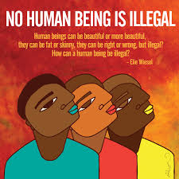
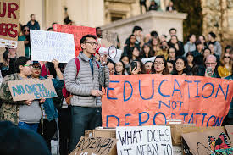
Immigration, These people have no choice but to come here this way
These are innocent people, families, mothers, fathers, daughters and sons doing nothing but escaping their troubled lives in hopes for something better, the promise land these are not criminals, convicts or psychopaths to be treated and stripped of basic human rights !!
Im a first generation student, I relate to this matter because my mother was also an immigrant but after years here she is now a resident and is working her way to becoming a citizen. But she lives in fear of one day being targeted.

Slide 5
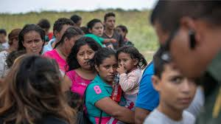
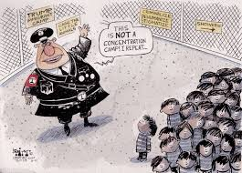
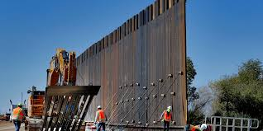
Border

Slide 6
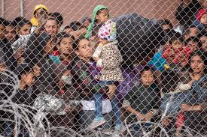
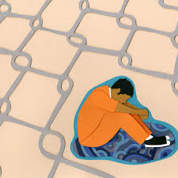
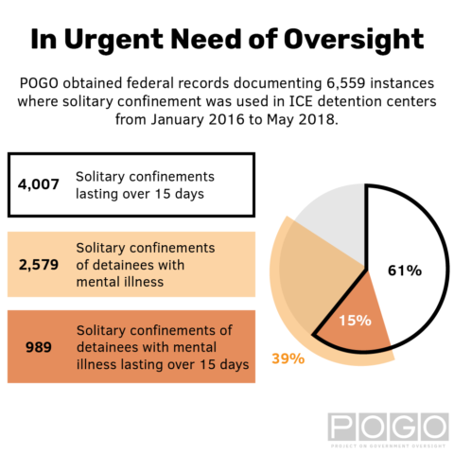
Detention Centers
massive overcrowding of poorly run detention facilities
lack resources
fail to uphold basic standards of medical and mental health care
ICE has an history of treating immigrants as criminals and so they subject them to humiliation and brutality
The majority of detainees never receive legal representation, which makes it more difficult not only to succeed in adversarial immigration proceedings, but also to complain about substandard treatment.

Slide 7
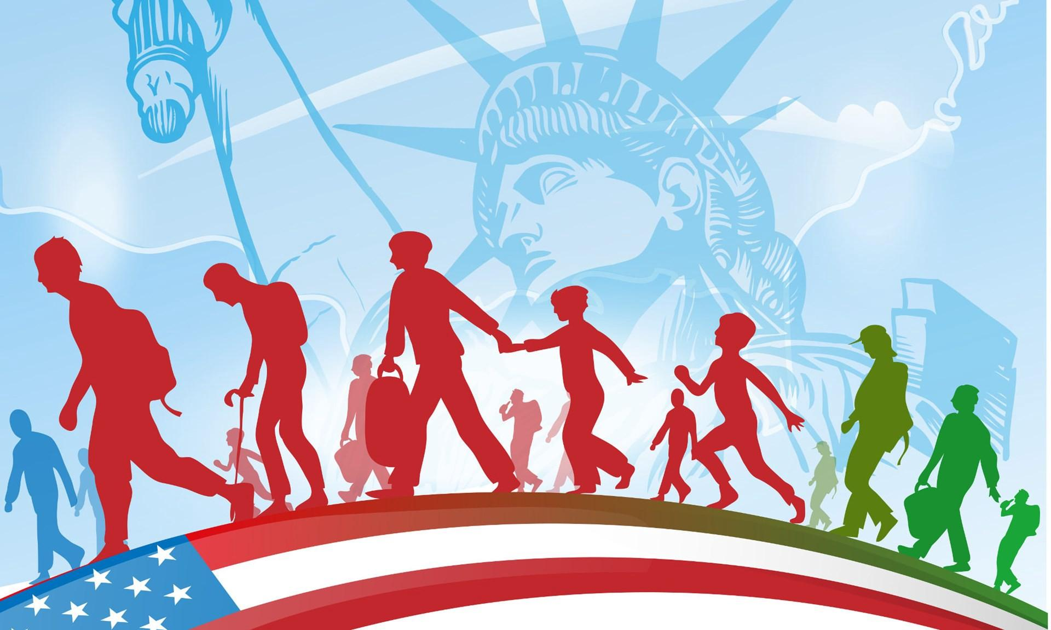
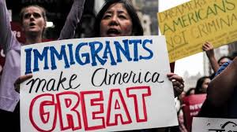
New policies created that unethically and severely punish illegal immigrants.
It’s shown that Migrants who had been coming from Mexico for generations to work were now being treated as suspected criminals.
ICE is deciding to abuse it by targeting long term permanent residents who have committed minimal crimes and because of that we see this huge spike in the deportations.

Slide 8
REFORM is Needed
Create Stronger U.S Latin American Relations and end Shameful Treatment of Latin Workers in U.S and abroad to gain reputation and respect back.
Give everyone a chance
Save on Detention and deportation fees and legalized detainees, they will eventually start paying axes improving the american economy.
The most recent major immigration reform enacted in the United States, the Immigration Reform and Control Act of 1986, made it illegal to hire or recruit illegal immigrants.
Recession + Immigration = Economy Improvements

Slide 9
Q: What are the challenges immigrant families in the usa face in accessing services ?
A: Challenges that immigrants families face in the usa in accessing services are having low rates of health insurance and receive lower quality care than U.S born citizens.
Q: What are factors that make immigrants come to america ?
A: The factors are a pursue of a better Life, Fleeing corrupt worn torn countries.
Many Immigrants seek citizenship even though the process is lengthy, costly and extremely difficult
Q: What should ICE do to fix its policies ?
A: ICE should be more considerate to families and keep them together
Throughout their process through immagration customs.

Slide 10
