Slide 1
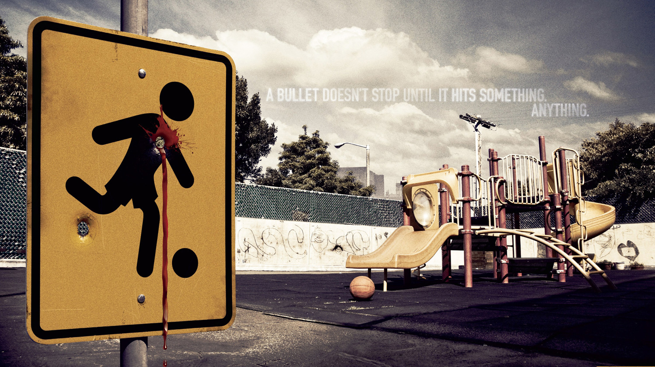

Slide 2
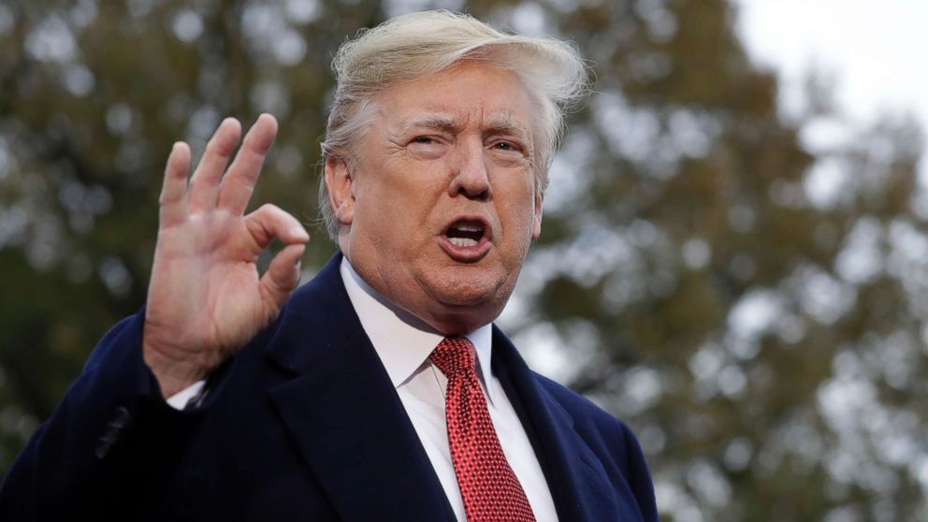
Current Solution
Background Check (America’s solution )
Trump’s solution (Prevent School Shootings)

Slide 3
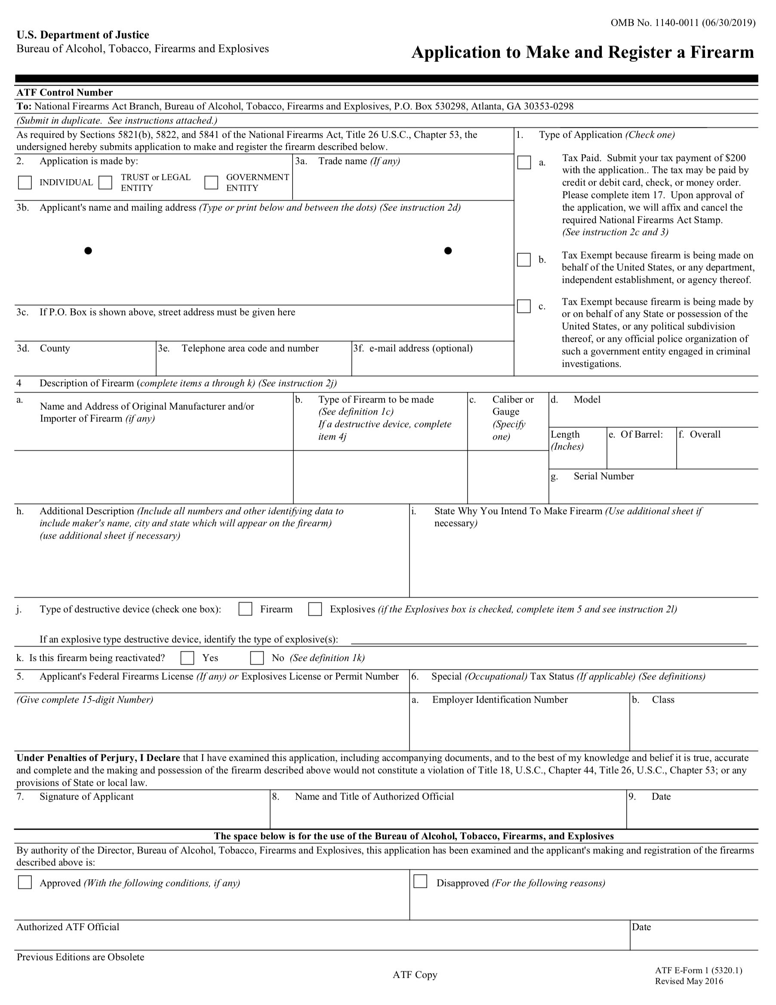
Background Check ³
Current Solution
Gun Buyers fill out ATF (The Federal bureau of alcohol, tobacco, Firearms and Explosives)
Required information includes:
name,
Address,
place of birth,
race and citizenship.
A social security number (optional)
3. guns, Hundreds of stores sell. “This Is How Easy It Is to Buy Guns in America.” CNNMoney, Cable News Network, money.cnn.com/2015/06/19/news/guns-background-checks/index.html.

Slide 4
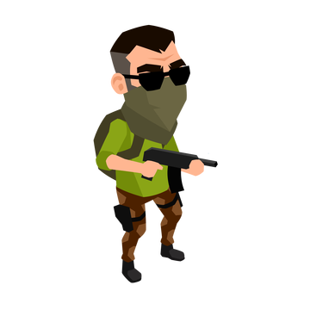
Background Check ³
Current Solution
Questions asked:
Have you ever been convicted of a felony?
Are you an unlawful user of, or addicted to, marijuana or any other depressant, stimulant, narcotic drug, or any other controlled substance?
Are you a fugitive from justice?
Have you ever been committed to a mental institution?
3. guns, Hundreds of stores sell. “This Is How Easy It Is to Buy Guns in America.” CNNMoney, Cable News Network, money.cnn.com/2015/06/19/news/guns-background-checks/index.html.
Notes:
ANimate and work cite

