Slide 1
Background ¹
The Problem
What is Gun Violence?
Violence committed through the use of gun.
Homicide, Mass shooting, school shootings…. etc.
2. How bad is the gun violence crisis in America?
One of the deadliest crisis
has taken many human lives
Increasing day by day
America's Gun Culture in 10 Charts.” BBC News, BBC, 27 Oct. 2018, www.bbc.com/news/world-us-canada-41488081.

Slide 2
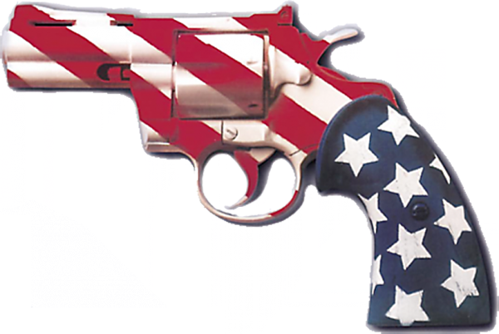
Background
The Problem
3. Where?
Mostly in America
4. When?
1976 to 2018
5. Who is affected?
Anyone
America's Gun Culture in 10 Charts.” BBC News, BBC, 27 Oct. 2018, www.bbc.com/news/world-us-canada-41488081.

Slide 3
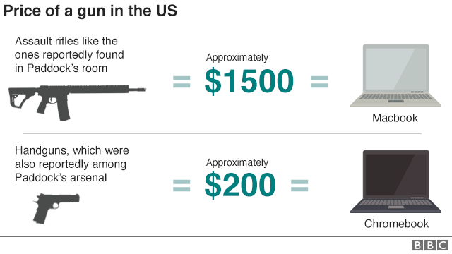
Background
The Problem
6. Why the problem has worsened?
Weak gun control laws
Gun ownership
Cheap Guns
America's Gun Culture in 10 Charts.” BBC News, BBC, 27 Oct. 2018, www.bbc.com/news/world-us-canada-41488081.

Slide 4
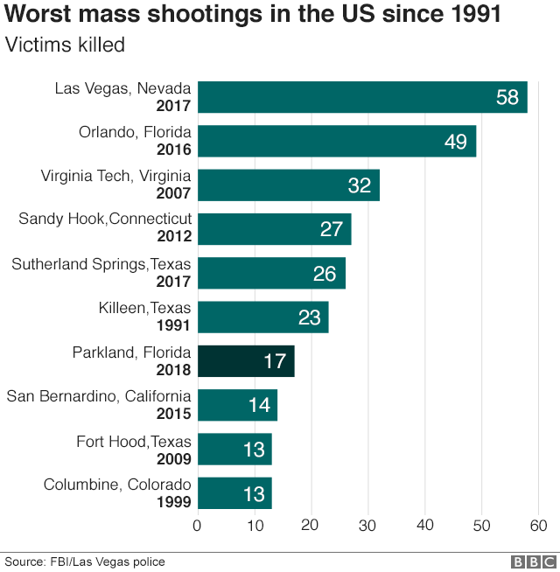
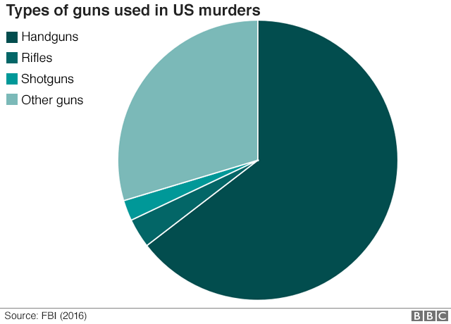
The Problem
Statistics ²
2. Lopez. “2018 Was by Far the Worst Year on Record for Gun Violence in Schools.” Vox.com, Vox Media, 10 Dec. 2018, www.vox.com/2018/12/10/18134232/gun-violence-schools-mass-shootings.

Slide 5
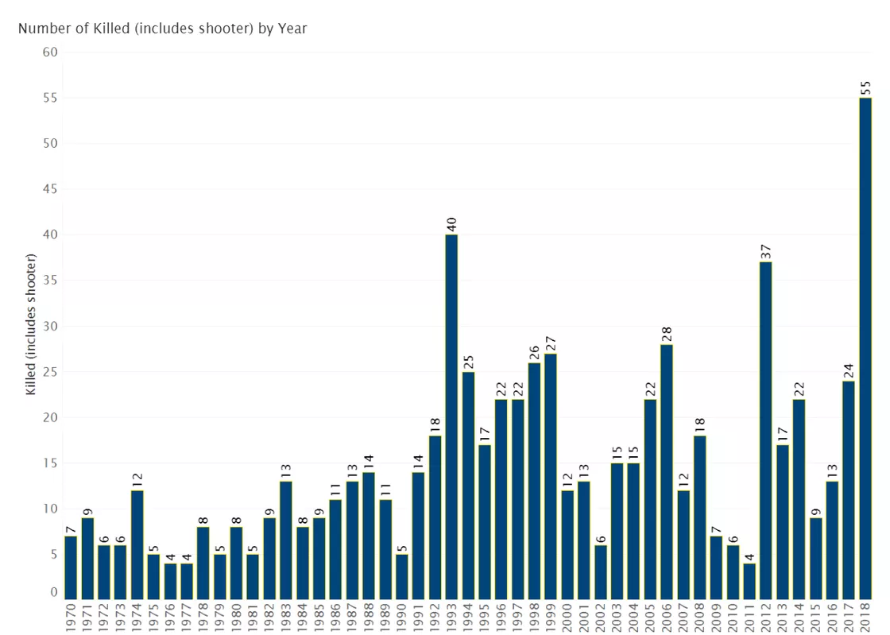
The Problem
Statistics
Number of Victims from School Shootings (1976 - 2018)......
2. Lopez. “2018 Was by Far the Worst Year on Record for Gun Violence in Schools.” Vox.com, Vox Media, 10 Dec. 2018, www.vox.com/2018/12/10/18134232/gun-violence-schools-mass-shootings.

