Slide 1
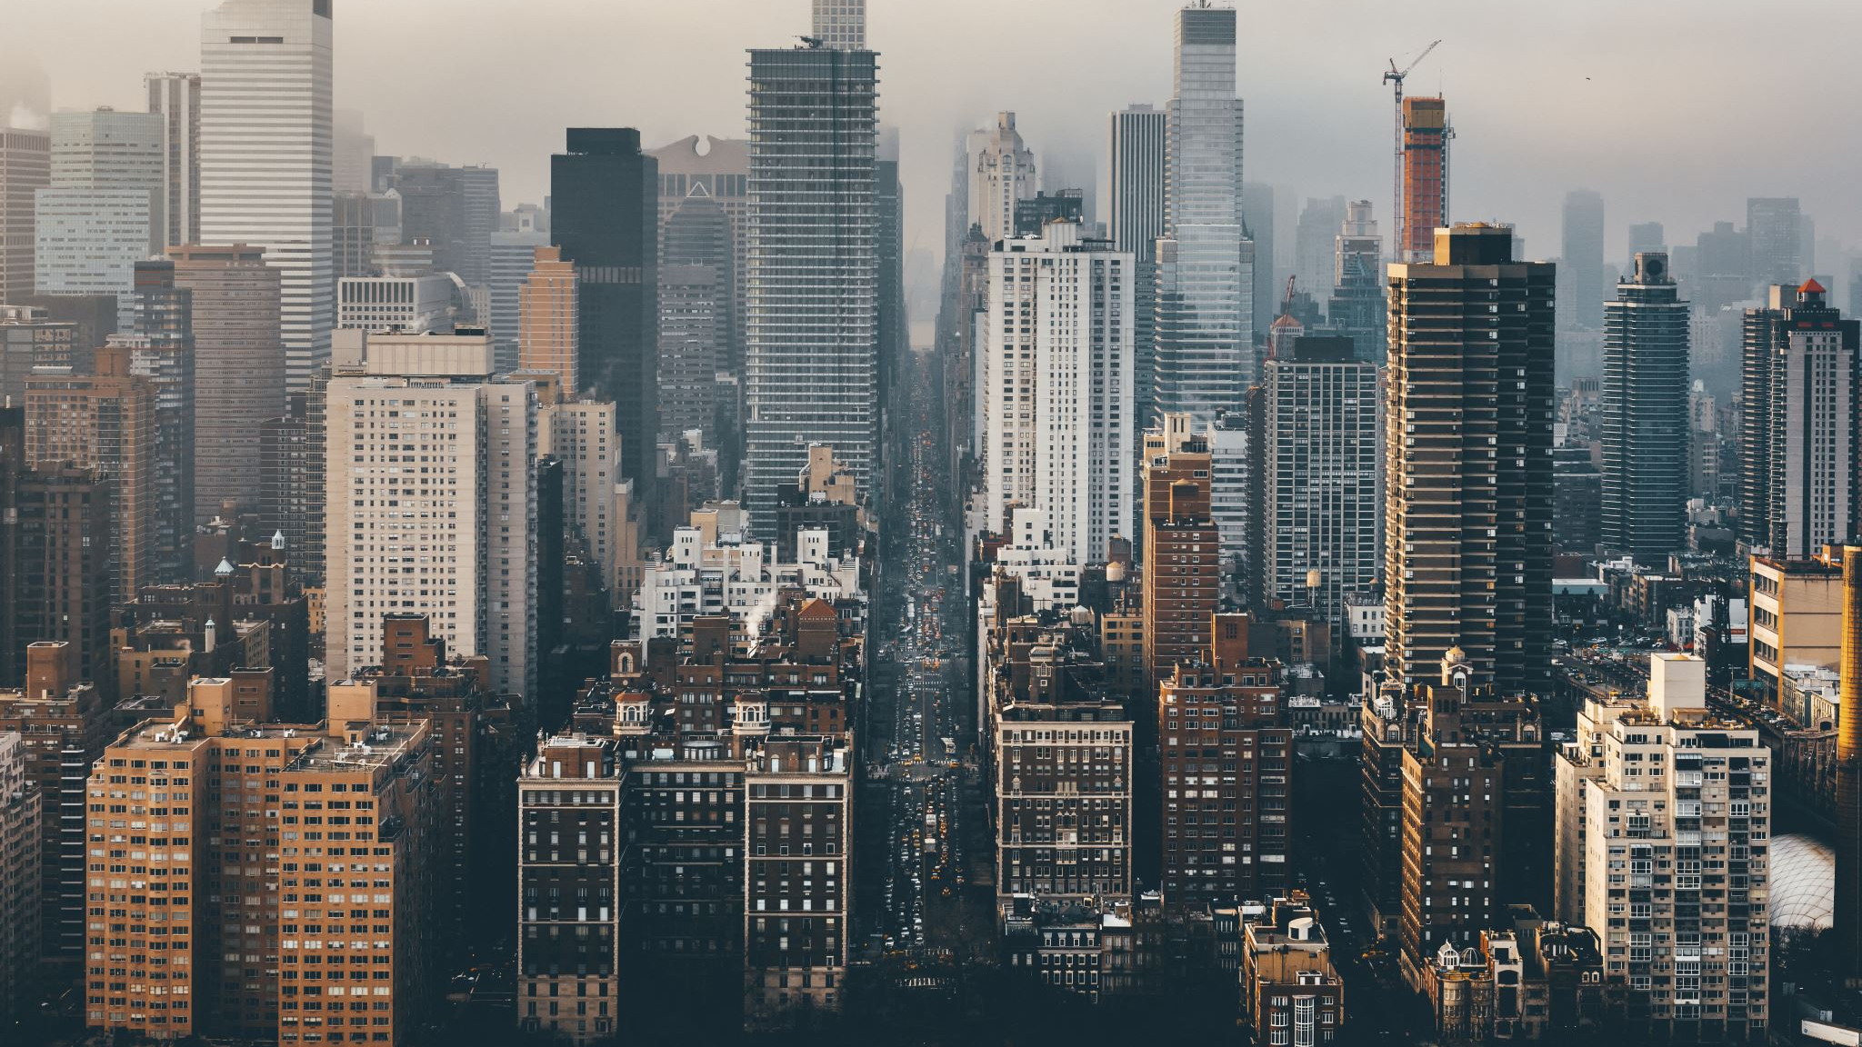
Dear President Joseph Robinette Biden
Sincerely
Muhammad
Musharib

Slide 2
President Elect
Congratulations, on becoming the president not only the president but becoming a leader of the most powerful country in the U.S. I look forward on obeying the rules and regulations that your administration makes.
President Biden, In the content of Asia, there's many conflict going on between two Country.

Slide 3
Islamic Republic of Pakistan
My native country, and the home of beautiful mountains the Nanga Parbat and the Tirich Mir. Pakistan was not always called Pakistan; it was called India before. After the Britain domination. Pakistan on August 14, 1947 gain the independent from India and becoming a separate state of Indian Muslims.

Slide 4
The Republic of India
The most popular country in the modern world today in Asia after China. India shares border with Nepal, China, Pakistan and Bangladesh. The history of Mahatma Gandhi is also linked with India because India got their independent from Great Britain, with the most known leader Gandhi.

Slide 5
History of Kashmir
The beautiful land of Kashmir was once a neutral land, without any association with India and Pakistan. In the year 1947, Pakistan wanted to occupied Kashmir, but the ruler allied with India, since then the dispute of two both nuclear power country is on the rise, and also both country want to expand their land.

Slide 6
Religious Dispute
The maharaja belonged to Sikhism, and majorities of Muslims lived in Kashmir,
Unfortunately, when Pakistan tried to take over Kashmir, the maharaja allied with India because he was not a Muslim, he belong to Sikhism religion.
The only reason why Pakistan wanted to take over Kashmir was because Majorities of Muslims lives in Kashmir

Slide 7
Kashmir Dispute
All of Kashmir is claimed by both India and Pakistan, however the region has been divided with them since 1947. India governs Kashmir's southern portion, which has also incorporated as a state of Jammu and Kashmir. The state of Jammu and Kashmir even contained the northeastern part of the region until India 's failure in the Sino-Indian War of 1962, which India also occupies.

Slide 8
Conclusion
Kashmir is the most beautiful place in the world, yet both countries are fighting for it, President Biden I request you to have a briefing with the Prime minister of India Narendra Modi, and the Prime Minister of Pakistan Imran Khan because Its easy to start a war, but end to stop. Thank you, Mr. President.

Slide 9
Citation
“The Latest Kashmir Conflict Explained.” United States Institute of Peace, 28 Aug. 2019, www.usip.org/publications/2019/08/latest-kashmir-conflict-explained. Volunteers, Video. “Enforced Disappearances in Kashmir: A State’s Denial and a Community’s Agony.” Video Volunteers, 2019, www.videovolunteers.org/enforced-disappearances-inkashmir-a-states-denial-and-a-communitys-agony/?gclid=Cj0KCQjwtsv7BRCmARIsANu- CQcTNMroFHWfZNz2Mhm3mtv43eTFWGNhpoLnu2OViv8UpXElt6lTC0aApXrEALw_wcB. Faleiro, Sonia. “VALLEY OF UNREST: India’s Unending Occupation of Kashmir.” Harper’s Magazine, no. 2042, 2020, p. 53. EBSCOhost, search.ebscohost.com/login.aspx?direct=true&db=edsggo&AN=edsgcl.633685018&site=edslive&scope=si “Sharma Condemns Illegal Occupation of Kashmir by India.” Balochistan Times (Baluchistan Province, Pakistan), no. 212, 2020. EBSCOhost, search.ebscohost.com/login.aspx?direct=true&db=edsgin&AN=edsgcl.631475107&site=edslive&scope=site. “Indias Occupation over Kashmir Main Hurdle in Regional Peace: JI.” Pakistan Observer (Islamabad, Pakistan), no. 231, 2020. EBSCOhost, search.ebscohost.com/login.aspx?direct=true&db=edsggo&AN=edsgcl.633215034&site=edslive&scope=site.

