Slide 1
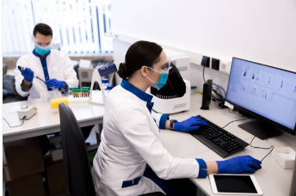
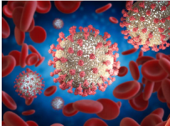
Hypothesis
What influenced the emergence of the Coronavirus and what the world will be like after defeating it.

Slide 2
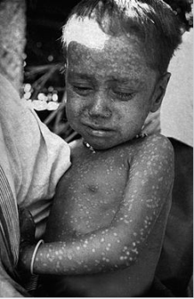
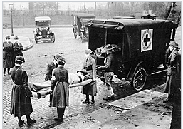
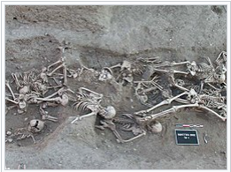
Epidemics of the past
Natural, or, as it was also called earlier, smallpox is a viral infection that only humans suffer. It was widespread throughout the globe, the death rate among the sick reached 40%. "Spanish flu" infected 30% of the world's population, every fifth infected died. The plague came to Earth three times, striking and completely obliterating cities and settlements.

Slide 3
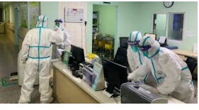
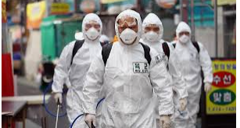
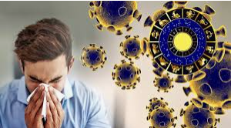
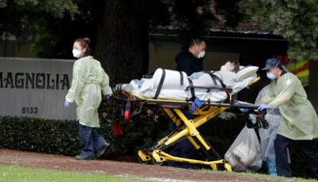
Pandemic 2020
“We have a bleak future,” said Dr. Harvey W. Feinberg. No one knows where this crisis is taking us. The pandemic has become the most serious test for humanity in the past 100 years.

Slide 4
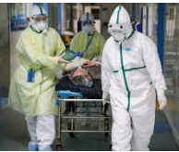
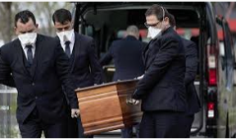
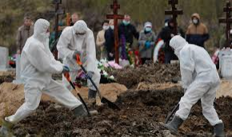
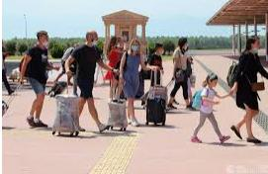
Life today
Today there is a second wave, which brought even more deaths than the first. Even more sick people. Many countries are closed to travelers. Doctors cannot cope with such a number of cases.

Slide 5
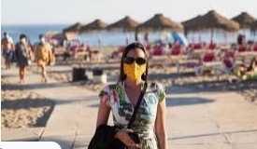
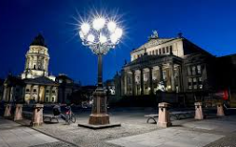
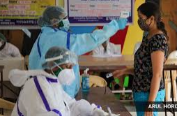
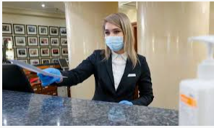
Changes in daily life
We go out for a walk wearing a mask and gloves. In the evenings, the streets of Europe were empty. Many work from home, remotely. Museums and theaters are being closed.

Slide 6
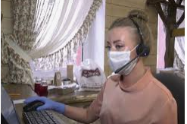
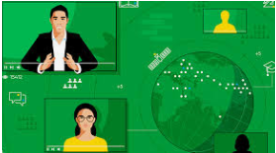
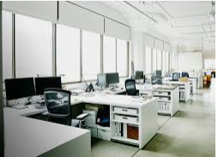
Business 2020
Many companies have transferred their employees to online work. All educational institutions have switched to online education. Many companies broke down and went bankrupt. Some industries laid off more than half of their employees.

Slide 7
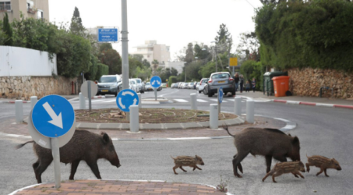
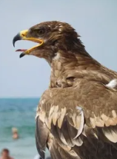
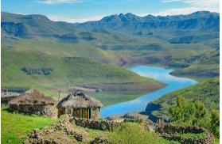
In nature 2020
Wildlife reacted quickly to the changes. And in one of the ports of Sardinia, dolphins were recently spotted. In addition, wild animals have begun to appear in cities around the world.

Slide 8
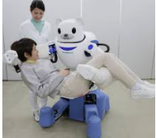
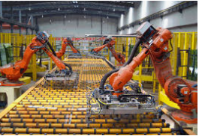
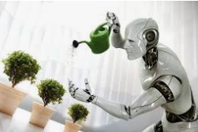
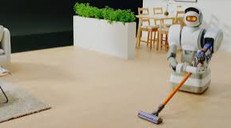
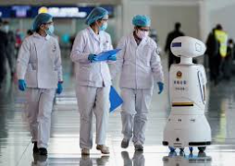
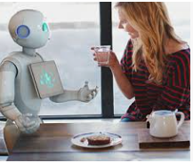
Breakthrough in the economy
The use of robots in medical institutions (delivering drugs, food), robots at the airport, in government institutions.

Slide 9
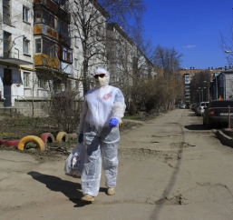
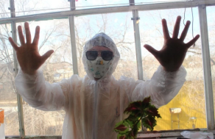
Phobias in a pandemic
Take out the trash in a protective suit
Fear of self-isolation
Although under the conditions of global quarantine, our life has changed before our eyes, old fears and phobias have not disappeared anywhere, and in this nervous environment panic should be avoided and be able to separate false facts from real

Slide 10
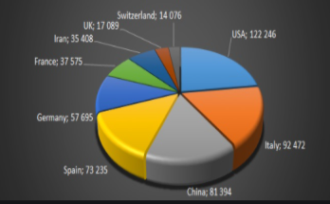
How the virus spreads
Urban growth and massive migration have influenced the spread of dangerous diseases.

Slide 11
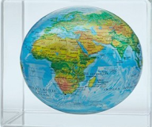
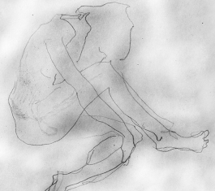
Coronavirus is changing the relationship between people.
People who live alone may feel more lonely - even if they are comfortable without a relationship under normal circumstances. Those who live with a family may find themselves on the verge of divorce, and some may even be subject to domestic violence. Many families with small children are unable to cope with their energy on their own, so many mothers feel nervous breakdowns.

Slide 12
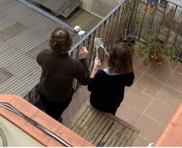
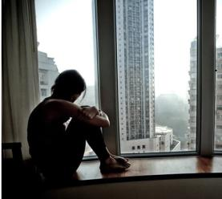
Staying at home is getting harder and harder.
In Barcelona, ​​in particular, the police have already fined those who walked the dog for two hours or walked three kilometers from home with it. A man who was walking a teddy dog ​​was also detained. But polls show that most Americans support isolation. A recent Pew Research poll found 66 percent of respondents feared governments would lift restrictions too quickly.

Slide 13
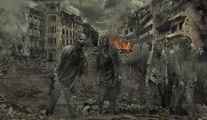
Joe Heal's book "Firefighter".
This book was published in 2016, as if the author saw the future exactly in this form, predicting to us people that trouble is at the threshold. We can say that the epidemic described in the book is very similar to the epidemic of the past (plague), and also similar to the Coronavirus raging today.
A new epidemic is spreading across the country like wildfire. This is Dragon Scale, an extremely contagious fungus that causes beautiful black and gold spots on the body, similar to a tattoo, and then burns the wearer in a flash of spontaneous combustion. Millions are infected, but there is no vaccine. No security.

Slide 14
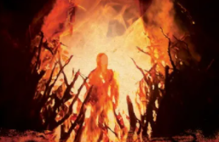
Joe Heal's book "Firefighter".
The brutality with which the infected people were destroyed in this book is horrifying. The difference in our society is very obvious. But there is also a common thing, many people who are asymptomatic go to work, to the store, to a public place, thereby increasingly infecting others. In this book, people also did not want to go to the boxes for the infected, because they did not want to say goodbye to their loved ones forever..

Slide 15
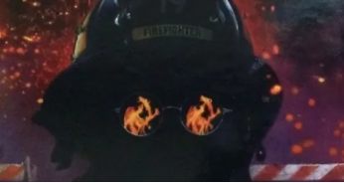
Joe Heal's book "Firefighter".
In the book, infected people were destroyed, they did not spare either children, women, old people or young people. I cannot understand and accept the fact that sick people need to be destroyed, this is not acceptable in our society.

Slide 16
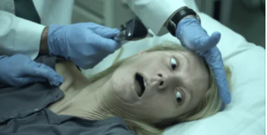
Movie-Contagion (2011)
This film, which was filmed almost 8 years before the outbreak of the Covid-19 epidemic, describes the spread of the virus in exactly the same way as it did in 2019. The same virus came from a man who became infected in a distant province of China, and spread just as quickly. Within three months, almost all countries of the world were infected.

Slide 17
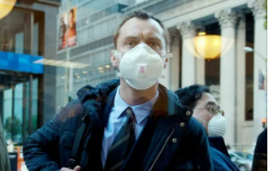
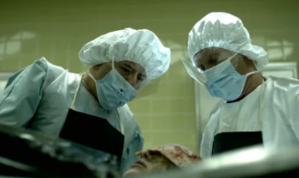
Movie-Contagion (2011)
Of course, this film is not a documentary, so only fictional characters can be seen in it, but the author was close enough to the current situation of the spread of the Coronavirus. Of course, medicine and a great breakthrough in this area helped the heroes of the film. I think that medicine also plays an important role in the fight against the epidemic in our life.

Slide 18
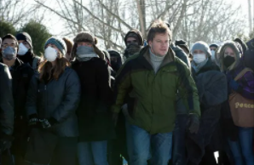
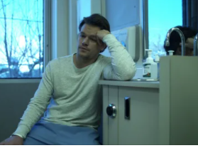
Movie-Contagion (2011)
In this film, it is shown that, just like in our life, people were offered isolation from each others, as well as the use of protective equipment (masks). What was one of those activities that helped cope with the virus?

Slide 19
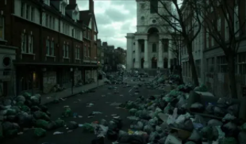
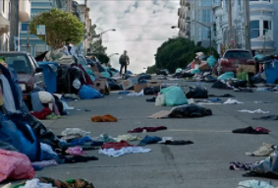
Movie-Contagion (2011)
I found the answer to one of my questions, albeit indirectly, in this film - "Coronavirus is changing the planet's climate - is it true or myth?" Of course this is a myth. It is not coronavirus that is changing the climate of our planet, rather man and his activities have changed the climate and lead to global problems on Earth.

Slide 20
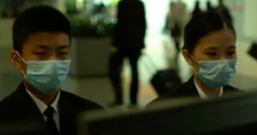
Movie-Contagion (2011)
After watching this film, I was once again convinced of personal hygiene and, of course, taking protective measures when visiting crowded places. Not all people observe precautions in relation to themselves, maybe after watching such movies, many will think about the need to apply protective measures for themselves.

Slide 21
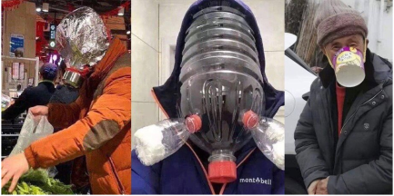
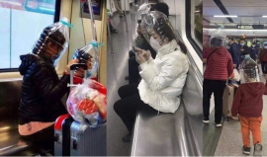
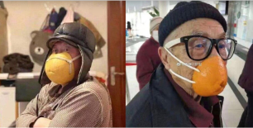
Optimism in dealing with the epidemic
Some people take all the changes too dramatically, so in the metro of different countries you can see such masks and face protection measures that delight others.

Slide 22
Human capital is the foundation of economic growth.
The Coronavirus has reminded humanity that human capital is the foundation of economic growth. That today there is a rethinking of the work of social mechanisms and there is hope that it is a person who will be in the focus of attention of the post-crisis economy.

Slide 23
Changes in people's lives.
The attitude of people towards their health has already changed. Many have changed their way of life: they replaced passive rest with active ones, began to play sports, lead a healthy lifestyle. Moreover, you can see that the whole family is involved in sports.

Slide 24
A healthy lifestyle is a way to live a long life.
Many have changed their dietary habits: they gave up junk food (chips, soda) and switched to a healthy diet. Almost no one remained indifferent to the changes in our life.

Slide 25
The medical profession becomes one of the main.
The work of doctors, immunologists and virologists has become more appreciated all over the world. All over the world they began to pay serious attention to hygiene and sanitary safety, people around the world have got cleaner hands.

Slide 26
Application of new technologies in business.
Covid-19 can become a powerful push that the world has long lacked. This is an incentive for the development of civilization. Perhaps today there will be a rapid breakthrough in economics and science

Slide 27
Business during Covid-19
Businesses will operate more efficiently by reducing their emissions into the environment. Perhaps they will take care of the distant future, and not just live in the present. Surely many companies will provide possibilities for their employees to continue working from home.

Slide 28
Change in medicine.
Certain professions will change dramatically or disappear forever. In medicine, big changes are already underway, and after the virus is defeated, I think medicine will reach a higher level, using the latest technologies in its arsenal. In the conditions of self-isolation, many doctors performed remote visits.

Slide 29
Strengthening the role of the state.
After all, the Coronavirus will give a strong impetus to digital technologies and this will strengthen the state system of our country. I think that we are in for a powerful social restructuring, the role of the state will increase, which will have to raise the market destroyed by the pandemic and fulfill social obligations. All efforts will be devoted to ensuring stability and meeting the basic needs of the population.

Slide 30
Our life
After the global crisis, society itself will change. Adaptation to a new way of life is inevitable and we have new horizons for development.

Slide 31
Work cited
Contagion. Dir. Steven Soderbergh. Perf. Robin Bonaccorsi. Warner Bros. 2011. DVD
Donald, McNeil Jr. “The Coronavirus in America: The year ahead” The New York Times, Apr. 2020. Web. 13 Oct. 2020.
Joe Hill, The Fireman A Novel. William Morrow and Company, 2016. Web.
https://lifehacker.ru/posledstviya-koronavirusa/
https://yandex.ru/images/search?text=%D0%BA%D0%BE%D1%80%D0%BE%D0%BD%D0%BE%D0%B2%D0%B8%D1%80%D1%83%D1%81%20%D0%B8%20%D0%B5%D0%B3%D0%BE%20%D0%BF%D0%BE%D1%81%D0%BB%D0%B5%D0%B4%D1%81%D1%82%D0%B2%D0%B8%D1%8F&stype=image&lr=10865&source=wiz
https://360tv.ru/news/tekst/buduschie-oslozhnenija/

