Slide 1
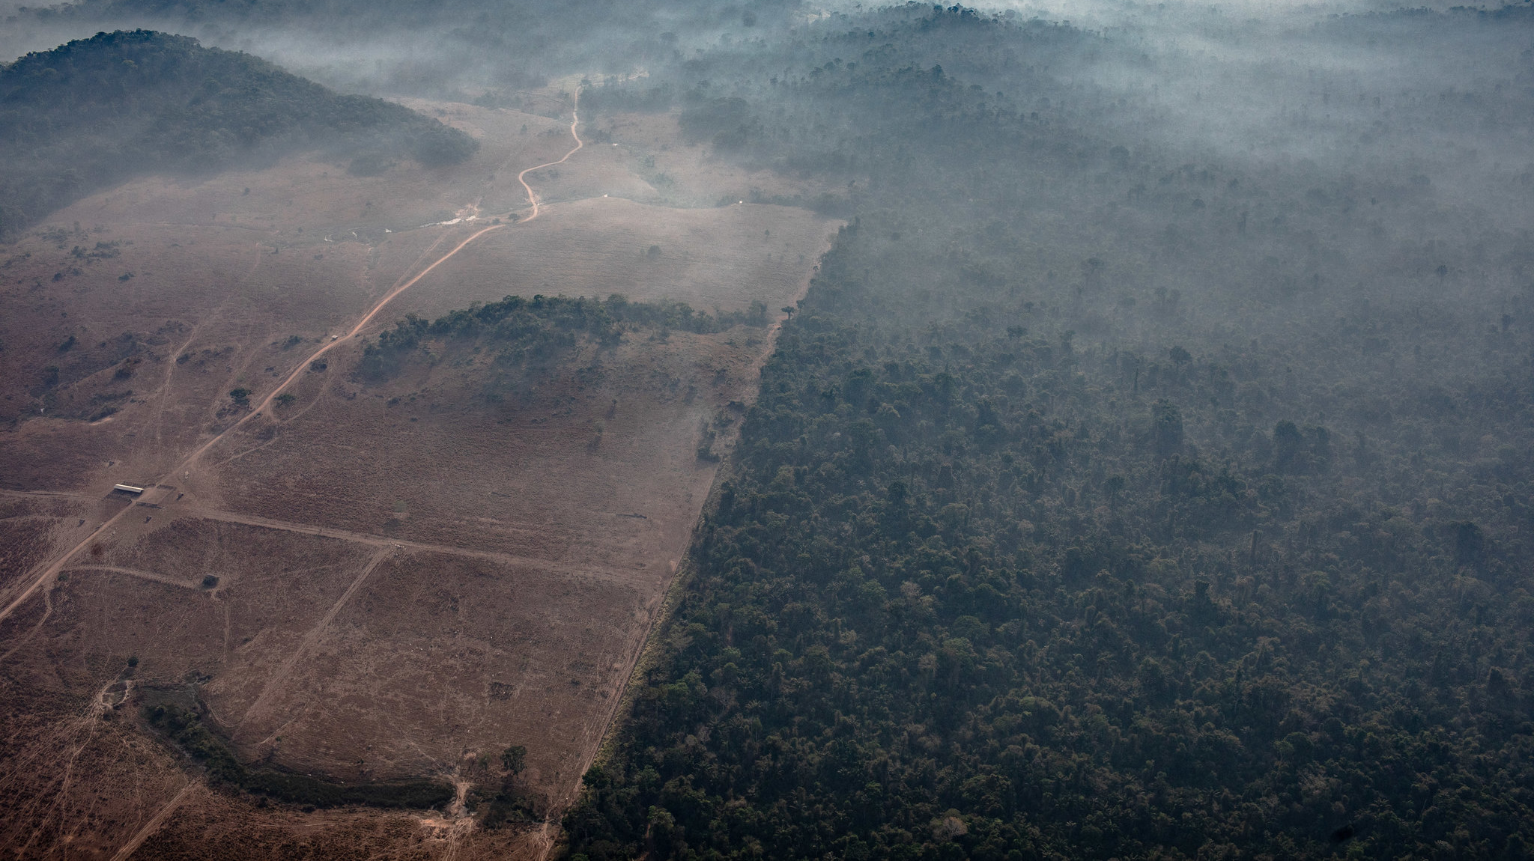
Unit 3 Multi-Modal Project
What are the methods of deforestation expansion?

Slide 2
Introduction
What are the methods of deforestation expansion?
The understanding of plant and animal relations is essential if the rainforest is to be understood. I have always liked solving problems, so I still stick to topics that I think are interesting.
When indigenous communities living in a forest have lived there for many generations, deforestation problems are more problematic.
Researchers usually generate many more research questions than they ever try to answer. It means I must have some way of evaluating the research question I developed to choose which ones to pursue.

Slide 3
Quotation
“The causes of this rapid depletion are complex and much debated. Kummer argues that we must consider deforestation as a flow, or "the recent marginal change (negative) of stock" (p. 142). The stock is forest cover, which is the total of both negative and positive changes over time.”

Slide 4
Deforestation in the Postwar Philippines
Backwoods spread in the Philippines most likely declined from roughly 70% of the land region in 1900 to half by 1950. Kummer's essential concern is estimating deforestation in the post-World War II period.
In the recent past, half of the Philippine forests' reduction is a dismaying, but not especially surprising, conclusion. The causes of this rapid depletion are complex and much debated—commercial logging, both legal and illegal, followed by agricultural expansion forces postwar deforestation.

Slide 5
Introduction
It is increasingly concerning about deforestation and biodiversity loss in forests; I have always hoped to answer this research question. I expect to find practical solutions to the problems concerning deforestation.
Policies to effectively reduce deforestation are discussed within a land rent framework.
For example, the Amazon basin contains the largest rainforest in the world. It is an ecosystem that may support 30% of terrestrial species worldwide and store vast carbon amounts.
It has a significant impact on global climate and weather patterns. Few would argue that this is a significant landscape of the planet.

Slide 6
What I found

Slide 7
What I found.
In my research I found what it means to evalutae my research question.
For example, in source 1, Backwoods spread in the Philippines most likely declined from roughly 70% of the land region in 1900 to half by 1950. Commercial logging, both legal and illegal, followed by agricultural expansion forces postwar deforestation.
What surprised me about this research is how informative these sources are. Even though they are different genres they all present you with good analytics and, sometimes, specific details.

Slide 8
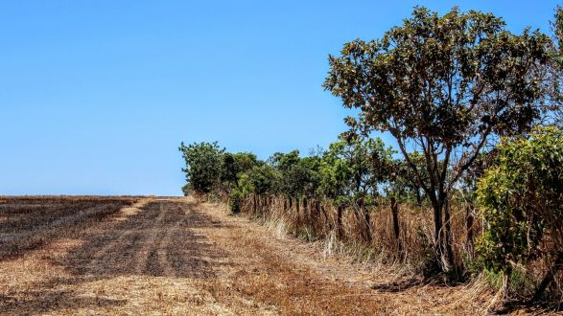
How serious/concerning is deforestation around the world?
Deforestation is serious, especially in the northwest and northeast regions of the delta
Most deforestation is happening in the tropics today. With the construction of new roads through dense forests, areas inaccessible in the past are now within reach.
Developing alternatives to deforestation can help reduce the need for clearing of trees. For instance, a fundamental reason for deforestation in an area is the desire to expand the amount of land used for agriculture.

Slide 9
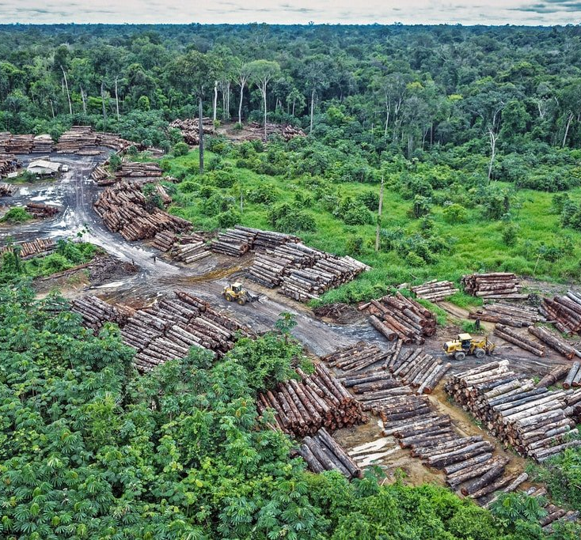
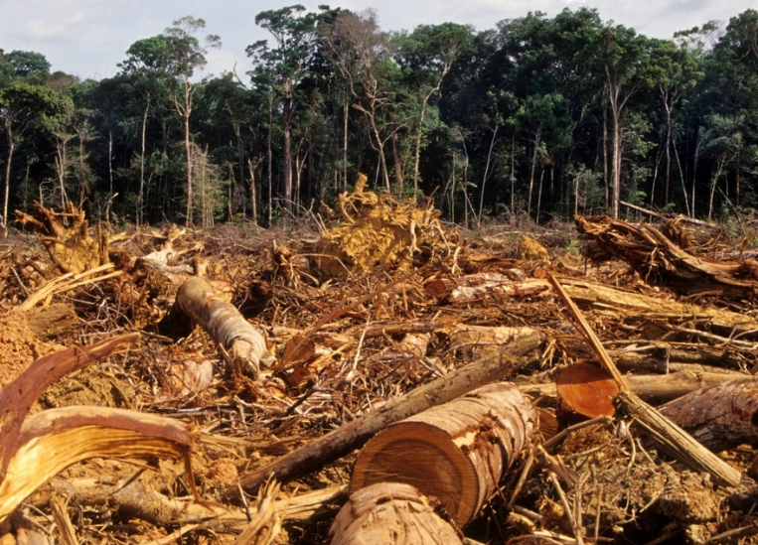
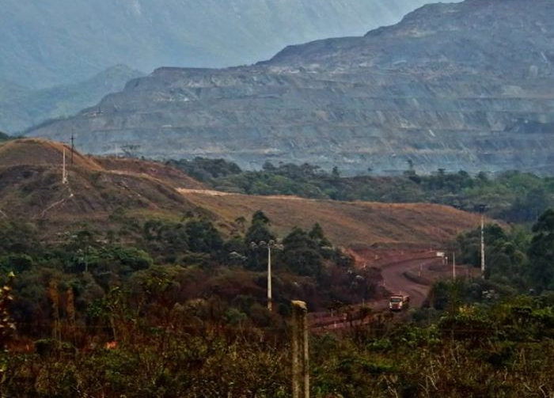

Slide 10
How serious/concerning is deforestation around the world?
However, if people adopt sustainable agricultural practices or use new farming technologies and cultivations, the need for more land can be reduced.
I think foreigners from exotic and tropical countries needs to know about my research.
Brazil lost annually more forests than any other country in 2005. A recent study has shown that Brazil has today reduced the Amazon rain forest deforestation by 70 percent. It is good news.
Forests are essential to Earth's life. Food, fuel, shelter, recreation and livelihoods, freshwater, soil protection, climate regulation, biodiversity protection, and carbon storage are provided.

Slide 11
Conclusion
Forests provide habitat for wildlife and plants — in tropical rainforests, 80 percent of global biodiversity is found. The losses of 137 plants, insects, and animals are estimated to occur every day — an average of 50,000 species per year.
The risk of extinction from over-harvesting and deforestation lies with four hundred medicinal plants, leading to the loss of future disease cures. This does not even include plants of which we do not know the therapeutic potential.
Forests contribute towards combating global warming through carbon dioxide removal and storage and growing from the atmosphere.

Slide 12
Conclusion
The burning and wood degradation of carbon dioxide and deforestation can produce carbon secreted on the soil. Seventeen percent of all carbon emissions in the 1990s were deforested but now has fallen to 10%. Even though the news is good about Brazil and 17 countries, Brazil has destroyed over 224,000 kilometers of the Amazon Forest since 1980, which is almost Texas's size.

Slide 13
References:
Richards, John F. Deforestation in the Postwar Philippines. no. 1, Routledge, 1 Jan. 1993, pp. 93–94, doi:10.2307/143892.
“Studies from World Agroforestry Center Yield New Information About Urban Planning (Effectiveness of Protected Areas in Preventing Rubber Expansion and Deforestation in Xishuangbanna, Southwest China).” China Weekly News, NewsRX LLC, 2018, p. 131–.
"Findings on Deforestation Reported by Investigators at Obafemi Awolowo University (Understanding changes in a Tropical Delta: A multi-method narrative of landuse/landcover change in the Niger Delta)." Ecology, Environment & Conservation, 8 Dec. 2017, p. 408. Gale Academic OneFile,. Accessed 21 Oct. 2020.
Escobar, Herton, Brazil’s deforestation is exploding—and 2020 will be worse.AAAS,sciencemag, Nov. 22, 2019

