Slide 1
Multimodal Repurposing Assignment Acculturation
Jean Holmi Germain

Slide 2
Acculturation - Historical approaches
Acculturation is a process of social, psychological, and cultural change that stems from the balancing of two cultures while adapting to society's prevailing culture. Acculturation is a process in which an individual adopts, acquires, and adjusts to a new cultural environment.
The first psychological theory of acculturation was proposed in W.I. Thomas and Florian Znaniecki's 1918 study, The Polish Peasant in Europe and America.
Those phenomena result when groups of individuals having different cultures come into continuous first-hand contact, with subsequent changes in the original cultural patterns of either or both groups.

Slide 3
Acculturation - Effect
I’m From Haiti
I'm From Spain
I'm from Brazil
The effects of acculturation can be seen at multiple levels Individuals of a differing culture try to incorporate themselves into the new, more prevalent culture by participating in aspects of the more prevalent culture, such as their traditions, but still hold onto their original cultural values and traditions.

Slide 4
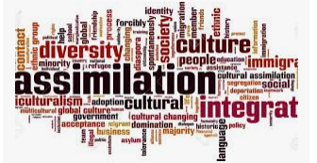
Acculturation-Group Level
At this group level, acculturation often results in changes to culture, religious practices, health care, and other social institutions; including ramifications on the food, clothing, language, and more.

Slide 5
2- Conceptual models
2.1-Theory of Dimensional Accrual and Dissociation
Although numerous models of acculturation exist, the complete models take into consideration the changes occurring at the group and individual levels of both interacting groups.
2-2- Fourfold models
The fourfold model is a bilinear model that categorizes acculturation strategies along two dimensions. The first dimension concerns the retention or rejection of an individual's minority or native culture. Whereas the second dimension concerns the adoption or rejection of the dominant group or host culture. From this, four acculturation strategies emerge.

Slide 6
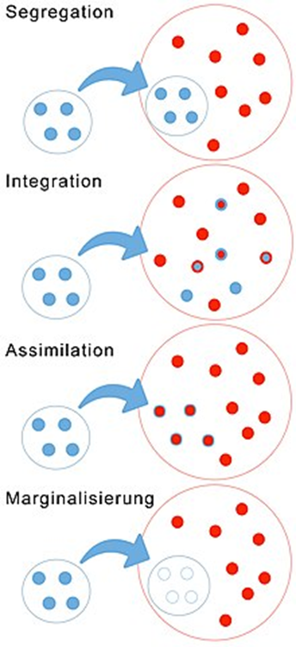
2-Conceptual models
2.3 - Marginalization occurs when individuals reject both their culture of origin and the dominant host culture.
2.4 - Separation occurs when individuals reject the dominant or host culture in favor of preserving their culture of origin.
2.5 - Assimilation occurs when individuals adopt a dominant or host culture's cultural norms over their original culture.
2.6 - Integration occurs when individuals can adopt the dominant or host culture's cultural norms while maintaining their culture of origin.

Slide 7
• Predictors of acculturation strategies
The fourfold models used to describe individual attitudes of immigrant's parallel models used to describe group expectations of the larger society and how groups should acculturate.
In a melting pot society, in which a harmonious and homogenous culture is promoted, assimilation is the endorsed acculturation strategy.

Slide 8
Acculturation - Other outcomes - Culture
CULTURE
When individuals of a certain culture are exposed to another culture (host) that is primarily more present in the area that they live, some aspects of the host culture will likely be taken and blended within aspects of the original culture of the individuals.
My bible is Koran, I can teach you
I’m from Morocco, I can tell you about our Music
I need to show my African Dance

Slide 9
Acculturation - Other outcomes - Language
In some instances, acculturation results in the adoption of another country's language, which is then modified over time to become a new, distinct, language. For example, Hanzi, the written language of Chinese language, has been adapted and modified by other nearby cultures, including Japan (as kanji), Korea (as hanja), and Vietnam (as hán tự).

Slide 10
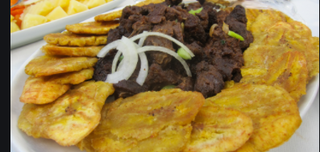
Acculturation - Other outcomes - Food
Food habits and food consumption are affected by acculturation on different levels. Research indicated that food habits are discreet and practiced privately, and change occurs slowly.
Haitian Food (Plaintain & Griot Porc
Chickens Wings- American popular meet
Vietnam - Buffet

Slide 11
REFLECTION
I think there is much interest in the thesis that acculturation processes are accompanied by personality changes. That occurs when groups of individuals of different cultures come into continuous first-hand contact, which changes the original culture patterns of either or both groups.
Also, several acculturation theories note the importance of the surrounding context, but few studies describe neighborhood influence on immigrant adaptation due to the complexity of individual and contextual influence on immigrant adoption.
For better understanding, we need to know the role of communication in the accumulation process that establishes a link between people from different countries.
The Jewish Immigration in 1492 to North America

Slide 12
Quotation
“If you want to be relevant only in your household, then you only need to know the things that are important in your house, and if you want to be relevant in your neighborhood, you need to know what's important in your neighborhood. The same thing applies to your city, state, and country. And if you want to be relevant to the entire world, program that computer known as your brain with all kinds of information from everywhere in order to prepare yourself.”
(Ben Carson, One Nation: What We Can All Do to Save America's Future)

Slide 13
Conclusion
Acculturation is the transfer of values and customs from one group to another. The change in the culture of a group or an individual as a result of contact with a different culture. Haitian people, when they come to the USA, start loving pizza and hamburgers; it’s an example of acculturation. The same American people who start loving and dancing the Haitian music it’s an example of acculturation.

Slide 14
Work cited
Ben Carson, One Nation: What We Can All Do to Save America's Future;https://www.google.com/search?q=acculturation+quotation+image
https://www.goodreads.com/quotes/tag/acculturation
https://www.google.com/search?rlz/Images

