Slide 1
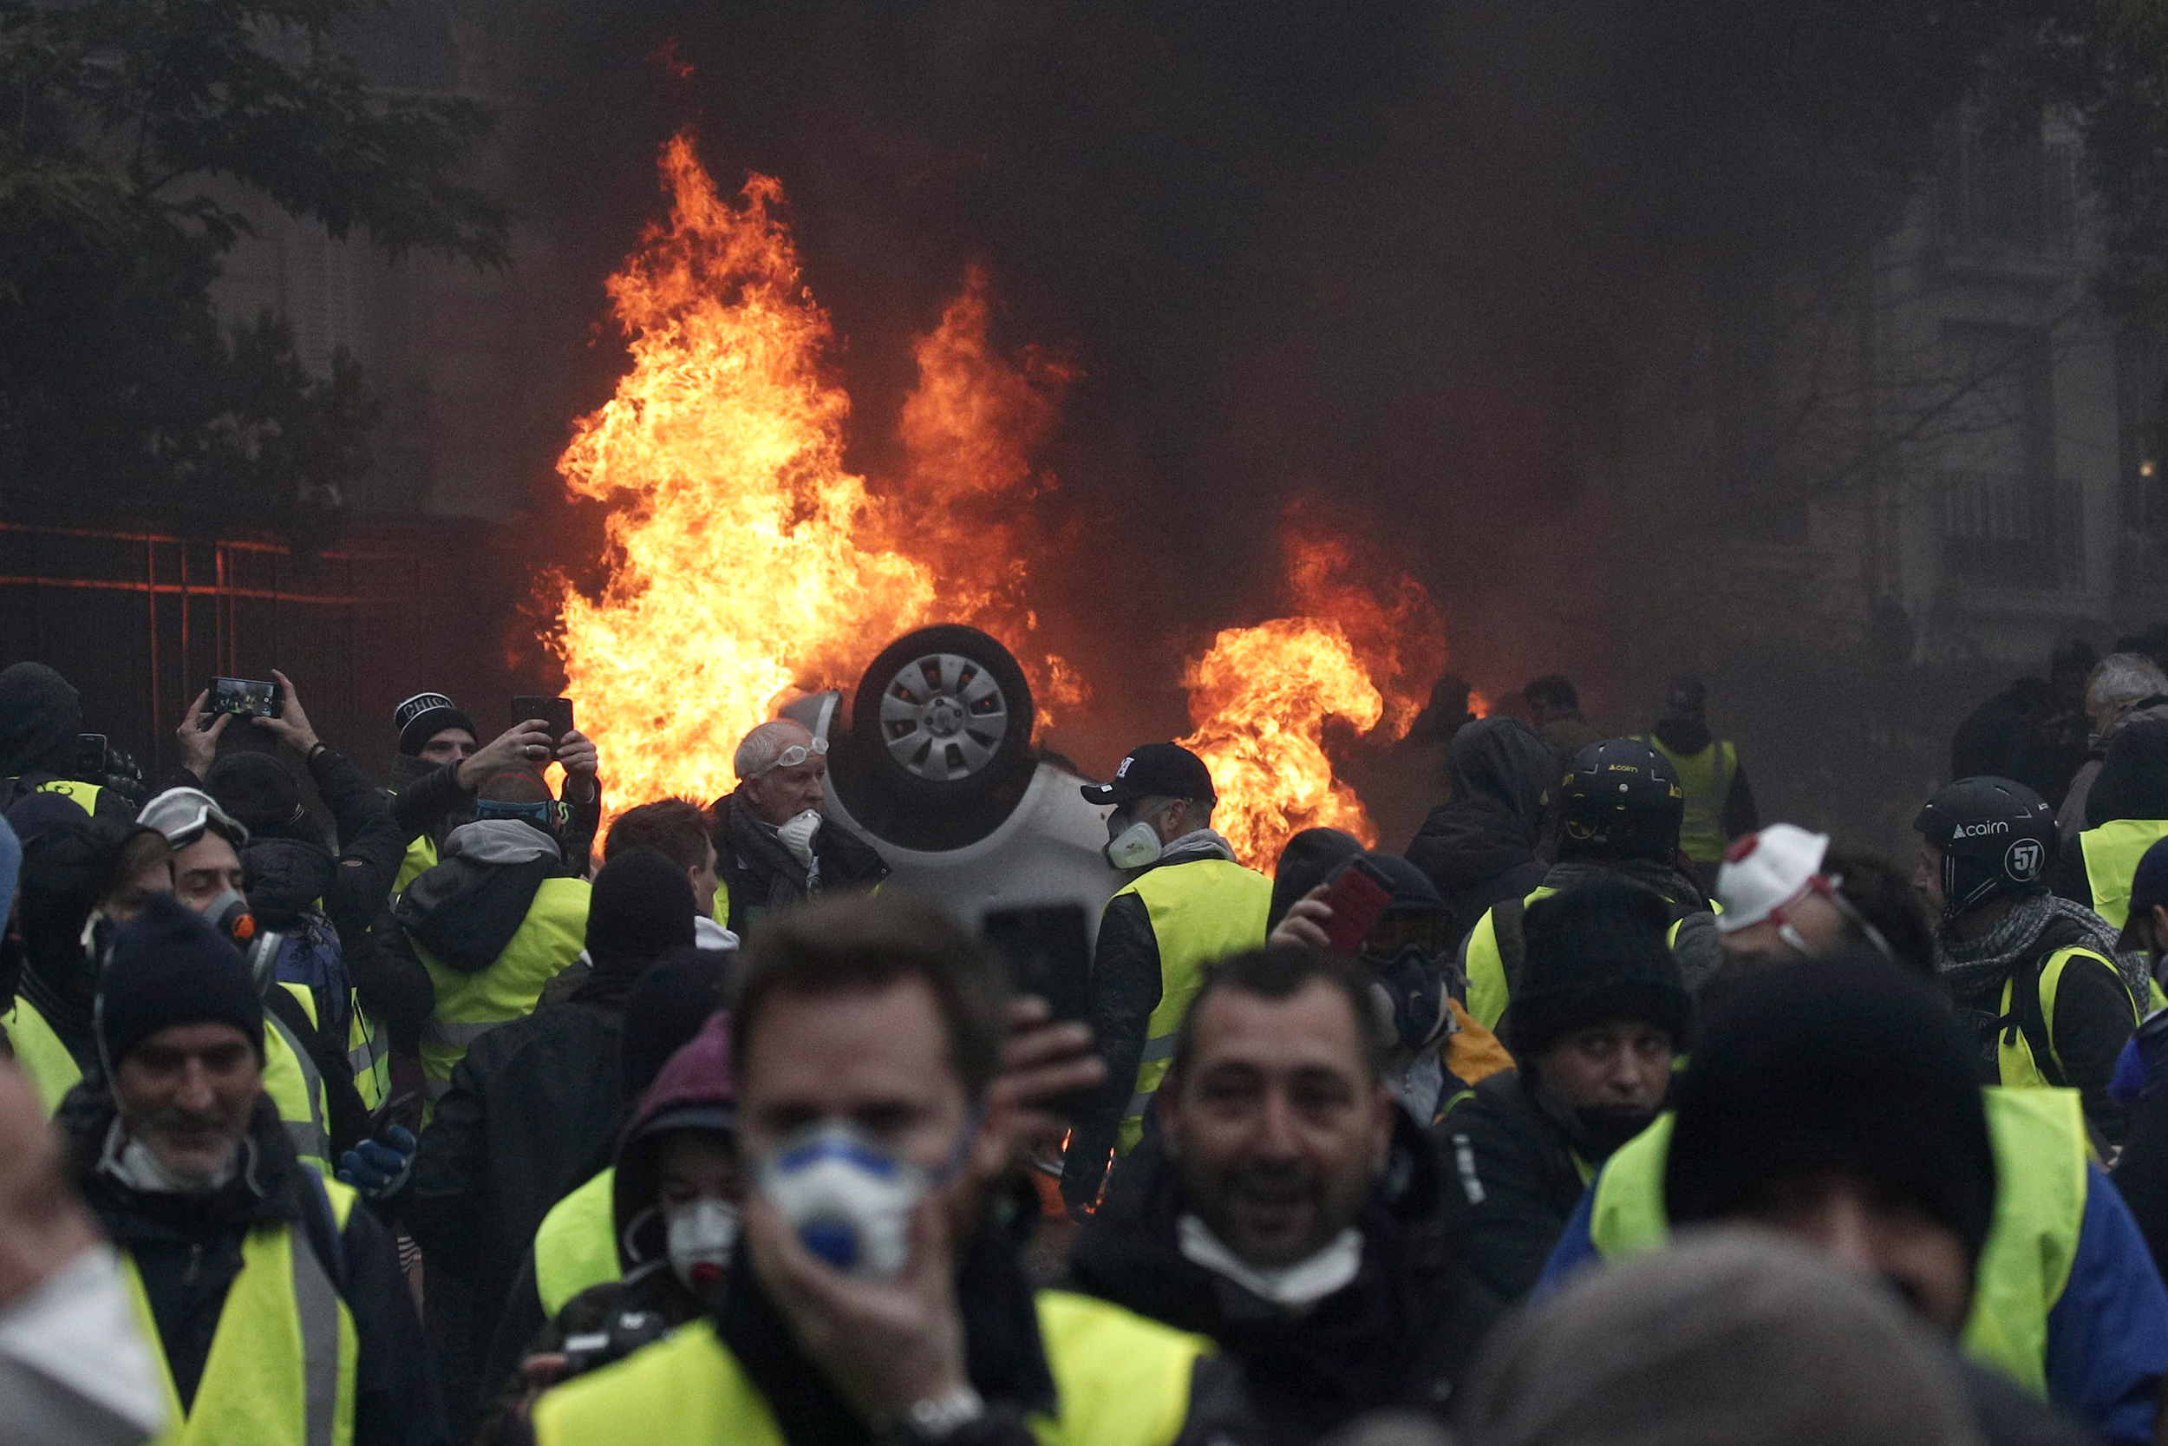
France, as you know, is a hellhole, but mostly because the pastry is too rich, not because the people are too poor or deprived of basic liberties.
French Drivers Say this to Gas Tax!!!!!!!!!!!!
This French tax revenue is spent on programs — universal health care, lengthy paid maternity leave, unemployment benefits — designed to render society more cohesive and capitalism less cutthroat. … Socialist presidents have governed France for half of the past 38 years.
https://www.minnpost.com/eric-black-ink/2019/03/as-americans-fret-about-socialism-a-peek-at-france/
https://social-ecology.org/wp/2020/03/new-institute-of-social-ecology-and-communalism-iesc-founded-in-france/

