Slide 1
Austerity did not come in one fell swoop in Sweden, but by a thousand small cuts.
Rather than persistently suggesting that the American Dream can be realized by expanding government or raising taxes, it is time for Sanders and his comrades to go back to school and study history. The true lesson to be learned from the Scandinavian experience is that the Nordic-style welfare-state models haven’t worked nearly as well as American democratic socialists like to pretend.
https://www.jacobinmag.com/2020/03/swedish-social-democracy-reformisterna
https://www.nbcnews.com/think/opinion/bernie-sanders-wrong-democratic-socialism-sweden-everywhere-else-ncna1158636

Slide 2
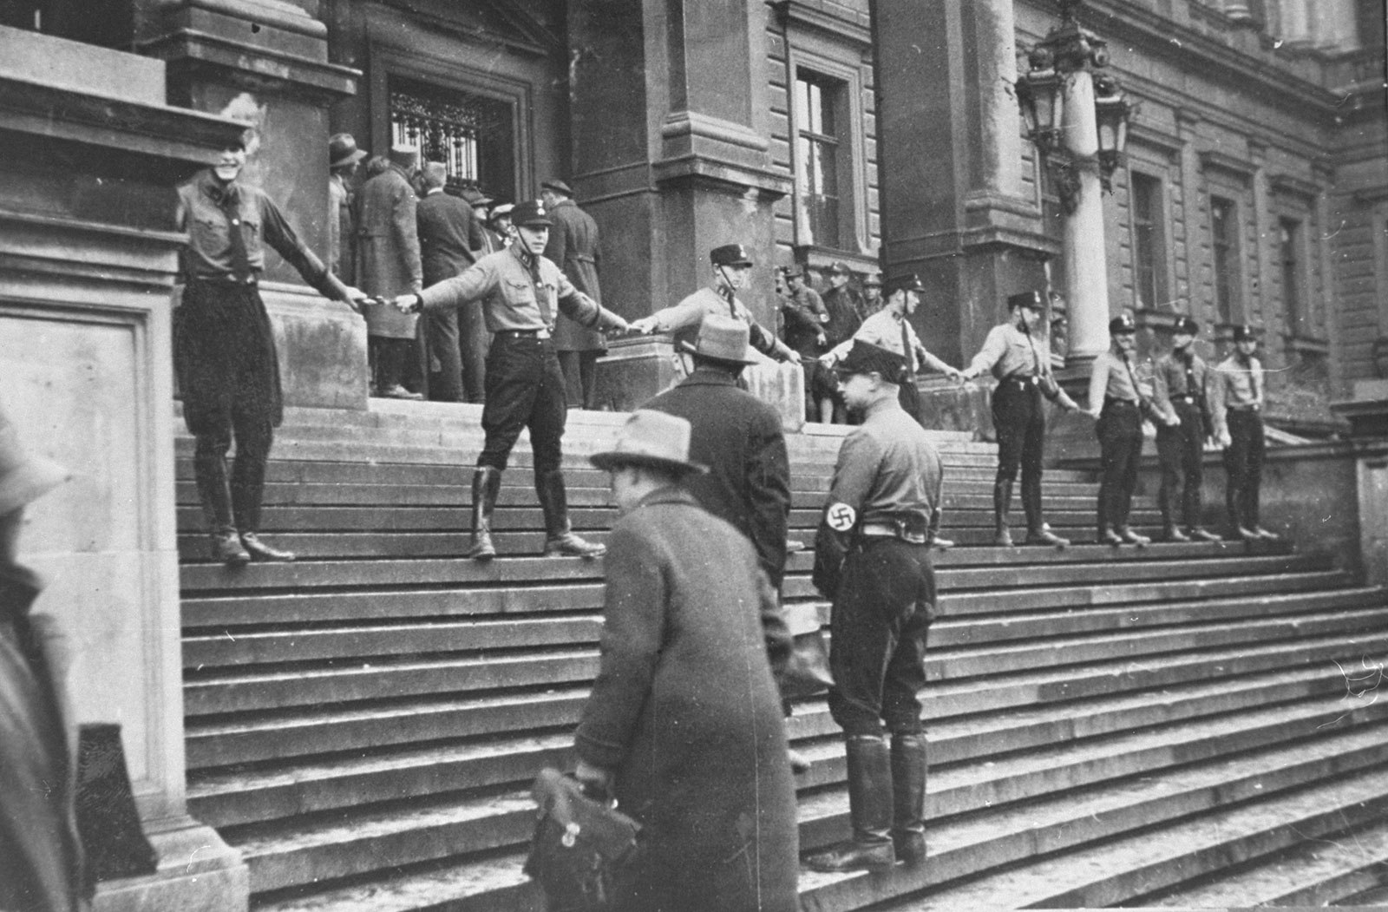
Their ideology is rooted in the assumption that the Nazi party would never have been able to come to power in Germany if people had more aggressively fought them in the streets in the 1920s and 30s.
The SA’s violence against Jews and communists was unbridled, yet some of Ernst Röhm’s interpretations of Nazi ideology were literally socialistic and in opposition to Hitler’s, including supporting striking workers and attacking strike-breakers.
https://www.historyhit.com/hitlers-bullyboys-the-role-of-the-sa-in-nazi-germany/
https://www.adl.org/antifa

