Slide 1
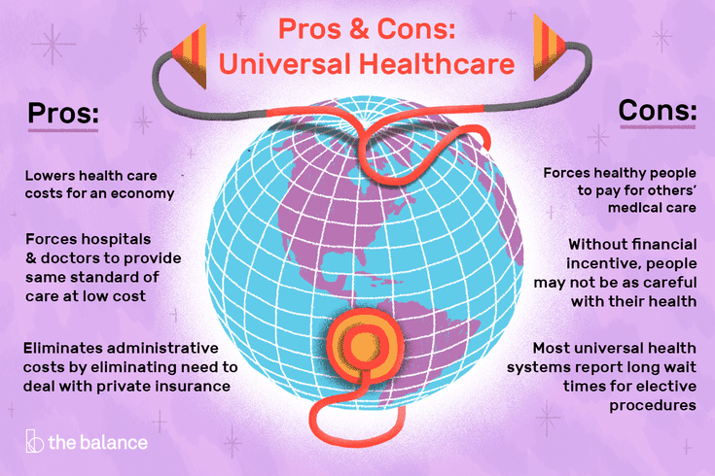
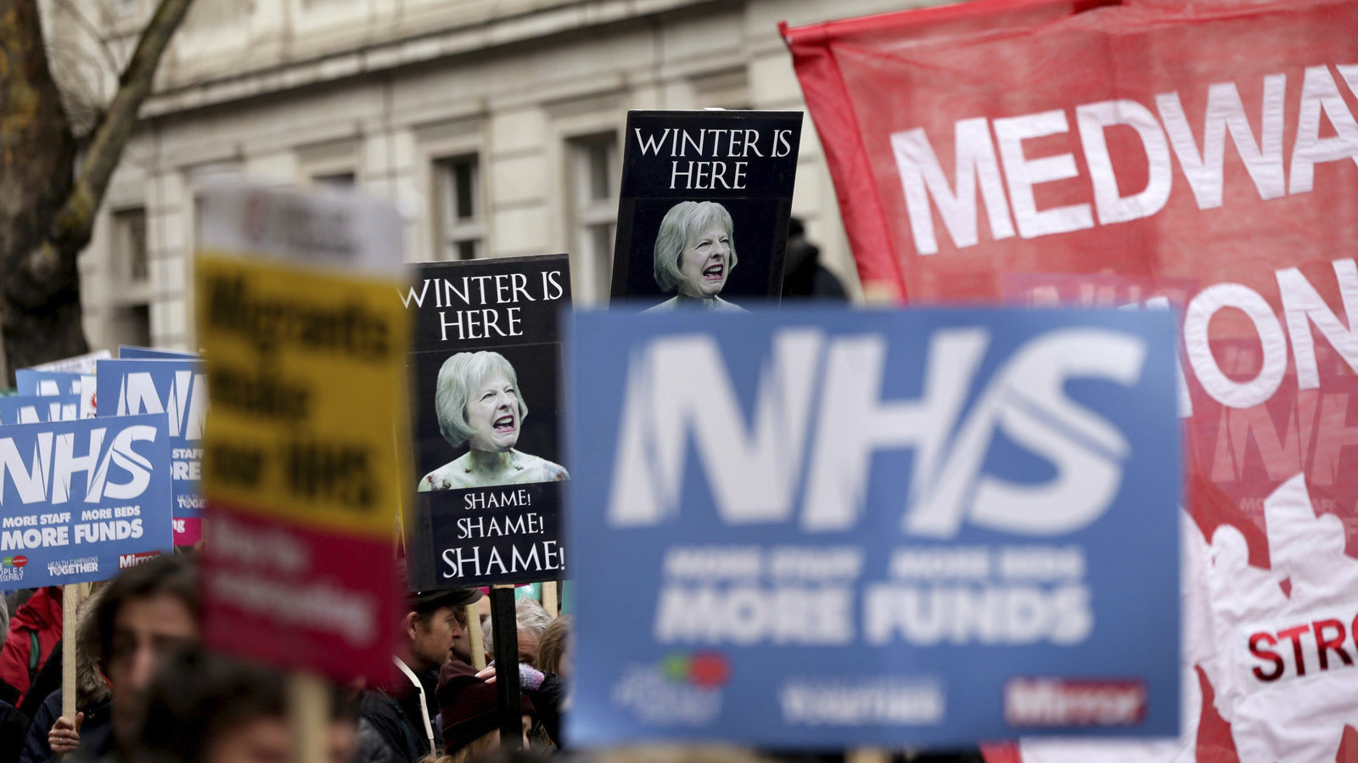
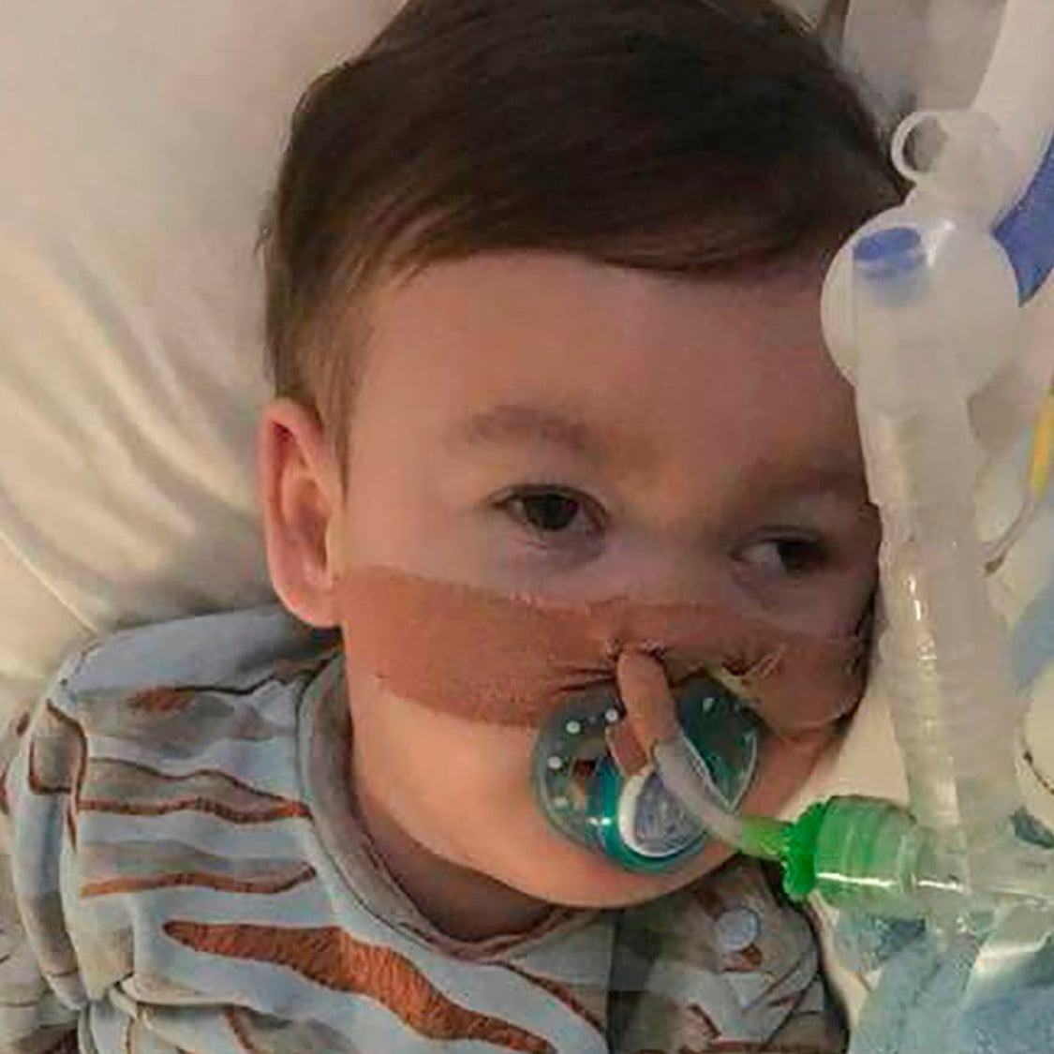
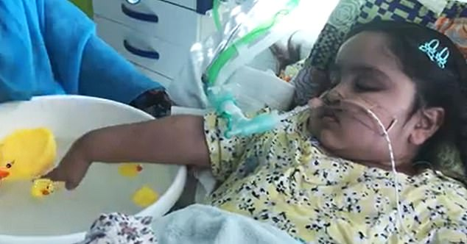
Court rules gravely ill UK child cannot travel to Vatican hospital
Talfida Begum
NHS decided the medical fight was futile.
The parents won the court fight and the child went to Italy for surgery.
Court rules gravely ill UK child cannot travel to Vatican hospital R.I.P.
Alphie Evans
Socialized medicine update: Britain cancels 50,000 surgeries as NHS hospitals face winter crisis
https://www.washingtonexaminer.com/socialized-medicine-update-britain-cancels-50-000-surgeries-as-nhs-hospitals-face-winter-crisis
https://www.vox.com/policy-and-politics/2018/4/27/17286168/alfie-evans-toddler-uk-explained

