Slide 1
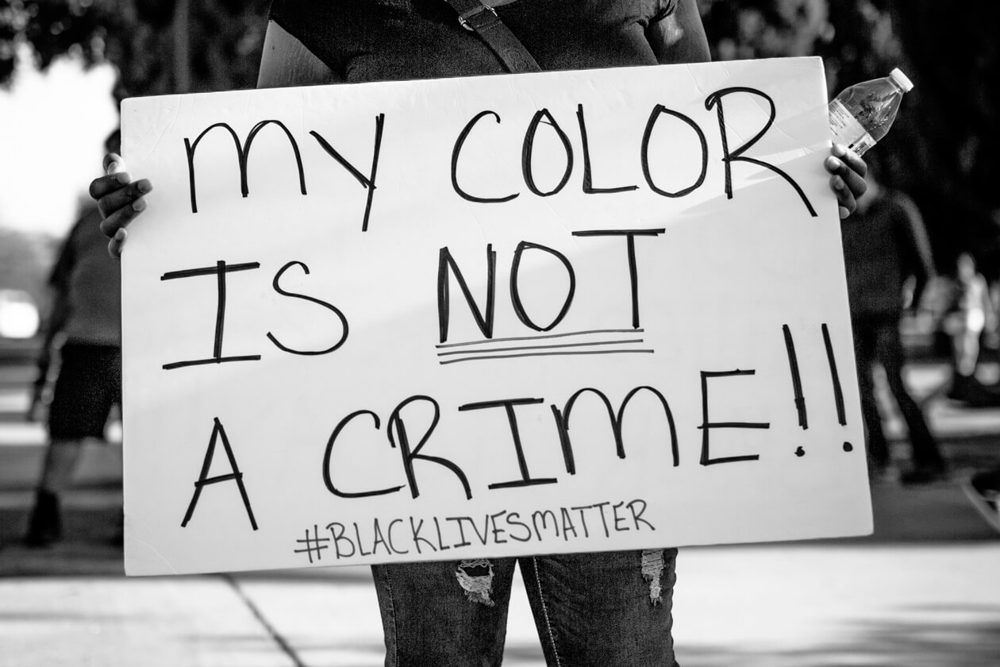
How has the Justice system failed African Americans.
Two Justice Systems

Slide 2
A Failed System
Most people of color are incarcerated in the United States than any other nation.
The United States leads the world in incarceration, with over 2.4 million people behind bars—a 500 percent increase over the past 30 years. The United States has 5 percent of the world population, yet approximately 25 percent of its prisoners.
More than 60 percent of the people in prison are people of color. For black males in their twenties, one in every eight is in prison or jail on any given day

Slide 3
Mass incarceration
Sentencing policies, implicit racial bias, and socioeconomic inequity contribute to racial disparities at every level of the criminal justice system. Today, people of color make up 37% of the U.S. population but 67% of the prison population. Overall, African Americans are more likely than white Americans to be arrested; once arrested, they are more likely to be convicted; and once convicted, they are more likely to face stiff sentences. Black men are six times as likely to be incarcerated as white men and Hispanic men are more than twice as likely to be incarcerated as non-Hispanic white men.

Slide 4
Institutional racism
Institutional racism, also known as systemic racism, is a form of racism that is embedded as normal practice within society or an organization. It can lead to such issues as discrimination in criminal justice.

Slide 5
Public Safety
Crime rates have declined substantially since the early 1990s, but studies suggest that rising imprisonment has not played a major role in this trend. The National Research Council concluded that while prison growth was a factor in reducing crime, “the magnitude of the crime reduction remains highly uncertain and the evidence suggests it was unlikely to have been large.” Several factors explain why this impact was relatively modest.
First, incarceration is particularly ineffective at reducing certain kinds of crimes: in particular, youth crimes, many of which are committed in groups, and drug crimes. When people get locked up for these offenses, they are easily replaced on the streets by others seeking an income or struggling with addiction.
Second, people tend to “age out” of crime. Research shows that crime starts to peak in the mid- to late- teenage years and begins to decline when individuals are in their mid-20s. After that, crime drops sharply as adults reach their 30s and 40s. The National Research Council study concludes:

Slide 6
Racial Disparity
American Indian youth are THREE TIMES as likely as white youth to be held in a JUVENILE DETENTION facility.
1 in every 10 black men in his thirties is in PRISON or JAIL on any given day
1 in 3 Black men born in 2001 can expect to go to prison in their lifetime.

Slide 7
Police Brutality and the unequal justice system towards African Americans

Slide 8
'Is The American Justice System Racist?

Slide 9
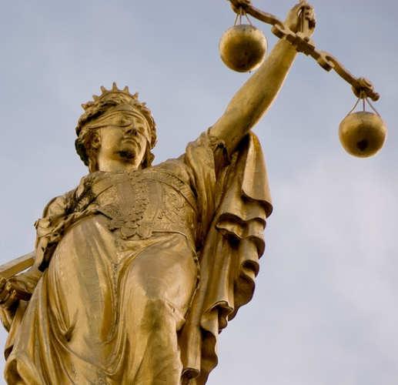
Fixing a broken system
Our criminal justice system is broken. Our nation’s laws should focus on imprisoning the most dangerous and violent members of our society. Instead, our criminal justice system traps non-violent offenders – disproportionately African-American men – in a cycle of poverty, unemployment, and incarceration.

Slide 10
10 ways to Fix the Criminal Justice System
1. Pay Attention to — and Speak Out — About Injustice Whenever You See It. The criminal justice system is desperately in need of reform. But reform will only occur when people speak with unified conviction about a more just and equitable system that focuses more on public safety than on a person’s skin color or class status. When people in large numbers speak out for justice, policymakers will have no choice but to respond.
2. Require All States to Provide Compensation to the Exonerated. I cannot imagine anything worse than a person being wrongly convicted for a crime they did not commit. Only 30 states, plus Washington D.C., have laws that provide compensation to the wrongly convicted. Some of these laws provide only token support to the exonerated, while 20 states provide no compensation at all. When the criminal justice system makes a grievous mistake by sending an innocent person to prison, the state has a moral and ethical responsibility to make amends by providing adequate financial support, counseling, educational and job training, and housing. If your state doesn’t have a law, ask your legislator to pass one.
3. Hold Prosecutors and Police Responsible for Deliberate Misconduct. Police and prosecutors who deliberately engage in misconduct are rarely held liable for their actions. I’m talking about serious misconduct that lands innocent people in jail, such as hiding or destroying evidence that could clear the accused of charges, or fabricating evidence to make a defendant appear guilty, or relying on testimony that is known to be false or obtaining and then using coerced confessions. That needs to change. And fast. A policy of liability for deliberate misconduct could make those state actors think twice before they play fast and loose with people’s lives.
4. End the Death Penalty. The death penalty is racist, expensive and outdated. White victims appear to matter the most, and black defendants and black victims appear to matter the least. Not only is the death penalty discriminatory, but it is expensive. Death penalty cases cost millions more than non-capital cases ending in a life sentence. We could take those savings and do a whole lot of good, for a whole lot of people. And dare I say it? The death penalty is just flat out wrong. Europe and most of the Americas have abolished it, leaving the United States in the company of China, North Korea, and Pakistan on the list of countries who retain the punishment. Come on, now. It is time. Get rid of it.
5. Support the Passage of Laws That Reduce Overly Harsh Sentences. People are serving life sentences for non-violent drug offenses or for certain felonies under habitual offender laws. These sentences are unnecessary and are overly punitive. They often fall on the backs of the poor and people of color. And they cost a fortune. Support bills such as the Smarter Sentencing Act, and other laws that may be pending in your state.

Slide 11
10 ways to Fix the Criminal Justice System
6. Support Public Defender Offices and Other Organizations that Fight for Equality in the Criminal Justice system. Public defenders serve poor people accused of crimes. It is a hard and often heart-breaking job, involving far too many cases and far too little resources to do the job required of them by the Constitution. A good public defender is the best defense against any governmental overreaching that may occur in the system, and offices need financial support to address today’s indigent defense crisis.
7. Support Alternatives-to-Arrest and -Incarceration Programs. Too many people wind up in the criminal justice system. Some people are arrested who should not be. And once an arrest is made, a cycle of incarceration begins that is often skewed against the poor and poor people of color. Support initiatives that offer alternatives to the justice system, such as after school programs, mental health centers, and drug treatment options. These programs require funding and are costly in the short term. But a healthier community is better -and safer - in the long run than an incarcerated one
8. Reduce Violence in Prison by Improving Prison Accountability and Leadership. People are sent to prison because they were convicted of a crime. Their punishment is the prison sentence itself. Yet, thousands of prisoners - including those who are incarcerated for non-violent crimes - become the victims of sexual assault and other violent attacks while serving prison sentences. When their sentence is over, they return to society more damaged, traumatized, and maladjusted then when they entered in the first place. If you want to reduce high rates of recidivism, then make prisons safer and hold administrators accountable for the devastating violence that occurs under their watch.
9. Stop the Use of Solitary Confinement in Prisons, Particularly for Juveniles in Detention Facilities. Solitary confinement has become a widespread prison management tool where people are held, in extreme isolation, sometimes for years or decades. But it does more harm than good. People locked up in solitary often come out more psychologically and physically damaged than when they went in. Solitary confinement is fundamentally inhumane, extremely costly, contrary to the public good, and often unnecessary.
10. Return to Community Policing. If the police personally know the folks they are tasked to serve, then they get a sense of who lives in the neighborhood, who is dealing drugs, and who is going to school. With knowledge, comes trust. With knowledge, police are better able to make informed, life-and-death, split second decisions. Just look at Camden, New Jersey - one of the poorest cities in New Jersey, with a stunning crime problem. The recently formed Camden County police force has implemented a new community policing program, and homicides have dramatically declined. There is still much to be done, but community policing has had an important impact. Advocate for its return

Slide 12
References
https://hubblecontent.osi.office.net/contentsvc/videohostpage/video?lcid=1033&syslcid=1033&uilcid=1033&app=3&ver=16&build=16.0.13328&platform=Win32&streamsso=true&appCorrelation=BC577BA3-3E95-4F01-AB41-AB7FBB3A99DE&url=https%3A%2F%2Fwww.youtube.com%2Fembed%2F4BEdqIAIbAs%3Ffeature%3Doembed
https://www.afsc.org/story/facts-about-mass-incarceration-people-color-us#:~:text=The%20United%20States%20leads%20the%20world%20in%20incarceration%2C,the%20people%20in%20prison%20are%20people%20of%20color.
https://www.bing.com/videos/search?q=how+has+the+system+failed+african+american+powerpoint&&view=detail&mid=BAE0664F35879CD1DF2FBAE0664F35879CD1DF2F&&FORM=VRDGAR&ru=%2Fvideos%2Fsearch%3Fq%3Dhow%2Bhas%2Bthe%2Bsystem%2Bfailed%2Bafrican%2Bamerican%2Bpowerpoint%26FORM%3DHDRSC3
https://www.bing.com/images/search?view=detailV2&ccid=nkdPDDMJ&id=B6300C52457D36E58ECF2A2A2F27C2BEF5130325&thid=OIP.nkdPDDMJjkPn0AUKFXzYdgHaEK&mediaurl=http%3a%2f%2fmedia3.s-nbcnews.com%2fj%2fnewscms%2f2015_29%2f1129756%2fjustice_reform_c_37ce422b575f51a2eb6746b32d7314d9.nbcnews-ux-2880-1000.jpg&exph=602&expw=1072&q=Us+Prison+Population+by+Race&simid=607987749683859210&ck=341A78CF8DA4382261BCF148D9916212&selectedIndex=23&FORM=IRPRST&ajaxhist=0
https://www.sentencingproject.org/publications/shadow-report-to-the-united-nations-human-rights-committee-regarding-racial-disparities-in-the-united-states-criminal-justice-system/

Slide 13
References
https://www.bing.com/videos/search?q=criminal+justice+system+and+african+american&&view=detail&mid=40BC798DCECC15C2263D40BC798DCECC15C2263D&&FORM=VRDGAR&ru=%2Fvideos%2Fsearch%3Fq%3Dcriminal%2520justice%2520system%2520and%2520african%2520american%26qs%3DRI%26form%3DQBVR%26sp%3D2%26ghc%3D1%26pq%3Djustice%2520system%2520and%2520afr%26sk%3DSC1%26sc%3D2-22%26cvid%3D9E3BAD6C5F854D8AB1C37C381D0B675D
https://www.usatoday.com/story/news/nation/2020/06/15/systemic-racism-what-does-mean/5343549002/
https://www.huffpost.com/entry/top-10-ways-to-fix-the-cr_b_6362274
https://www.bing.com/images/search?view=detailV2&ccid=Wgu3fF1J&id=F6C149C4DE2299F710B50D2DAAEA52AEA35FE6F9&thid=OIP.Wgu3fF1J2tuaPl9hqLBa8QHaE8&mediaurl=https%3a%2f%2fs3.amazonaws.com%2fwalrus-assets%2fimg%2fBlackLivesMatter-FI.jpg&exph=840&expw=1260&q=black+lives+matter&simid=608042313016413651&ck=3C34A7DF853D8DEFCE01B21678EAEBE0&selectedIndex=54&FORM=IRPRST&ajaxhist=0

