Slide 1
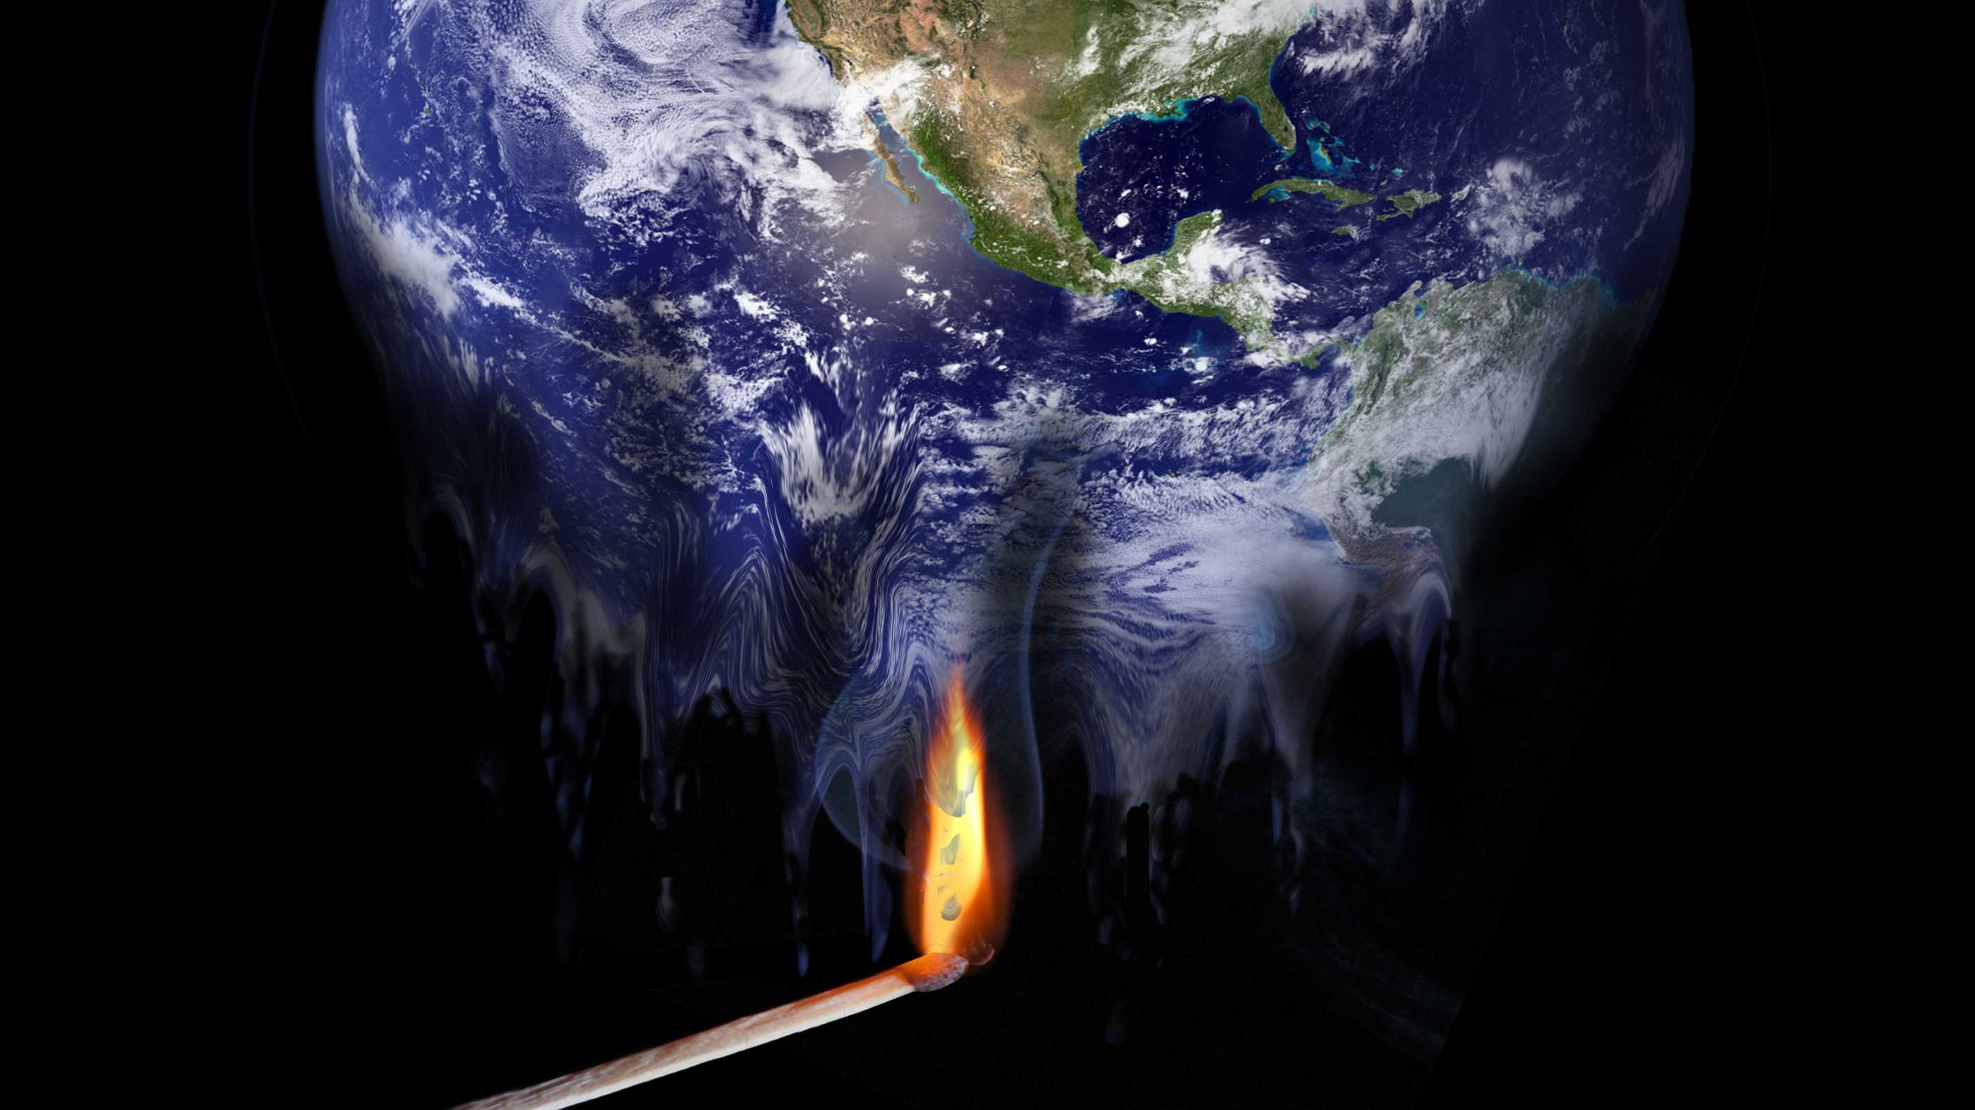
The Real task on hand: Climate change
Rex Dovolani Eng 1121 Professor J. Penner

Slide 2
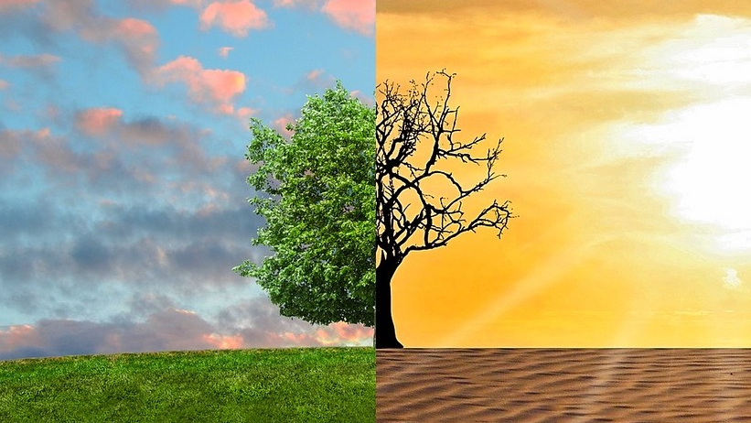
What is climate?
Climate is the average of weather over a long period of time.
Climate enables us to determine:
- hot or cold
- cloudy or clear
- humid or dry
- hurricane or tornado
- snowfall or snowmelt
Climate Change is the change in weather patterns
This Photo by Unknown Author is licensed under CC BY-SA

Slide 3
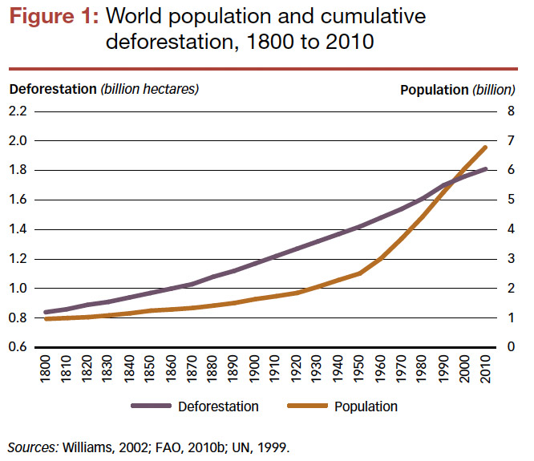
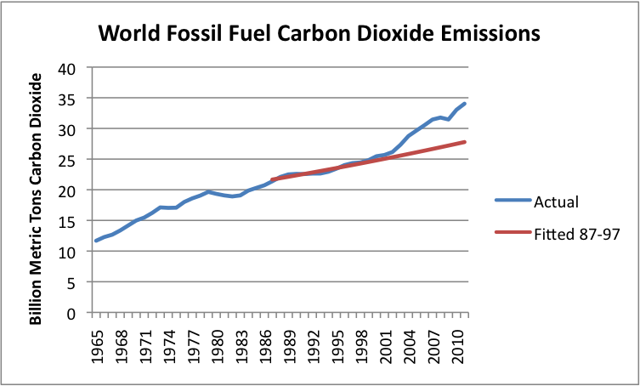
Causes of climate change
Two Human Activities are the main cause of climate change:
Deforestation: removal of trees for use of agriculture
Air Pollution: the release of harmful substances into the environment, caused by cars, airplanes and other chemicals

Slide 4
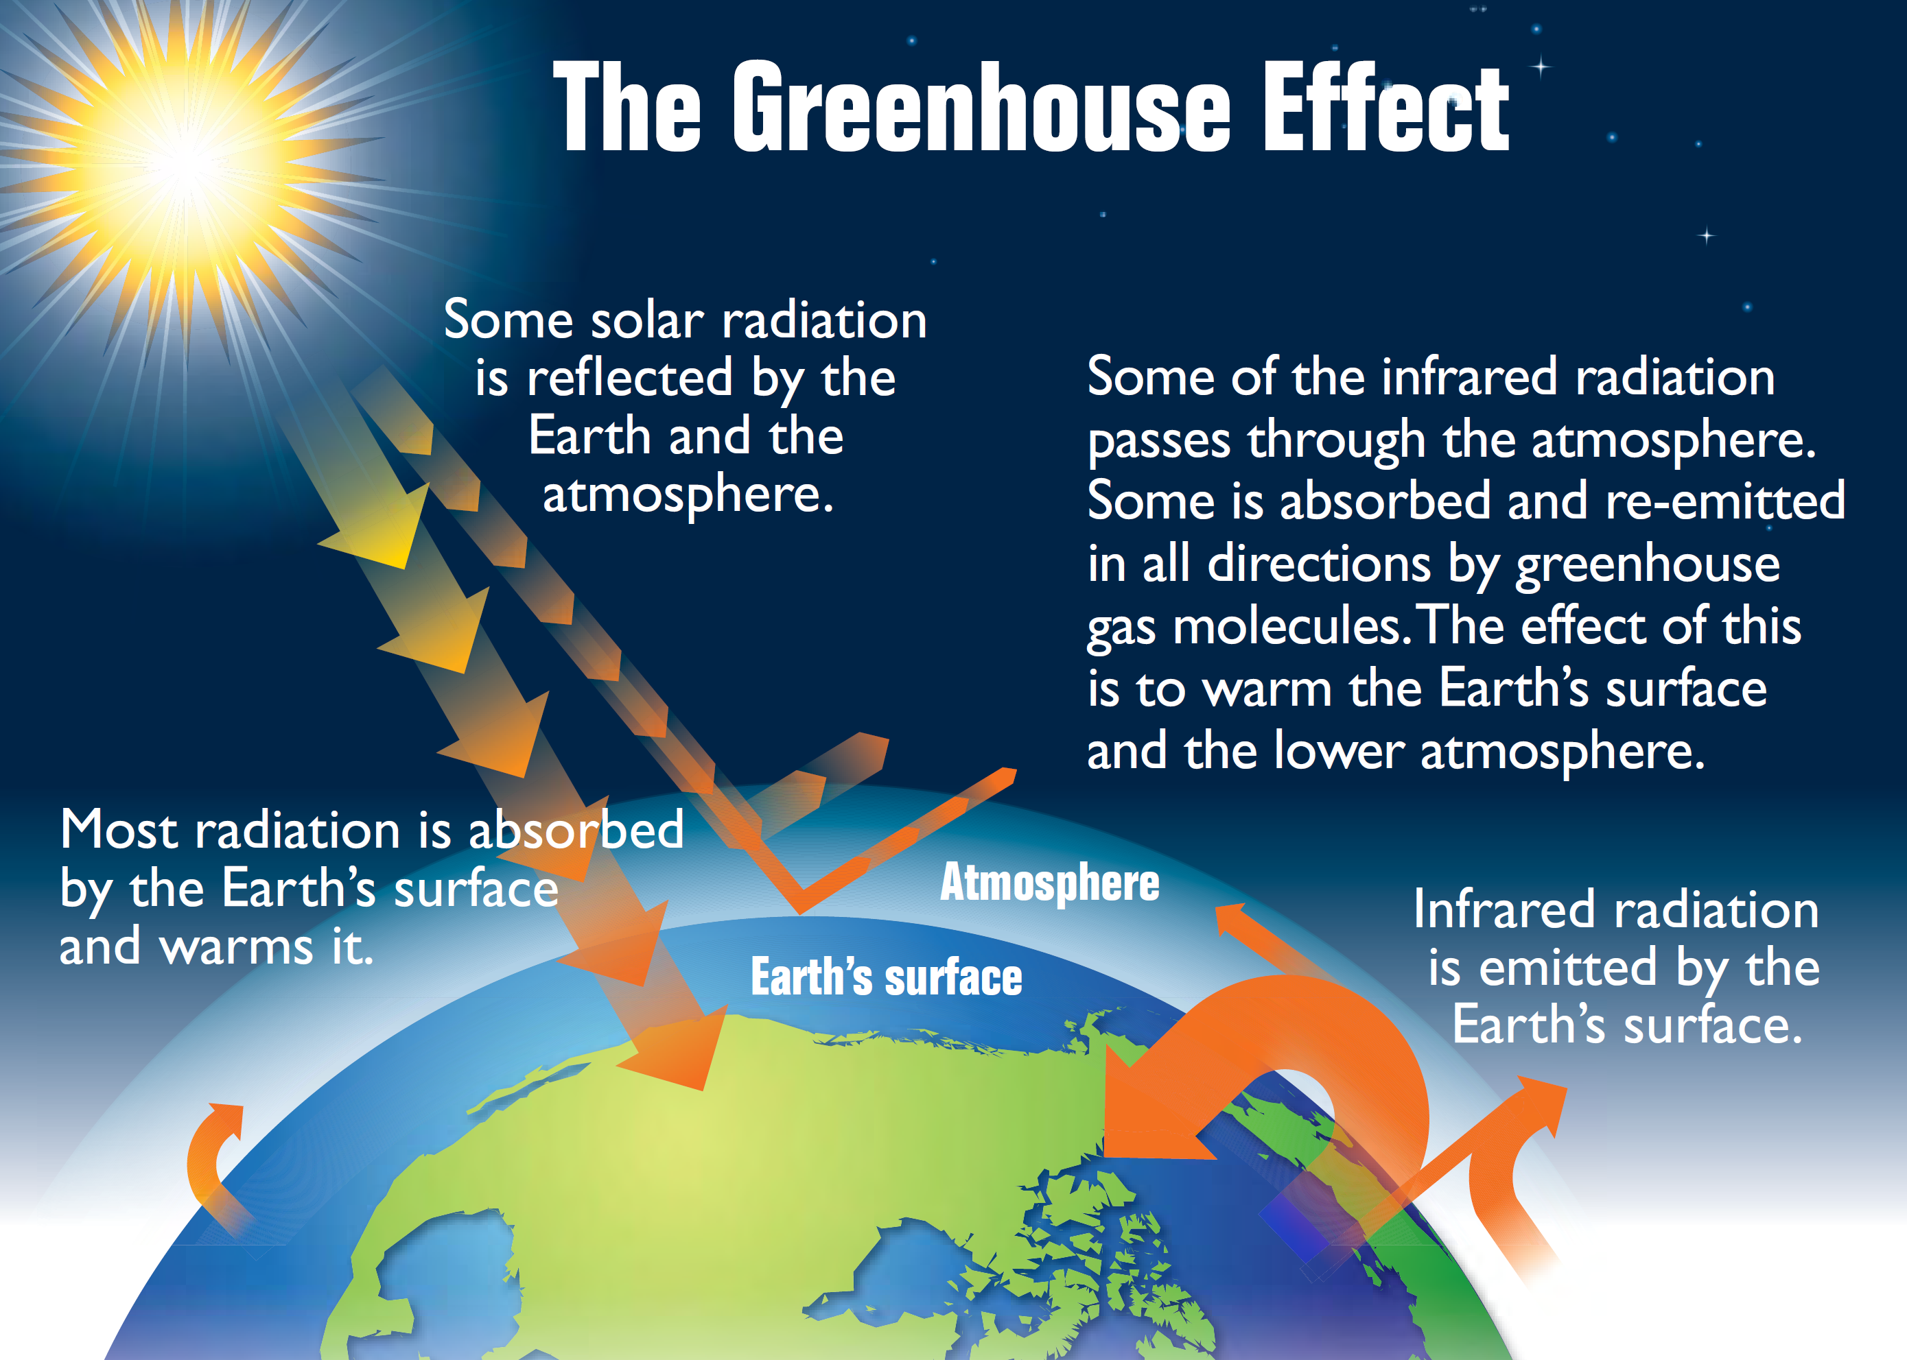
Greenhouse gases
Gases in our atmosphere play a role like glass does in a greenhouse. It contracts the heat from the sun and does not allow it back into space.
Some gases are escaping into our atmosphere due to human activity, such as:
Carbon Dioxide (C0₂)
Nitrous Oxide
Methane
Fluorinated gases
This Photo by Unknown Author is licensed under CC BY-SA
This Photo by Unknown Author is licensed under CC BY-SA

Slide 5
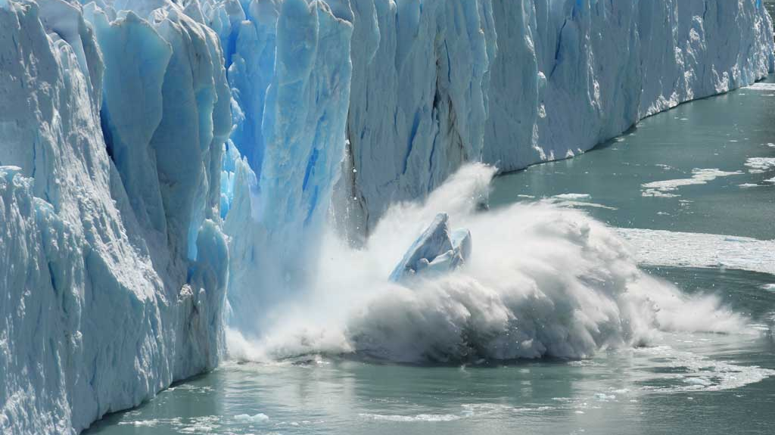
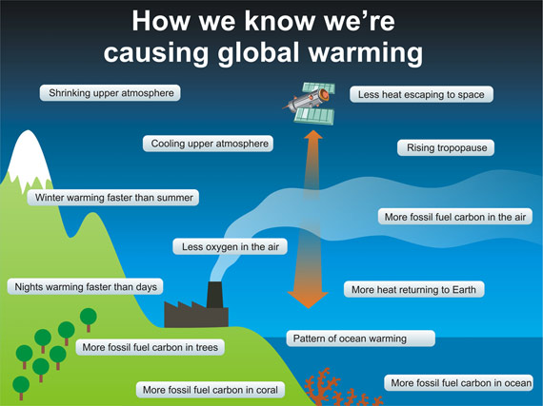
What are the contrasts?
This Photo by Unknown Author is licensed under CC BY
This Photo by Unknown Author is licensed under CC BY
This Photo by Unknown Author is licensed under CC BY-NC-ND

Slide 6
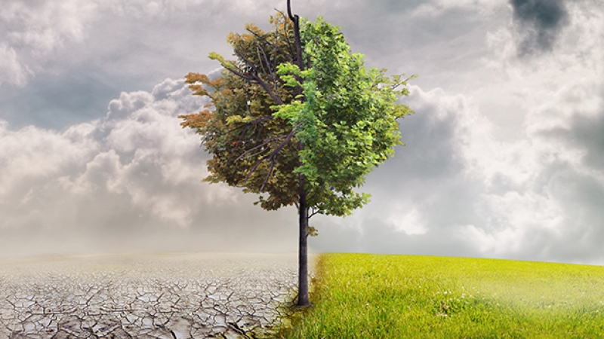
CLIMATE Change Global warming
- Long-term change in average - Long-term heating of the
weather patterns globes climate system
- if surface TEMPERATURE - increase in surface
increases, REGIONAL OR TEMPARTURE DUE TO BUILD-UP
OR LOCAL TEMPARTURES MAY OF GRENHOUSE GASES IN
DECREASE OR REMAIN THE SAME ATMOSPHERE
This Photo by Unknown Author is licensed under CC BY-NC

Slide 7
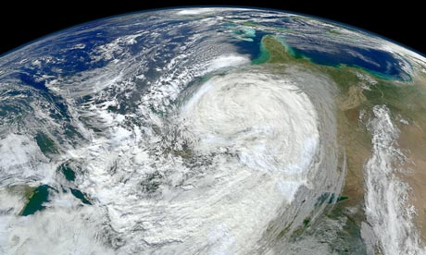
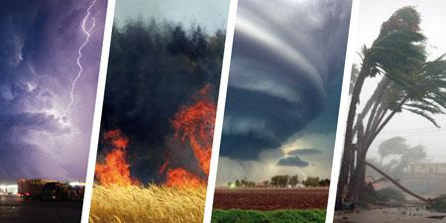
Extreme weather and climate change
Climate change is expected to increase the chance of more frequent extreme weather events with higher intensities. The rise in sea levels increase the impact of costal storms and warming. Forming extreme weather events such as:
Hurricanes
Tornadoes
Extreme precipitation
wildfires
This Photo by Unknown Author is licensed under CC BY-SA-NC
This Photo by Unknown Author is licensed under CC BY-ND

Slide 8
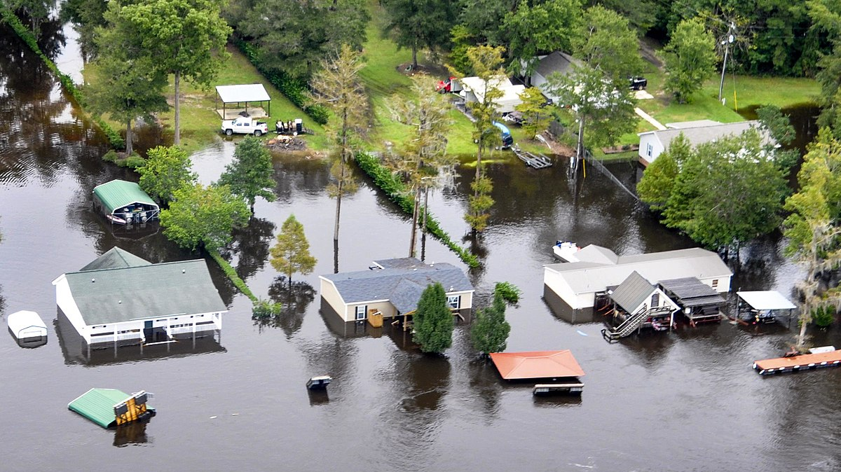
Potential Risks
Climate change does not only pose a risk to our environment and ecosystem. It puts humans at risk of health conditions.
Hotter days, more rain and higher humidity can produce more ticks, which can spread infectious diseases like Lyme disease.
Extreme weather events can cause power outages that could impact our hospitals and transportation system when needed most
Heat waves, droughts and trauma from floods can lead to mental health issues such as, but not limited to; anxiety, depression and suicide.
Decline in crop production could lead to undernutrition, hunger and dramatic increase in prices of food.
This Photo by Unknown Author is licensed under CC BY-SA

Slide 9
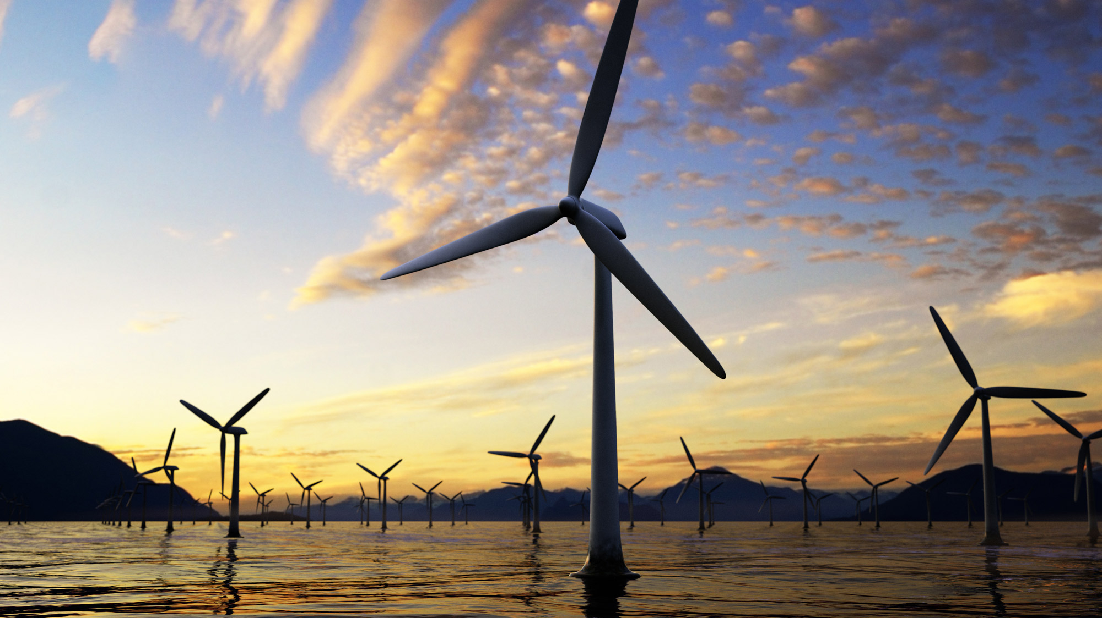
Can we find a solution?
This Photo by Unknown Author is licensed under CC BY-SA-NC

Slide 10
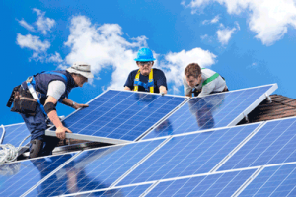
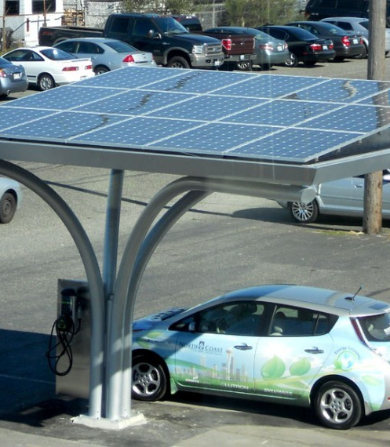
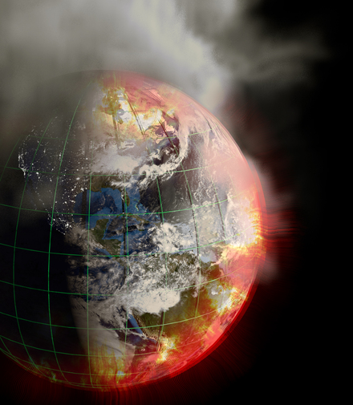
Slowing THE RATE OF co₂ Emissions
The emissions of CO₂ will continue to rise because of population and economic growth. We need to use more efficient energy and reduce the dependency on CO₂. However, using more efficient energy can have an opposite affect due to more of the population relying on efficient energy.
We need to create strict restrictions to create strong incentives for the worlds industry to transition. For example, use electric powered vehicles and phase out fossil fuel vehicles. Furthermore, we need to invent new and better technology without it, it will be nearly impossible to create a world with zero CO₂ emissions.
This Photo by Unknown Author is licensed under CC BY-SA
This Photo by Unknown Author is licensed under CC BY-ND

Slide 11
Are we good on time?
We need to find ways to reduce CO₂ emissions today. As we invent what we will need in the future, we need to burn fewer fossil fuels over the next few years, this way we can allow more time for innovation to catch up.
This Photo by Unknown Author is licensed under CC BY-SA

Slide 12
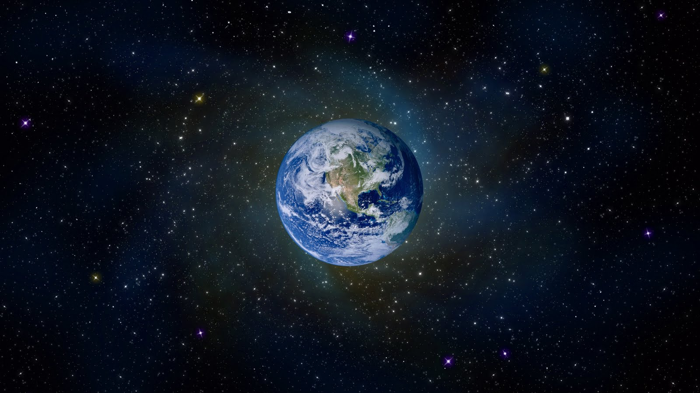
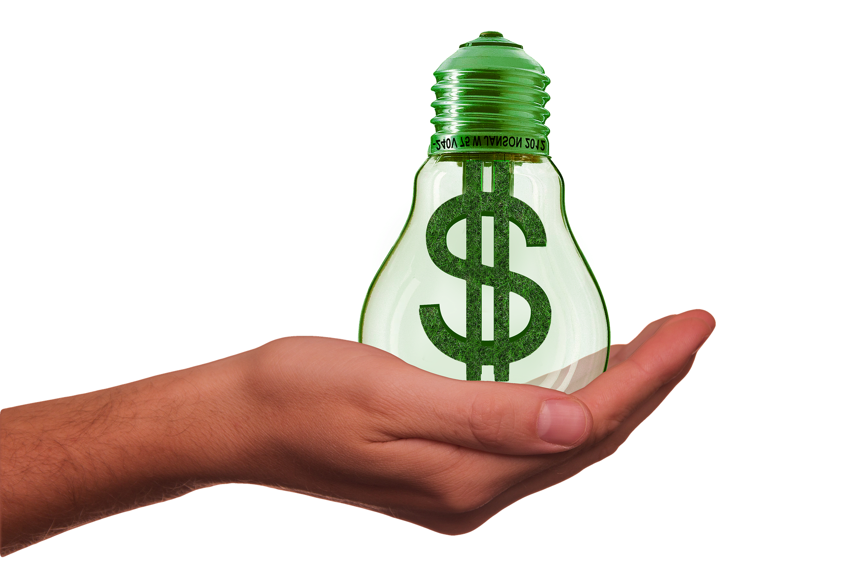
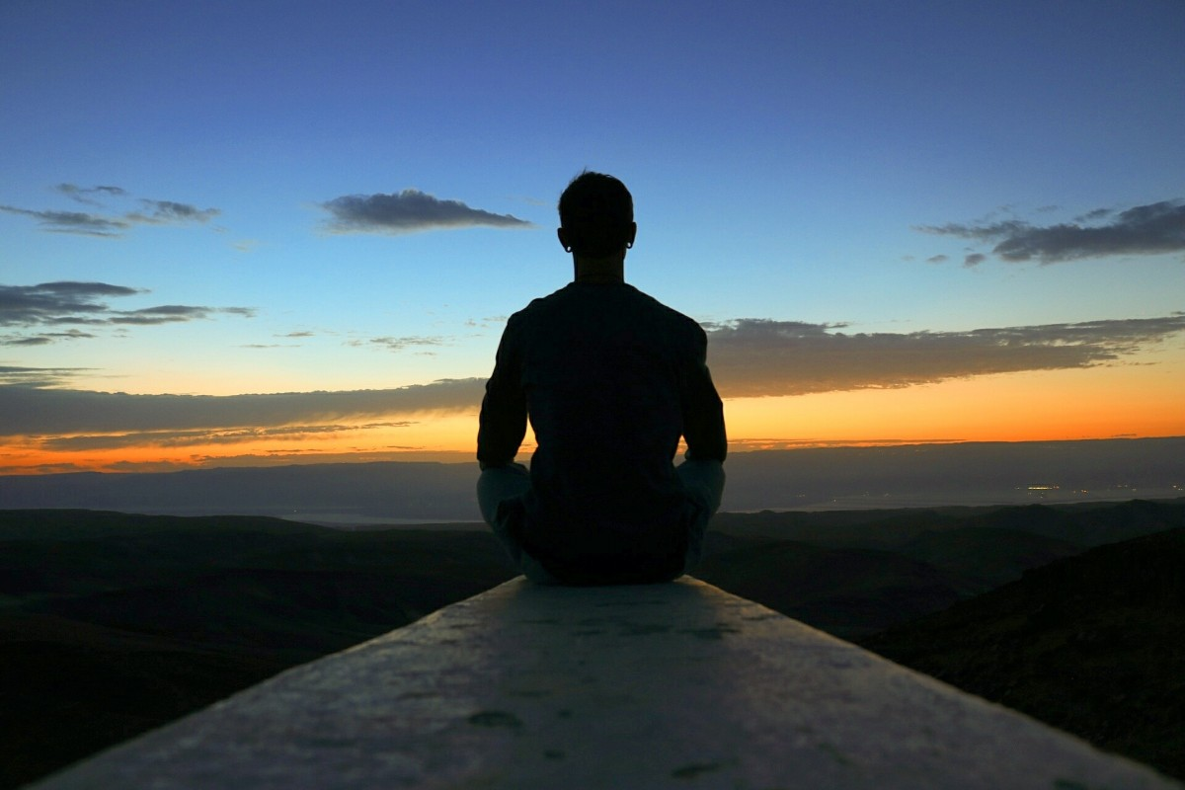
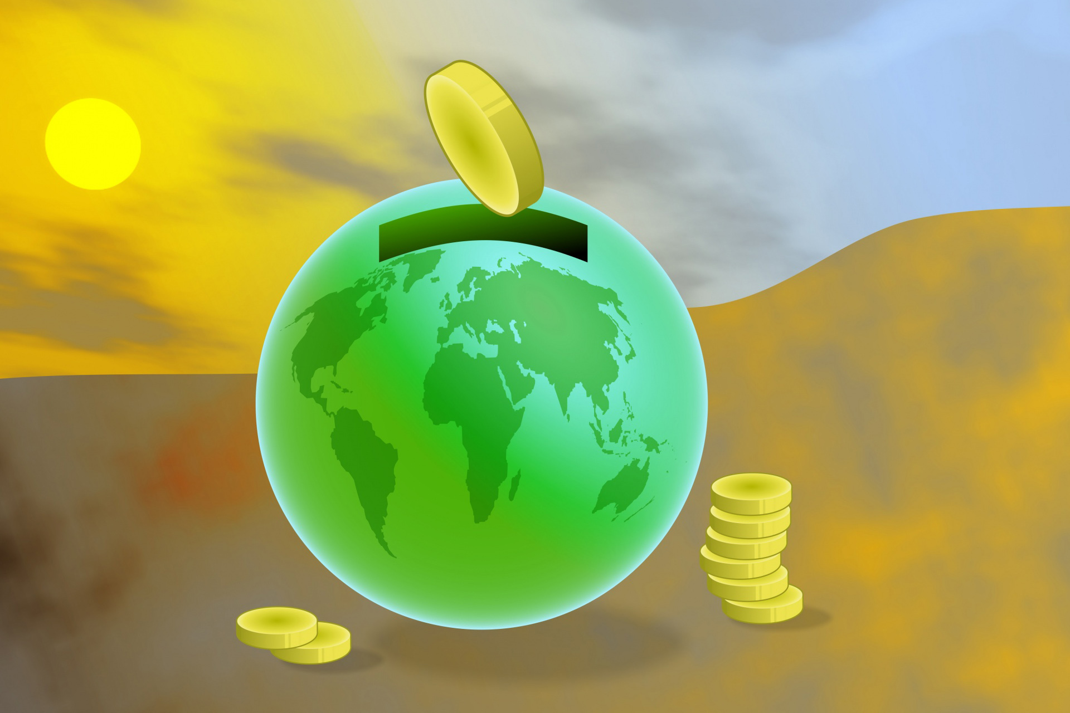
LET’S SOLVE THE TASK AND SAVE OUR PLANET
Bring up climate change in your daily conversations
Green your commute, move closer to work
Use energy wisely and save money also!
Consume less, waste less, and enjoy more life!
Invest in renewable energy
This Photo by Unknown Author is licensed under CC BY-NC-ND

Slide 13
REFERENCES
https://ec.europa.eu/clima/change/causes_en
https://climate.nasa.gov/causes/
https://www.climate.gov/news-features/climate-qa/whats-difference-between-global-warming-and-climate-change
https://www.youtube.com/watch?v=wbR-5mHI6bo&t=161s

