Slide 1
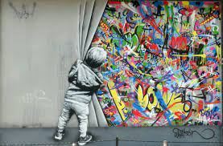
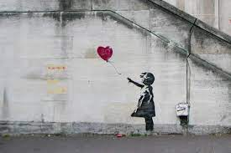
Street art
Alexxa Cornejo

Slide 2
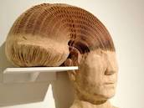
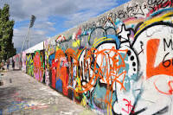
What is street art?
How can using street art help?
Street art is a form of artwork that is displayed in public on buildings, streets, trains and other publicly viewed surfaces. Street art is also related to graffiti art that it is created in public locations and is usually unsanctioned.
By portraying the realities of poverty, discrimination, and systemic injustices, street art advocates for positive change and social empathy. Street art has a long history of political expression and activism that creates awareness. Artists use their work to challenge political leaders, ideologies, and policies.
Different types of street art
They’re many different types of street art for example, graffiti , which is very common and what we usually see. 3D sculptures, poster art, chalk art etc.

Slide 3
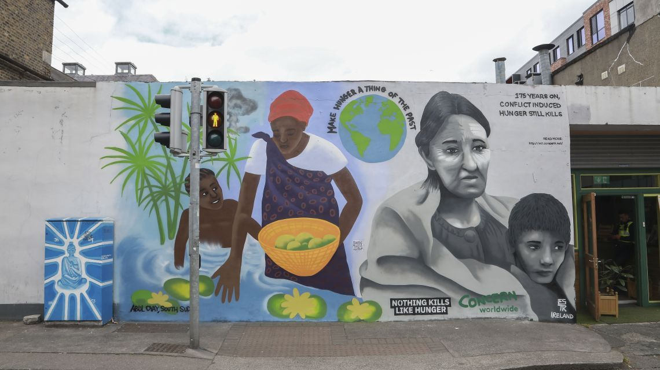
Mentor piece
The point of view of this piece is written from two different perspectives. One is from the Irish famine point of view while the other was inspired by growing up in South Sudan through famine.

