Slide 1
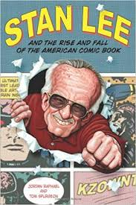
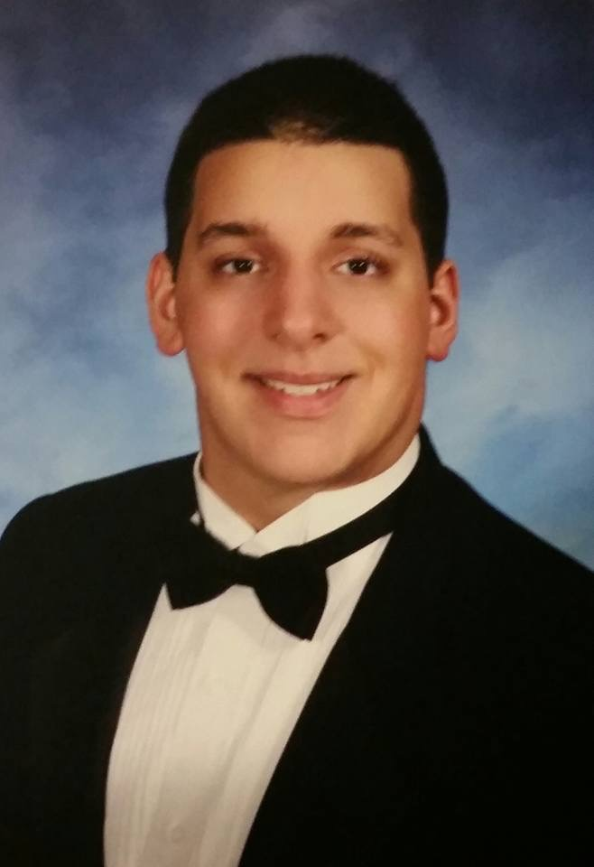
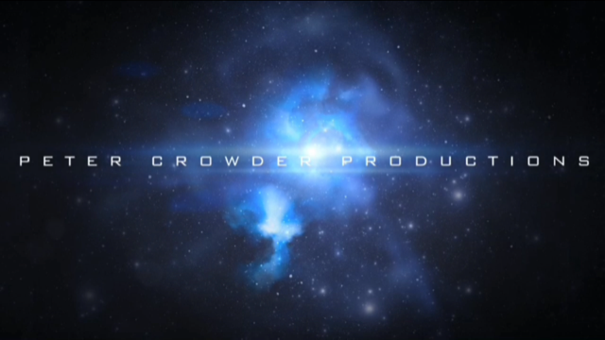
True Believers: A Stan Lee Tribute Documentary
Written ,Directed, Edited and Narrated by: Peter Crowder

Slide 2
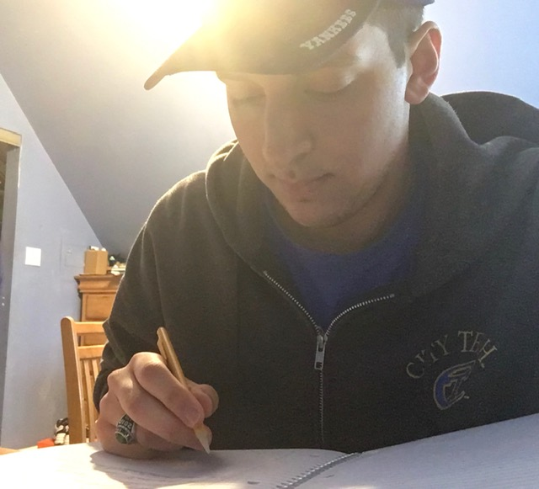
Introduction
What I decided to do for my culmination project is to create a documentary movie. (what project is)
My film is called “True Believers: A Stan Lee Tribute film”. It is a tribute to the creator of Marvel Comics, Stan Lee.(what the film is about and its title)
I am the writer, director and narrator of the film. (what I have done for the film)

Slide 3
Overview
What I plan to discuss in “True Believers” is the history of Stan’s life, his life with creating comics, the people he met along the way, and the people who had gotten to know him, whether it be friends or fans.
The process included gathering a lot of equipment such as cameras (canon, and iPhone), microphones, and editing software(Avid MC, iMovie).

Slide 4
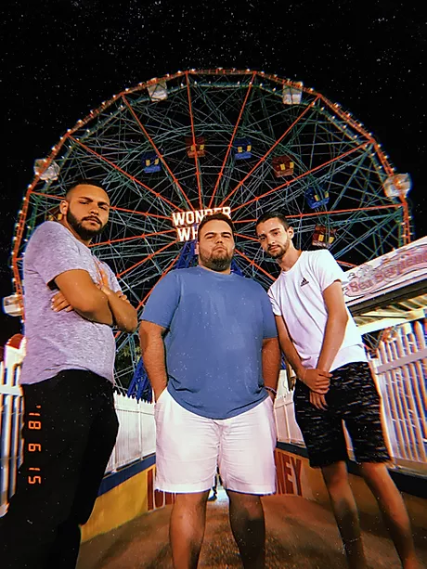
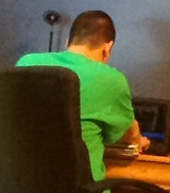
Basic Information
I worked on this with a small group of close friends that all agreed to volunteer and help me create this movie. They had a lot of the equipment that I required for making the film, since they have their own short film production team.
I had worked on this film throughout the last 6+ months gathering research, writing the scripts, recording the footage, etc.
All of the footage was done from home and recorded in Brooklyn, New York, which is the basis for many of Stan's works. Many of the people that I interviewed for the film range from friends and close relatives to people I had encountered on the streets.
A lot of the research and information provided for the film was given from research sites, such as biography.com and britannica.com.

Slide 6
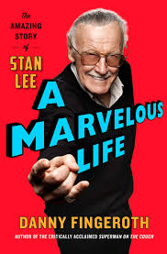
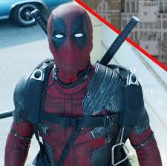
Process
First, I had to gather research on the history of Stan’s life and the roads he took to get where he was.
Next, I created a list of people to interview, as well as a list of questions for them to answer while I interview them.
Then I recorded footage of interviews at different locations, establishing shots, narrations, as well as gathering images of Stan, his characters, and many important factors in his life. This took several months and many small reshoots.
Lastly, I had to edit the film together and set the shots correctly.

Slide 7
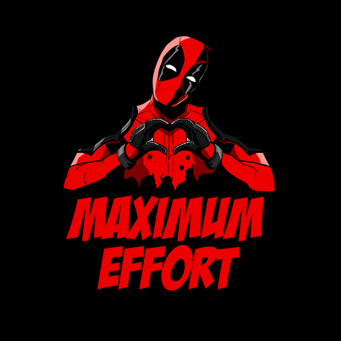
How I feel now about the project.
After completing this project. I feel acceptingly proud of myself that I was able to make something this phenomenal, and I am certain that Mr. Lee would agree.
The conclusion that I came up to is to be happy with the work that you created. Because, even if people might not like it, you can at least be glad you made something that you enjoy, and you got to do it with others.

