Slide 1
VIGNETTS of DENTAL RESTORATIONS
by Opal Thomas RAD 1218
CROWNS
PFM
DENTAL
IMPLANTS
BRIDGES
PANORAMIC IMAGE of DENTAL IMPLANTS in MANDIBLE
RADIOPAQUE : PORCELAIN FUSED to METAL, BRIDGES: PONTICS & ABUTMENTS RADIOPAQUE

Slide 2
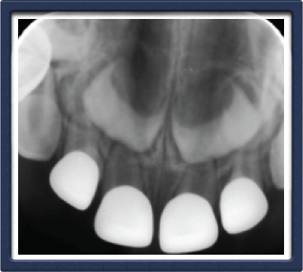
IMPLANTS
TITANIUM SCREWS,ANCHORED IN ALVEOLAR BONE
CROWNS CAN BE SINGLE/MULTIPLE UNITS, PFM or ZIRCONIA
[all porcelain]
Zirconia
All radiopaque, smooth margin
All metal
GOLD

Slide 3
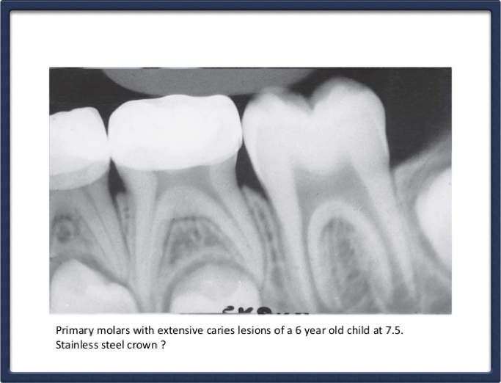
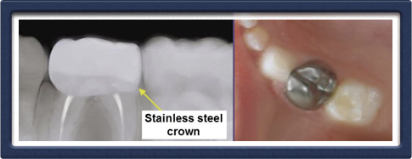
STAINLESS STEELE CROWN on Primary Teeth
CLINICAL &
RADIOGRAPHY
RADIOPAQUE

Slide 4
MAXILLARY SINGLE/FIVE UNIT PFM BRIDGE
PORCELAIN is RADIO LUCENT ; FUSED to a RADIOPAQUE METAL BASE

Slide 5
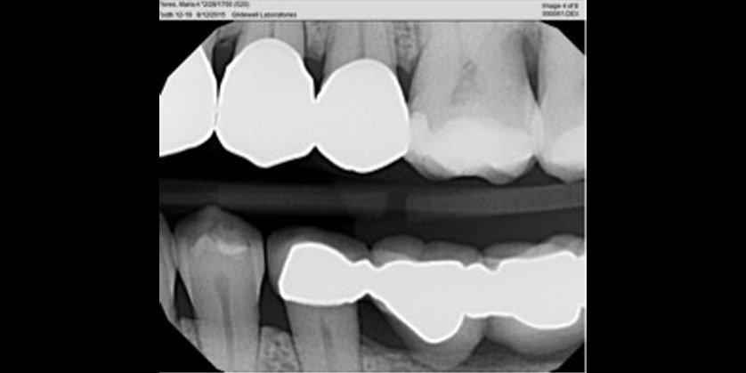
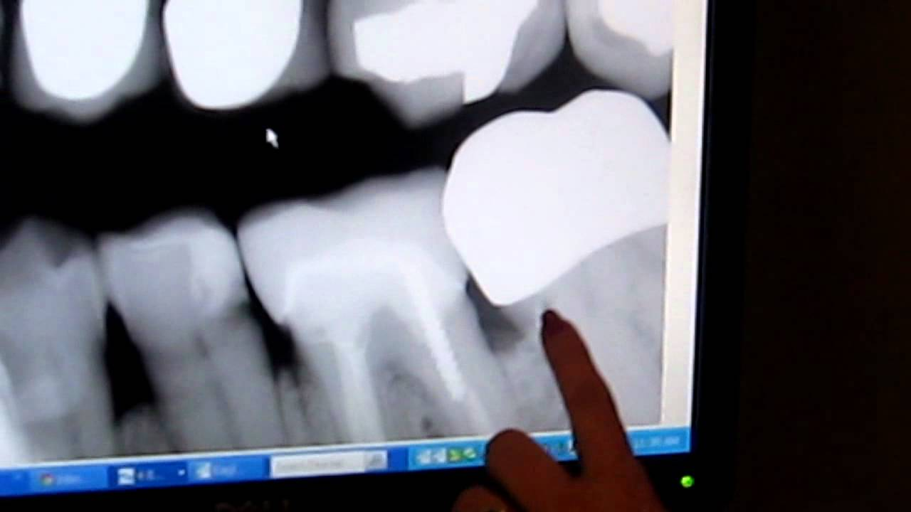
ALL

Slide 6
Mixed Restorations
Amalgam filling [silver metal] is radiopaque;
Composite filling [tooth colored]is less radiopaque

Slide 7
ZINC OXIDE EUGENOL [ZOE]
AKA : Intermediate Restorative Material {IRM}
Clinical & Radiograph Evaluation of ZOE.
Less Radiopaque
Uses & Characteristics:
Cementing agents for crowns & FPD’s
Temporary restorations
Eugenol is used to calm the nerves in the tooth

Slide 8
ZINC PHOSPHATE CEMENT
Less Radiopaque
ZINC PHOSPHATE CEMENT:
Similar uses as ZOE
Uses & Characteristics:
Cementing agents for crowns & FPD’s
Temporary restorations
Insulating base
Produces heat when mixed.
[Glass slab is indicated]

Slide 9
CALCIUM HYDROXIDE SEALERS
Exhibits antimicrobial properties and have
osteogenic potential to promote apical closure of immature tooth
Temporary dressings for canals

Slide 10
Dycal Calcium Hydroxide Liner
RADIOPAQUE
Dycal Calcium Hydroxide Liner
is a two-component, rigid-setting, self-curing material designed for use in direct and indirect pulp capping and as a protective liner under dental adhesives, varnishes, filling materials, cements, and other base materials.

Slide 11
REFERENCES:
–GOOGLE IMAGES-

