Slide 1
MOSQUITOES AND THE DISEASES THEY SPREAD IMAGES

Slide 2
Anopheles stephensi
Anopheles stephensi is found throughout the Middle East and South Asia. It is the main malaria vector in urban India, often making use of water that collects at construction sites or other industrial areas. It comes in three different forms: one that prefers urban habitats and likes biting humans; one that lives rurally and feeds on animals; and one that does a mix of the two.
Credit: Lauren Holden/Wellcome Collection
BIGPICTUREEDUCATION.COM

Slide 3
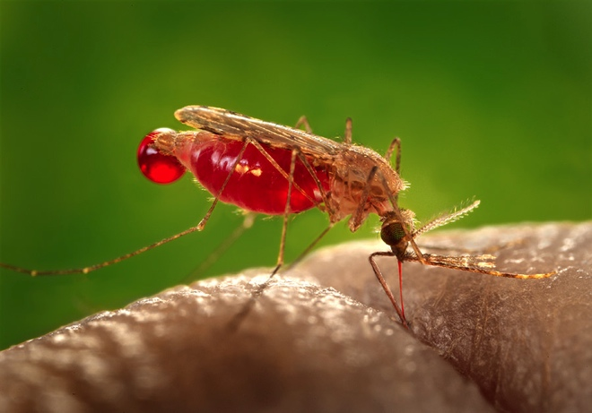
Anopheles gambiae
Anopheles gambiae lives in the African tropics. It is one of the most efficient vectors of malaria in the world. It breeds very quickly (growing from egg to adult in just six days under optimum conditions), and its larvae are often found in shallow temporary pools, such as tyre tracks or hoof prints filled with rainwater. There are a number of mosquitoes that are physically very similar to Anopheles gambiae but which behave very differently (several, for example, use salt water to breed). These related species have their own names, but are together known as the Anopheles gambiae complex.
Credit: James Gathany, Centers for Disease Control and Prevention/Flickr

Slide 5
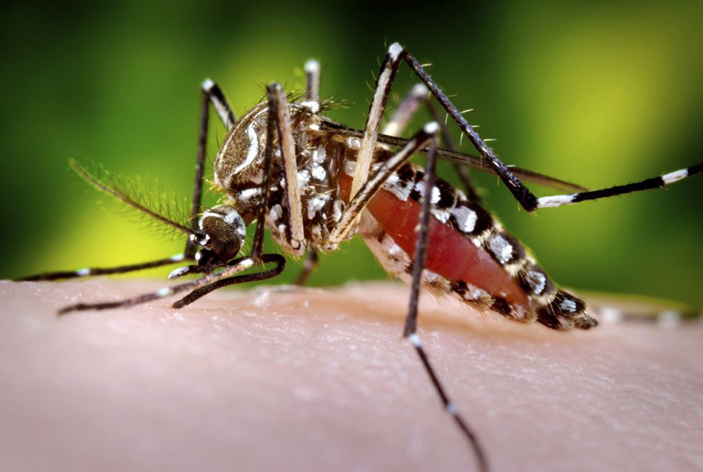
Aedes aegypti
Aedes aegypti – also known as the yellow fever mosquito – originated in Africa, but today can be found in tropical and subtropical regions across the world. It may even be moving into the USA and Europe. It has adapted well to living in urban environments, exploiting bodies of stagnant water created by humans. It is responsible for spreading the Zika virus, and also transmits the viruses that cause yellow fever, chikungunya, dengue fever, West Nile fever and eastern equine encephalitis.
Credit: James Gathany, Sanofi Pasteur/Flickr
BIGPICTUREEDUCATION.COM

Slide 6
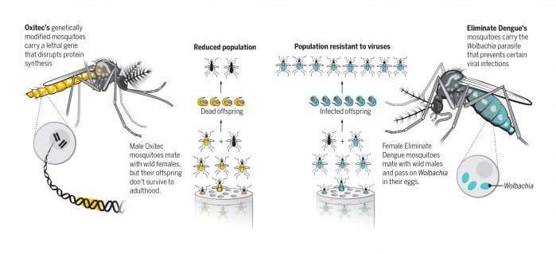

Slide 10
Life cycle stag two: larva
The eggs then hatch into larvae, which live just under the water’s surface. They feed on microorganisms such as algae and bacteria, breathing air from above the surface. Depending on the species, larvae breathe either by using a tube (known as a siphon) or through holes in their abdomen (called spiracles). The larva pictured – of the genus Culex – uses siphons.
Credit: laboratorio diagnostica ancona IZSUM/Flickr
BIGPICTUREEDUCATION.COM

Slide 11
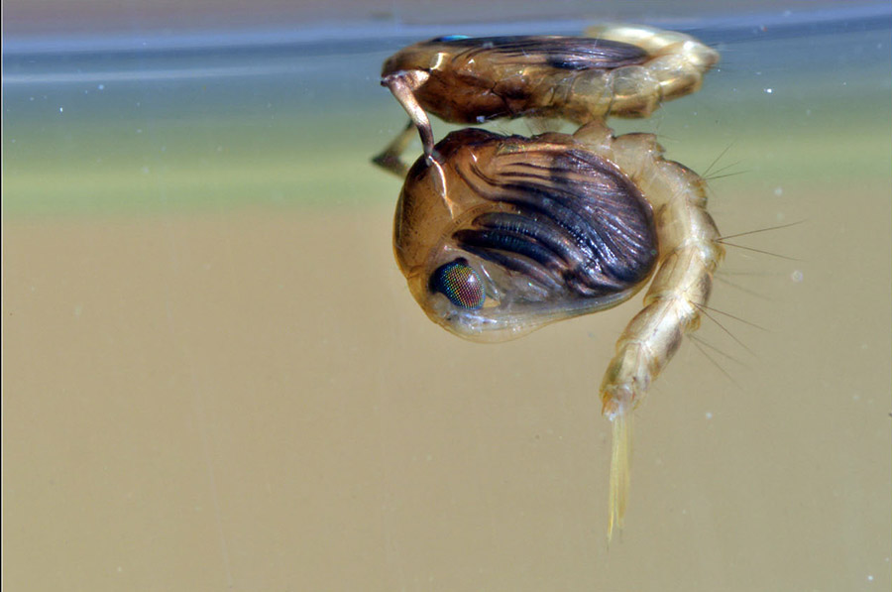
Life cycle stage three: pupa
As it grows, a larva sheds its skin. A larva will do this four times before turning into a comma-shaped pupa. The mosquito now stops feeding, but still needs to stay near the water’s surface to breathe. It is during this stage that the mosquito metamorphoses into a winged insect. The pupa pictured belongs to the genus Culex.
Credit: Christophe Quintin/Flickr (CC BY-NC)
BIGPICTUREEDUCATION.COM

Slide 12
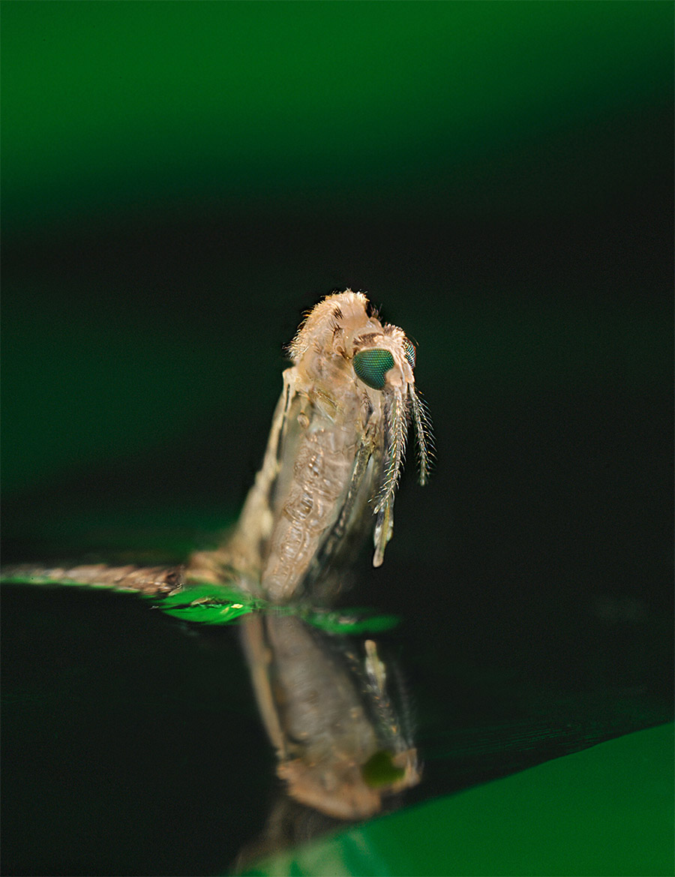
Life cycle stage four: adult
After resting and developing, the pupa’s skin splits to allow the adult mosquito to emerge. The adult rises out of the water (as pictured), before resting on the surface, allowing its body to dry and harden. It then flies away. A few days after emerging, adults will begin to mate – restarting the life cycle. This emerging mosquito belongs to the genus Anopheles.
Credit: James Gathany/Centers for Disease Control and Prevention
BIGPICTUREEDUCATION.COM

Slide 13
Life cycle stage one: egg
A mosquito’s life cycle begins with an adult female laying eggs, which then need a body of water to hatch into (usually stagnant fresh water). Some species lay eggs directly onto the water’s surface, sticking them together as a raft; others drop theirs in one by one. Some instead prefer to lay their eggs near to water, leaving them to be flooded. This is a scanning electron micrograph image of the surface of a mosquito egg; air is trapped in the round gaps which allows the eggs to float on the surface of the water, preventing them from sinking.
Credit: Kevin Mackenzie, University of Aberdeen/Wellcome Collection

Slide 14
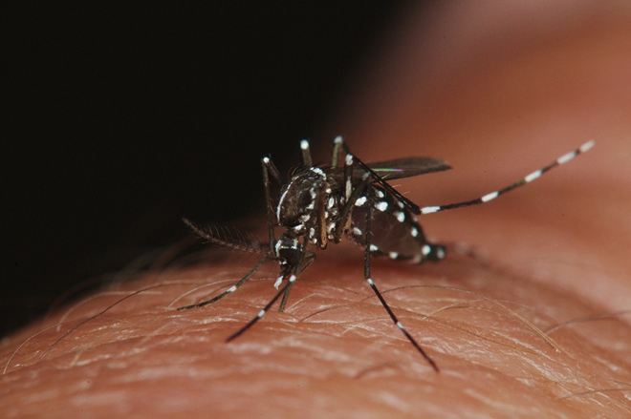
Aedes albopictus
Also known as the Asian tiger mosquito, Aedes albopictus transmits the viruses that cause yellow fever, chikungunya, dengue fever, West Nile fever and eastern equine encephalitis. It also spreads the Zika virus as well as some roundworm parasites, such as dog heartworm (Dirofilaria immitis). Originally from Asia, it has settled in pockets around the world – for instance in Albania and Italy – and is considered the most invasive species of mosquito. It is very adaptable, breeding in both artificial and natural bodies of water.
Credit: James L Occi/Flickr

Slide 15
Culex mosquito
Culex is a large genus of mosquitoes made up of over 700 species. Examples can be found across the world. Some Culex species are known to spread filariasis – a disease caused by certain types of roundworm – as well as viruses that trigger various forms of encephalitis (brain inflammation). The mosquito pictured is Culex pipiens, the common house mosquito.
Credit: Volkmar Becher/Flickr
BIGPICTUREEDUCATION.COM

Slide 16
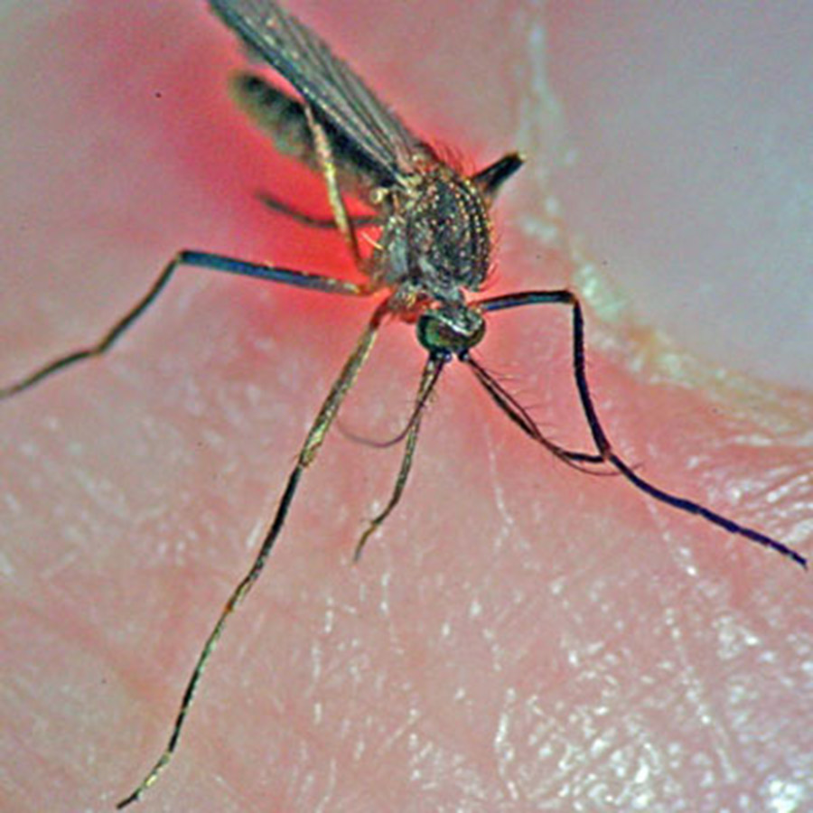
Culiseta melanura
Culiseta melanura, the black-tailed mosquito, spreads eastern equine encephalitis. Its habitat stretches from Quebec in eastern Canada down the east side of the USA and into eastern Mexico.
Credit: Mafloceb/Wikimedia Commons

Slide 17
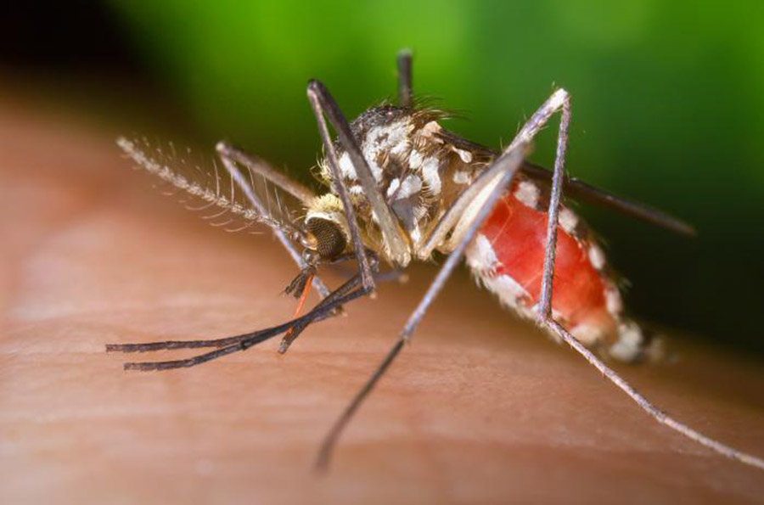
Aedes triseriatus
Aedes triseriatus is a species native to eastern North America. Its preferred place to breed is in water trapped in tree holes. It is the primary vector of La Crosse virus, which causes a form of encephalitis. Unlike many mosquitoes, Aedes triseriatus likes to bite during the day.
Credit: James Gathany, Centers for Disease Control and Prevention/Flickr (CC BY)
BIGPICTUREEDUCATION.COM

Slide 18
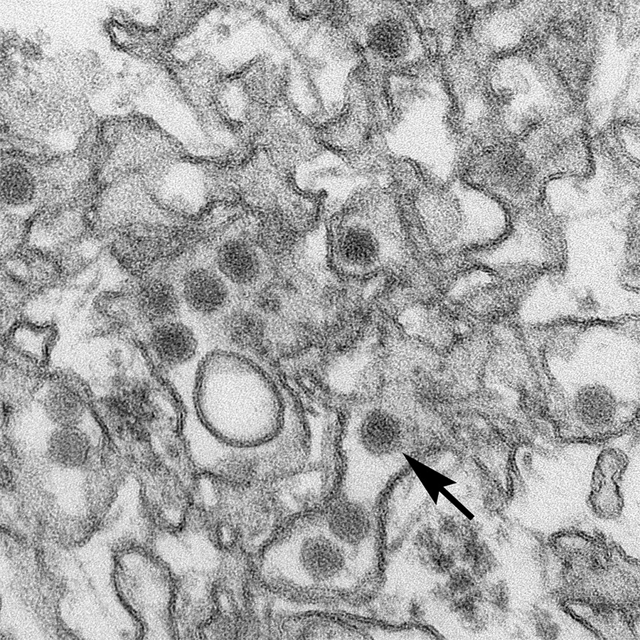
Zika virus
Transmission electron micrograph (TEM) of the Zika virus. The arrow is pointing to a single virus particle. The most common symptoms of Zika virus disease are fever, rash, joint pain and conjunctivitis. Following a major outbreak in South America in 2016 – by far the largest to date – researchers think it might also cause microcephaly (underdevelopment of the head and brain) in unborn children. Previous outbreaks have occurred in Africa, South-east Asia and the Pacific Islands.
Credit: Cynthia Goldsmith/Centers for Disease Control and Prevention

Slide 19
Malaria
Blood smear showing the presence of Plasmodium falciparum parasites, which cause malaria, in red blood cells.
Malaria is endemic in equatorial countries across the world.
Credit: Manchester Metropolitan University/Flickr

Slide 20
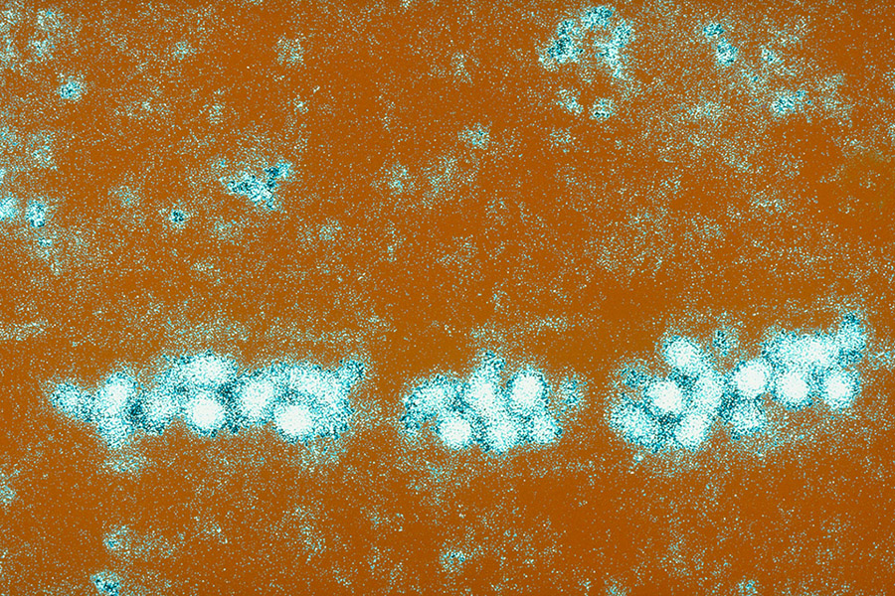
Yellow fever
Electron microscope image of the yellow fever virus. Symptoms of yellow fever commonly include chills, nausea and muscle pain. It may also damage the liver and lead to the skin turning yellow. An effective vaccine for yellow fever exists, but despite this it still kills around 30,000 people a year. Ninety per cent of these deaths occur in Africa.
Yellow fever is common in tropical and subtropical areas of Africa and South America.
Credit: Alain Grillet, Sanofi Pasteur/Flickr

Slide 21
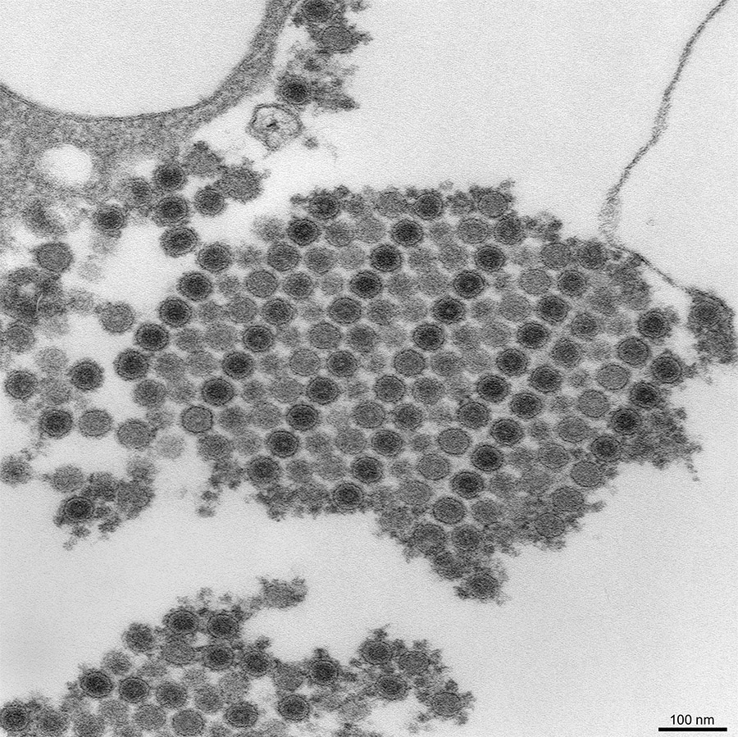
Chikungunya
Transmission electron micrograph (TEM) depicting numerous chikungunya virus particles. The main symptoms of chikungunya are fever and joint pain, which is often debilitating. The virus sometimes also causes rashes. The disease typically occurs in Africa, Asia and the Indian subcontinent, but in recent years outbreaks have also been recorded in France, Italy and Croatia.
Credit: Cynthia Goldsmith/Centers for Disease Control and Prevention
BIGPICTUREEDUCATION.COM

Slide 22
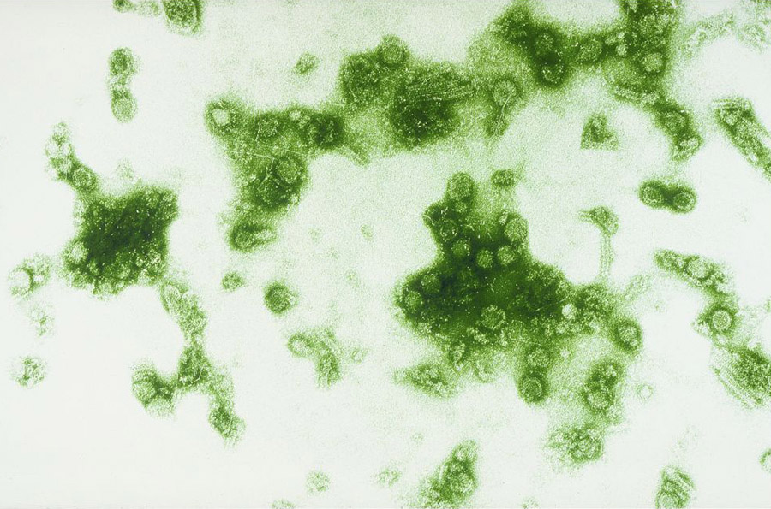
Dengue fever
The dengue virus, as seen under an electron microscope. Highly common in tropical and subtropical regions, it is one of the leading causes of illness in the world, infecting up to 400 million people each year. Like many viral infections, its typical symptoms include fever, headaches, and bone, muscle and joint pain.
Credit: Institut Pasteur and Sanofi Pasteur
BIGPICTUREEDUCATION.COM

Slide 23
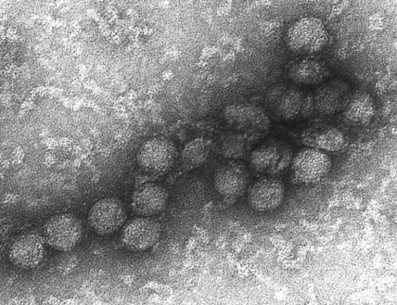
West Nile virus
An electron micrograph of the West Nile virus, commonly found in Africa, western Asia and the Middle East, but also now present in the USA, Australia and parts of Europe.
The virus can infect humans, birds, horses and some other mammals. Only around one in five infected humans will develop a fever, and of these, only one in 150 cases will be severe. However, severe infections can lead to encephalitis, meningitis and polio-like symptoms.
Credit: Cynthia Goldsmith/Centers for Disease Control and Prevention

Slide 24
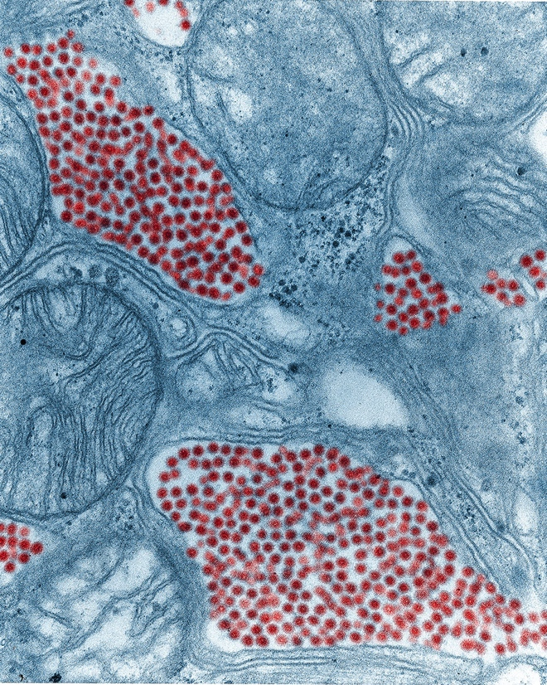
Encephalitis
Various viruses spread by mosquitoes cause encephalitis, or inflammation of the brain. This can result in headaches, fever and fatigue, and in serious cases brain damage and even death. The image above is a colourised transmission electron micrograph (TEM) of a mosquito’s salivary gland filled with eastern equine encephalitis virions (in red). This virus affects eastern parts of the USA, infecting humans, horses and birds.
Credit: Fred Murphy and Sylvia Whitfield/Centers for Disease Control and Prevention

Slide 25
Filariasis
Filariasis is a disease caused by parasitic roundworms of the Filarioidea type, which are transmitted to humans as larvae by certain mosquitoes and flies. They then grow into adults inside the human body. Different species of worm prefer to live in different parts of the body. The worm pictured, Wuchereria bancrofti, lives in the lymph system and can cause a drastic swelling of tissues known as elephantiasis.
Credit: Marc Perkins/Flickr

Slide 26
Reusing our images
Images and illustrations
All images, unless otherwise indicated, are from Wellcome Images.
Contemporary images are free to use for educational purposes (they have a Creative Commons Attribution, Non-commercial, No derivatives licence). Please make sure you credit them as we have done on the site; the format is ‘Creator’s name/Wellcome Images’.
Historical images have a Creative Commons Attribution 4.0 licence: they’re free to use in any way as long as they’re credited to ‘Wellcome Library, London’.
The Flickr images that we have used in this gallery, unless otherwise stated, are available under a Creative Commons Attribution, Non-commercial, No derivatives licence.
Cartoon illustrations are © Glen McBeth. We commission Glen to produce these illustrations for ‘Big Picture’. He is happy for teachers and students to use his illustrations in a classroom setting, but for other uses, permission must be sought.
We source other images from photo libraries such as Science Photo Library, Corbis and iStock and will acknowledge in an image’s credit if this is the case. We do not hold the rights to these images, so if you would like to reproduce them, you will need to contact the photo library directly.
If you’re unsure about whether you can use or republish a piece of content, just get in touch with us at bigpicture@wellcome.ac.uk.

