Slide 1
Healthy Teeth, Healthy Body
A Fun Guide to Healthy Strong Teeth
Presented by:
Yasareny Esquina Alleyne
Edneshia Lambert
Opal Thomas

Slide 2
Sad Teeth have Cavities

Slide 3
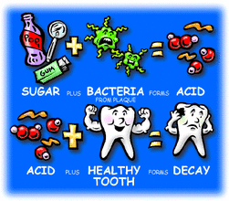
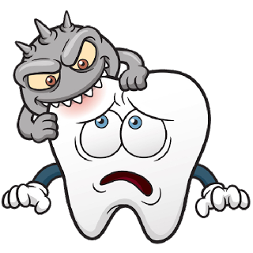
Early Childhood Caries Aka: Baby Bottle Decay
Streptococci mutans bacteria are the main contributor in decay.
Such bacteria can be transmitted from caregiver to babies and children through saliva. Sugar containing food

Slide 4
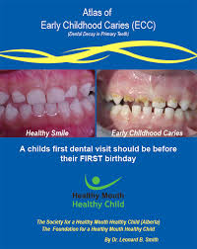
Early Childhood Caries can Lead to...
EXTREME PAIN
SPREAD OF INFECTION & CELLULITIS
CROOKED BITE [MALOCCLUSION]
EXTENSIVE & COSTLY DENTAL TX
INABILITY TO CONCENTRATE
IMPAIRED LANGUAGE DEVELOPMENT
HIGH RISK OF DEVELOPING TOOTH DECAY IN PERMANENT DENTITION

Slide 5
Healthy Teeth
Brushing
Eating Healthy foods
3. Visiting your Dentist

Slide 6
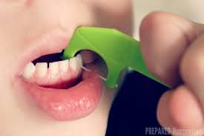
FIRST: FLOSS USING A FLOSS PICK
https://www.google.com/search?hl=en&source=hp&ei=gbmGXobHIc_n_Qa5ybf4CQ&q=how+to+floss+your+teeth+with+floss+picks&oq=FLOSSING+TEETH+WITH+FLOSS+PIC&gs_lcp=CgZwc3ktYWIQARgBMgIIADIFCAAQzQIyBQgAEM0CMgUIABDNAjIFCAAQzQI6BQgAEIMBOgQIABADOgYIABAWEB46CAgAEBYQChAeUPy8BFjSsAVg0eAFaABwAHgAgAGGAYgBzxWSAQQyMS44mAEAoAEBqgEHZ3dzLXdpeg&sclient=psy-ab

Slide 7
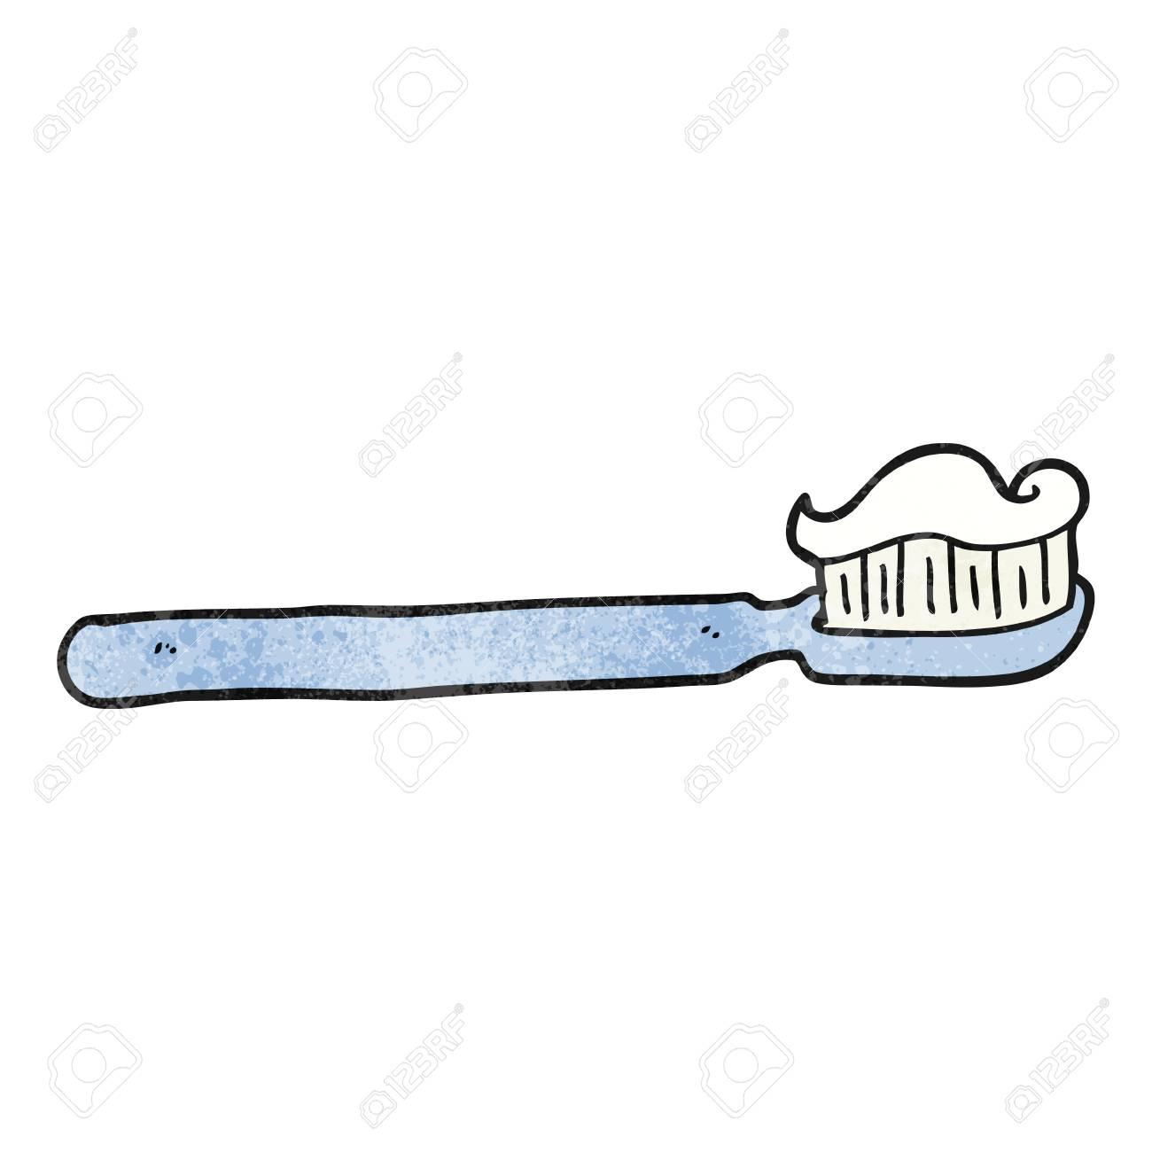
How to Brush
Brush all the sides of your teeth!
Put the brush with toothpaste in your mouth
Move your brush in circles on your teeth on the right side
Move your brush in circles on your front teeth
Move your brush in circles on the teeth on the left side
Move your brush in circles on the tops of your teeth and the insides of your teeth
Turn your brush around and brush your tongue
Rinse your mouth
And you’re done!

Slide 8
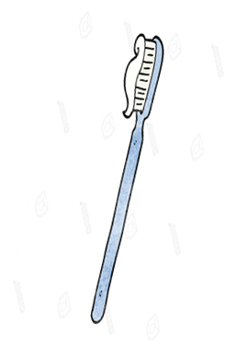
Steps to Brush

Slide 9
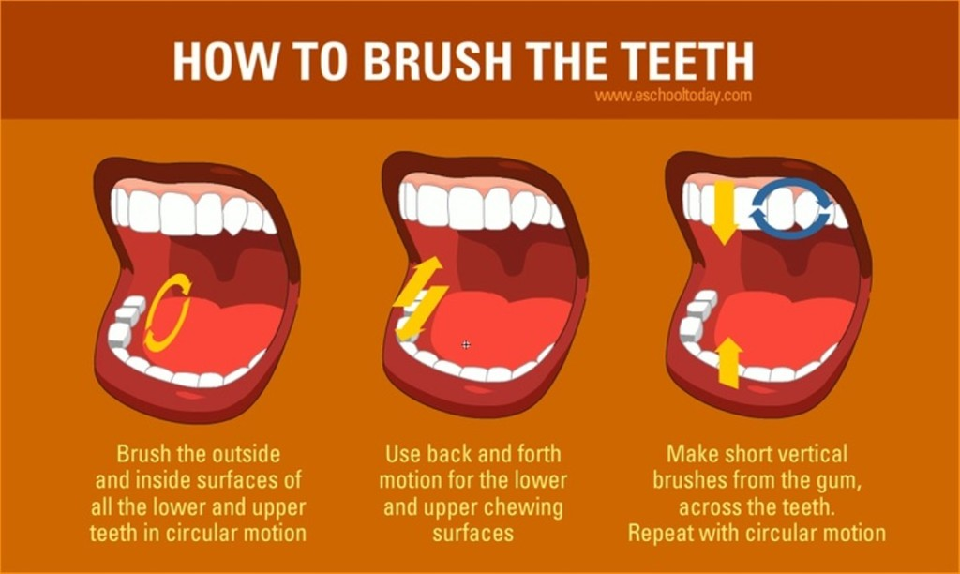

Slide 10
Healthy Foods
Are:
1) Colorful
2) Delicious
3) Grow in the ground or on trees

Slide 11
Unhealthy Foods
1)Come in packages
2) Make you sick if you eat too much
3) Are sticky, salty, sweet, or greasy

Slide 12
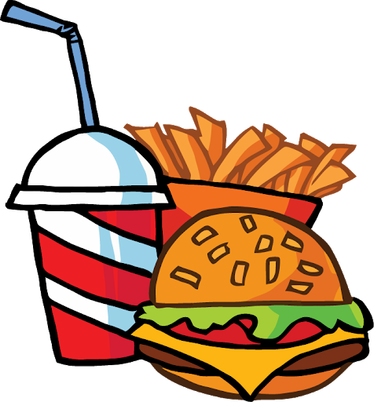
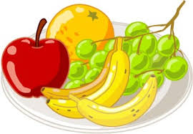
HEALTHY OR NOT?
NOT HEALTHY
HEALTHY
Colorful
Delicious
Grows on Trees
Salty
Greasy
In a bottle
https://clipartix.com/snack-clip-art-image-45266/

Slide 13
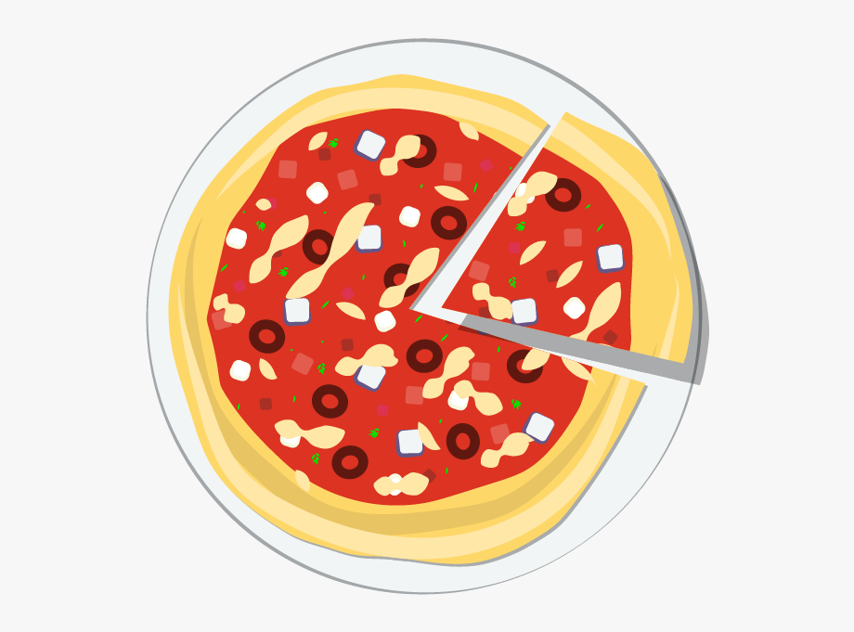
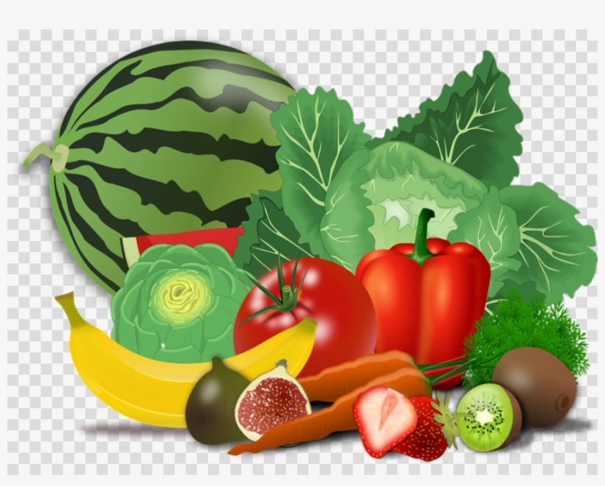
HEALTHY OR NOT?
HEALTHY
NOT HEALTHY
Colorful
Delicious
Grows on trees
Salty
Greasy
https://www.jing.fm/iclip/u2q8t4r5i1r5a9q8_beef-jerky-clipart-unhealthy-food-circle/

Slide 14
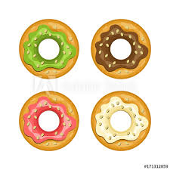
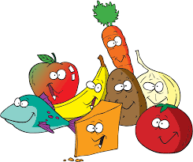
HEALTHY OR NOT?
NOT HEALTHY
HEALTHY
Salty
Greasy
In a bottle
Colorful
Delicious
Good for your body
http://clipartmag.com/snacks-cartoon

Slide 15
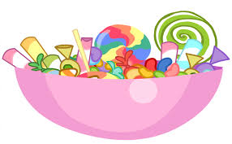
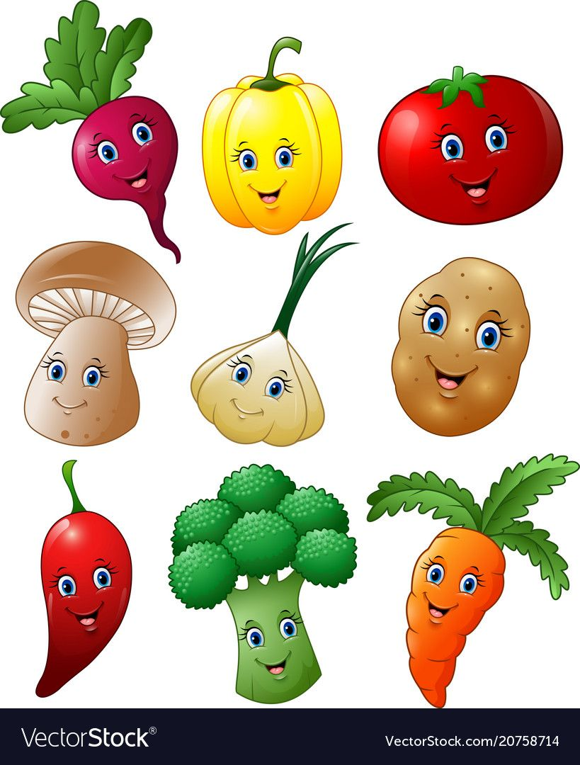
Not Healthy VS. Healthy Snacks
https://www.istockphoto.com/vector/healthy-and-unhealthy-food-concept-vector-isolated-cartoon-illustration-gm1073700510-287434613

Slide 16
Visit your Dentist

Slide 17
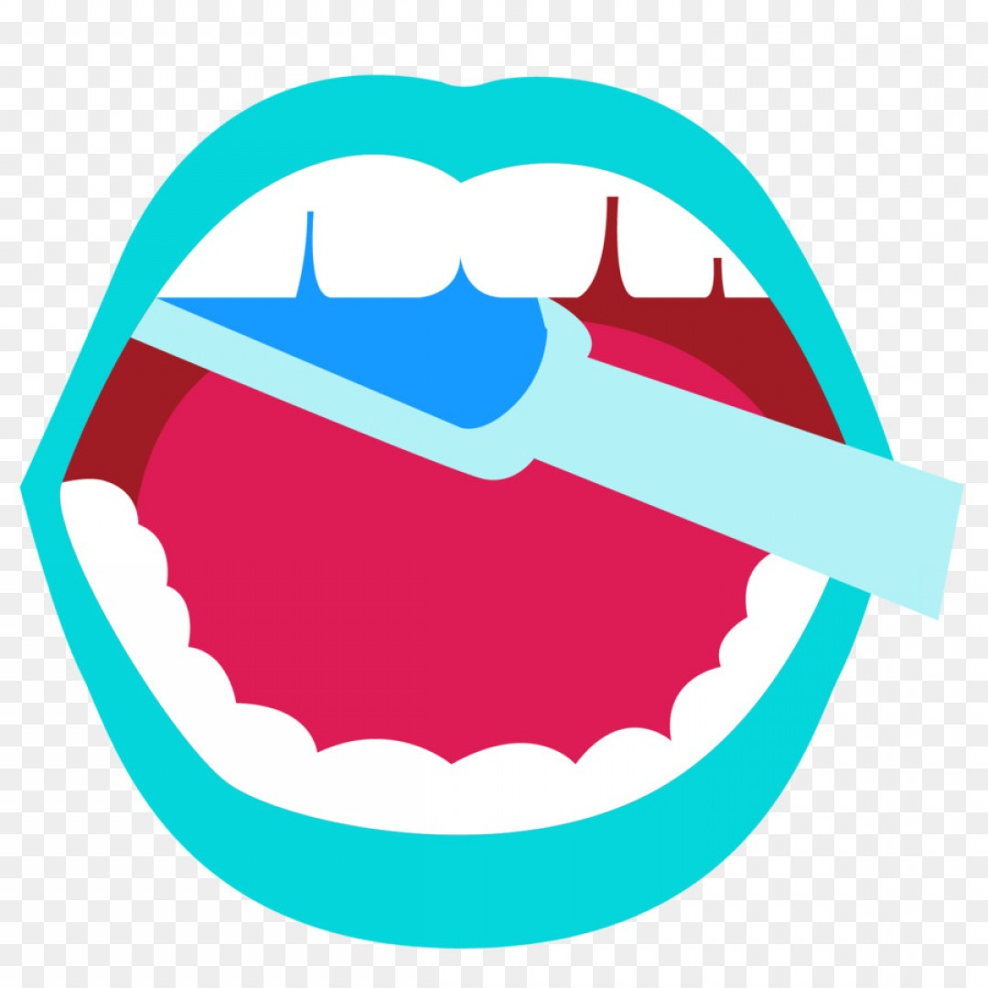
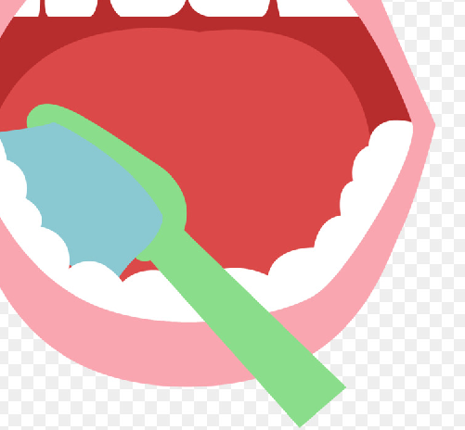
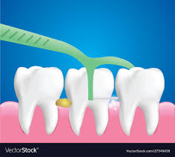
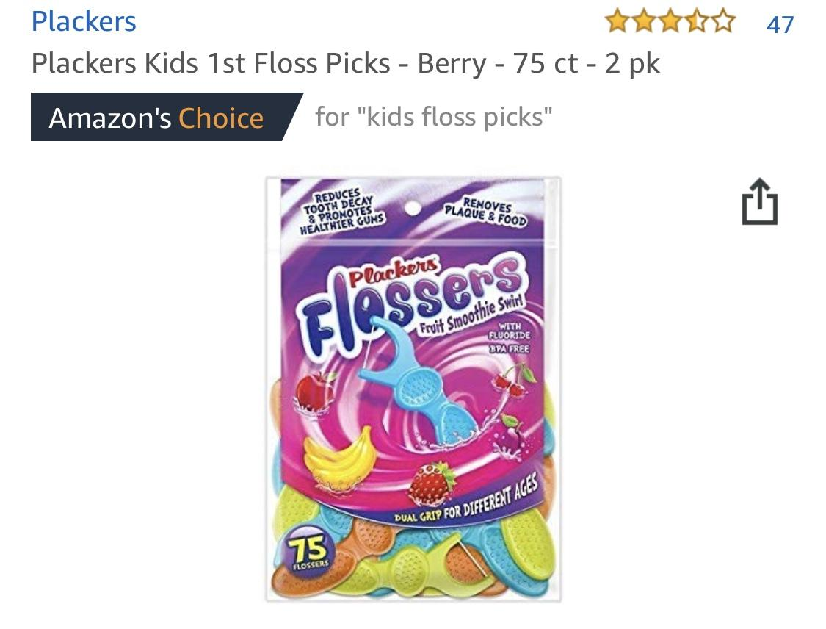
Brush, Brush Brush & FLOSS!

Slide 18
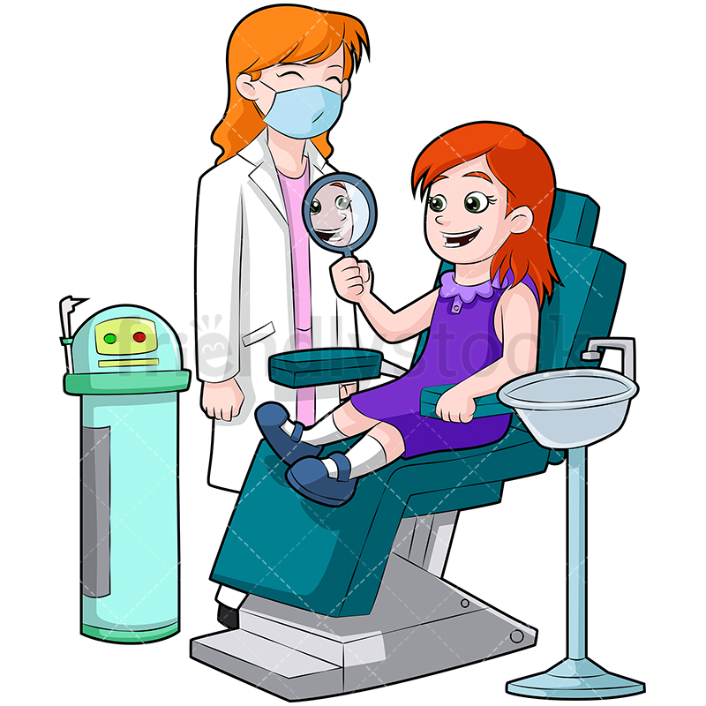
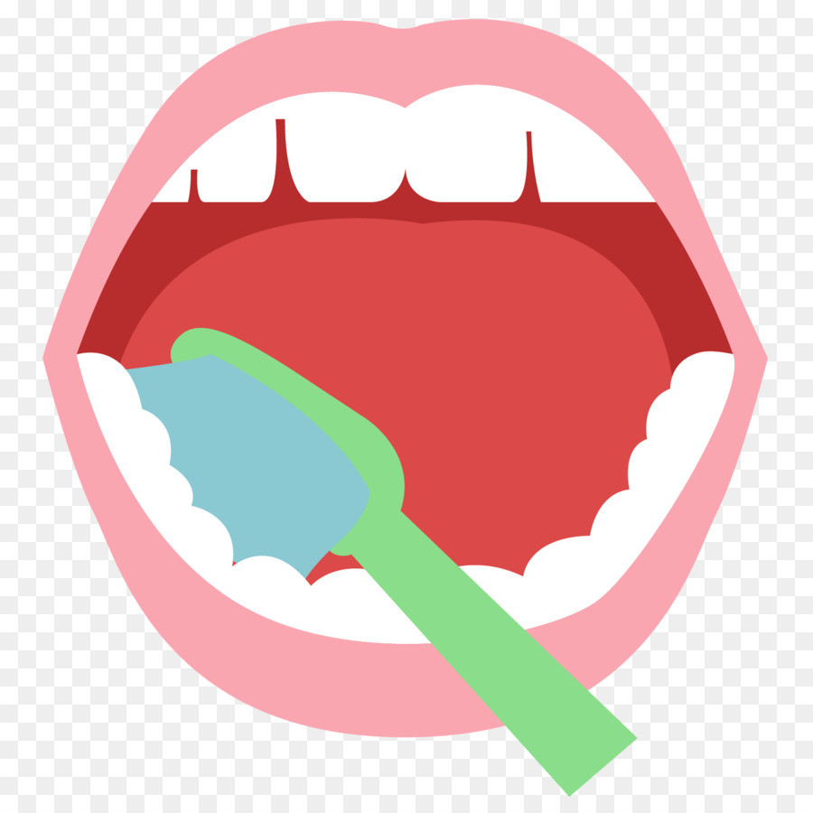
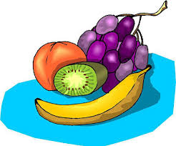
Don’t Forget….

Slide 19
Brushing + Eating Healthy + Going to the Dentist

Slide 20
References
Albino J, Tiwari T. Preventing Childhood Caries. Journal of Dental Research. 2016;95(1):35-42. doi:10.1177/0022034515609034.
Boustedt K, Dahlgren J, Twetman S, Roswall J. Tooth Brushing Habits and Prevalence of Early
Childhood Caries: A Prospective Cohort Study. European Archives of Paediatric Dentistry.
2019;21(1):155-159. doi:10.1007/s40368-019-00463-3.
Inan-Eroğlu E, Özşin-Özler C, Erçim RE, Büyüktuncer Z, Uzamış-Tekçiçek M, Güçiz-Doğan B.
Is Diet Quality Associated With Early Childhood Caries in Preschool Children? A
Descriptive Study. The Turkish Journal of Pediatrics. 2017;59(5):537-547.
doi:10.24953/turkjped.2017.05.006
Websites:
https://ciroccodentalcenterpa.com/dental-care/what-is-an-abscessed-tooth/
https://www.pinterest.com/pin/633459503814982939/
https://friendlystock.com/product/little-girl-dentist-chair-looking-clean-teeth-mirror/
https://www.hiclipart.com/free-transparent-background-png-clipart-ibdfw

Slide 21
Thank you!

