Slide 1
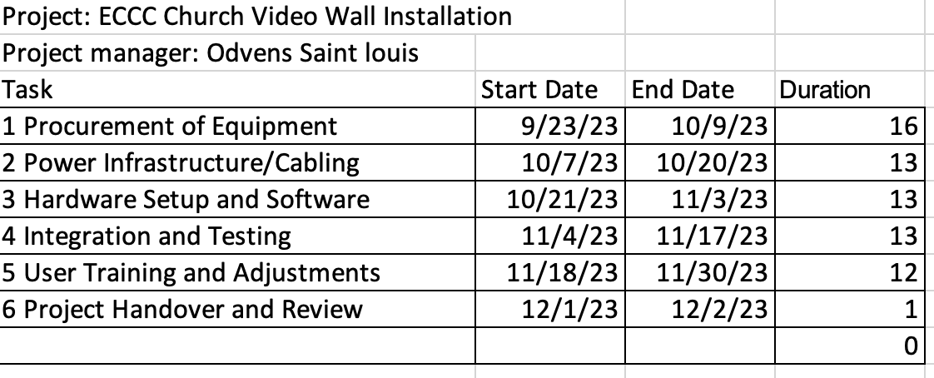
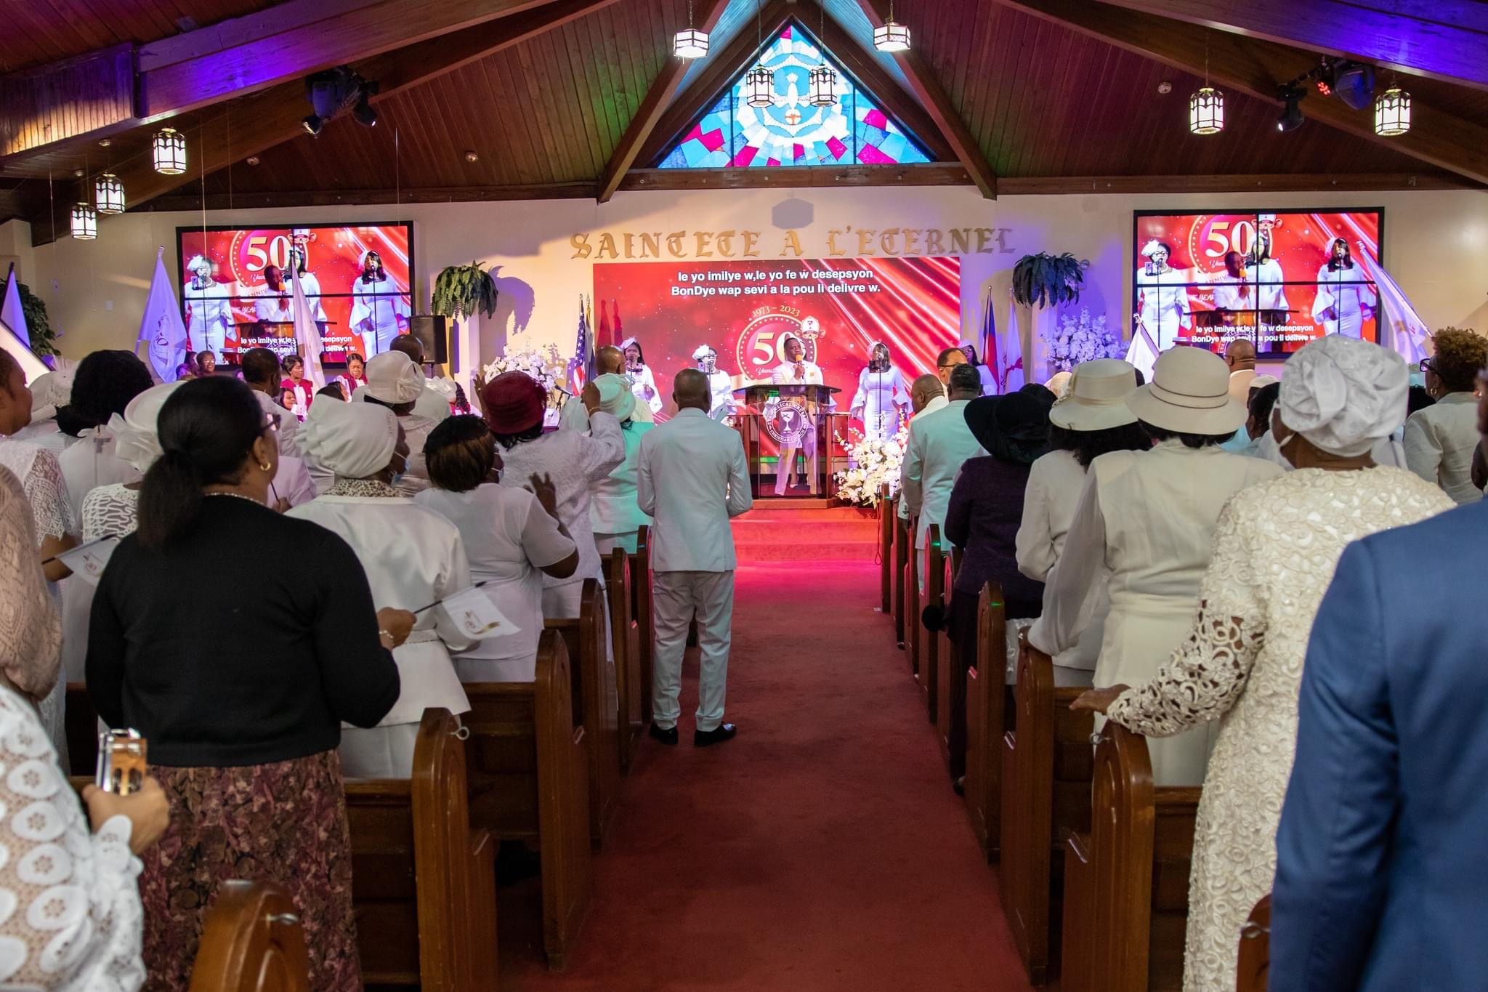
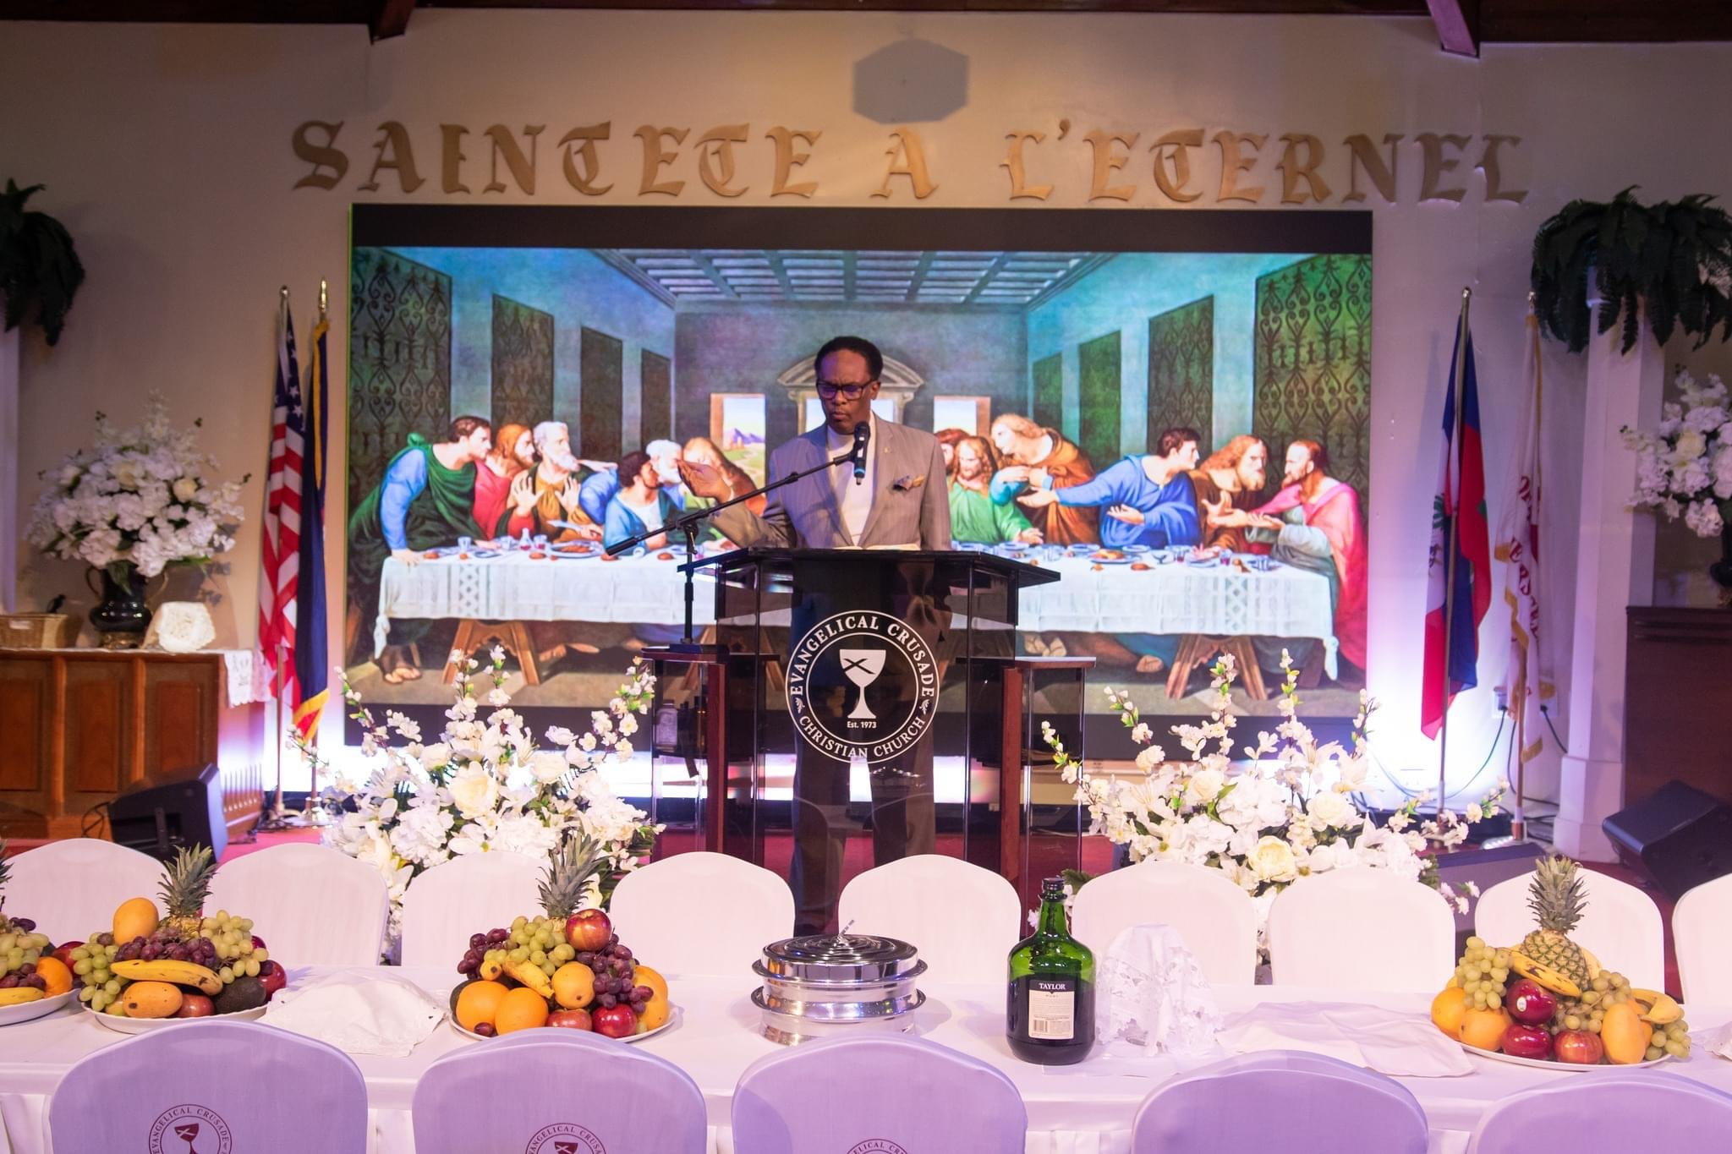
More Than A Wall. Odvens Saint Louis Department of Entertainment Technology
Summary
This project will be embarking on the exciting project of creating a video wall at our church, Evangelical Crusade Christian Church (ECCC), to enhance our worship and outreach efforts
Description
The purpose of this project is to modernize our visual capabilities during services and events, allowing us to connect with our congregation and the broader community in a more engaging and immersive way.
Deliverables
A fully operational video wall system integrated with ProPresenter.
High-quality video output and smooth content playback.
Comprehensive user manual for operating and maintaining the system.
Training sessions for church staff to effectively use and manage the system.
Required Resources
15 skilled workers for installation and setup.
Electricians for installing dedicated power plugs.
Project manager (myself) to oversee the project and ensure adherence to the schedule and budget. I have to make sure the project goes as plan on time and keep records of all our tracks as of bills and time management.
Schedule
Results
Enhanced Worship Services and Events: The implementation of the video wall has significantly enhanced worship services and events at ECCC Church. The congregation now experiences a more engaging and immersive worship environment. Visual presentations are more impactful, contributing to a deeper spiritual connection among attendees.
High-Quality Visual Output: The video wall system consistently delivers high-quality visual output and smooth content playback. This has not only improved the quality of presentations but has also elevated the overall multimedia capabilities of the church.
Conclusion
The Video Wall Installation project at ECCC Church has been a significant endeavor aimed at enhancing worship services and events through impactful visual presentations. As the project manager, overseeing this project has been a valuable learning experience, not only in terms of technical skills but also in leadership and teamwork.
Budget
Methods
Hardware Selection:
M1 Mac mini: $1,200
Decklink Duo: $500
Sonnet Echo Express SE IIIe Thunderbolt 3 Expansion Chassis for PCIe: $500
Cabling and Infrastructure:
Four Cat 6 wires: $200
Three dedicated 20-amp plugs (installation cost): $1,000
Labor Costs:
15 workers for 6 weeks, 40 hours/week each at $40/hour: $144,000
The Process
I will collaborate to plan, create, and present the video wall installation. We will start with a thorough needs assessment, budget planning, and equipment selection. The creative aspects, including content creation and design, will involve a team of artists and media professionals. Finally, the installation and testing phase will be managed by technical experts.
Literature cited
https://www.dgicommunications.com/led-video-wall-cost/?adgroup=dynamic&utm_source=google&utm_medium=cpc&utm_campaign=Video%20Wall%20%7C%20Search%20(National)&utm_term=&utm_content=519782124840&hsa_acc=3785407064&hsa_cam=6491763525&hsa_grp=121967438797&hsa_ad=519782124840&hsa_src=s&hsa_tgt=dsa-559349505972&hsa_kw=&hsa_mt=&hsa_net=adwords&hsa_ver=3&gad=1&gclid=CjwKCAjw-eKpBhAbEiwAqFL0mjDCo6th0dn0dajKDNWjAqo4l3nOro1MlblJmRNVAa3e_qRUkhU5IBoCTFoQAvD_BwE
https://www.youtube.com/watch?v=h8imXrmm-yw

